Slide 1
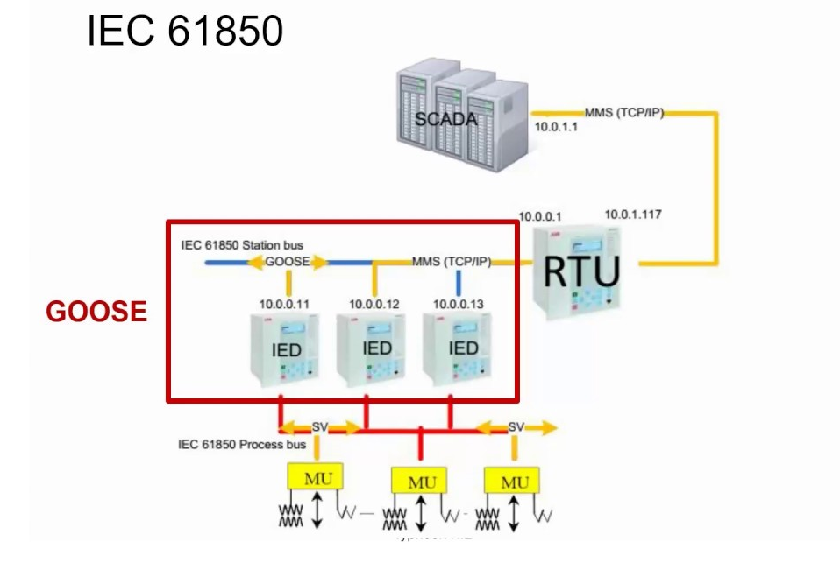
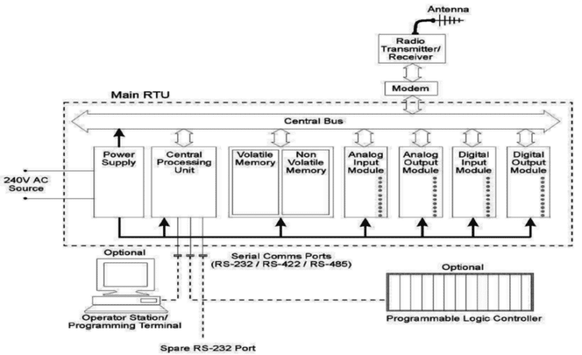

Slide 2
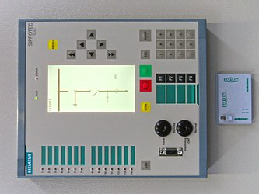
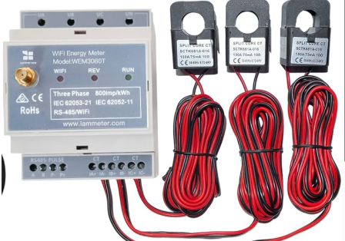
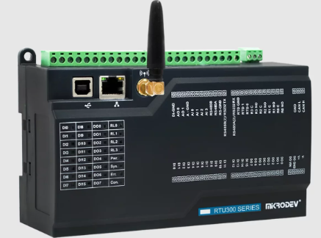
Metering Unit (MU)
Intelligent Electronic Device (IED)
Remote Terminal Unit (RTU)

Slide 3
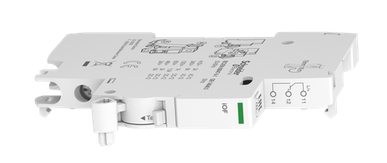
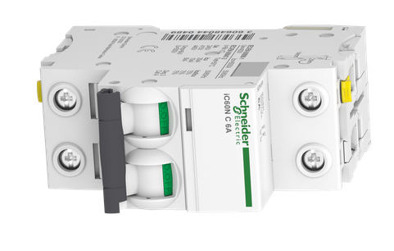
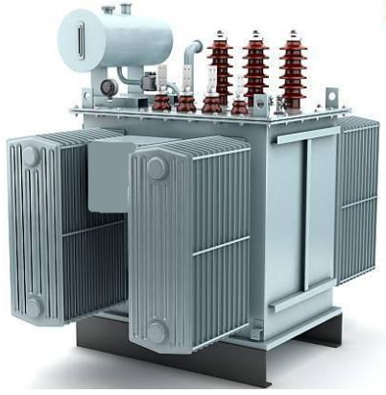
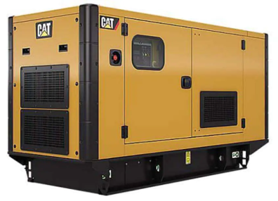

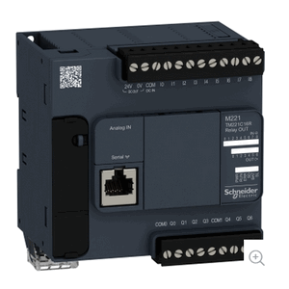
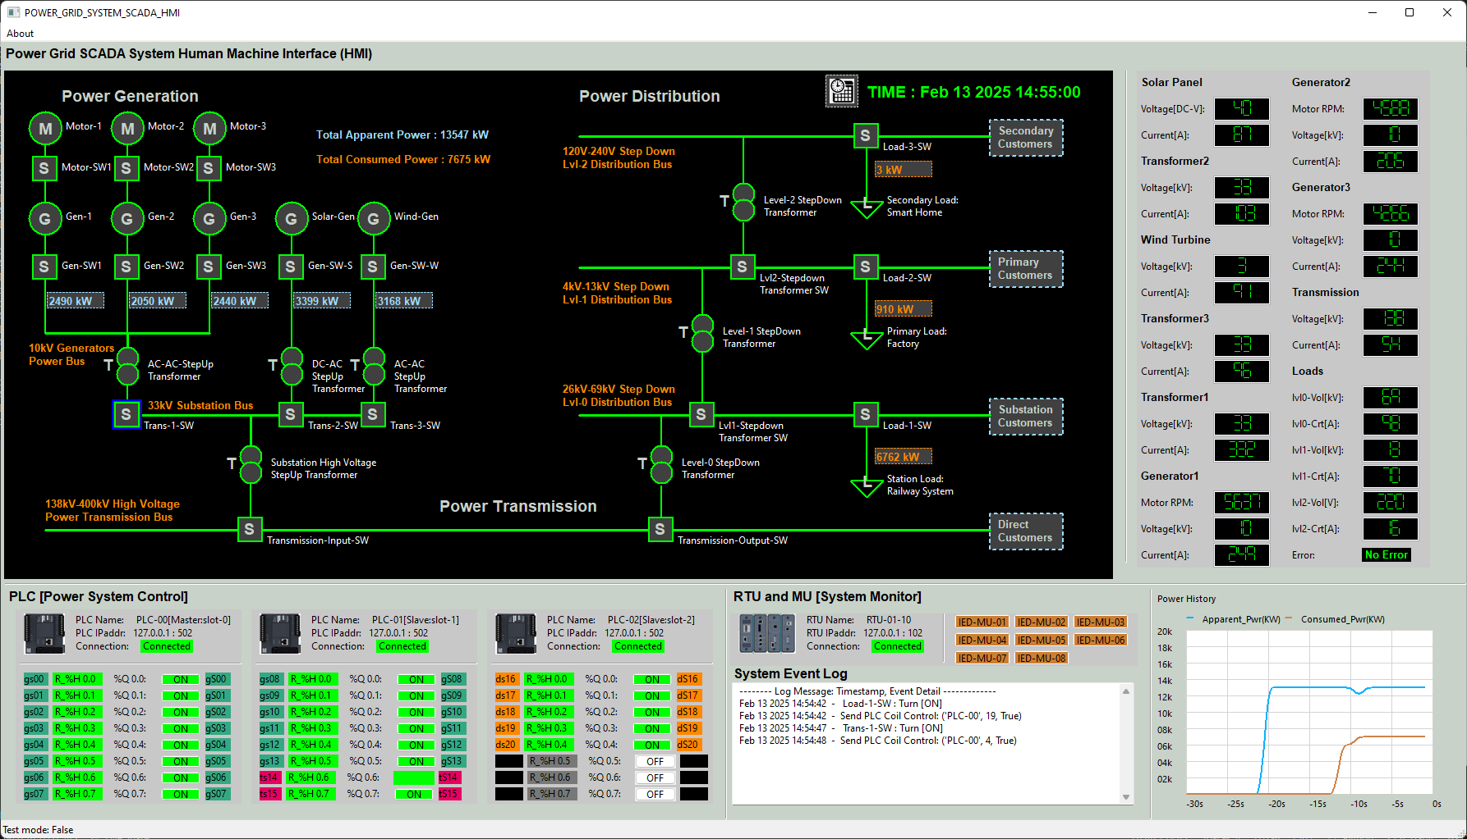

Breaker sensor
Power Transformer
Breaker sensor
Power Generator
Next Level device
Breaker 01
Breaker 02
MU 01
V1,
A1
V2,
A2
V2,
A2
V3,
A3
MU 03
V3,
A3
V4,
A4
MU 04
MU 02
IED 01
IED 02
IED 03
V1, A1,P1,S1
V2, A2,P2,S2
V3,A3,P3,S3
V4,A4,P4,S4
PLC
S7Comm
SCADA-HMI
RTU
Sensor state
Modbus-TCP
Radio Connection

Slide 4
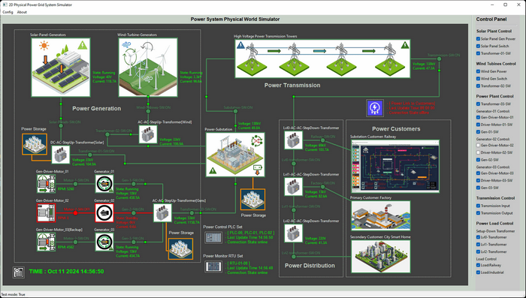
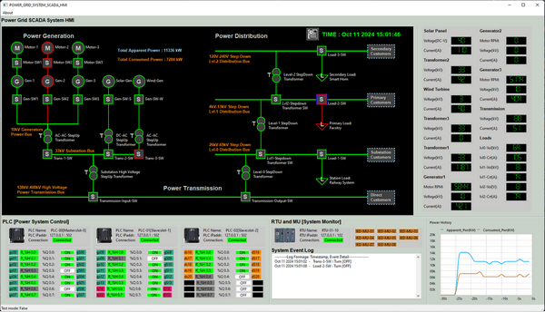
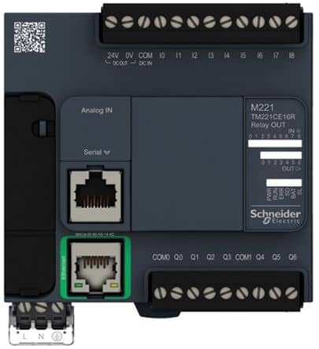
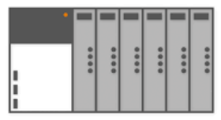
2D Power Grid Physical-world Simulation Program
Power Grid Supervisory Human Machine Interface
Circuit breaker logistic signal interface
SV sensors analog / linear signal interface
MMS client Interface
Modbus-TCP client interface
Measurement Unit simulation
Simulate Radio Link
PLC0
PLC1
PLC2
…
S7Comm Bus
MU00
MU01
MU08
PLC
simulation
IED 01
RTU 01
RTU 02
UDP Simulate Digital Signal
IED 01
IEC 61850 Modbus-TCP Bus

Slide 5
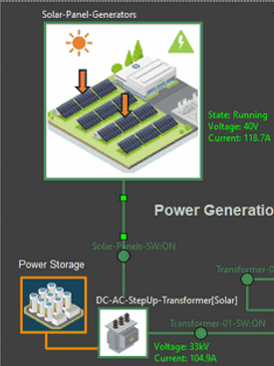
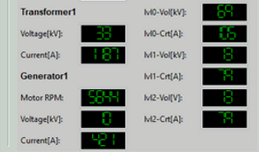
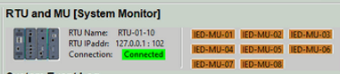
Physical world data generation
HMI IEC61850 data visualization
Work state: running, Idle , error
Power output state: Voltage, current
Special State: such as motor RPM, battery percentage
Solar farm MU
DC-AC Steup Transformer MU
S7Comm
SCADA Data Receiver
IED 01
RTU
MMS Radio Connection
Solar storage MU

Slide 6
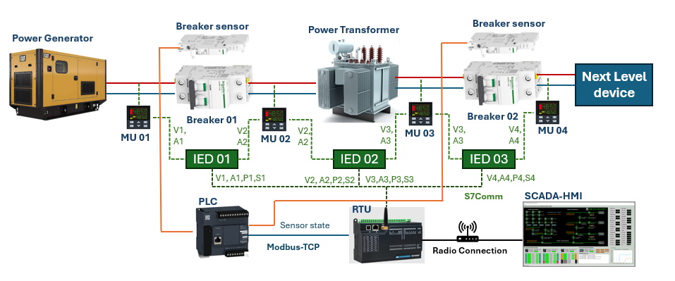
Implement MU-IED-RTU Monitor Workflow in Power Grid OT Cyber Physical Simulation System
Physical world data generation
HMI IEC61850 data visualization
Work state: running, Idle , error
Power output state: Voltage, current
Special State: such as motor RPM, battery percentage
Solar farm MU
DC-AC Steup Transformer MU
S7Comm
IED 01
SCADA Data Receiver
Solar storage MU
RTU
MMS Radio Connection

