Slide 1
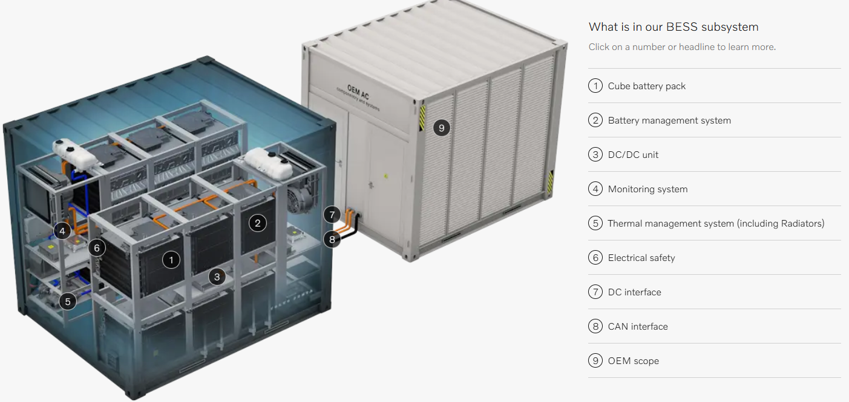

Simulated battery pack capacity value
Simulated basic Battery Charge/Discharge management system
Simulated ABB-AC500 IEC60875-104 PLC to monitor all the data in the BESS
Basic charge/discharge voltage and current safety mechanism
Simulated basic DC-AC converter to integrate in the power grid’s AC-AT step up transformers

Slide 2
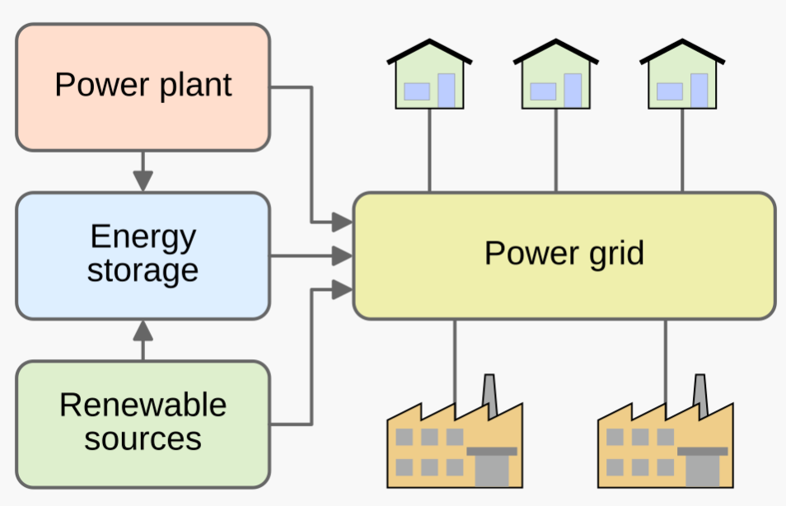
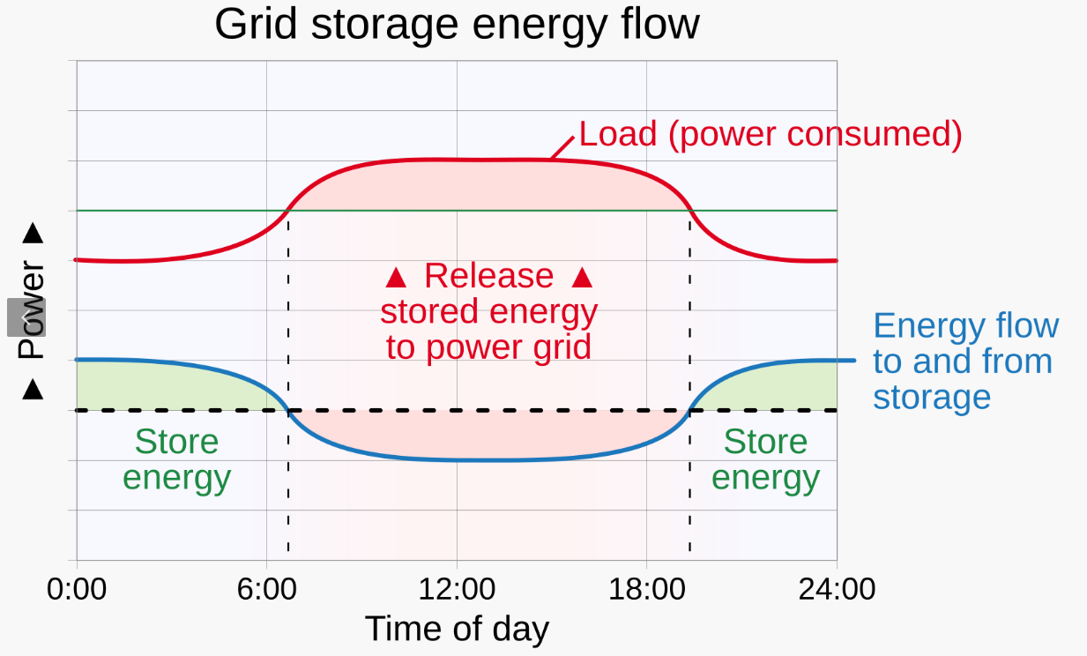

Slide 3
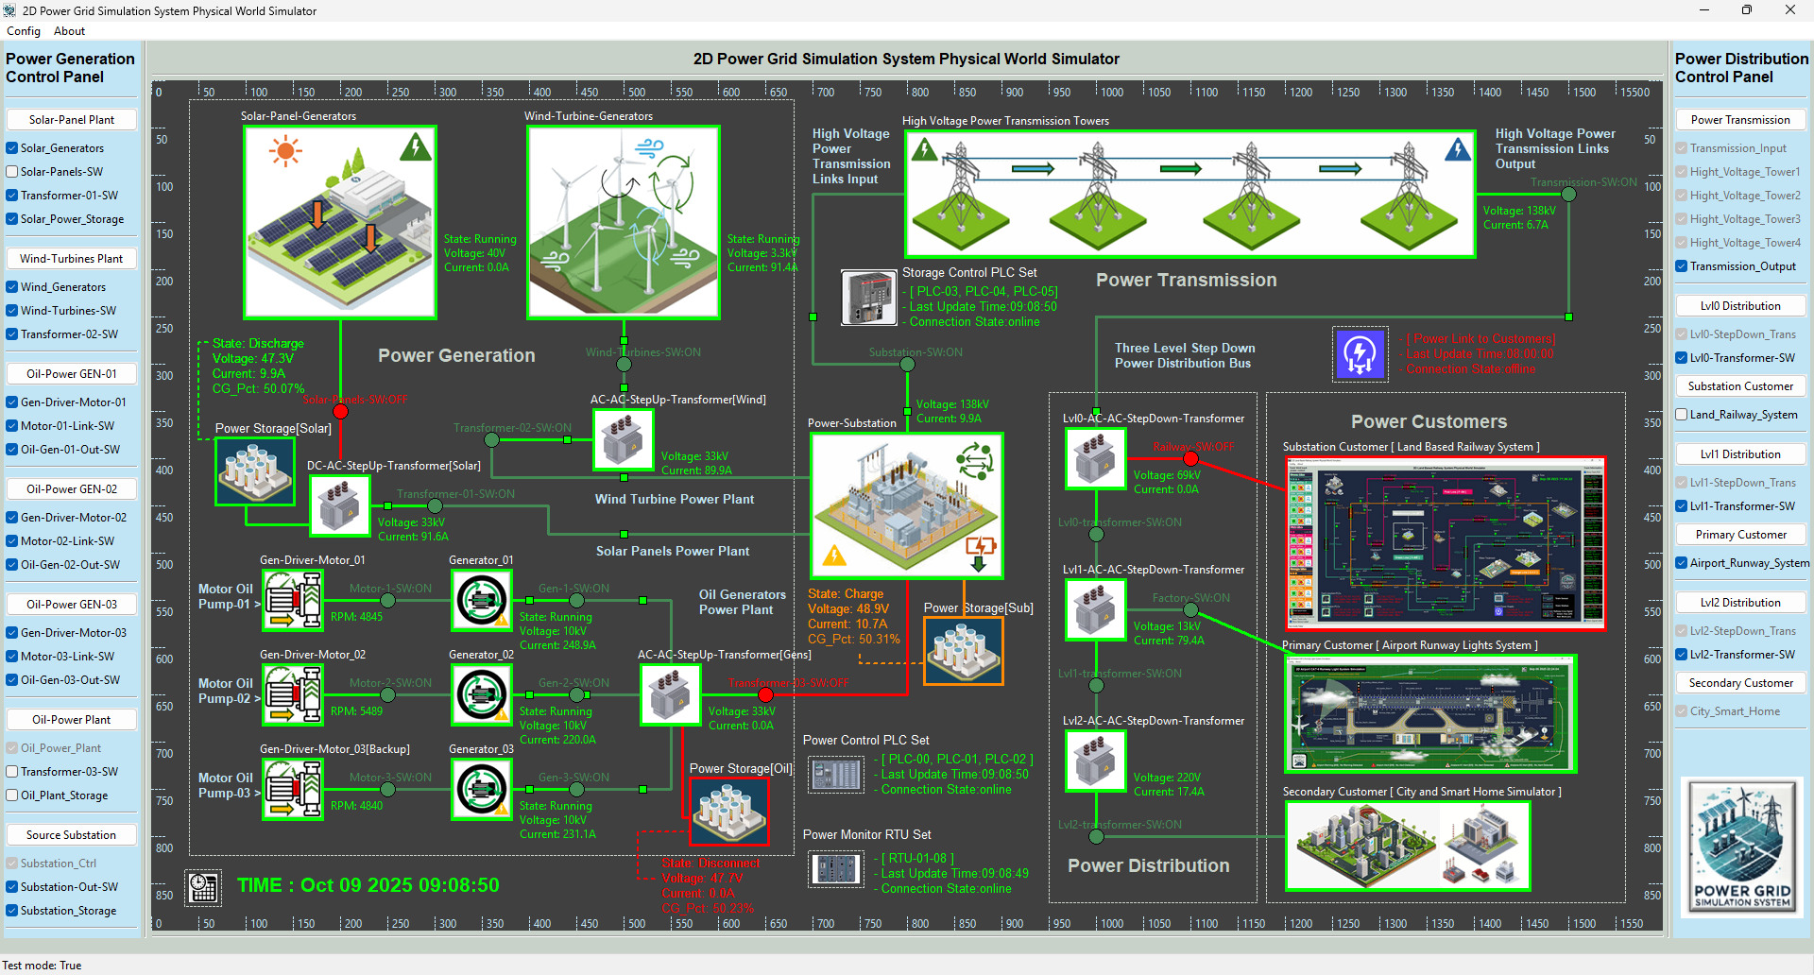
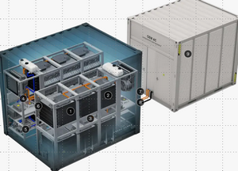
BESS
OEM Scope
Energy Battery Scope
BESS for power station
BESS for renewable power source
BESS for traditional power plant

