Slide 1




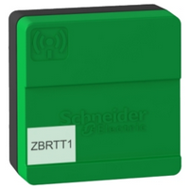
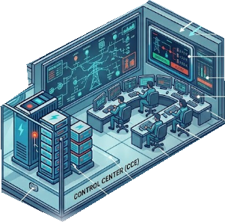

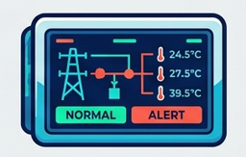

Power Grid Transformers
Cable Connector
High Voltage Power Transmission Cable
Battery Based Power Storage System
Power Grid Thermal State management Components
IOT Thermal Sensors
OCC Monitor HMI
2.4GHz WIFI network
WIFI Antenna
5G IoT Gateway
Local Monitor HMI
5G Network
2.4GHz WIFI network
Power Grid Control Center

Slide 2

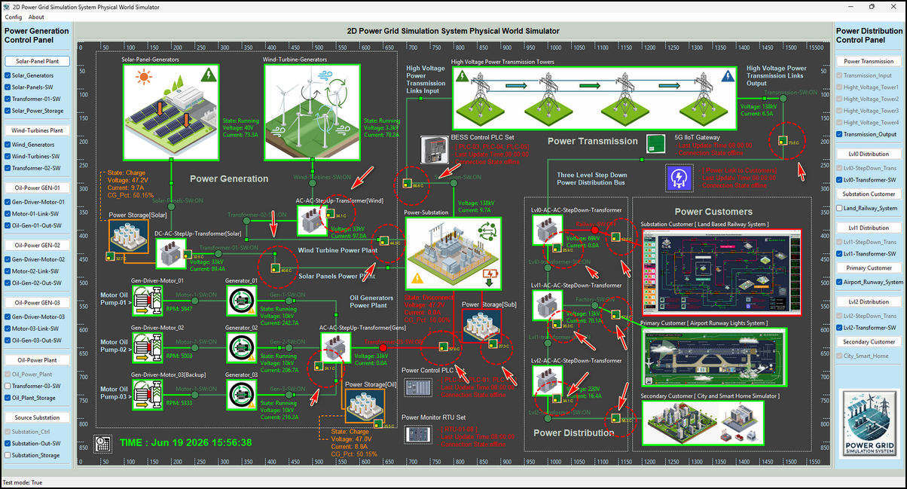
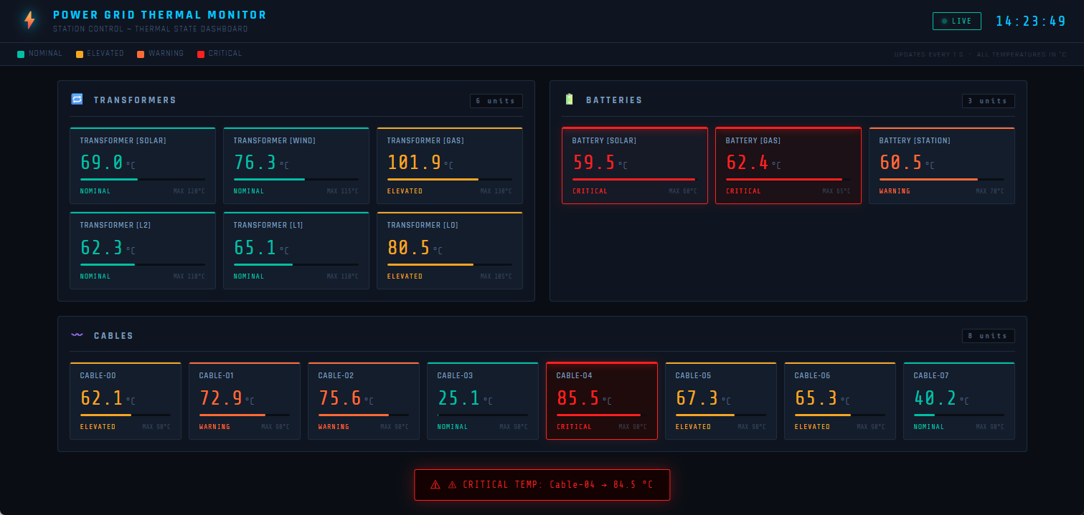
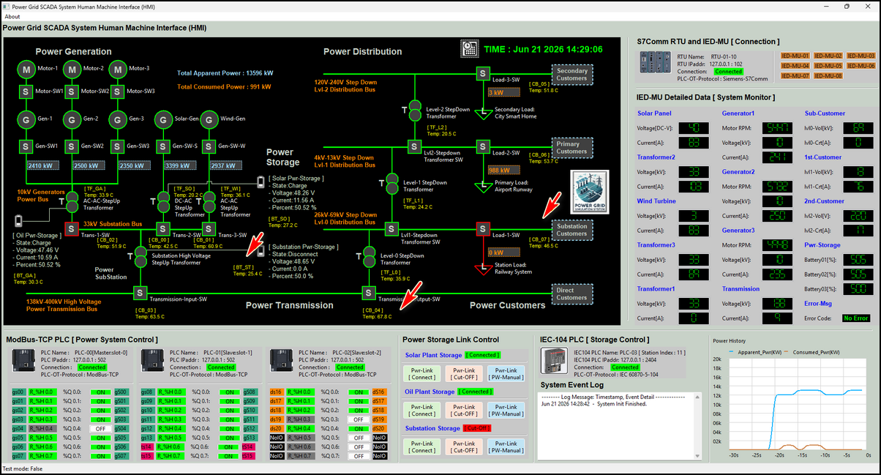
Implement Simulated 5G & Wi-Fi Industry IoT Thermal State Monitoring System (TSMS) for the Power Grid OT Cyber Twin Platform
Power Grid Transformers
Cable Connector
High Voltage Power Transmission Cable
Battery Based Power Storage System
Power Grid Physical World Simulator
IOT Thermal Sensors
2.4GHz WIFI network
Power Grid OCC TSMS Monitor HMI
Local TSMS HMI
WIFI Antenna
5G Network
2.4GHz WIFI network
Local Monitor HMI
5G IoT Gateway
Power Grid Control Center

Slide 3

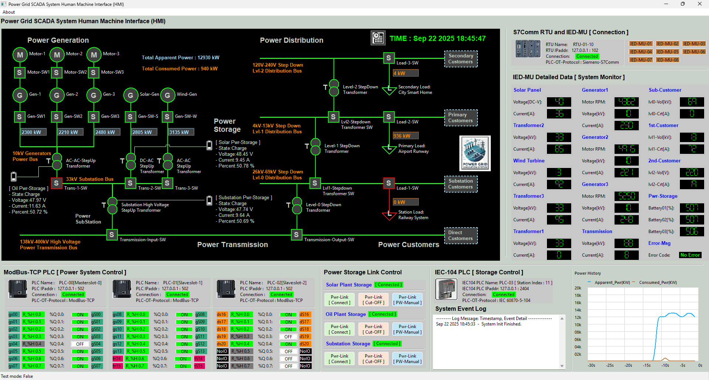

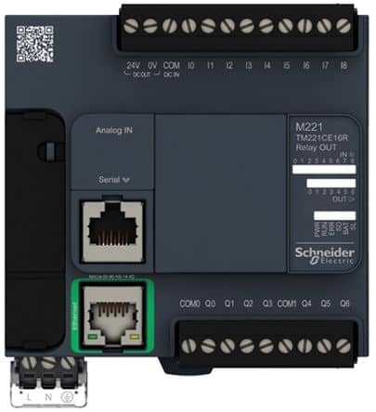
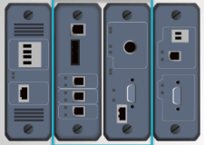

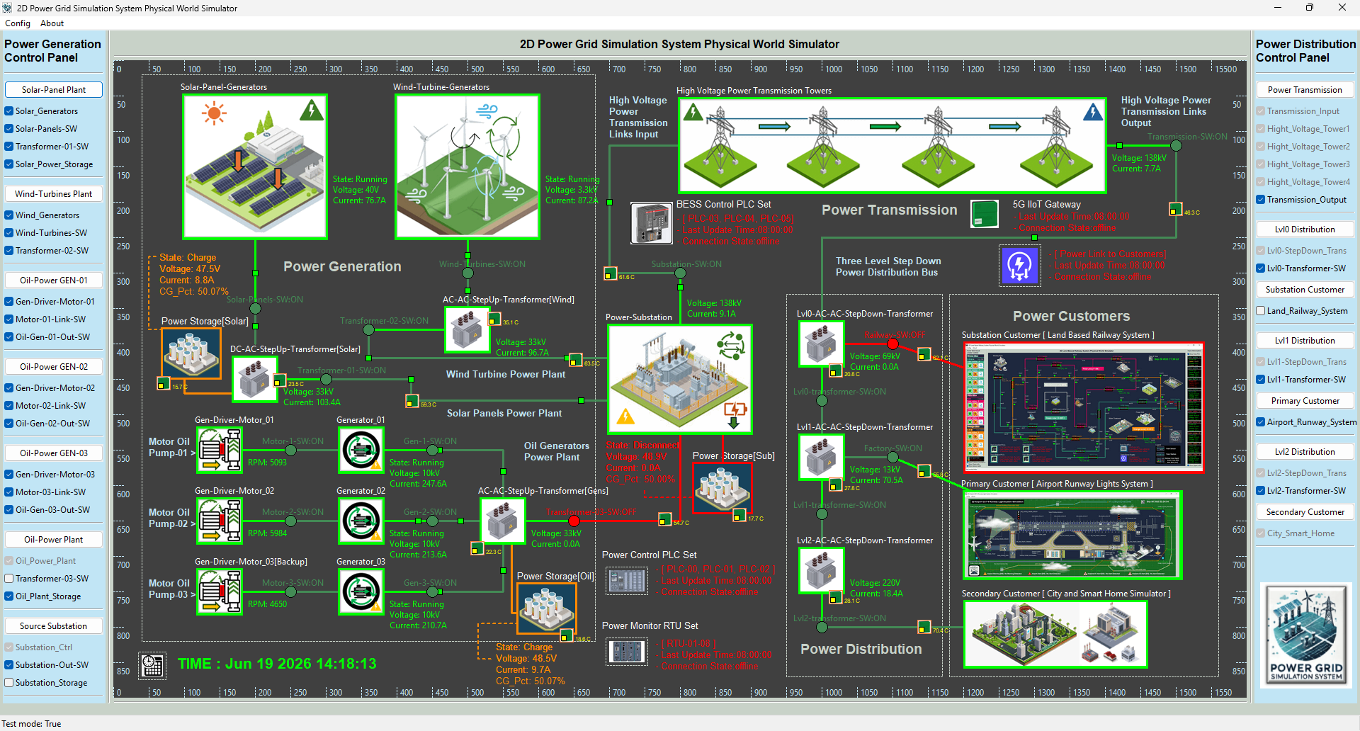
Power Grid Simulation System
Mini Energy-OT-System Cyber Range Platform
OCC Power System
Scada HMI
Level 2
Power Grid
Control Center Processing LAN
Power System control HMI
Power System Monitor HMI
Maintenance workstations
5G Receiver
MQTT Via 5G network
Modbus
S7Comm
IEC60870-104
Local Thermal State monitor HMI
Level 1
OT System Controller LAN
Generation Control PLC
Generation Monitor RTU
Transmission Control PLC
Transmission Monitor RTU
Distribution Monitor RTU
Distribution Control PLC
BESS Control PLC
5G IoT Gateway
Power System Physical World Simulator
Simulated Electrical signal
Level 0
Physical Process
Field I/O
device
Circuit breakers
Step up transformer
Electrical MUs
BESS Controller
2.4G WIFI Network
Power generator
Step down transformer
Station Loads
Auto BMS
Primary Loads
IoT sensor
Solar Panels
High voltage power bus
DC Interface
Wind Turbines
Low voltage power bus
Secondary Loads
OEM Scope

Slide 4
ZBRTT1 Thermal IoT Simulator
IoT Gateway Simulator
AES_Key + IoT_iv
UDP
MQTT Data Publish
UDP Client
Data Encryption
Real Thermal State data
WIFI Network
MQTT Data Structure
MQTT Client
MQTT Broker

Slide 5

Level0 OT Physical Field I/O Devices
MQTT Data Subscribe Request
MQTT Data Publish Request
Level1 OT Controller Devices
IoT 5G Antenna
Data Publish (Drone fly data)
Air Vacuum System Control RTU Simulation Framework
Data Publish ( temp and fan-speed data)
Input Parameter Dict
Auto
Control
Logic
MQTT Client
MQTT Broker
UDP Simulated Electrical Signal RTU Output
Output Parameter Dict
Data Publish ( Direct Overwrite control

Slide 6
IoT Key and iv Data Base
Local Historian Archive Data Base
ZBRTT1 Thermal IoT Simulator1
IoT Gateway Simulator
DB1
DB2
AES_Key + IoT_iv
Power Grid OCC HMI
MQTT Client
MQTT Data subscribe
MQTT Data Publish
2nd Data Encryption
ZBRTT1 Thermal IoT Simulator2
Data Decryption
Data Combine
5G Network
2.4G WIFI Network
MQTT Data Structure
MQTT Client
MQTT Broker
MQTT Client
…
MQTT Data subscribe
Local Monitor HMI
ZBRTT1 Thermal IoT Simulator-N
MQTT Client
MQTT Client

Slide 7
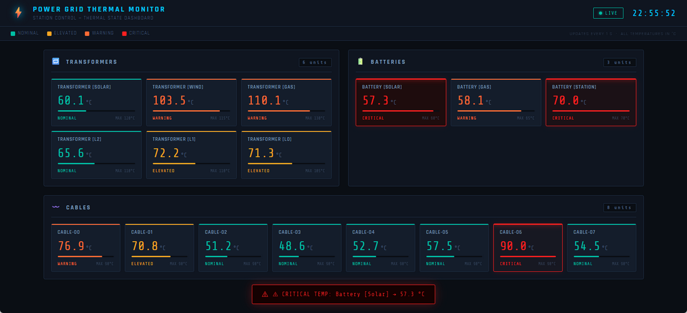
Power Plant Thermal Monitor HMI
OCC Power Grid Thermal State Monitor HMI
Power Generation Area IoT Gateway
MQTT Client
WIFI Network
MQTT Broker
Transmission Tower Thermal Monitor HMI
Power Transmission Area IoT Gateway
MQTT Client
WIFI Network
5G Network
MQTT Broker
Power Station Thermal Monitor HMI
Power Distribution Area IoT Gateway
MQTT Client
WIFI Network
MQTT Broker

Slide 8
