Slide 1
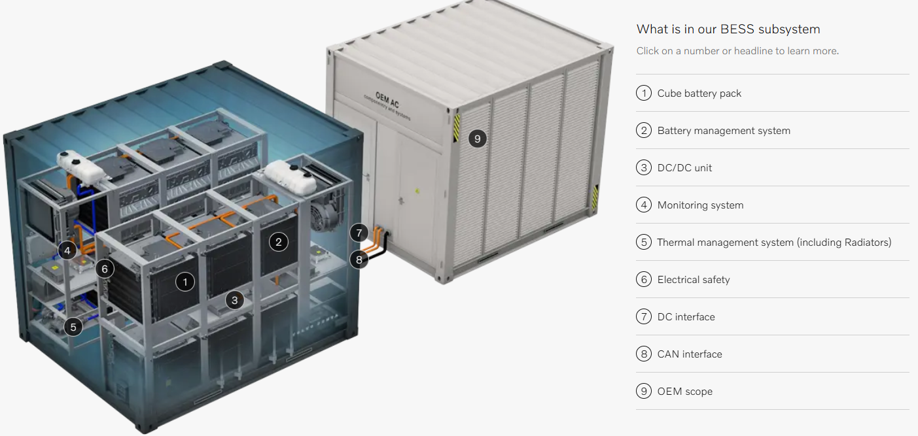

Simulated battery pack capacity value
Simulated basic Battery Charge/Discharge management system
Simulated ABB-AC500 IEC60875-104 PLC to monitor all the data in the BESS
Basic charge/discharge voltage and current safety mechanism
Simulated basic DC-AC converter to integrate in the power grid’s AC-AT step up transformers

Slide 2
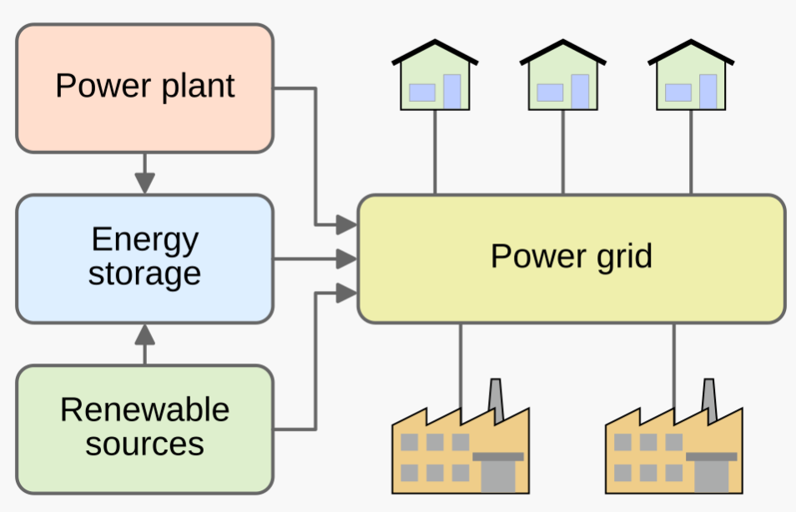
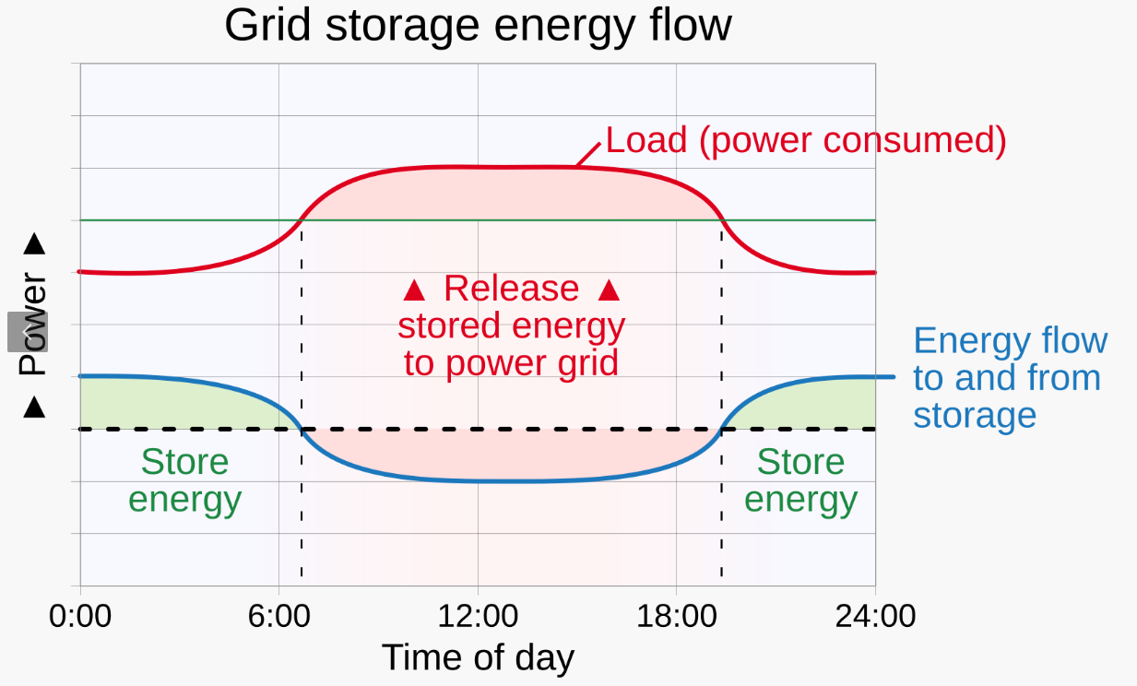

Slide 3
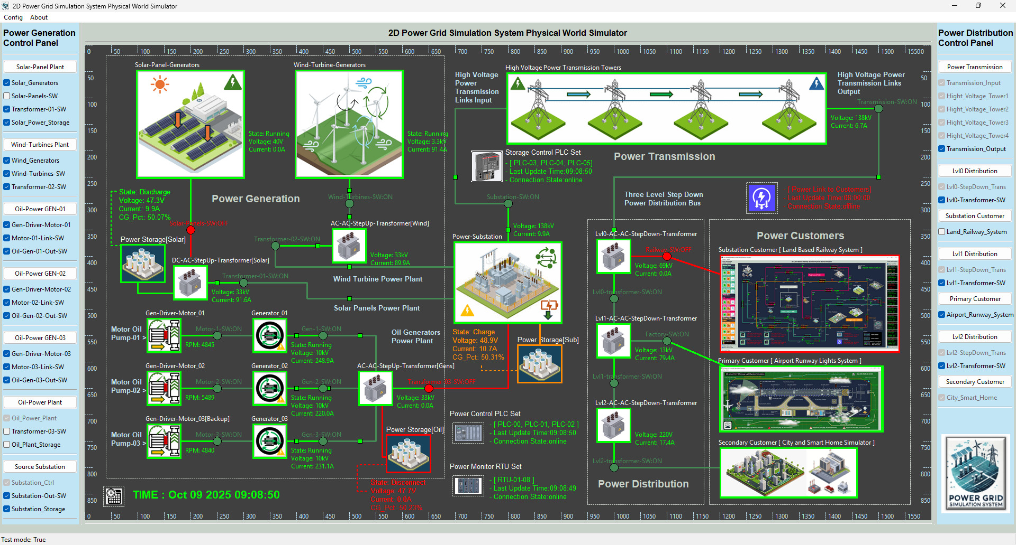
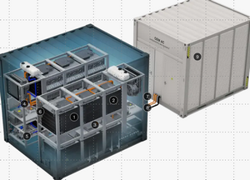
BESS
OEM Scope
Energy Battery Scope
BESS for power station
BESS for renewable power source
BESS for traditional power plant

Slide 4

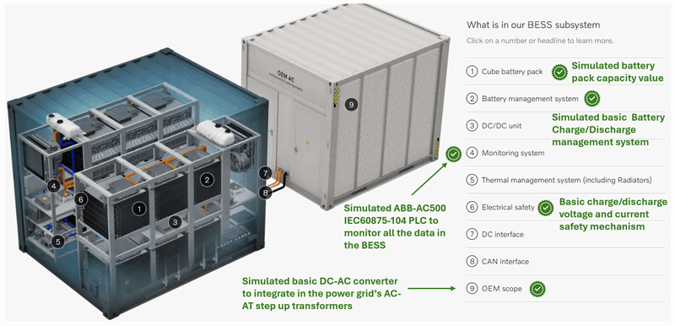
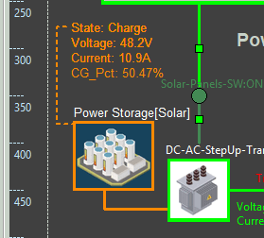
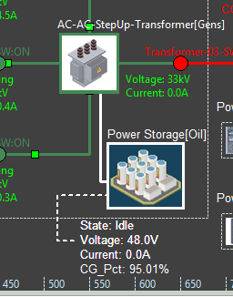
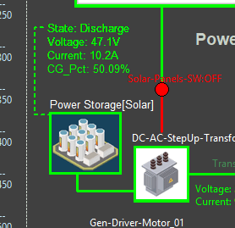
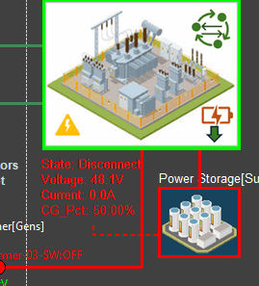
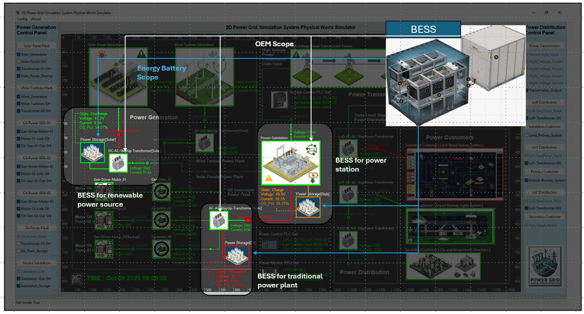
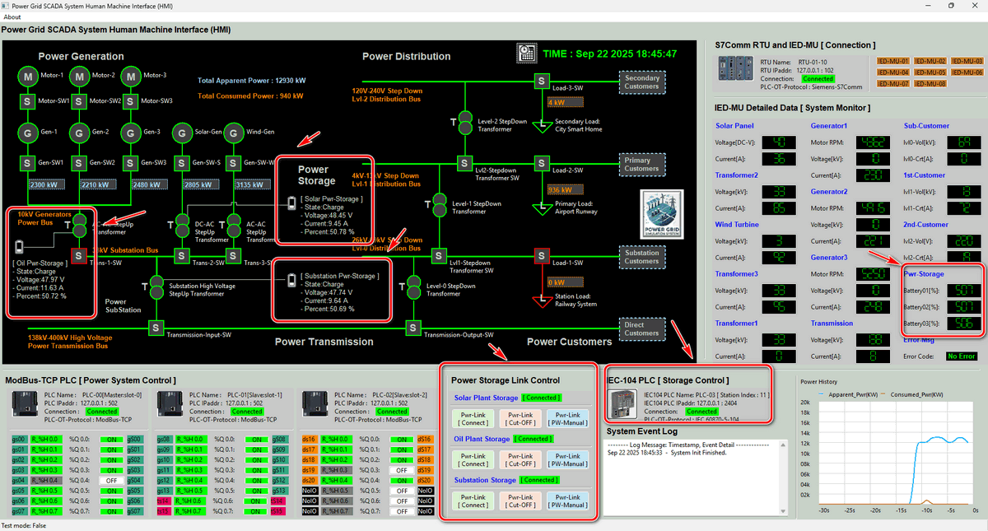

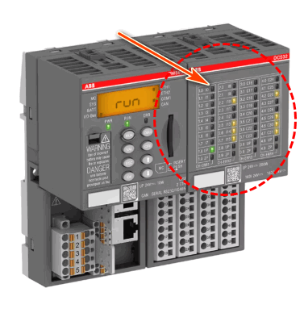
Implement Battery Energy Storage System (BESS) In Power Grid Simulation OT Cyber Range
Power Grid Cyber Range Physical World OT Components Simulator
Battery Based Energy Storage System (BESS)
Charging
Idle
Discharging
Disconnect
Power Grid Cyber Range Operator SCADA Human Machine Interface
Simulated Metering Unit Data
Simulated Electrical Signal
MU00
MU01
MU02
AC500 PLC Simulator
IEC61850 Bus
IEC60870-5-104 Bus
GOOSE (Generic Object-Oriented Substation Event) Network
SCADA (Supervisory Control and Data Acquisition) Network
Level 0 OT Physical Process Field I/O Device Layer
Level 1 OT System Controller LAN Layer
Level 2 Power Grid Control Center Processing LAN Layer

