Slide 1
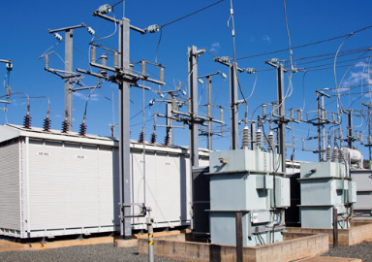
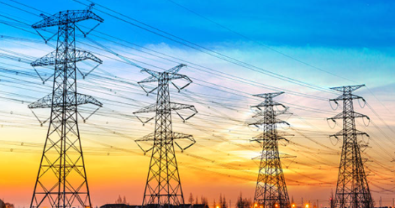


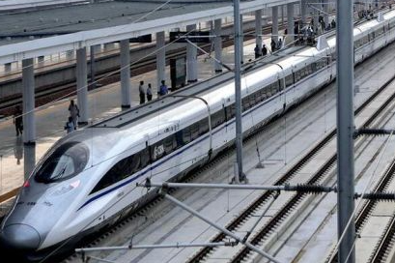
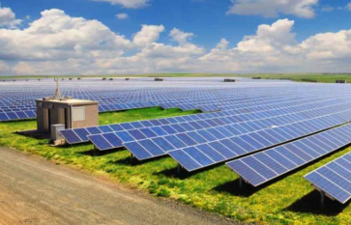
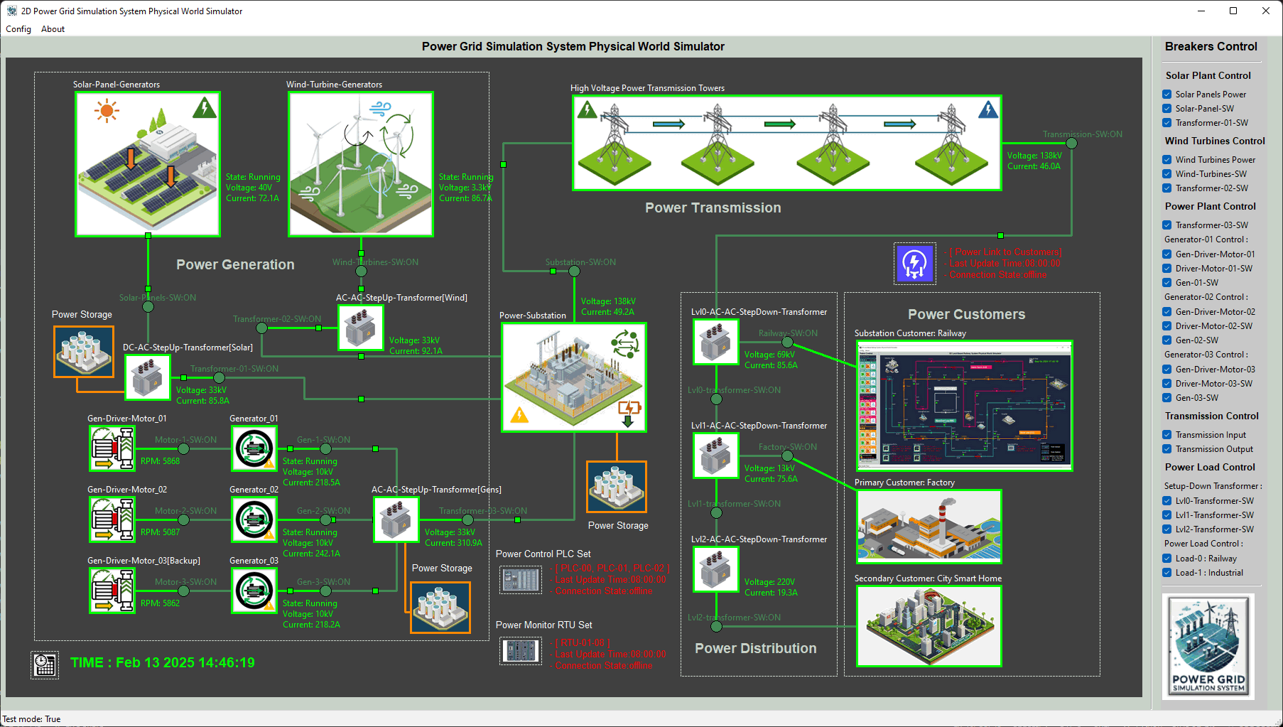
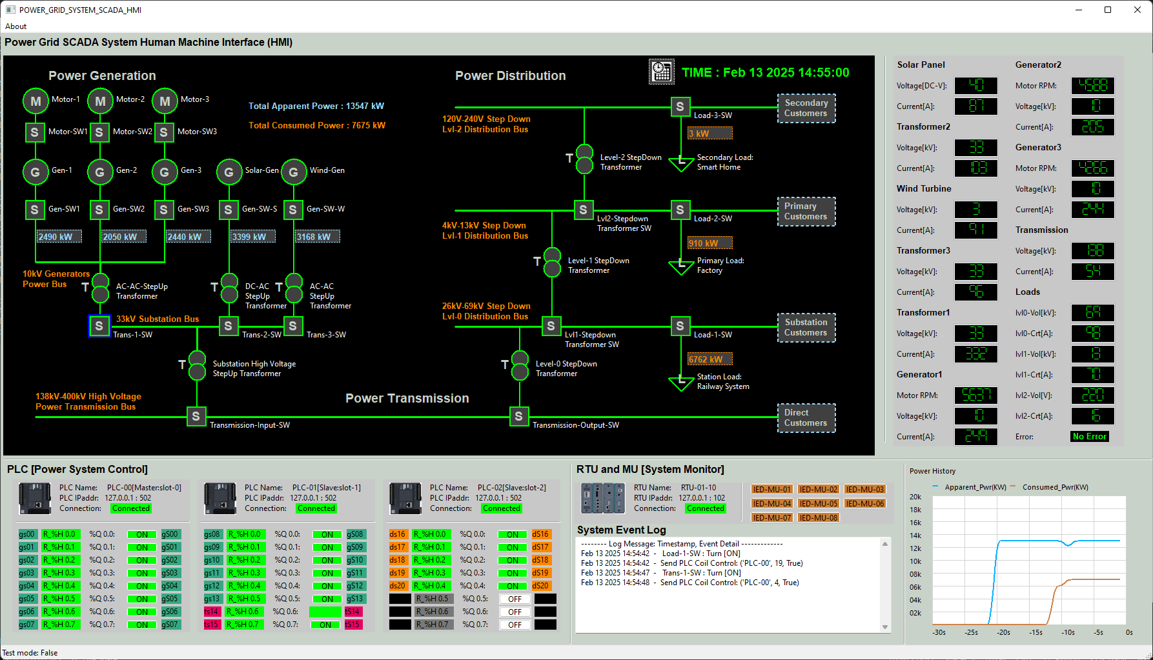
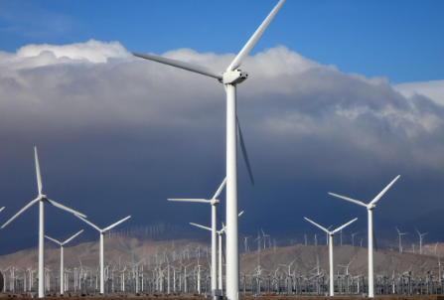
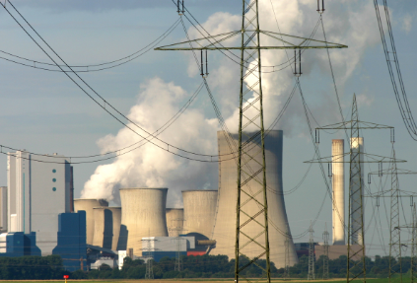
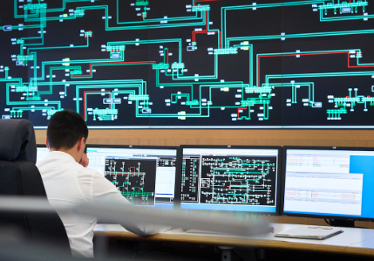
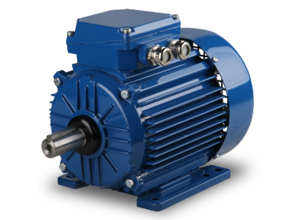
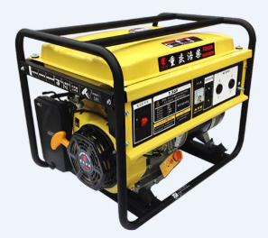
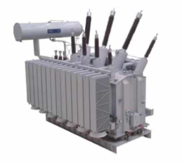
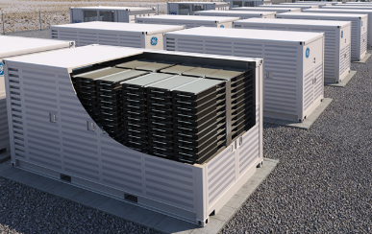
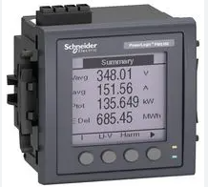
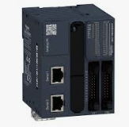
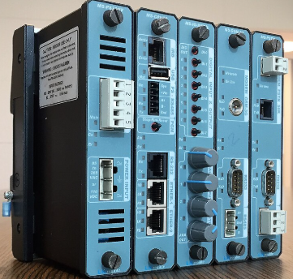
Power Grid Simulation System [ Mini OT-Energy-System Cyber Security Digital Twin ]
Power Substation
High Tension Power Transmission towers
City House
Railway
Industry
Solar Photovoltaic Farm
Human-Machine Interface
Wind Turbine Farm
Natural Gas Power Plant
Power Grid HQ Center
Gas Motor
Generator
Transformer
Power Storage
MU
PLC
RTU

Slide 2
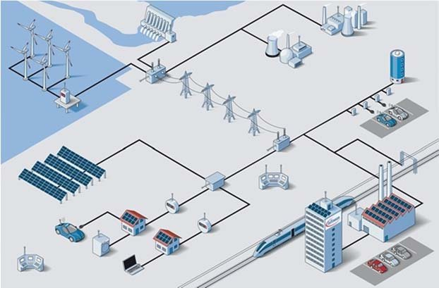
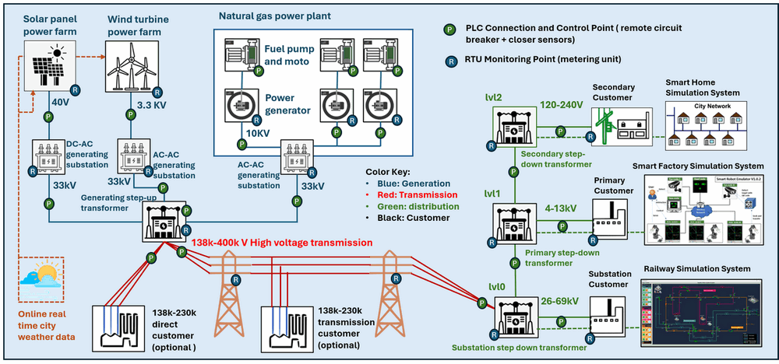
Real World Power Grid
Power Generation
Power Generation
Power Storage
Power Transmission
Grid Controller Center
Power Distribution
Power Generation
Power Distribution

Slide 3
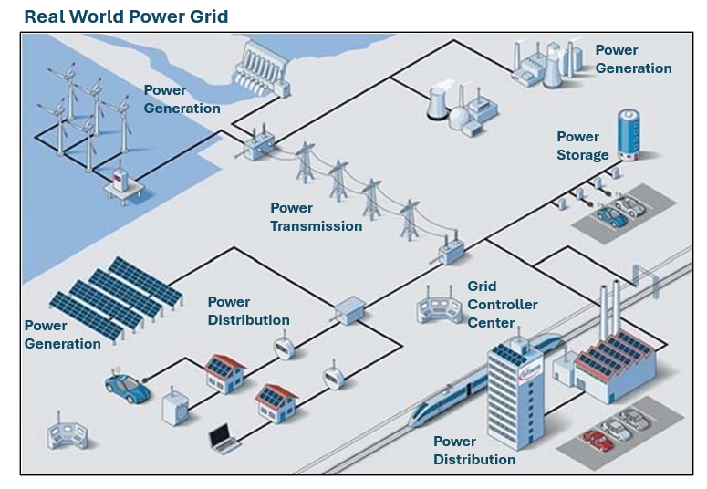
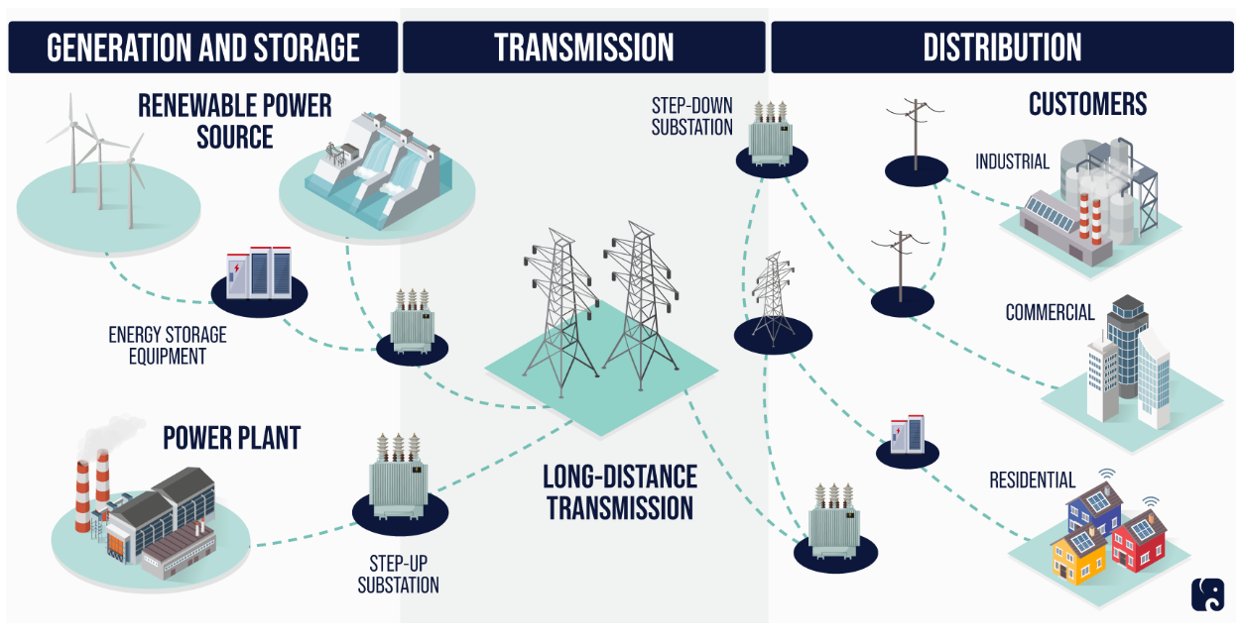
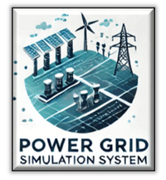
Virtualize
Physical World Components Simulation
Digital Equivalent
Power Grid HQ Center Control Console
Power Grid SCADA HMI
Simulate

Slide 4

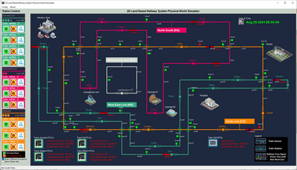
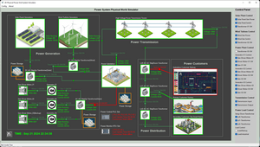
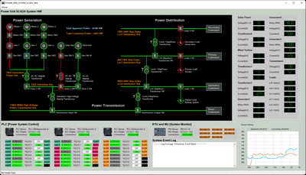

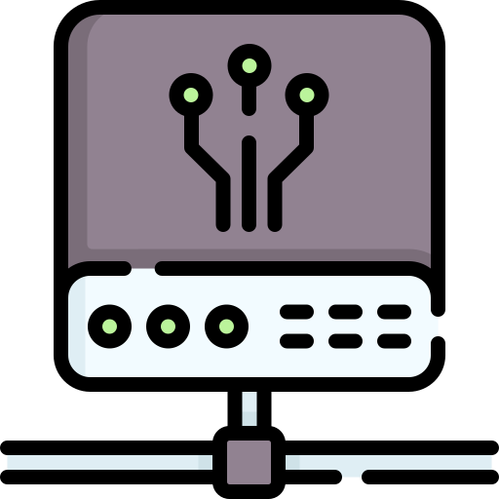

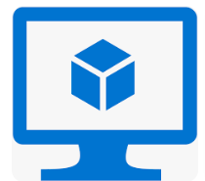

Power_Grid_OT_Simulation_System Environment Access Diagram
VM_ID: Small_PG_PW_Railway_0X
OS: Windows-10
Access Tool: TeamViewer
VM_ID:Small_PG_PW_PowerGrid_0X
OS: Windows-10
Access Tool: TeamViewer
VM_ID:Small_PG_SCADA_HMI_0X
OS: Windows-10
Access Tool: TeamViewer
TeamViewer Client
Internet
VM_ID:Small_PG_PW_Weather_0X
OS: Ubuntu 22.04
Access Tool: SSH
SSH Client
NCL Gateway
VM_ID:Small_PG_Router_0X
OS: Ubuntu 22.04
Access Tool:SSH
VM_ID:Small_PG_SCADA_PLC_0X
OS: Ubuntu 22.04
Access Tool: SSH
User
VM_ID:Small_PG_SCADA_RTU_0X
OS: Ubuntu 22.04
Access Tool: SSH
VM_ID: Transaction VM
OS: Ubuntu 22.04
Access Tool: SSH
VM_ID:Small_PG_PW_Weather_0X
OS: Ubuntu 22.04
Access Tool: SSH

Slide 5
