Slide 1
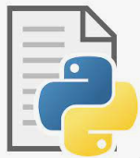
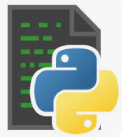
Source Code
Obfuscated Code
Source Code
Obfuscated Code
Python Program Obfuscator
Python Program Obfuscator

Slide 2
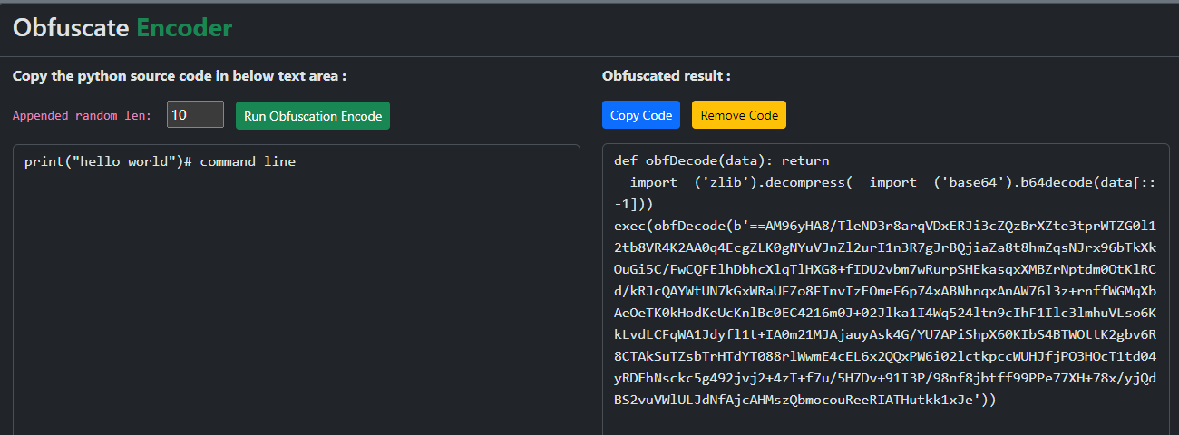
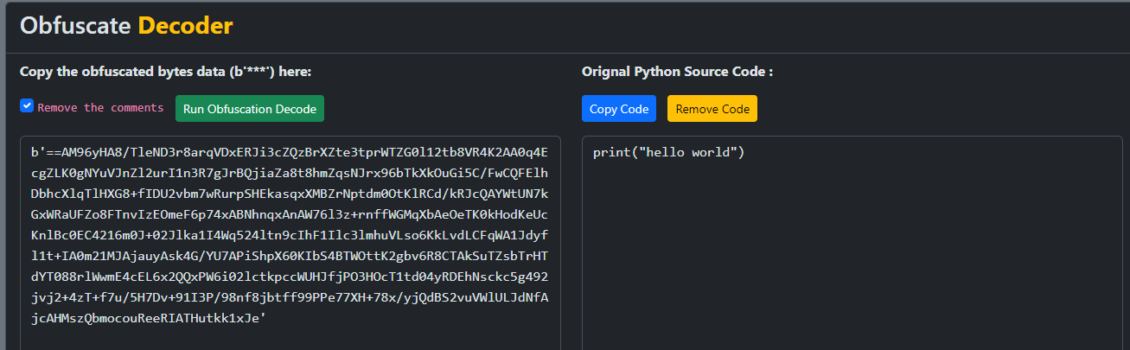
Encode one line source code to obfuscated unreadable program which can insert in normal source code and execute
Decode obfuscated bytes data back to normal source code

Slide 3
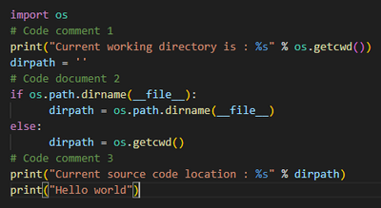
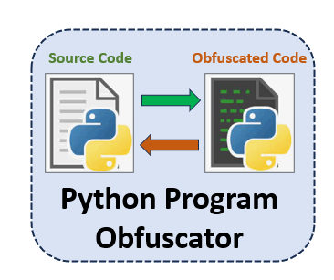
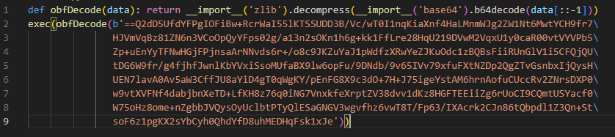
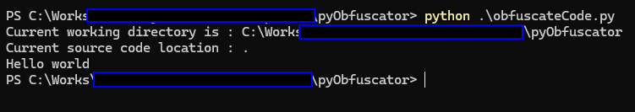
Python Source Code
Removes comments & doc strings
Insert random-contents or dead-code
Python Obfuscation Encoder
Input
Code string compress
Code content B64 Encode
Encode bytes data sequence reversing
Packing code with header
output
Clean added dead-code and random-contents
Obfuscated Executable Code
output
Code string decompress
Code content B64 decode
Encode bytes data sequence reversing
Input
Unpacking code bytes
Execute the obfuscated code
Python Obfuscation Decoder

Slide 4
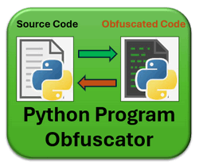
Python Program Obfuscation Tool
Python Source Code
Removes comments & doc strings
Insert random-contents or dead-code
Input
Code string compress
Code content B64 Encode
Python Obfuscation Encoder
Encode bytes data sequence reversing
Packing code with header
output
Clean added dead-code and random-contents
Obfuscated Executable Code
output
Code string decompress
Code content B64 decode
Encode bytes data sequence reversing
Input
Unpacking code bytes
Execute the obfuscated code
Python Obfuscation Decoder

Slide 5
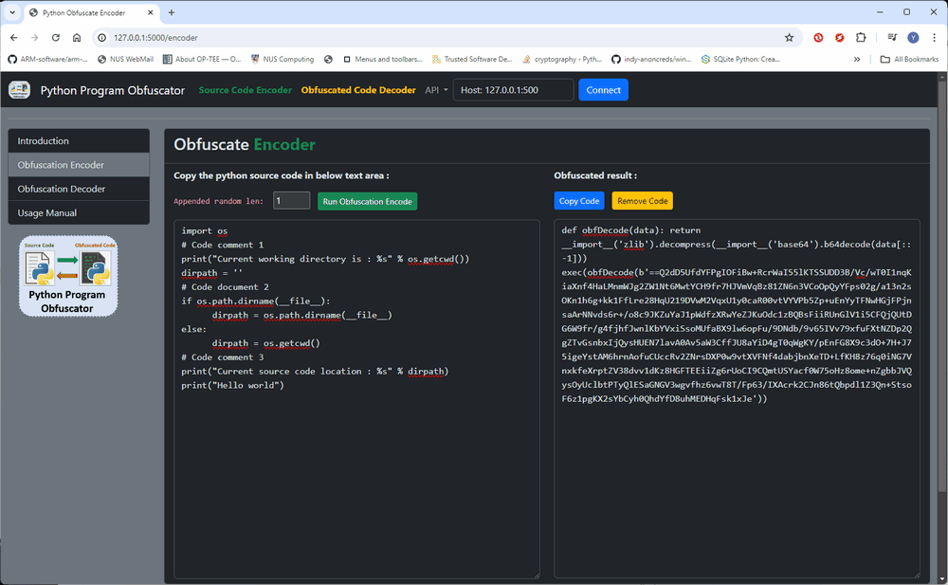
1
Select the length of appended random string
3
Press the encode button
Copy the obfuscated code or press the copy to clipboard button
2
Paste the source code in the text field
4

Slide 6
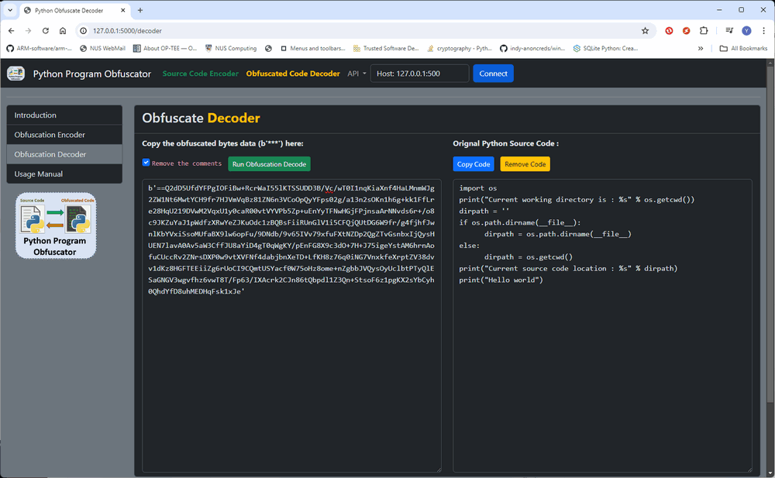
2
Select remove the comments checkbox to remove the added random contents
3
Press the decode button
1
Paste the obfuscated bytes data in the text field
Copy the decoded source code or press the copy to clipboard button
4

