Slide 1
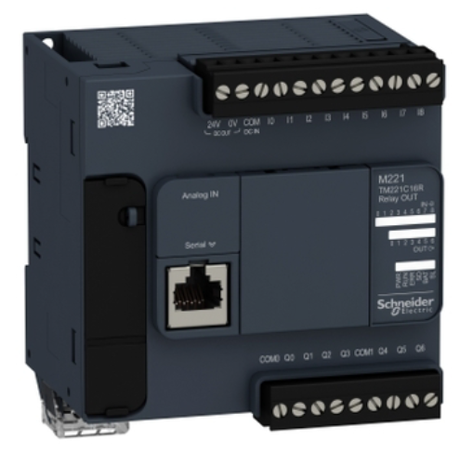
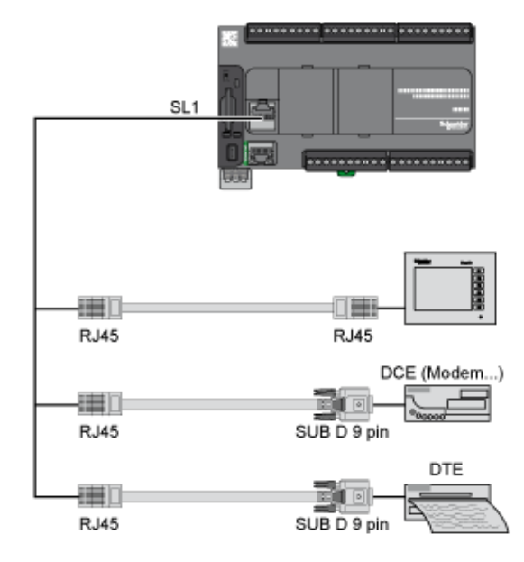

Slide 2



Rung0
HR0.0
HR0.7
C0.0
HR0.1
C0.1
Rung1
HR0.2
HR0.3
HR0.4
C0.2
Rung2
HR0.0
C0.3
Rung3
HR0.6
HR0.4
C0.4
Rung4
HR0.5
Rung5
HR0.2
HR0.6
C0.5
HR0.3
C0.6
Rung6
HR0.7
HR0.5
C0.7
Rung7

Slide 3


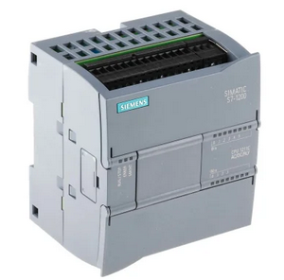
Level 1
OT Field PLCs Emulator LAN
Level 2
PLC Controller
Program LAN
M221 PLC Emulator
1 to 1 PLC controller
[Modbus]
1 to N PLC controller {Modbus]
M221 PLC Emulator
Mixed PLC controller [Modbus & S7comm]
S71200 PLC Emulator
Modbus-TCP bus
S7Comm bus

