Slide 1
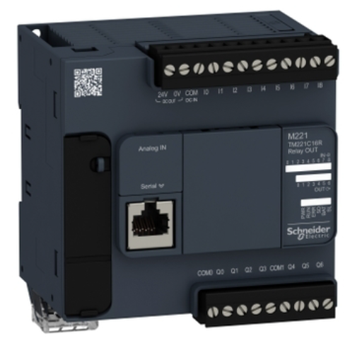
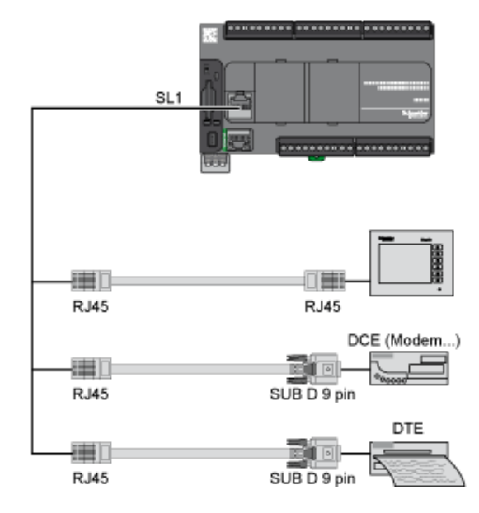

Slide 2



Rung0
HR0.0
HR0.7
C0.0
HR0.1
C0.1
Rung1
HR0.2
HR0.3
HR0.4
C0.2
Rung2
HR0.0
C0.3
Rung3
HR0.6
HR0.4
C0.4
Rung4
HR0.5
Rung5
HR0.2
HR0.6
C0.5
HR0.3
C0.6
Rung6
HR0.7
HR0.5
C0.7
Rung7

Slide 3
Level 1
OT Field PLCs Emulator LAN
Level 2
PLC Controller
Program LAN
M221 PLC Emulator

