Slide 1
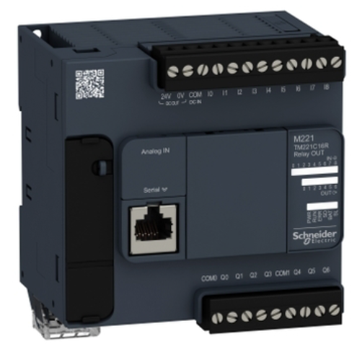
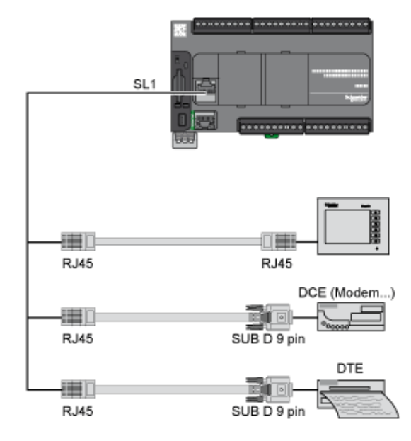

Slide 2



Rung0
HR0.0
HR0.7
C0.0
HR0.1
C0.1
Rung1
HR0.2
HR0.3
HR0.4
C0.2
Rung2
HR0.0
C0.3
Rung3
HR0.6
HR0.4
C0.4
Rung4
HR0.5
Rung5
HR0.2
HR0.6
C0.5
HR0.3
C0.6
Rung6
HR0.7
HR0.5
C0.7
Rung7

Slide 3

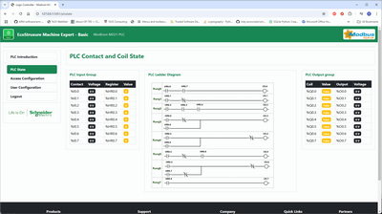





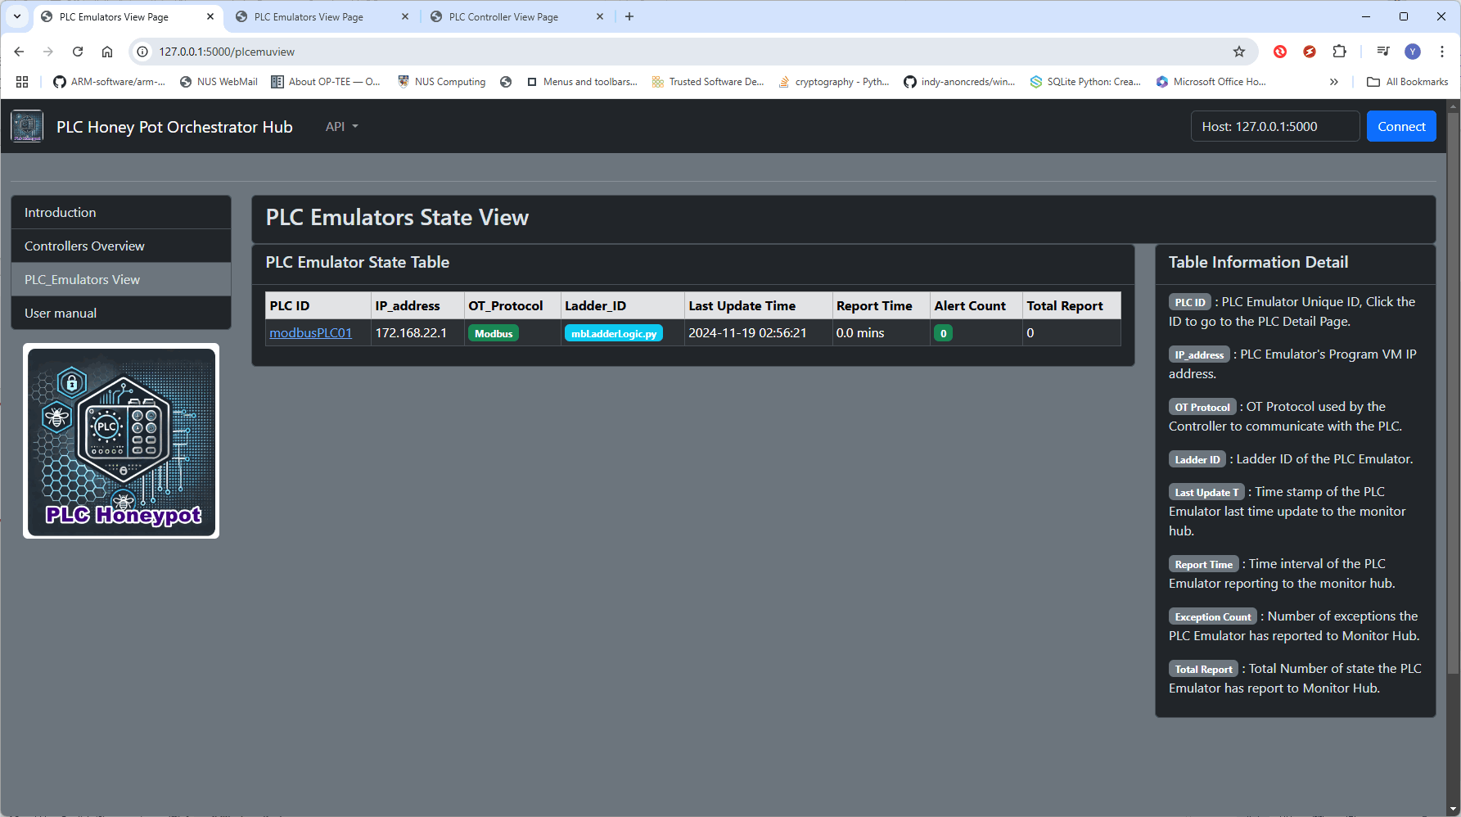

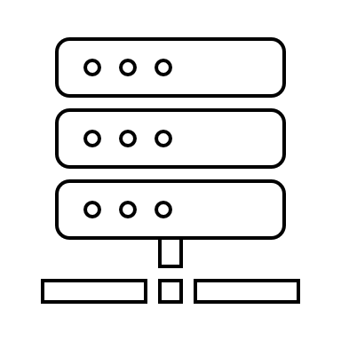
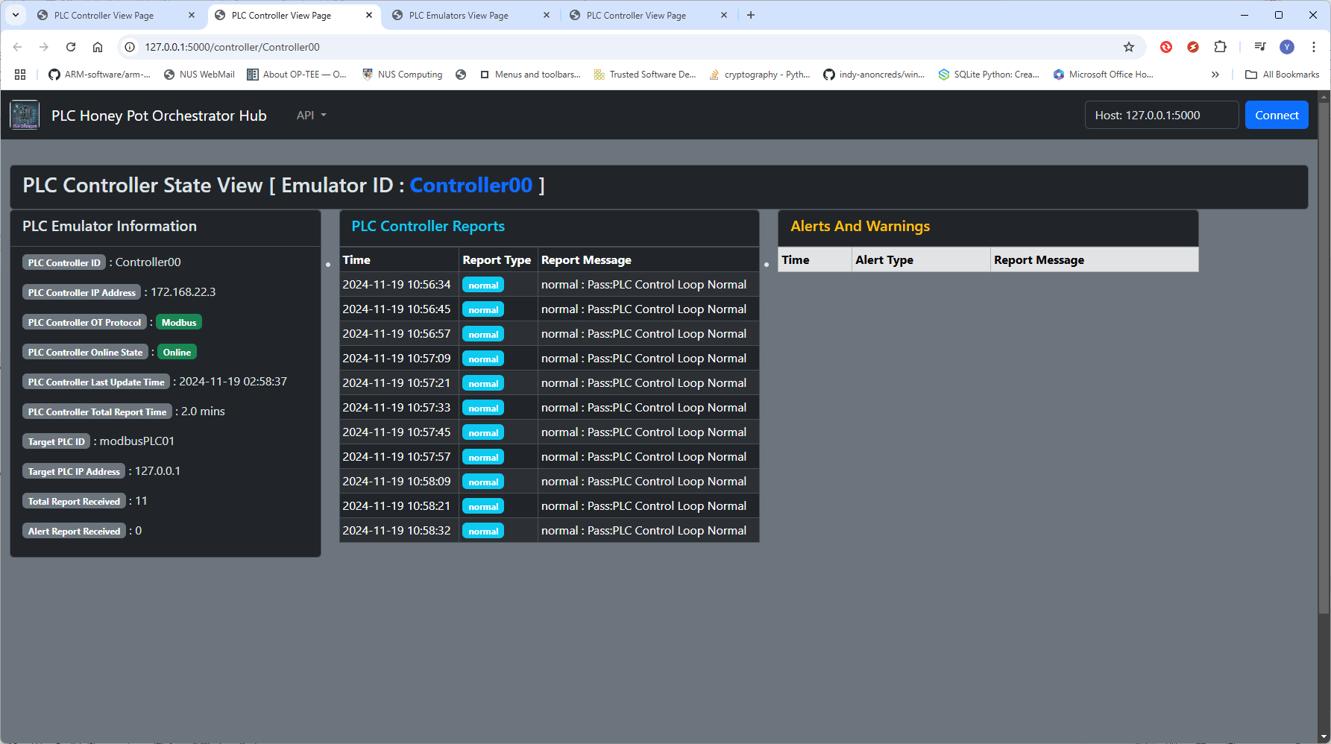
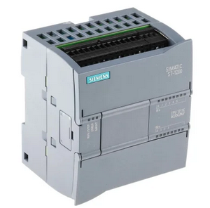
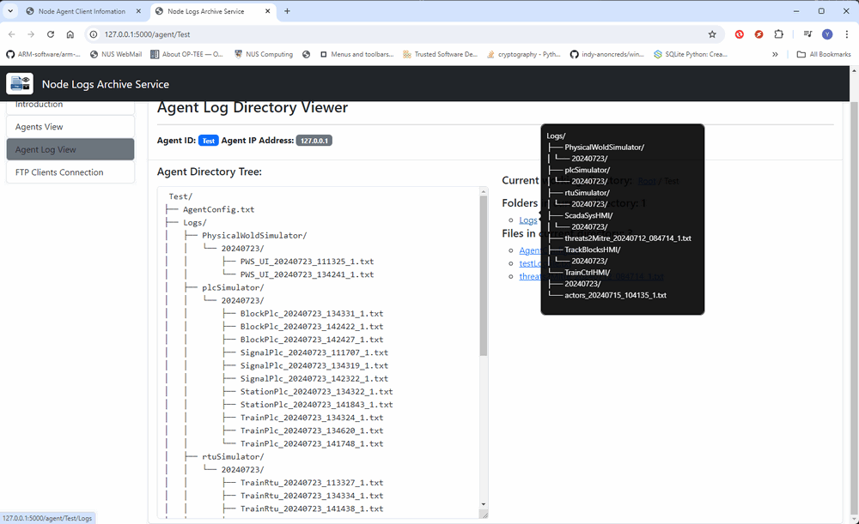



Python PLC Honeypot Project : System Structure and Workflow Overview Diagram
Red Team Attackers
Red Team Engineer
Blue Team Defender
Customized Ladder Logic Module
PLC Configuration Interface
Attack path/flow analysis
Attack detection
Unauthorized PLC config change http(s) request
OT attack Program
Customized Ladder logic module
Honeypot overview dashboard
Level 1
OT Field PLCs Emulator LAN
Level 2
PLC Controller
Program LAN
PLC Honey Pot Monitor LAN
FCI-OT-Attack Modbus request
Monitor dashboard server
M221 PLC Emulator
1 to 1 PLC controller
[Modbus]
Components state dashboard
Controller Modbus request
Monitor Data processing server
1 to N PLC controller {Modbus]
M221 PLC Emulator
Controller verification report
FDI-OT-Attack S7comm request
Mixed PLC controller [Modbus & S7comm]
S71200 PLC Emulator
Log Archive Server / DB
System Log data dashboard
Modbus-TCP bus
Controller S7comm request
S7Comm bus
PLC VM working Log files
Network traffic log files
Controller working Log files
Subsystem log report (FTP)
PLC state report
(http/https)

Slide 4
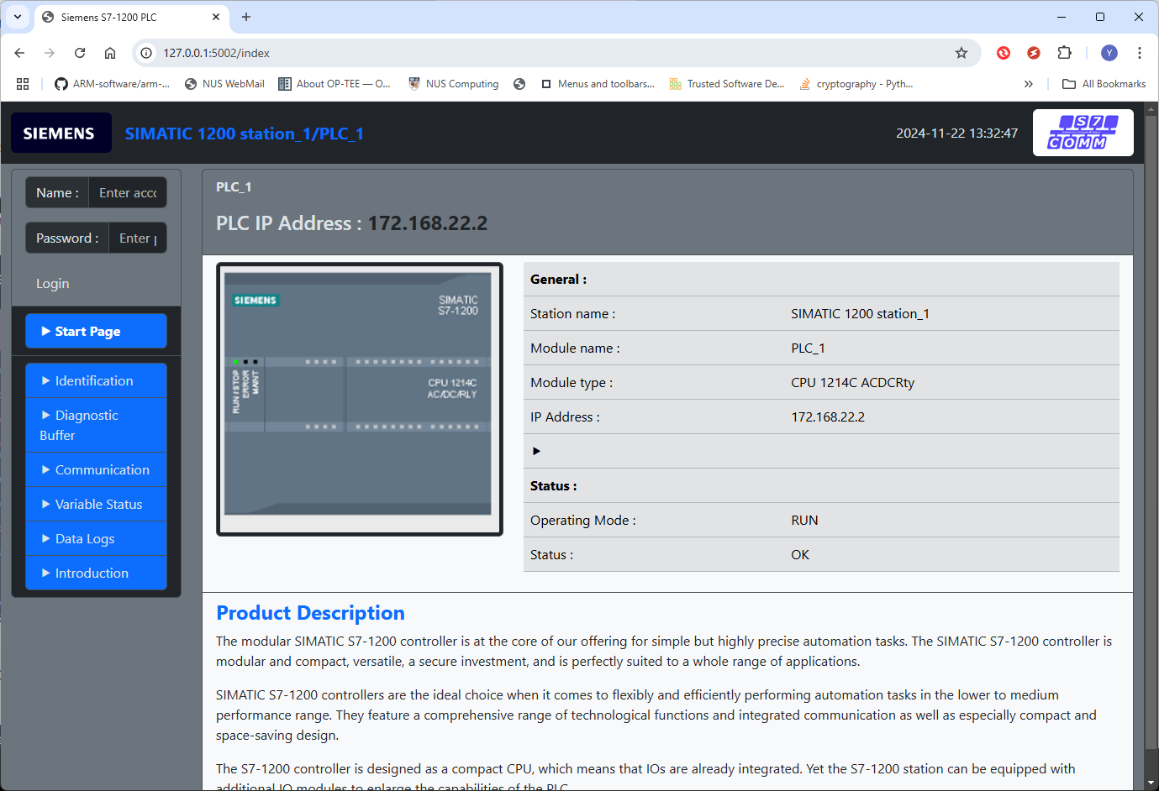



OT Honeypot Network
PLC Simulators
Orchestration Network
PLC log
Blue Team Defenders
Attacker config change request
PLC Report
FCI
OT-Attack Modbus request
PLC
Controllers
ModBus
Controller Report
Monitor server
Attackers
Log Archive Server / DB
S7Comm
OT attack Program
Controller log

Slide 5




Modbus PLC emulator VM
Orchestration Network
OT Honeypot Network
172.23.155.209
172.23.20.9
Maintenance Engineer VM
ID:modbusPLC01
Honeypot Monitor hub VM
S7comm PLC emulator VM
172.23.155.1xx
172.23.155.208
172.23.20.8
172.23.20.4
ID:S7commPLC02
172.23.155.1
Switch-1
Switch-2
172.23.20.1
S7comm PLC Controller VM
172.23.155.207
172.23.20.7
Honeypot Log Archive VM
ID:Controller02
Modbus PLC Controller VM
172.23.155.206
172.23.20.6
172.23.20.5
ID:Controller01

Slide 6
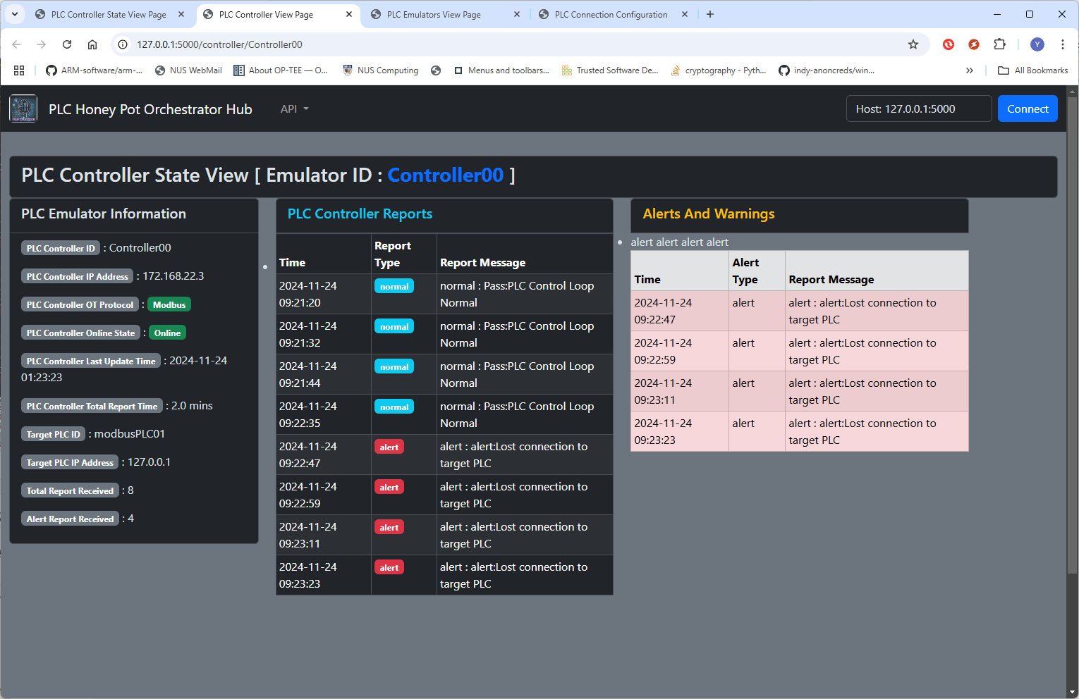
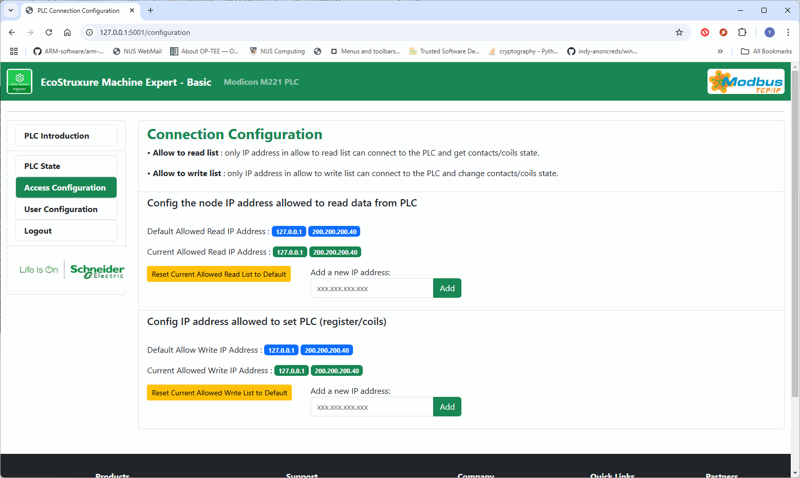
Python PLC Honeypot :
Environment Deployment and Attack Detection
Red Team Engineer
OT Honeypot Network
Modbus PLC emulator VM
172.23.155.209
Orchestration Network
Attack Path
1
172.23.20.9
Maintenance Engineer VM
2
1
Honeypot Monitor hub VM
Deploy
Path
ID:modbusPLC01
1
3
S7comm PLC emulator VM
1
172.23.155.1xx
2
172.23.155.208
172.23.20.8
Detect
Path
172.23.155.1
172.23.20.4
172.23.144.1
Nmap Scan
ID:S7commPLC02
1
Switch-1
Switch-2
Attacker
S7comm PLC Controller VM
172.23.20.1
3
172.23.155.207
172.23.20.7
2
Modbus False Command Injection attack script
2
ID:Controller02
Honeypot Log Archive VM
2
Modbus PLC Controller VM
Unauthorized access configuration
172.23.155.206
172.23.20.6
3
2
172.23.20.5
ID:Controller01
Defender
3
3

Slide 7
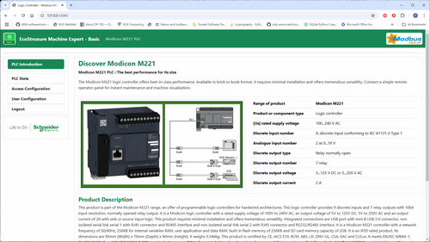
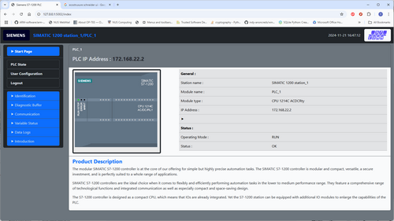
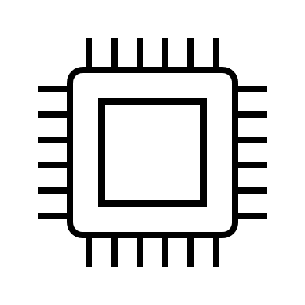
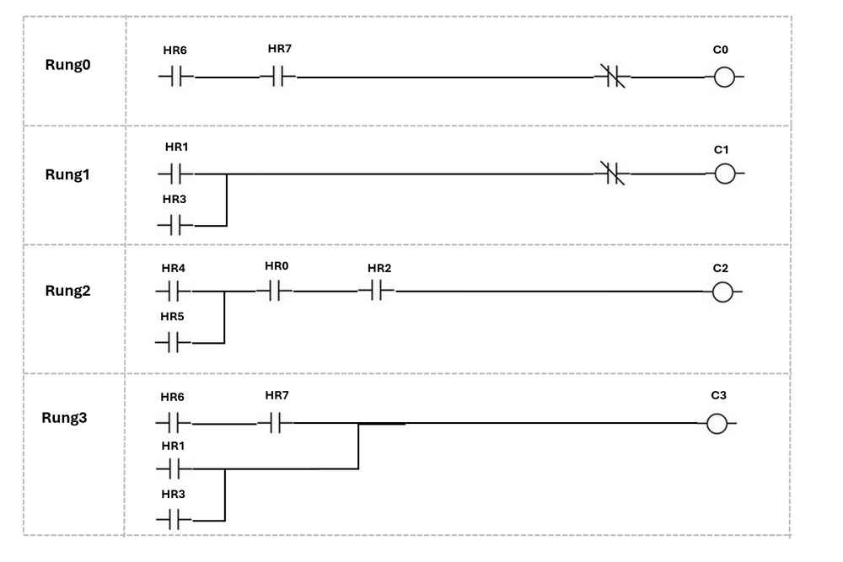
Design of Honeypot PLC Emulator
Deception Ecostruxure PLC Config UI
Honeypot PLC Simulator VM
PLC Emulation Program
PLC Log Archive Client
Local log storage
Flask thread
PLC Config Web interface module
Port 8080
Access and Config log
Data manager thread
Http(s)
Deception SAMTIC PLC Config UI
PLC request control log
OT Comm thread
Port 502/102
Log files management module
PLC Modbus/S7Comm Service module
System operation log
Function thread
File transmission thread
Ladder logic module
PLC Ladder logic execution module
Log data synchronize module
Report thread
PLC Register / Coil / Memory Module
ModBus-TCP
Or
S7Comm
Honeypot monitor report module
PLC Remote Controller VM
FTP
Orchestration Network
Http(s)
Port 8081
Port 5000
Log Data Archive VM
Honeypot Monitor VM
OT Honeypot Network

Slide 8

One to One Connection
One to N Connection
PLC Controller VM
PLC Controller VM
PLC Emulator VM-00
Ladder logic module
Config File
Ladder logic module
Config File
PLC Emulator VM-01
PLC Controller Program (Modbus-TCP)
PLC Emulator VM
PLC Controller Program (Modbus-TCP)
PLC Emulator VM-02
N to N Connection
Mixed OT Protocol Connection
PLC Controller VM
PLC Controller VM
PLC Controller Program (Modbus-TCP)
PLC Emulator VM-00
PLC Controller Program (Modbus-TCP)
PLC Emulator VM-00
…
PLC Controller VM
PLC Controller Program (Modbus-TCP)
PLC Emulator VM-0N
PLC Controller Program (S7Comm)
PLC Emulator VM-0N

Slide 9
Design of Honeypot PLC Remote Controller
Honeypot PLC Controller VM
PLC Controller Program
PLC Log Archive Client
Local log storage
OT Comm thread
Port 502/102
Data manager thread
PLC request control log
PLC Modbus/S7Comm Client module
System operation log
PLC Emulator
VM-01
Function thread
Modbus-TCP
Log files management module
Same Ladder logic module as target PLC
Controller Ladder logic execution module
PLC Emulator
VM-0N
File transmission thread
Verification Result
PLC Register / Coil / Memory Simulation
S7Comm
Log data synchronize module
Report thread
Honeypot monitor report module
OT Honeypot Network
FTP
Http(s)
Orchestration Network
Port 8081
Port 5000
Log Data Archive VM
Honeypot Monitor VM

Slide 10
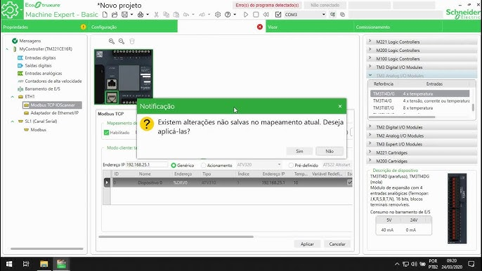

Schneider Electric EcoStruxure Machine Expert M22X PLC Configuration Interface
Honeypot Deception PLC Configuration Web Interface

Slide 11
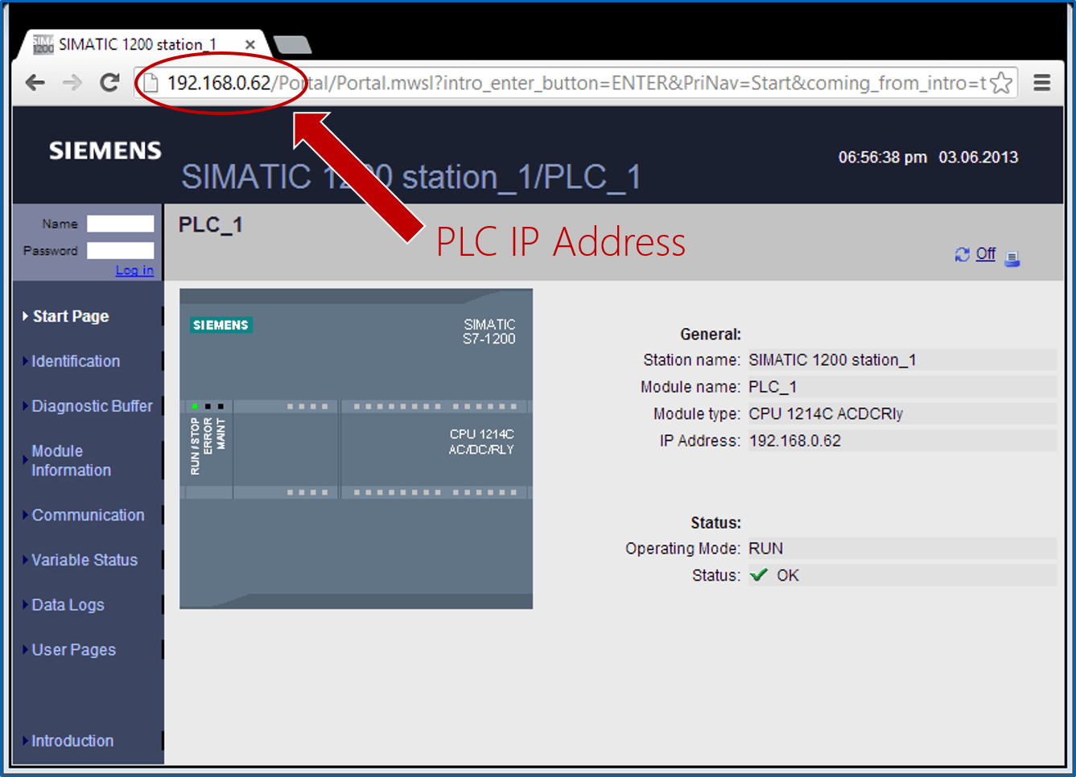
Siemens SIMATIC S7-1200 / S7-1500 Web Server
Honeypot Deception PLC Configuration Web Interface

Slide 12
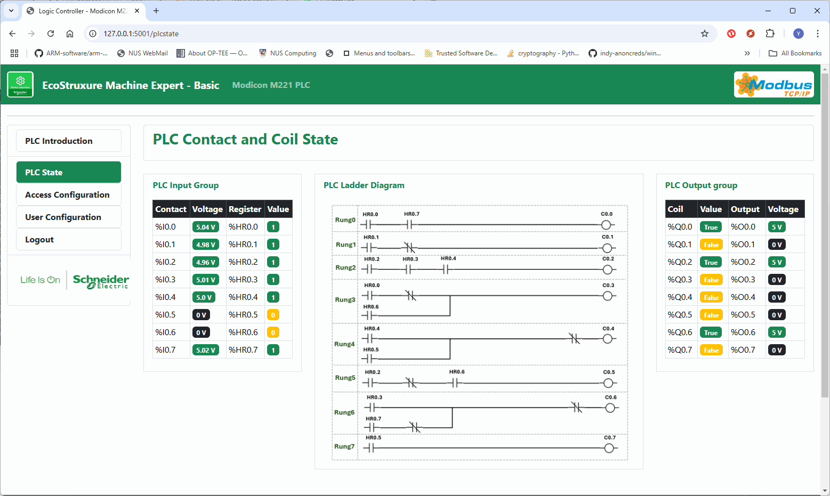
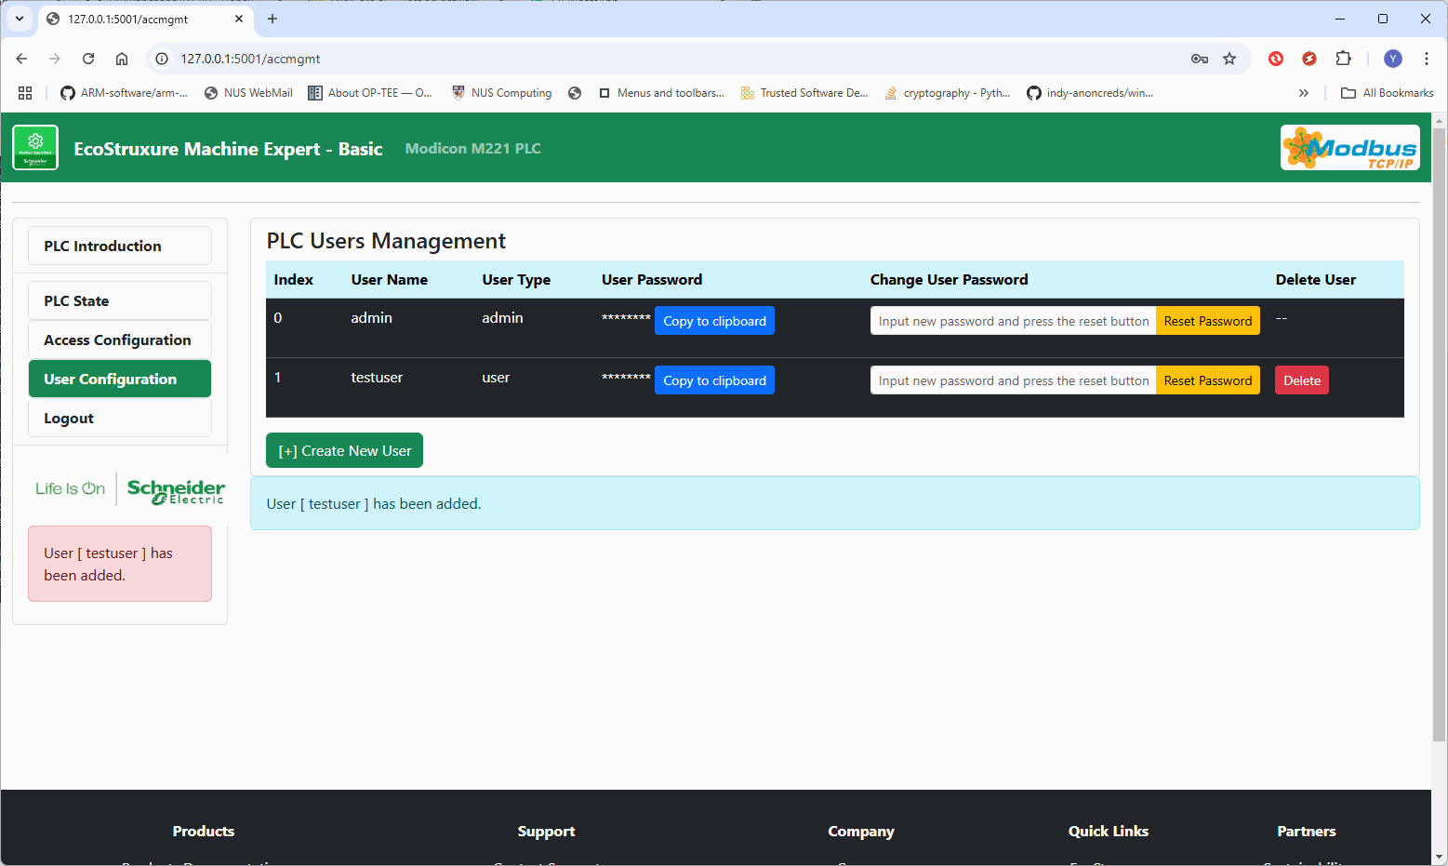
Honeypot Deception PLC Access Permission Config Page
Honeypot Deception PLC Main Landing Page
Honeypot Deception PLC User Configuration page
Honeypot Deception PLC I/O state and ladder logic page

Slide 13
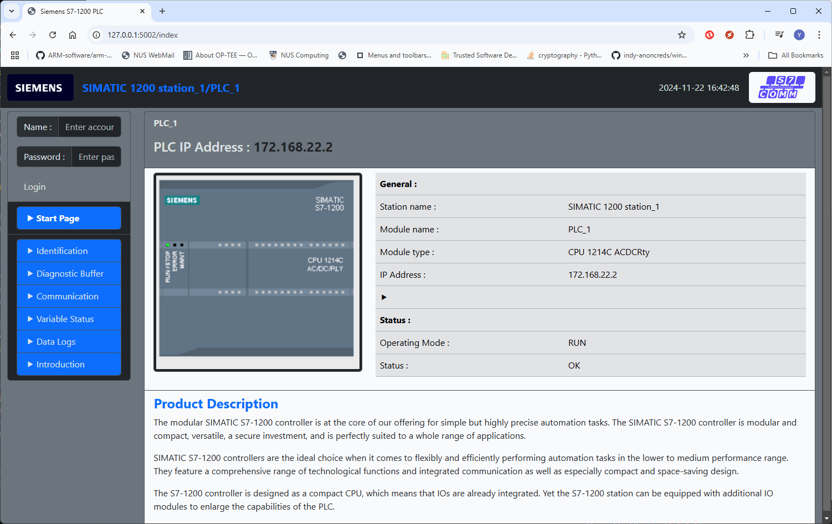
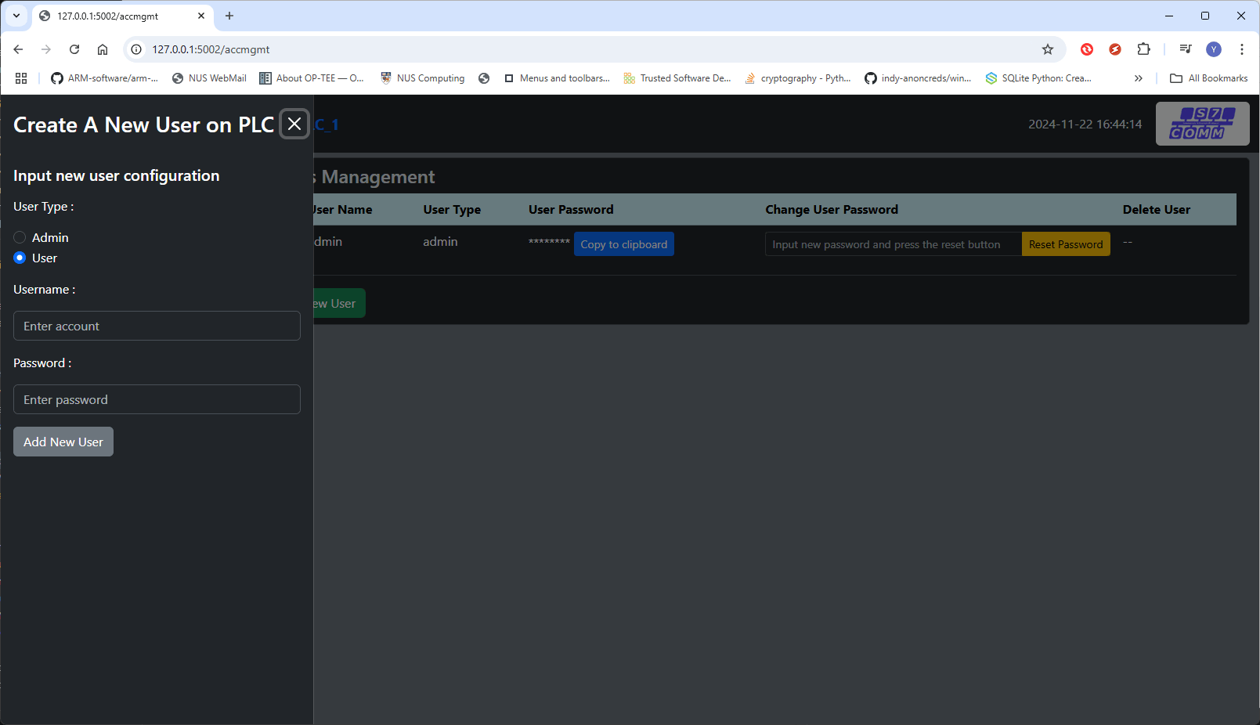
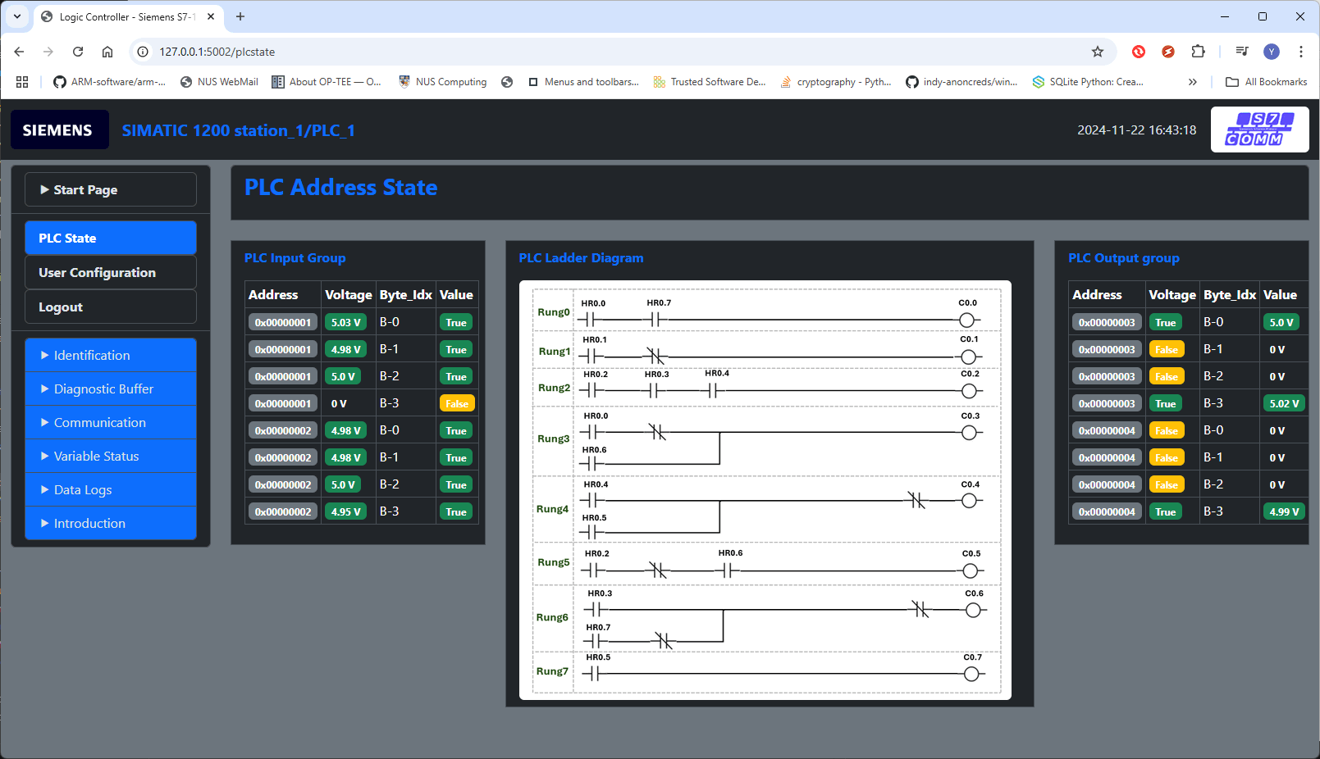
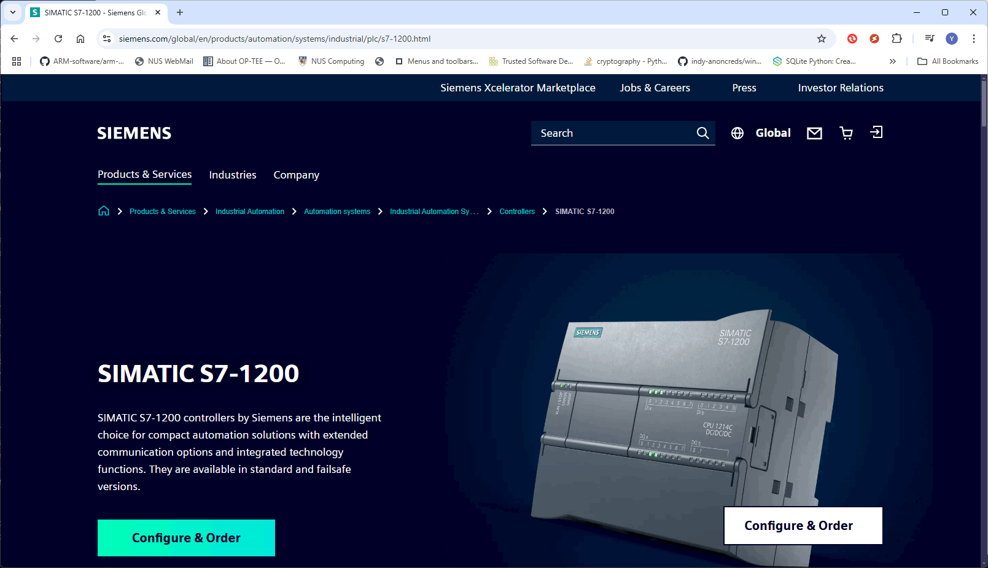
Honeypot Deception S71200 PLC Main Landing Page
Honeypot Deception S71200 PLC User Configuration page
Honeypot Deception S71200 PLC I/O state, memory and ladder logic page
Honeypot Deception S71200 PLC Introduction Page

Slide 14



PLC Honeypot Log Archive System Workflow
PLC Emulator or Controller programs
Log Archive Agent Init
Agent config file
Log Archive Service Init
Server config file
Main thread
Log file uploaded record
Main thread
Create log files
Record manager
Agent manager
User Config file
Local log storage
Orchestration Network
Sub-thread
Log directory tree generator
FTP Server
Web host module
New log check loop
Sub-thread
Log directory tree generator
New log upload queue manager
FTP Client
Web-Browser
Server log storage
Honeypot PLC Emulator or Controller Node
Honeypot Log Archive Server

Slide 15
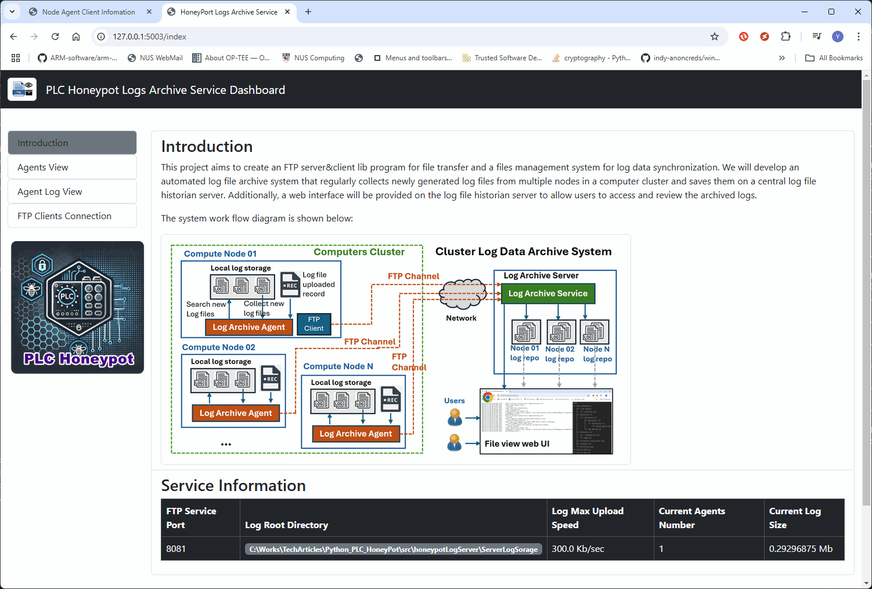
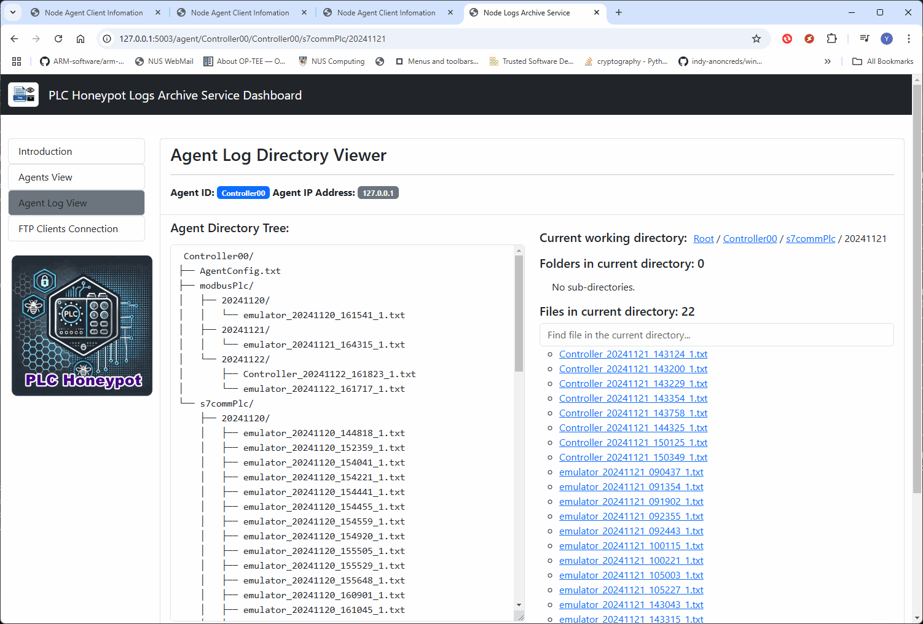
Honeypot log archive server main page
Honeypot log archive server components log view page

Slide 16
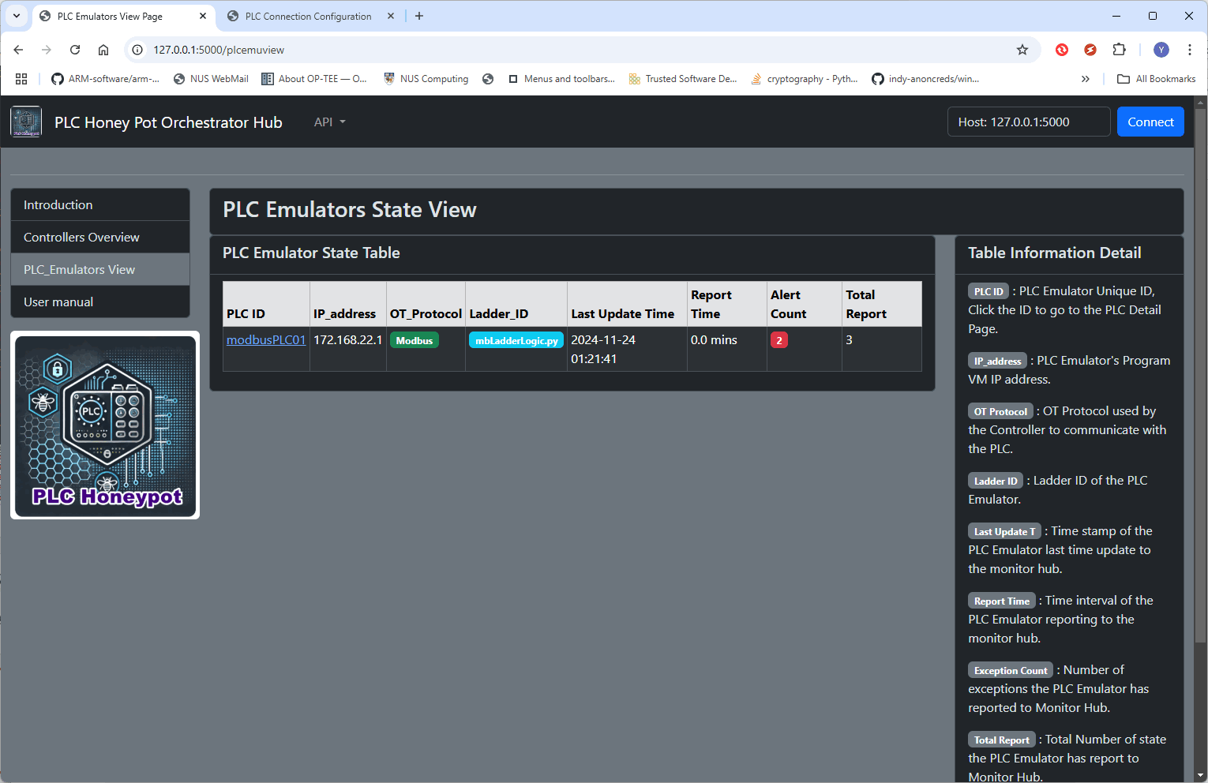
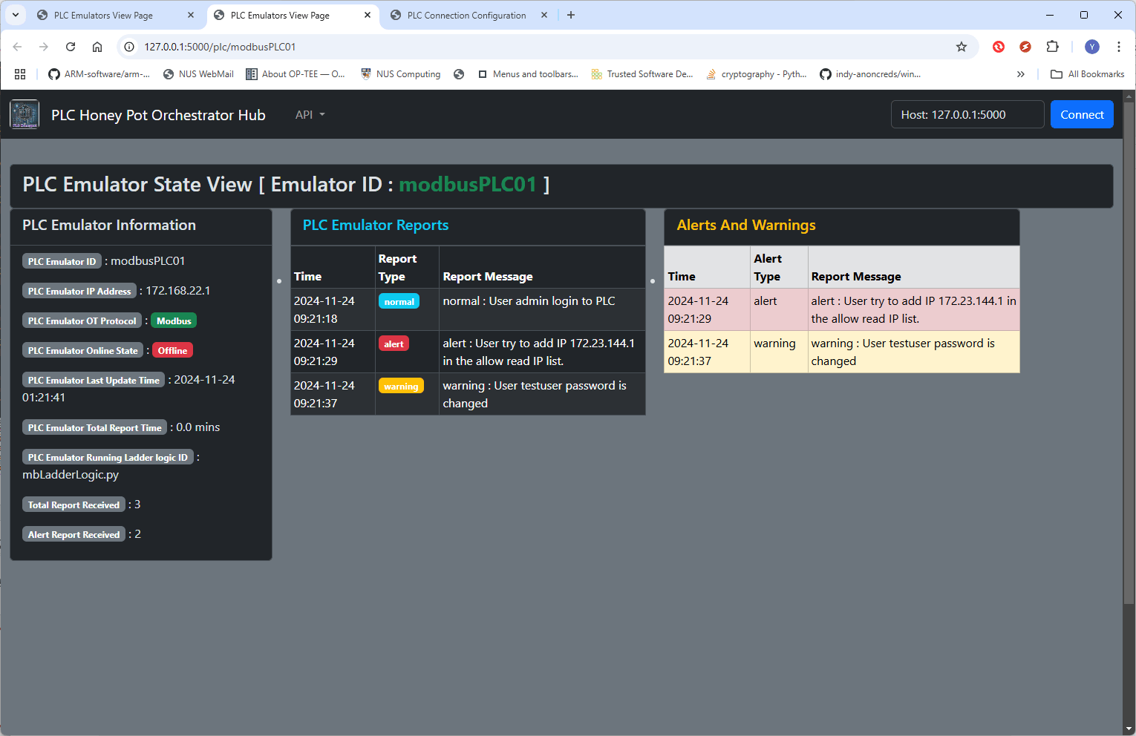
Honeypot All PLC Emulators Overview Page
Honeypot All PLC Emulator Detailed State Page

Slide 17
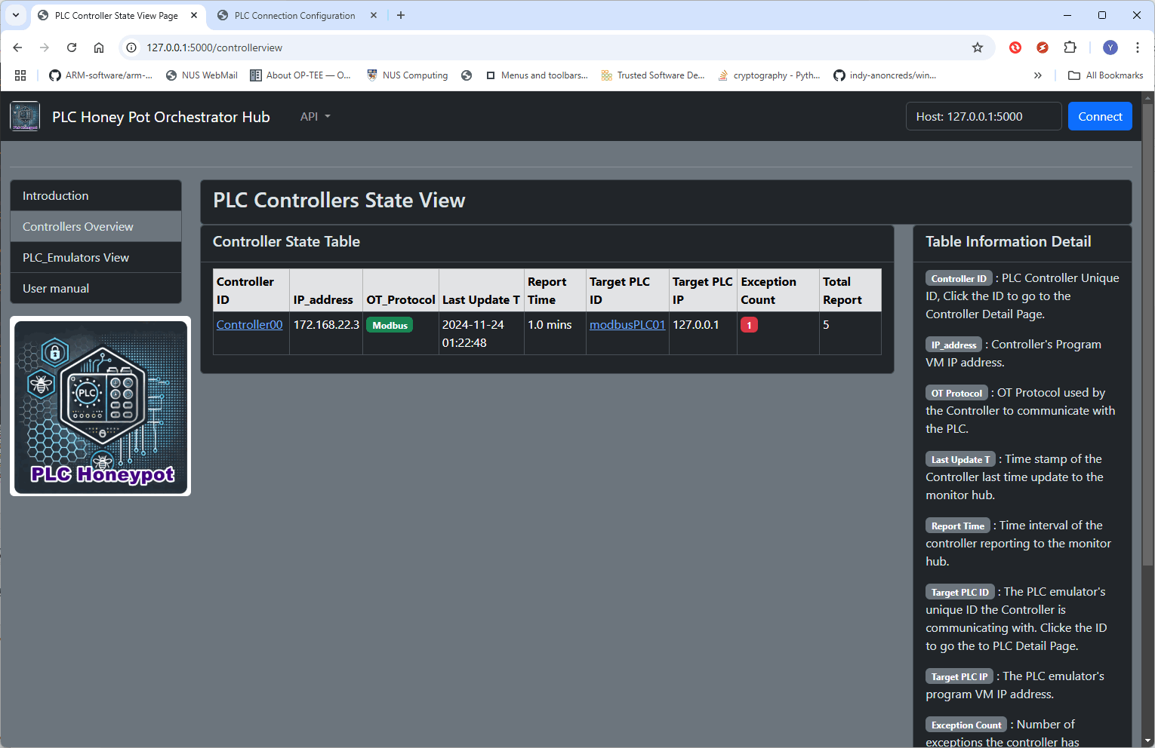
Honeypot All PLC Controller Overview Page
Honeypot All PLC Controller Detailed State Page

Slide 18
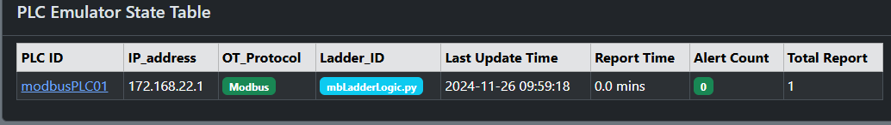
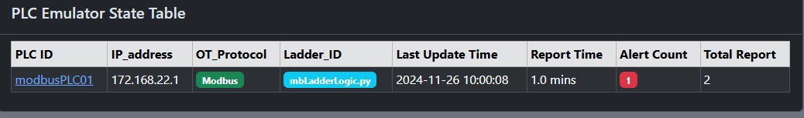
Honeypot Monitor Hub: Before PLC Report Alert
Honeypot Monitor Hub: After PLC Report Alert

Slide 19
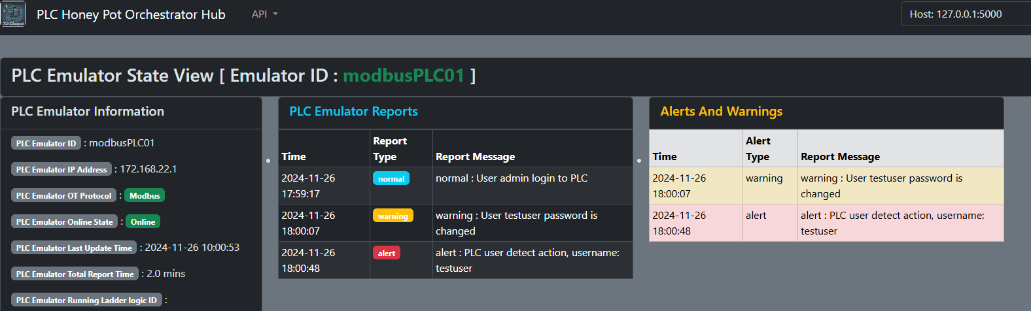
PLC alert report detail information.

Slide 20
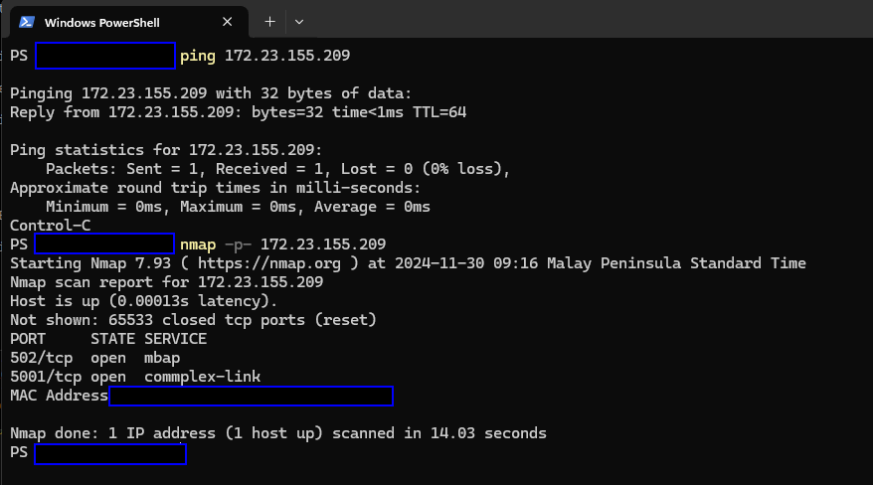
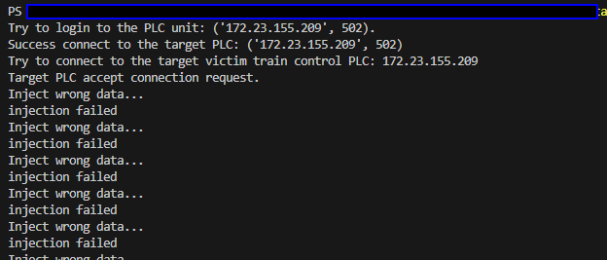

Slide 21
