Slide 1
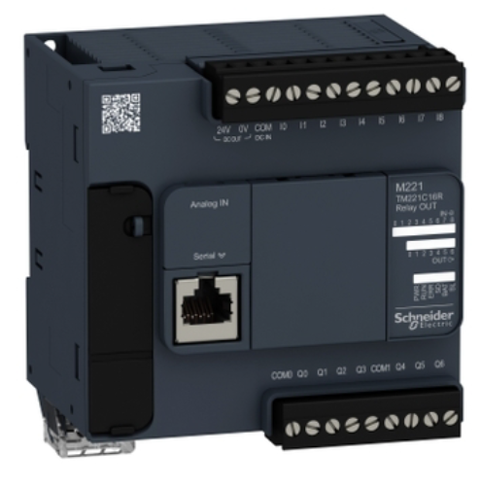
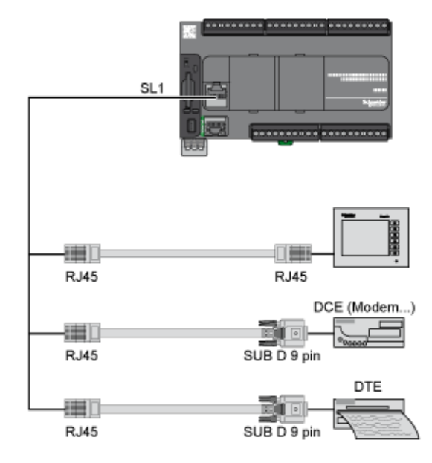

Slide 2



Rung0
HR0.0
HR0.7
C0.0
HR0.1
C0.1
Rung1
HR0.2
HR0.3
HR0.4
C0.2
Rung2
HR0.0
C0.3
Rung3
HR0.6
HR0.4
C0.4
Rung4
HR0.5
Rung5
HR0.2
HR0.6
C0.5
HR0.3
C0.6
Rung6
HR0.7
HR0.5
C0.7
Rung7

Slide 3

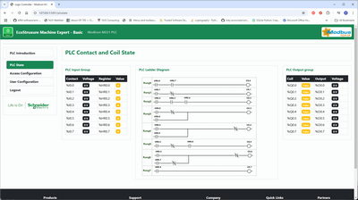





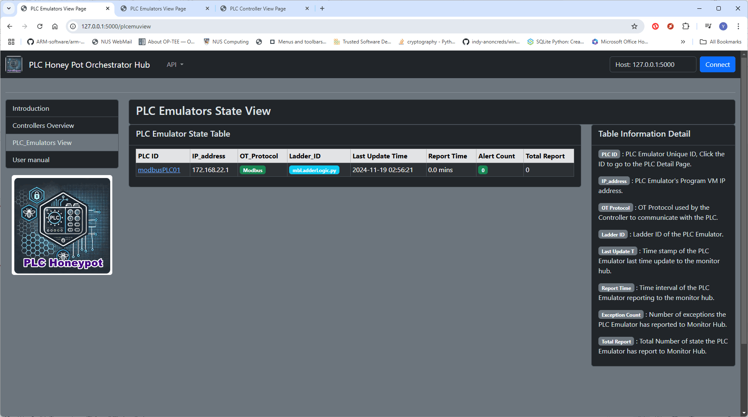

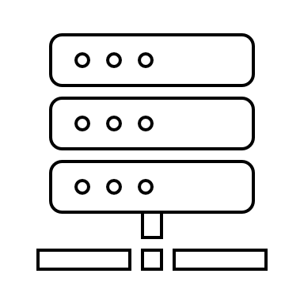
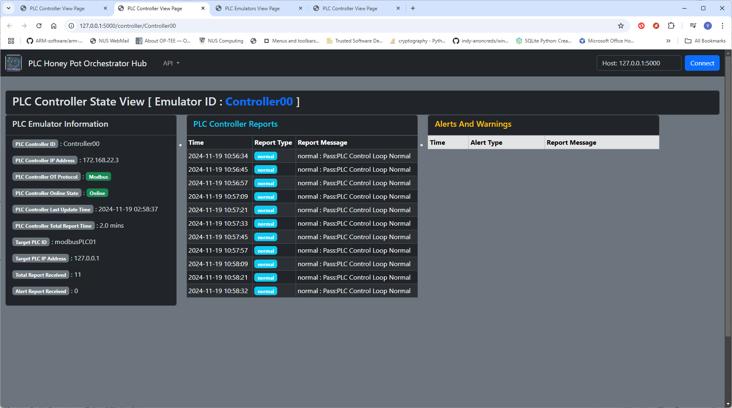
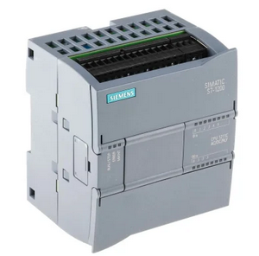
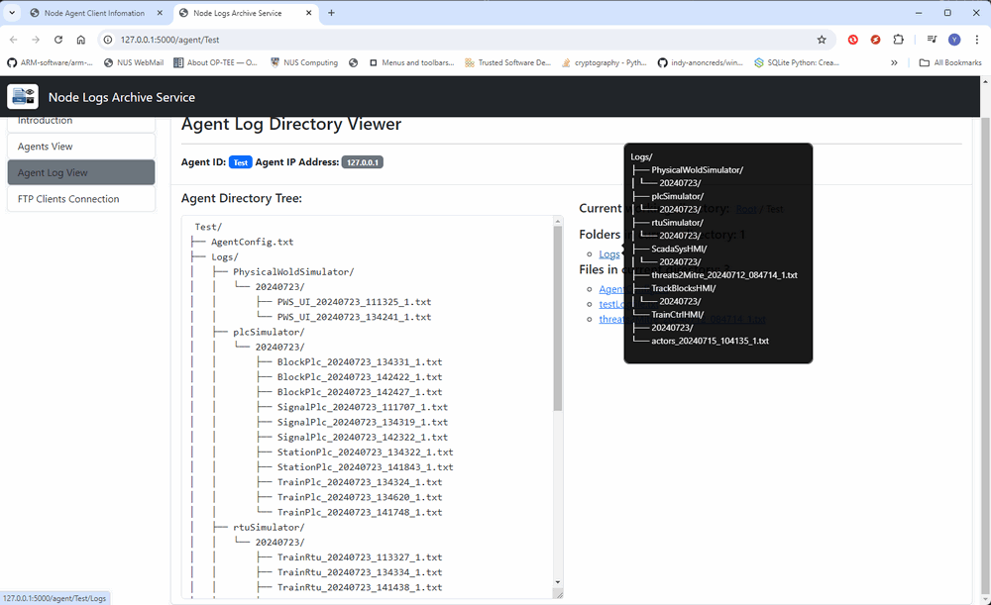



Python PLC Honeypot Project : System Structure and Workflow Overview Diagram
Red Team Attackers
Red Team Engineer
Blue Team Defender
Customized Ladder Logic Module
PLC Configuration Interface
Attack path/flow analysis
Attack detection
Unauthorized PLC config change http(s) request
OT attack Program
Customized Ladder logic module
Honeypot overview dashboard
Level 1
OT Field PLCs Emulator LAN
Level 2
PLC Controller
Program LAN
PLC Honey Pot Monitor LAN
FCI-OT-Attack Modbus request
Monitor dashboard server
M221 PLC Emulator
1 to 1 PLC controller
[Modbus]
Components state dashboard
Controller Modbus request
Monitor Data processing server
1 to N PLC controller {Modbus]
M221 PLC Emulator
Controller verification report
FDI-OT-Attack S7comm request
Mixed PLC controller [Modbus & S7comm]
S71200 PLC Emulator
Log Archive Server / DB
System Log data dashboard
Modbus-TCP bus
Controller S7comm request
S7Comm bus
PLC VM working Log files
Network traffic log files
Controller working Log files
Subsystem log report (FTP)
PLC state report
(http/https)

