Slide 1


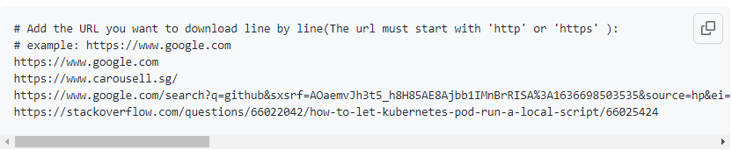
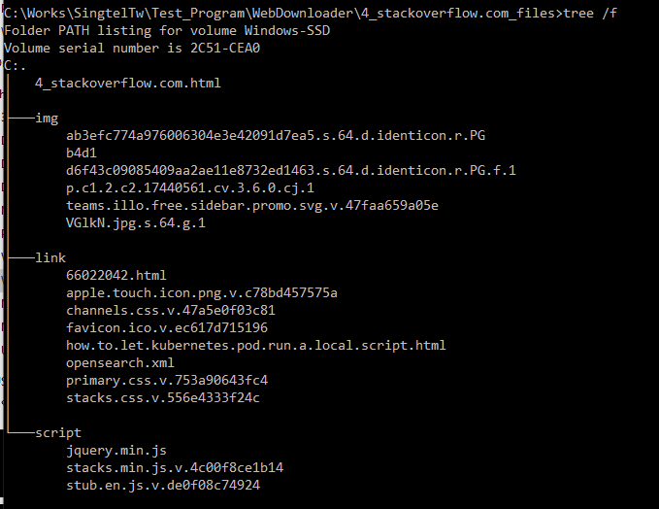
URLs list
URLs record file
Input
Python Web Contents Parser
Output
Python Web Download Tool
Sub pages
Images
Scripts
css
xml
Main HTML Page
URL domain folder
SSL certificate
URL Record

