Slide 1


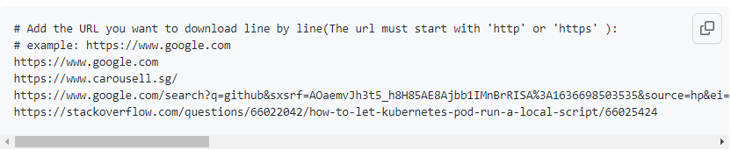
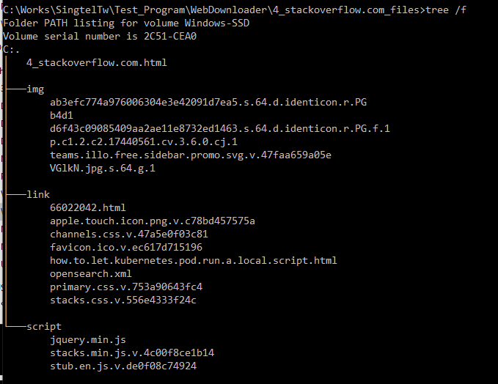
URLs list
URLs record file
Input
Python Web Contents Parser
Output
Python Web Download Tool
Sub pages
Images
Scripts
css
xml
Main HTML Page
URL domain folder
URL Record

