Slide 1
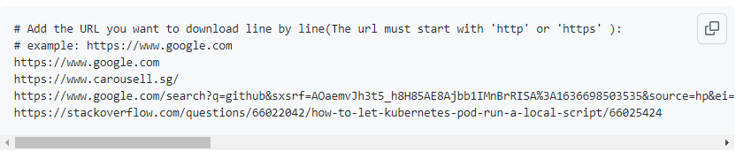
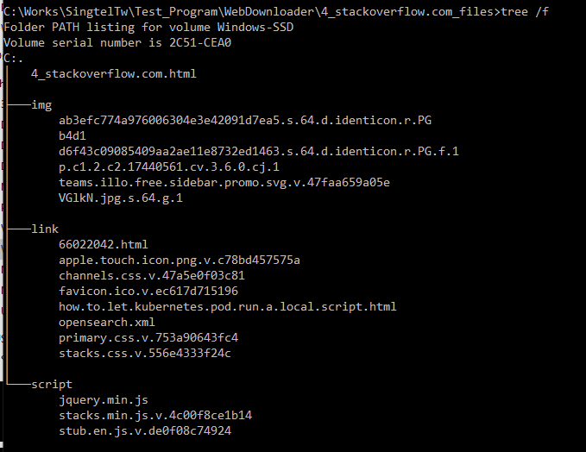
Web Downloader
Introduction
This module will provide API to download the webpage components : html file, image file, css file, xml file, javascript file, href link file based on the input url (the url must start with 'http' or 'https’ ).
Input
url list file
Web Downloader
Output
url domain folder
img
link
script
Main page
imgFlg: Set to "True" to download all the “<img>" tag files.
linkFlg: Set to "True" to download all the html section, image, icon, css file imported by “<href>"
scriptFlg: set to "True" to download all the .js file.

Slide 2
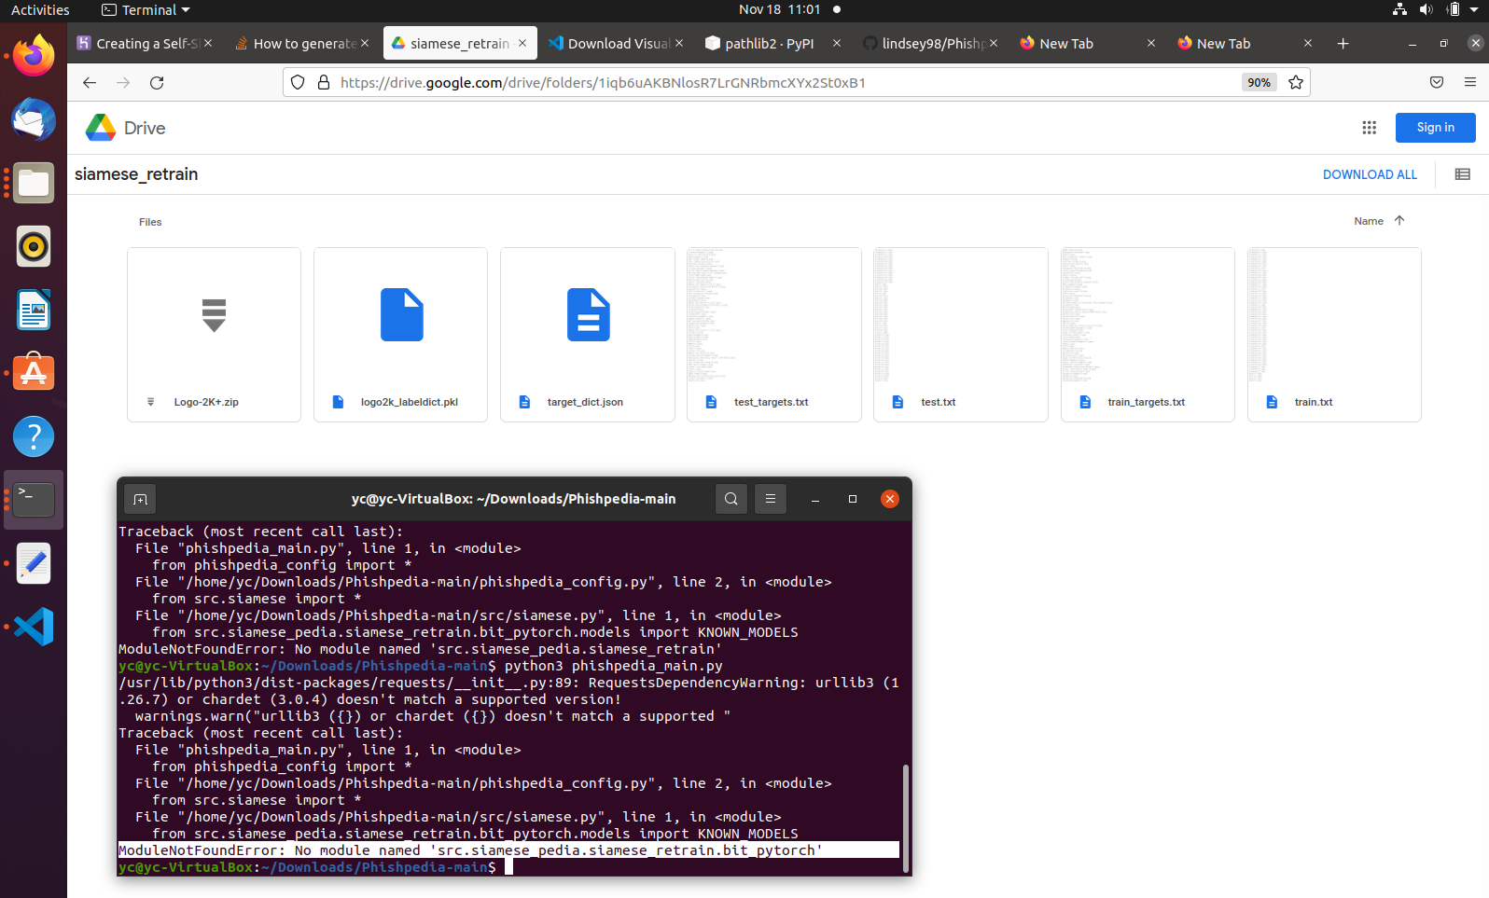
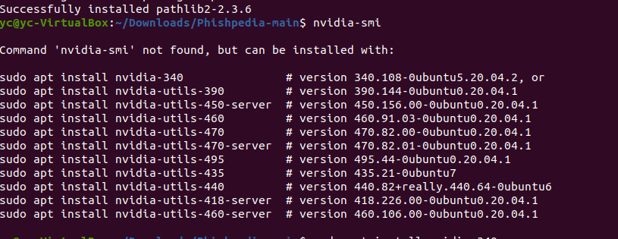
Phishpedia Integration
Modules missing
Progress
Setup the program execution environment : Ubuntu Finished , Windows got problem.
Problem 1 [fixed] : 2 libs: torch=1.6.0, pathlib 1.0.1 -> Windows compatible problem for 32 bit python.
Problem 2 [not fixed]: lib Detectron2 no more Windows support for torch > 1.6.0. pycocotool 64-bit Window install error.
2. Setup logo targetlist: Finished
3. Download model files: Finished
Problem 1 [Fixed]: Their document link doesn't contain the modules file they used in the program. As shown on the right side(Q: did they use the original version or they did any modify ? ):
4. Run experiment [Error]
- Problem 1[fixed] No nivida graph card and driver.
- Problem 2[not fixed]: only can install driver v-340 , then got error driver too old can not used by CUDA toolkit.
Q: Need I have a computer with real nivida graph card installed ?
Driver we tried

Slide 3
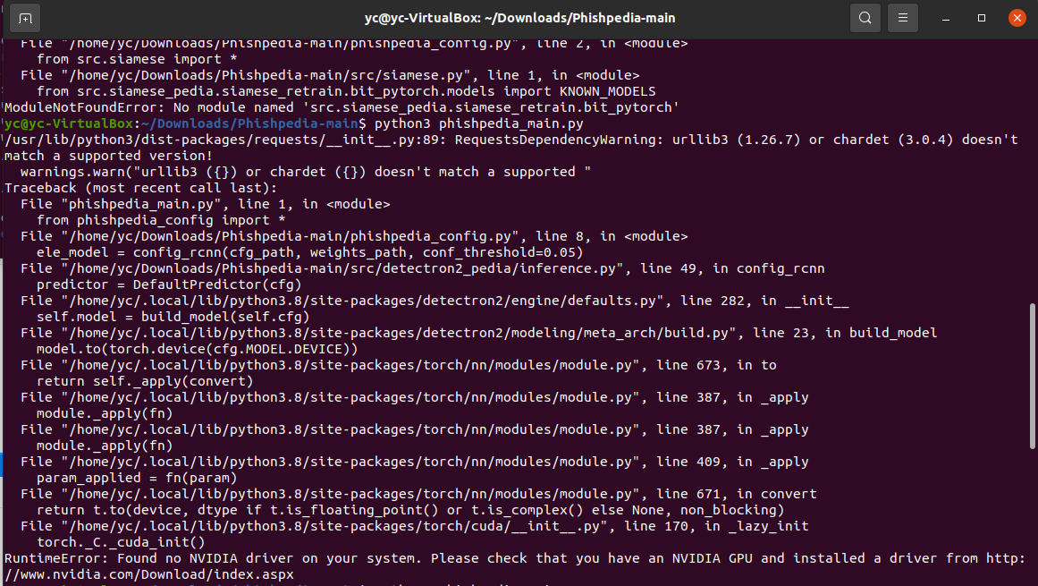
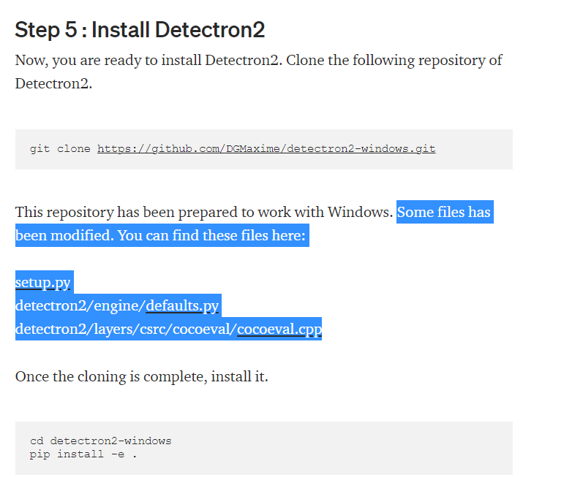
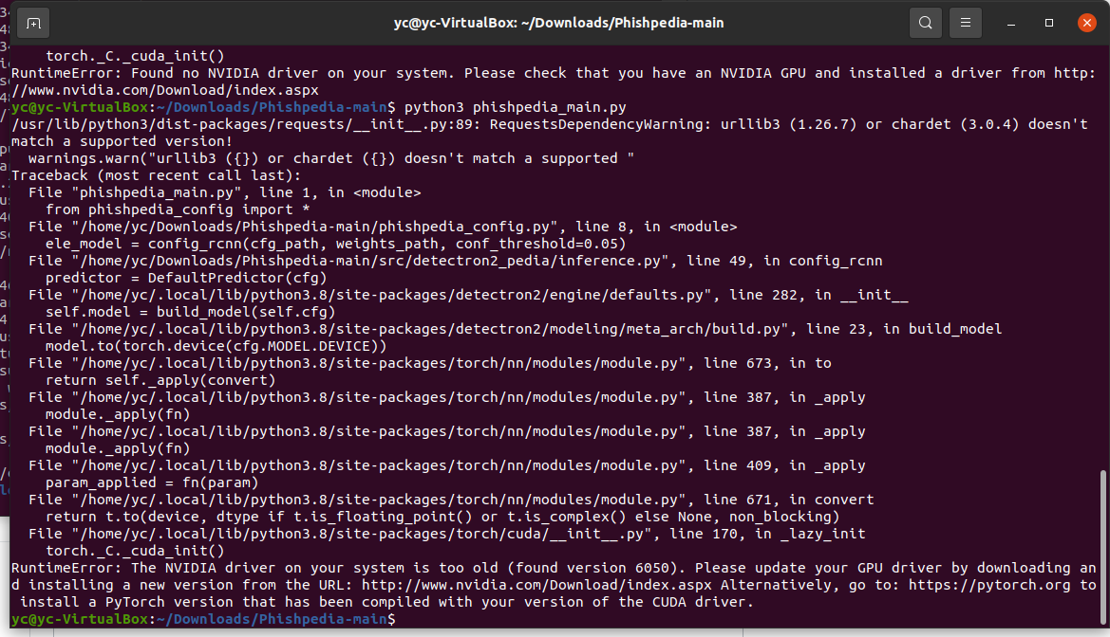
4. Problem 1
The lib Detectron2 git latest version has removed the part they can modify in the related file . The cocoeval.cpp is not used.
4. Problem 2
Problem: Ubuntu will not start after installed the nvidia driver n-375 and light-the-torch :
Solution:
1. Boot to a root shell
2. Uninstall all the nvidia drivers: sudo apt-get purge nvidia*

Slide 4
three column icons
Etiam sollicitudin dui ut elit lacinia, vitae aliquet nunc scelerisque. Duis ut sem bibendum, vehicula ligula non, varius eros. Duis tristique velit lectus, dapibus ullamcorper dui condimentum id.
Etiam sollicitudin dui ut elit lacinia, vitae aliquet nunc scelerisque. Duis ut sem bibendum, vehicula ligula non, varius eros. Duis tristique velit lectus, dapibus ullamcorper dui condimentum id.
Etiam sollicitudin dui ut elit lacinia, vitae aliquet nunc scelerisque. Duis ut sem bibendum, vehicula ligula non, varius eros. Duis tristique velit lectus, dapibus ullamcorper dui condimentum id.

