Slide 1



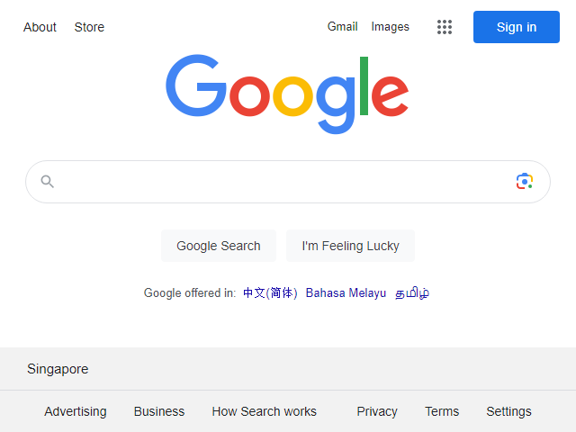
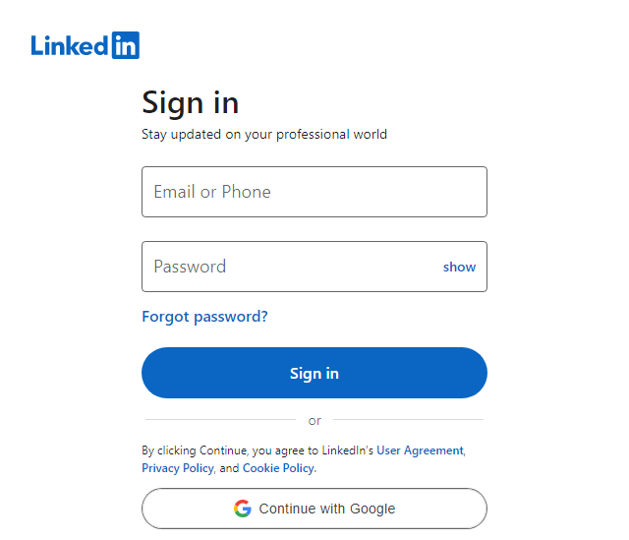
URLs list
URLs record file
Python Web Screenshot Tool
Google Chrome Driver
QT5 WebEngine Driver

