Slide 1
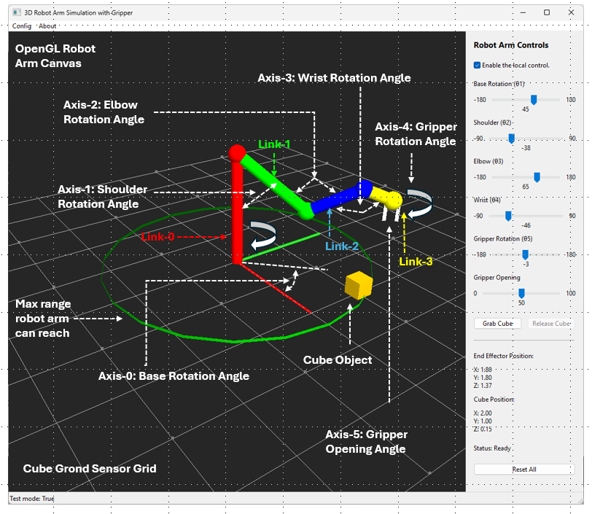
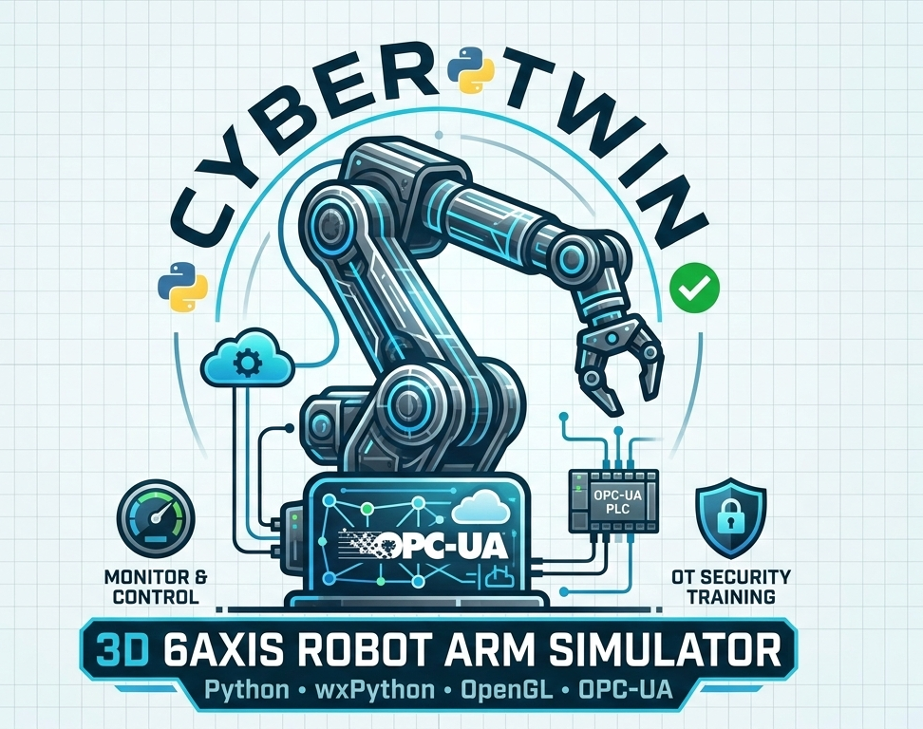
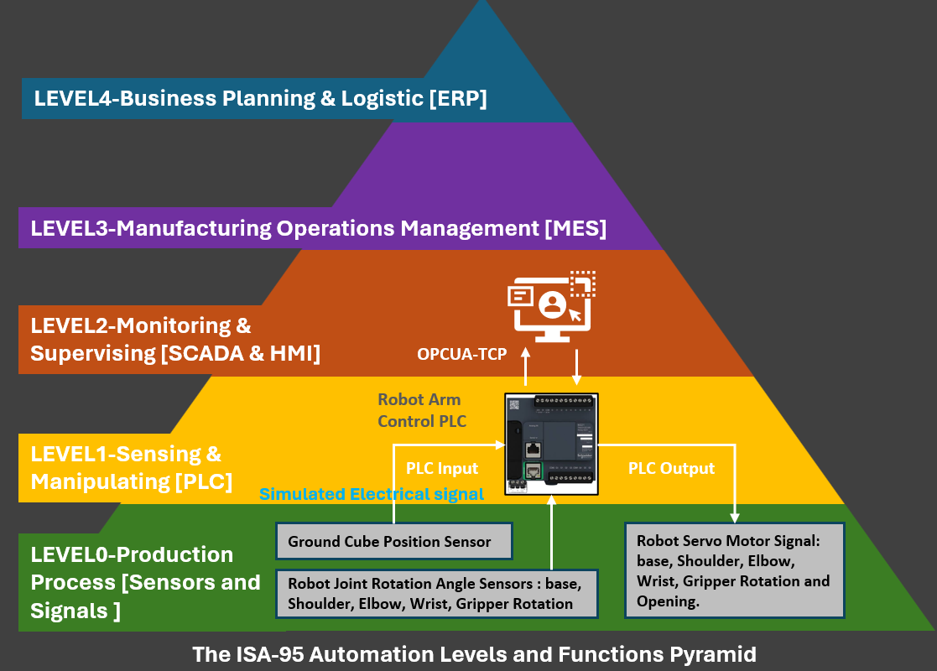
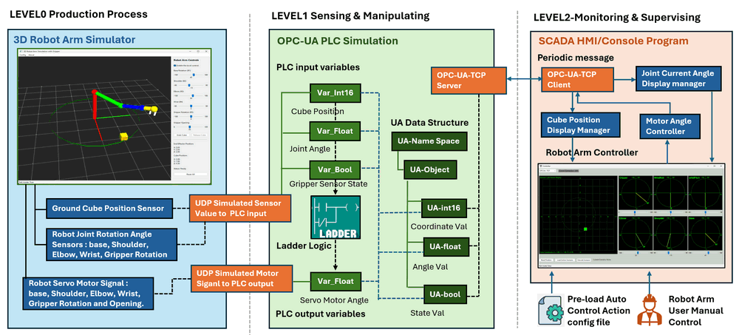
3D 6Axis Robotic Arm Simulator System with Python-wxPython-OpenGL and OPC-UA

Slide 2
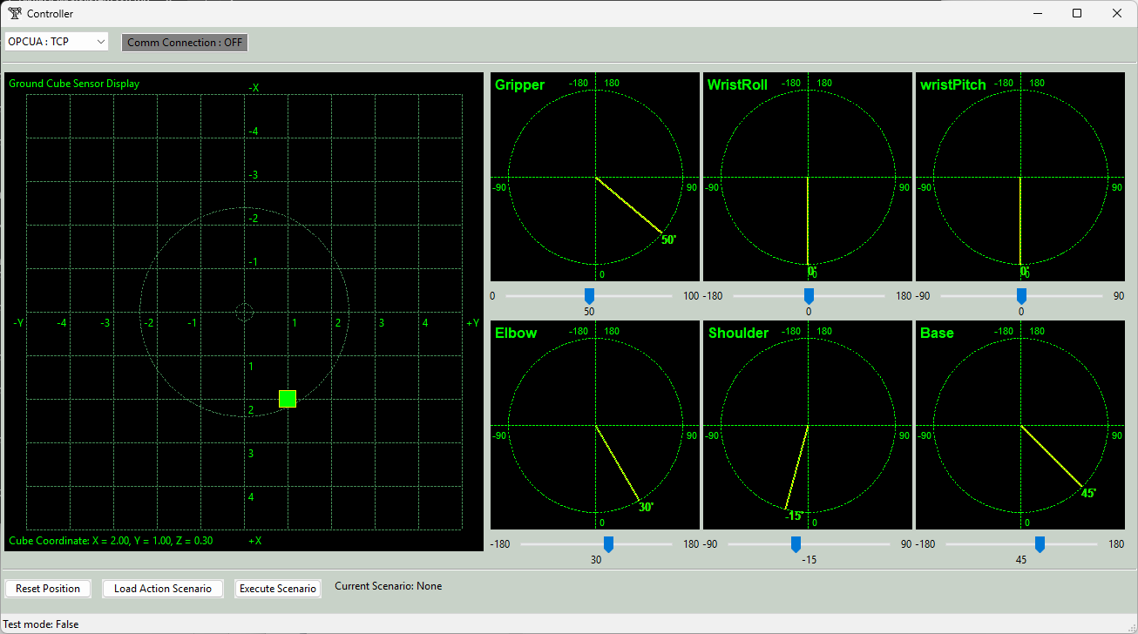


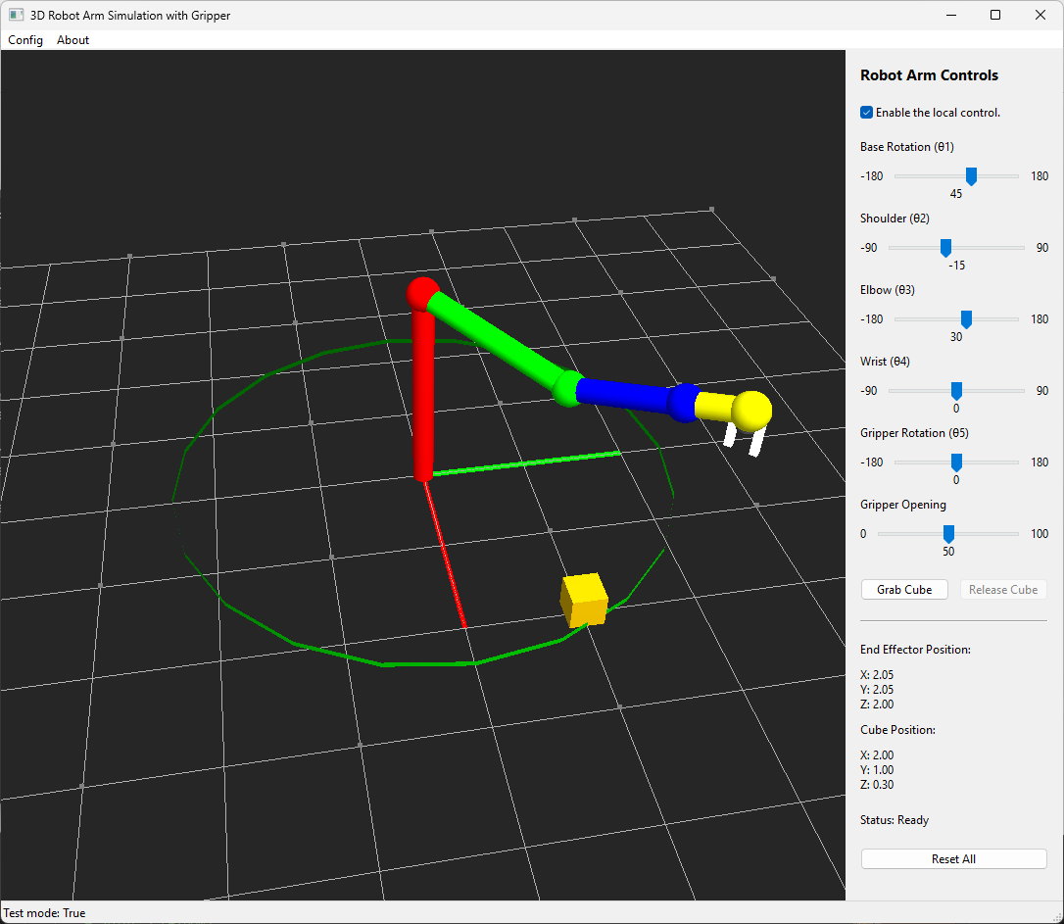
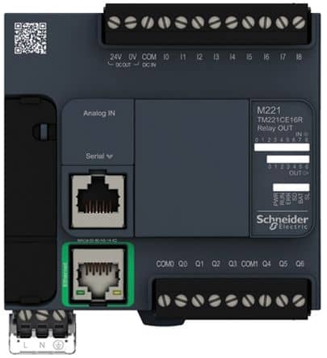
3D_6Axis_Robotic_Arm_Simulator with Python-wxPython-OpenGL and OPC-UA
LEVEL4-Business Planning & Logistic [ERP]
Robot Arm Simulator OPCUA Remote Human Machine Interface
LEVEL3-Manufacturing Operations Management [MES]
LEVEL2-Monitoring & Supervising [SCADA & HMI]
Python Virtual PLC Simulator with IEC 62541 OPC-UA-TCP
OPCUA-TCP
Robot Arm Control PLC
3D Robot Arm Simulator
LEVEL1-Sensing & Manipulating [PLC]
PLC Input
PLC Output
Simulated Electrical signal
LEVEL0-Production Process [Sensors and Signals ]
Ground Cube Position Sensor
Robot Servo Motor Signal: base, Shoulder, Elbow, Wrist, Gripper Rotation and Opening.
Robot Joint Rotation Angle Sensors : base, Shoulder, Elbow, Wrist, Gripper Rotation
The ISA-95 Automation Levels and Functions Pyramid

Slide 3
3D_6Axis_Robotic_Arm_Simulator with Python-wxPython-OpenGL and OPC-UA
LEVEL4-Business Planning & Logistic [ERP]
LEVEL3-Manufacturing Operations Management [MES]
LEVEL2-Monitoring & Supervising [SCADA & HMI]
OPCUA-TCP
Robot Arm Control PLC
LEVEL1-Sensing & Manipulating [PLC]
PLC Input
PLC Output
Simulated Electrical signal
LEVEL0-Production Process [Sensors and Signals ]
Ground Cube Position Sensor
Robot Servo Motor Signal: base, Shoulder, Elbow, Wrist, Gripper Rotation and Opening.
Robot Joint Rotation Angle Sensors : base, Shoulder, Elbow, Wrist, Gripper Rotation
The ISA-95 Automation Levels and Functions Pyramid

Slide 4



LEVEL0 Production Process
LEVEL1 Sensing & Manipulating
LEVEL2-Monitoring & Supervising
3D Robot Arm Simulator
OPC-UA PLC Simulation
SCADA HMI/Console Program
Periodic message
PLC input variables
OPC-UA-TCP Server
Joint Current Angle Display manager
OPC-UA-TCP Client
Var_Int16
Cube Position
UA Data Structure
Cube Position Display Manager
Motor Angle
Controller
Var_Float
UA-Name Space
Joint Angle
Robot Arm Controller
Var_Bool
UA-Object
Gripper Sensor State
Ground Cube Position Sensor
UDP Simulated Sensor Value to PLC input
UA-int16
Coordinate Val
Robot Joint Rotation Angle Sensors : base, Shoulder, Elbow, Wrist, Gripper Rotation
Ladder Logic
UA-float
UDP Simulated Motor Siganl to PLC output
Angle Val
Robot Servo Motor Signal : base, Shoulder, Elbow, Wrist, Gripper Rotation and Opening.
Var_Float
Servo Motor Angle
UA-bool
Pre-load Auto Control Action config file
Robot Arm User Manual Control
PLC output variables
State Val

Slide 5
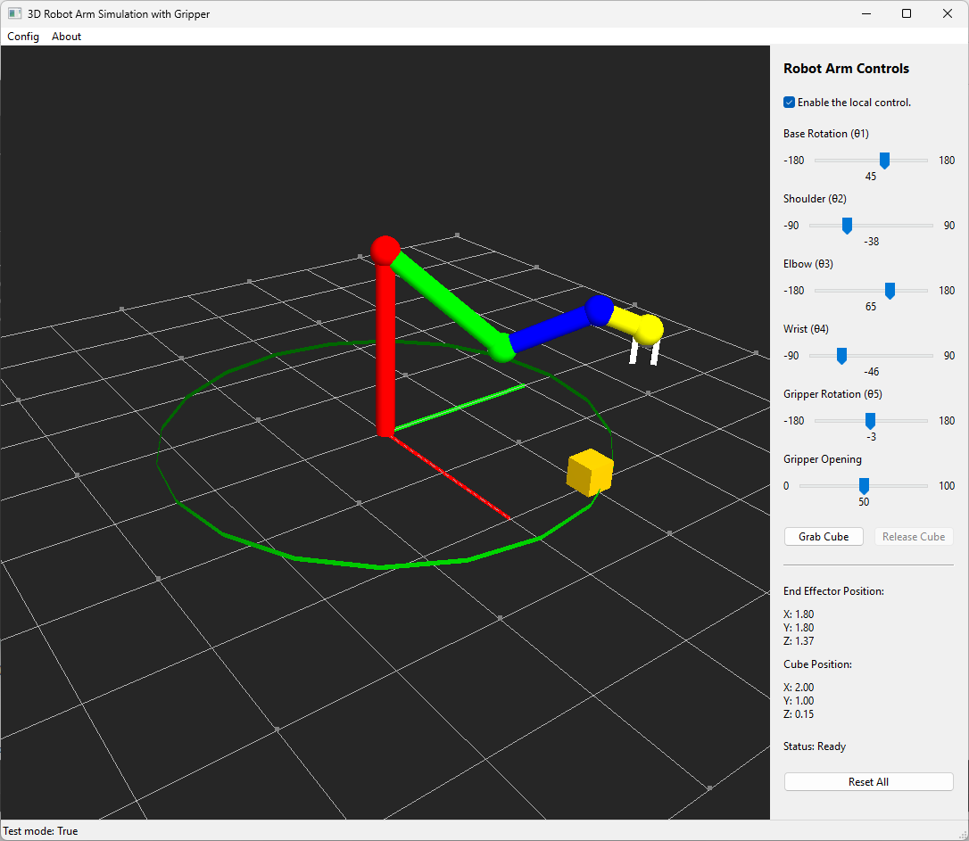
Local Control Panel
OpenGL Robot Arm Canvas
Local Control Enable/Disable Checkbox
Axis-3: Wrist Rotation Angle
Axis-2: Elbow Rotation Angle
Base Servo Motor Control Slider
Axis-4: Gripper Rotation Angle
Should Servo Motor Control Slider
Link-1
Axis-1: Shoulder Rotation Angle
Elbow Servo Motor Control Slider
Wrist Servo Motor Control Slider
Link-0
Link-2
Gripper Rotation Servo Motor Control Slider
Link-3
Gripper Opening Servo Motor Control Slider
Max range robot arm can reach
Cube Grab and Release Control Button
Cube Object
Axis-0: Base Rotation Angle
Calculated Gripper Position Coordinate
Cube Position Coordinate Display
Axis-5: Gripper Opening Angle
Current Operational State
Cube Grond Sensor Grid
Reset Button

Slide 6
OpenGL Robot Arm Canvas
Axis-3: Wrist Rotation Angle
Axis-2: Elbow Rotation Angle
Axis-4: Gripper Rotation Angle
Link-1
Axis-1: Shoulder Rotation Angle
Link-0
Link-2
Link-3
Max range robot arm can reach
Cube Object
Axis-0: Base Rotation Angle
Axis-5: Gripper Opening Angle
Cube Grond Sensor Grid

Slide 7
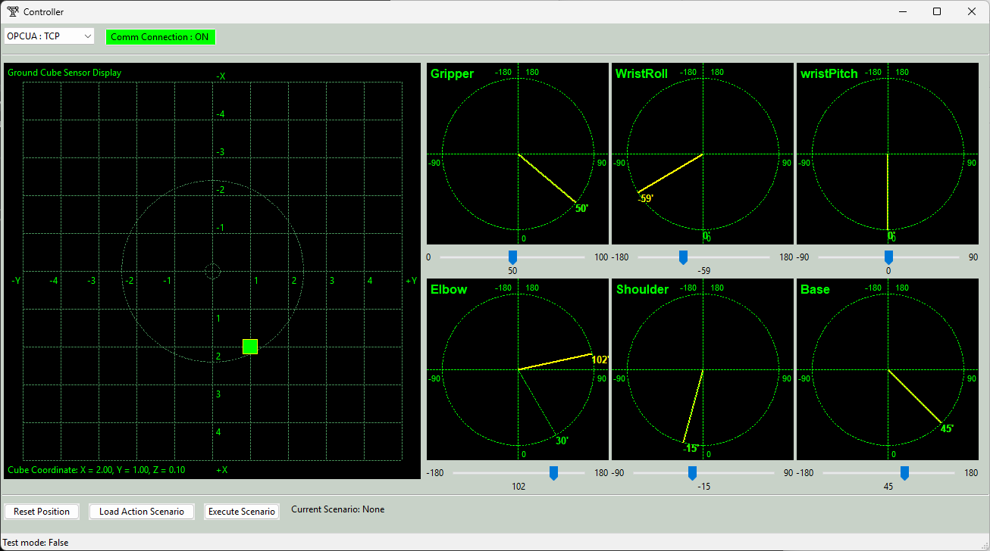
PLC Connection Protocol Selection
Current PLC Connection State
Cube Position X-Y Projection display
Joint sensor and motor angle display panel
Servo motor control slider
Cube Position
Reset Button
Robot Arm Action Sequence load and execution control
Current PLC Sensor Angle data [Green]
Current PLC Motor Target Angle data [Yellow ]

Slide 8
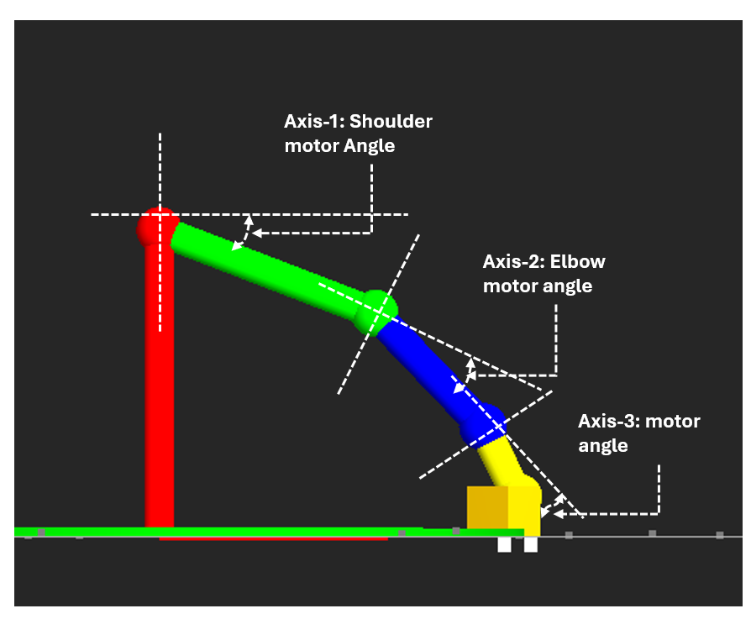
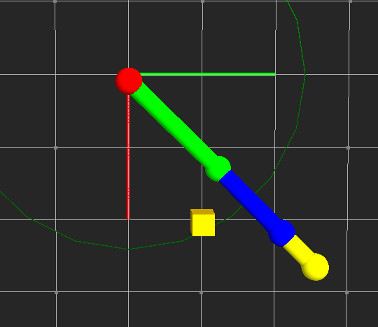
theta0: Base motor rotation angle
theta1 : Shoulder motor rotation angle
theta2 : Elbow motor rotation angle
theta3: Wrist motor rotation angle
d
e
f
a
b
c
Cube distance
Axis-0: Base Rotation Angle
a = cos(theta1)*1.5
b = cos(theta1+theta2)*1
c = cos(theta1+theta2+theta3)*0.5
X-Axis Cube distance = sqrt(x^2 + y^2) = a +b +c
d = sing(theta1)*1.5
e = sing(theta1+theta2)*1
f = sin(theta1+theta2+theta3)*0.5
Z-Axis distance = 2 = d +e +f
Axis-0: Base Rotation Angle = arctan(y/x), if x=0 and y >0 : 90, if x=0 y<0: -90.
Cube distance = sqrt(x^2 + y^2)

Slide 9
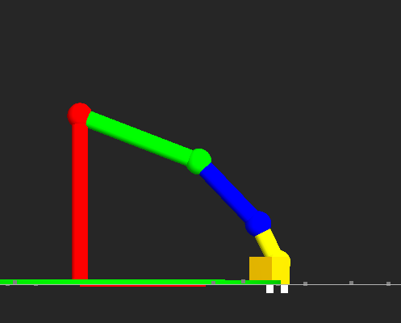
Axis-1: Shoulder motor Angle (x)
Axis-2: Elbow motor angle (y)
Axis-3: motor angle (z)

Slide 10
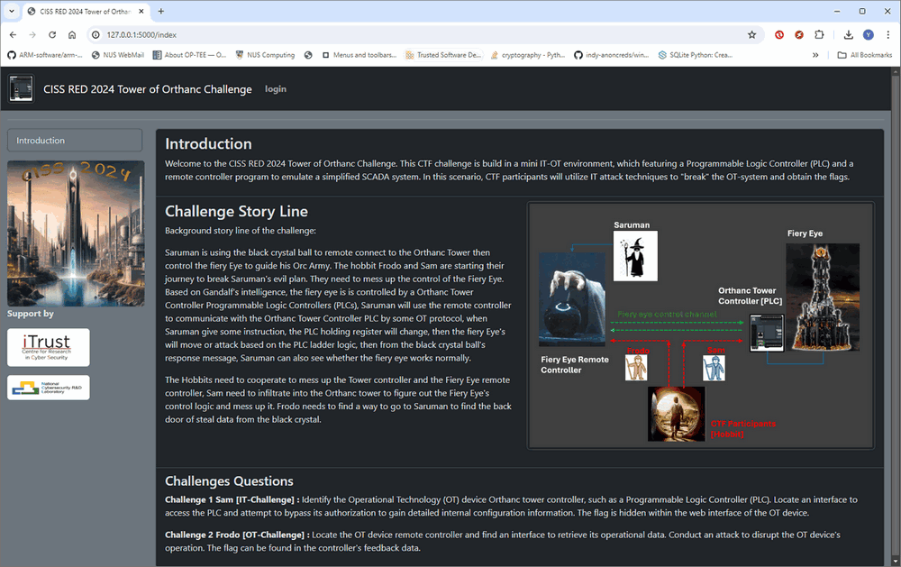
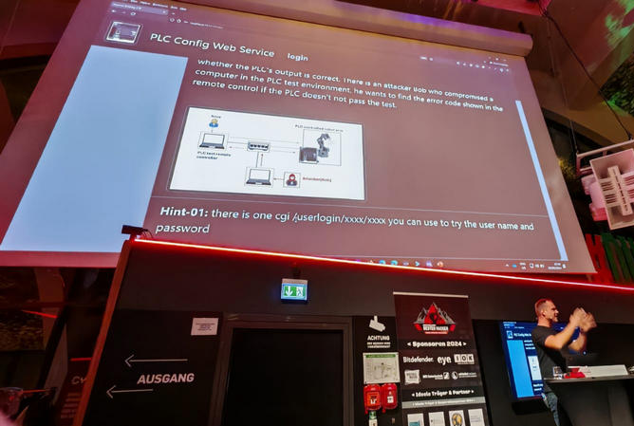
CISS 2024 Control The Orthanc Obstacles Challenge
Deutschlands Bester Hacker 2024 OT Challenge 1

Slide 11

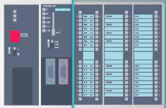

Robot Arm Simulator VM
OPCUA PLC Simulator VM
Robot Arm Remote Controller VM
Windows 10/11
Ubuntu 20.04
Windows 10/11
Network type : NAT
IP:192.168.10.11
Network type : NAT
Network type : NAT
IP:192.168.12.11
IP:192.168.10.12
IP:192.168.10.12
Robot Arm Simulator VM
OPCUA PLC Simulator VM
Robot Arm Remote Controller VM
Windows 10/11
Network type : NAT
IP:192.168.10.11
Network type : NAT
IP:192.168.10.12
Network type : NAT
IP:192.168.10.13
Switch 1
[192.168.10.1]

Slide 12
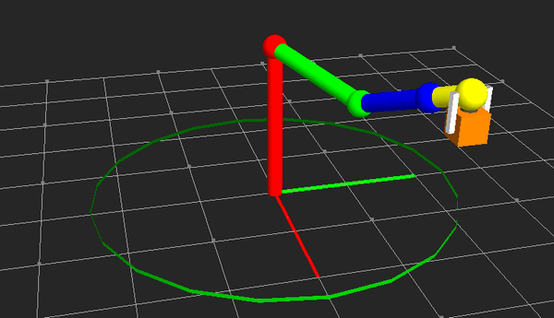
Wrist
Elbow
Wrist
Gripper
Shoulder
Base
Gripper Finger
Max Touch Range

