Slide 1


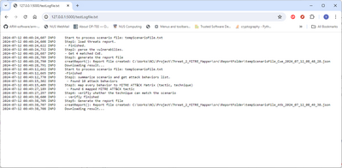


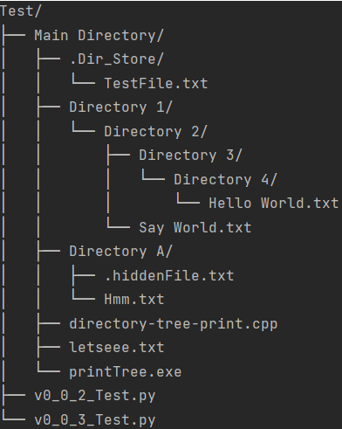
Compute Node 01
Computers Cluster
Cluster Log Data Archive System
Local log storage
Log file uploaded record
FTP Channel
Log Archive Server
Log Archive Service
Search new Log files
Collect new log files
Log Archive Agent
FTP
Client
Network
Compute Node 02
FTP Channel
Node 01
log repo
FTP Channel
Node 02
log repo
Node N
log repo
Local log storage
Compute Node N
Local log storage
Users
Log Archive Agent
…
Log Archive Agent
File view web UI

