Slide 1


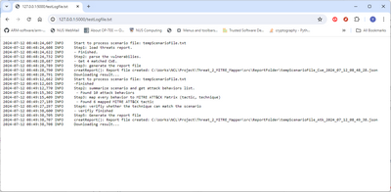


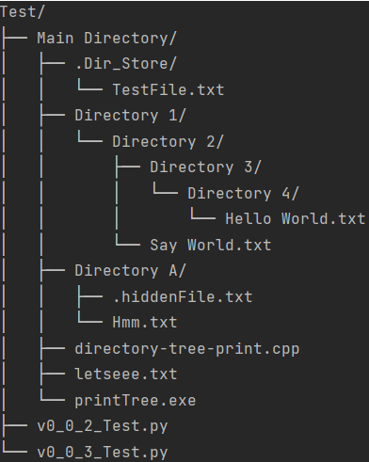



Compute Node 01
Computers Cluster
Cluster Log Data Archive System
Local log storage
Log file uploaded record
FTP Channel
Log Archive Server
Log Archive Service
Search new Log files
Collect new log files
Log Archive Agent
FTP
Client
Network
Compute Node 02
FTP Channel
Node 01
log repo
FTP Channel
Node 02
log repo
Node N
log repo
Local log storage
Compute Node N
Local log storage
Users
Log Archive Agent
…
Log Archive Agent
File view web UI

Slide 2

Computers Cluster Node
Log Archive Server
Log Archive Agent Init
Agent config file
Log Archive Service Init
Server config file
Function programs
Main thread
Main thread
Create log files
Record manager
Log file uploaded record
Agent manager
User Config file
Local log storage
Network
Sub-thread
Log directory tree generator
FTP Server
Web host module
New log check loop
Sub-thread
Log directory tree generator
New log upload queue manager
FTP Client
Web-Browser
Server log storage

Slide 3
