Slide 1
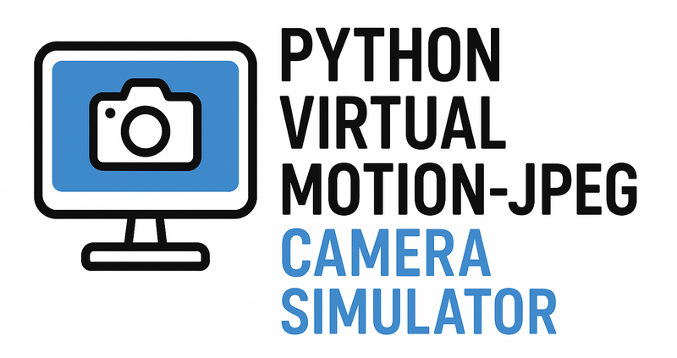

Slide 2
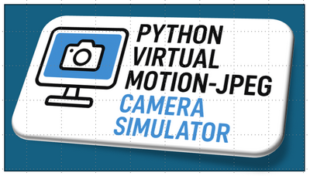

Slide 3

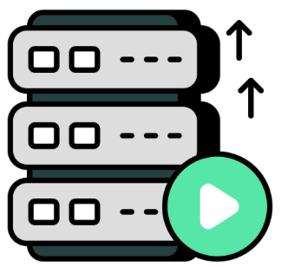




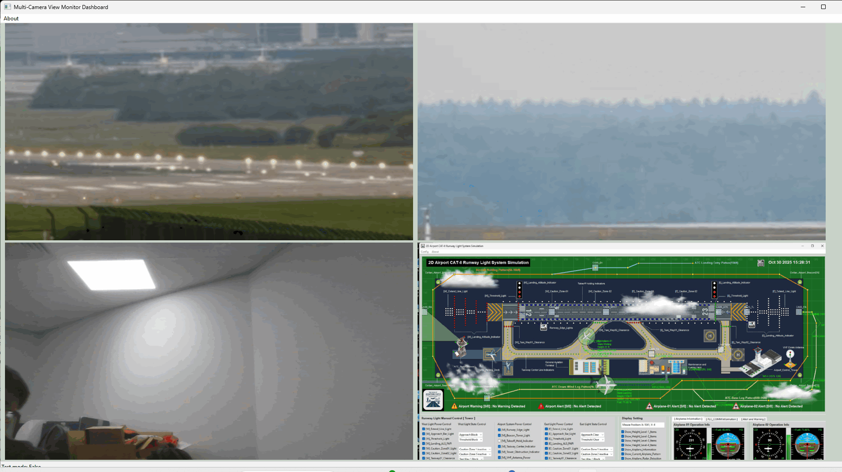
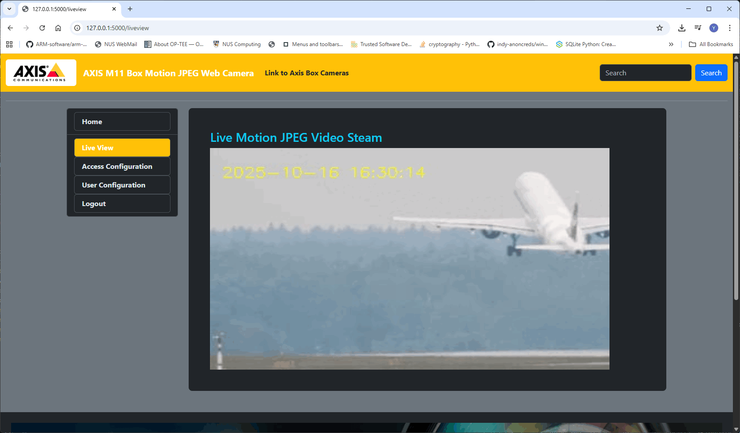
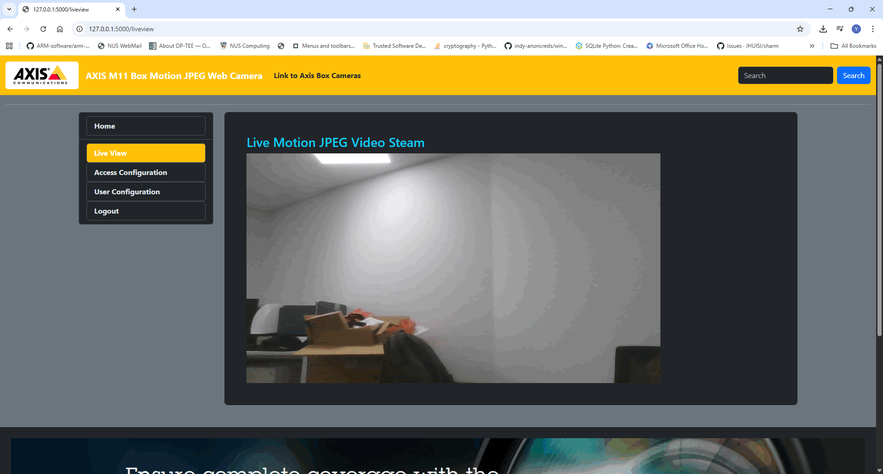
Real Camrea
RTSP Video server
Pictures Data Set
Screen Recording
Application Window Screen shot
5 Different Video Source
Multi-Camera View Monitor Dashboard
Camera Web UI pages
Virtual Camera Client Lib
Flask Camera Web server

Slide 4


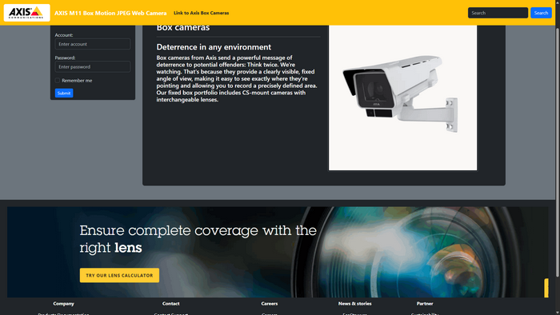
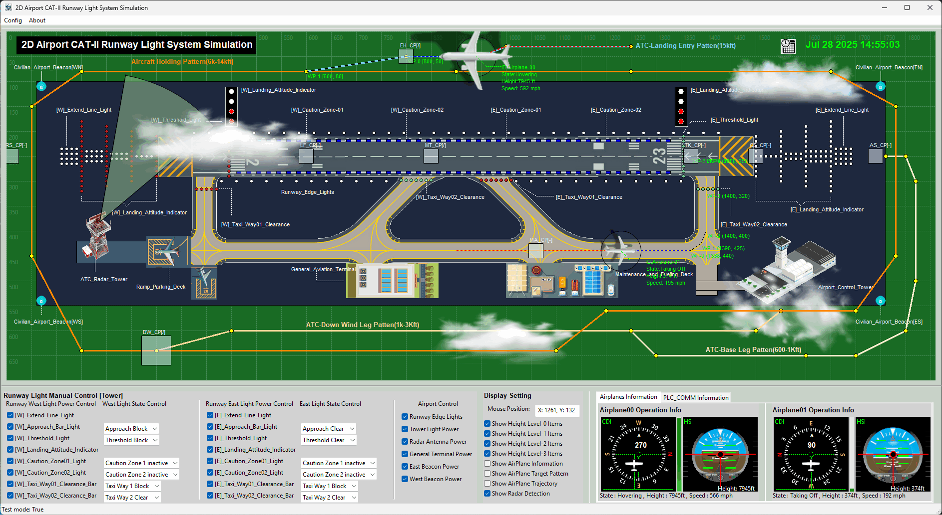
Video Stream Source
Web Browser
Flask Camera Server
User BD
Video Source Manger Module
Cyber Range Physical World Simulator F
User and Access Management Module
Flask Web Service Module
Data Manager Module

Slide 5
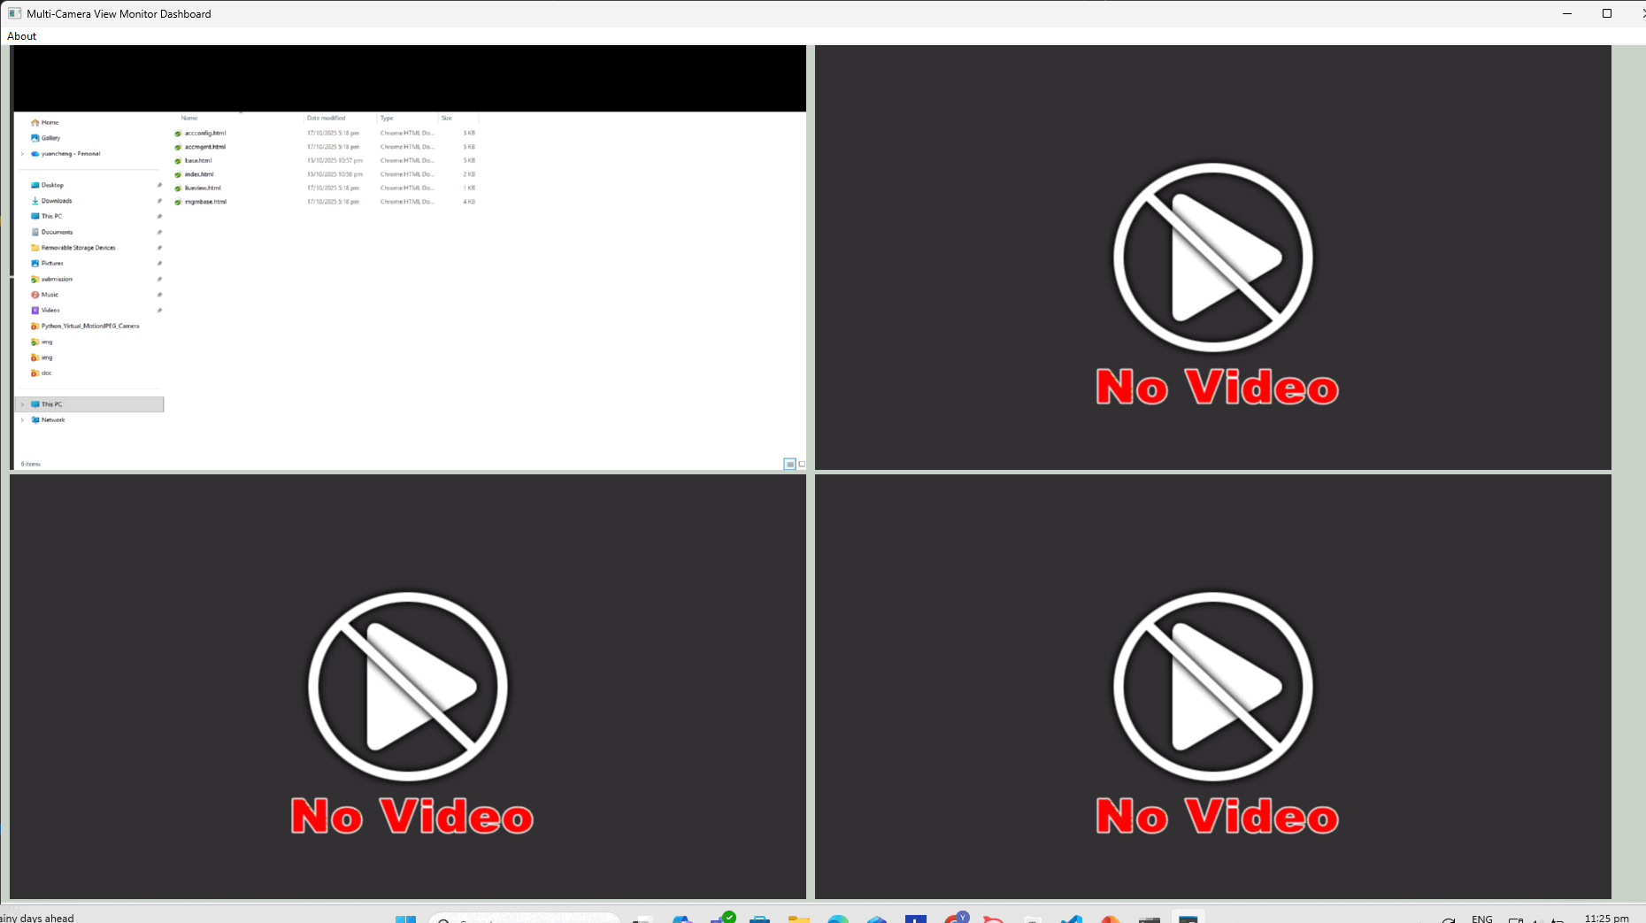
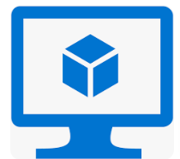


Camera Simulator 01 VM
Multi-Cam Monitor Dashboard 01 VM
IP-addr1
token1
token5
Camera Simulator 02 VM
Camera 05 Config File
IP-addr2
token2
Camera Simulator 03 VM
IP-addr3
Multi-Cam Monitor Dashboard 02 VM
token3
Network Switch
Camera Simulator 04 VM
IP-addr4
token4
Token1
|
token4
Camera Simulator 05 VM
IP-addr5
Camera01 -04 Config File
token5

Slide 6
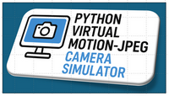
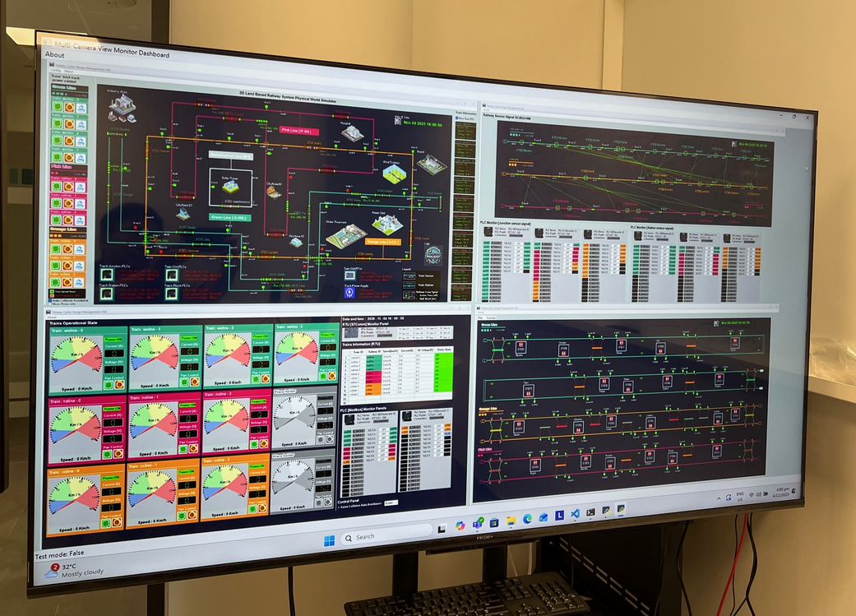
Python Virtual Motion-JPEG Camera Simulator
Web Browser View
RTSP Video Server
Pictures Dataset
Screen Recording
Application Window Screenshot
Real Camrea
5 Different Video Source
Flask Camera Server
User BD
Cyber Range Physical World Simulator
Video Source Manger Module
User and Access Management Module
Data Manager Module
Flask Web Service Module
MJPEG API
Multi-Cameras View Dashboards

