Slide 1
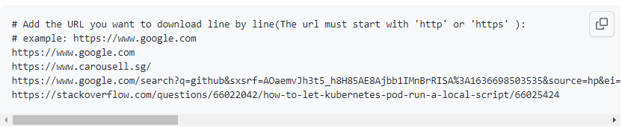
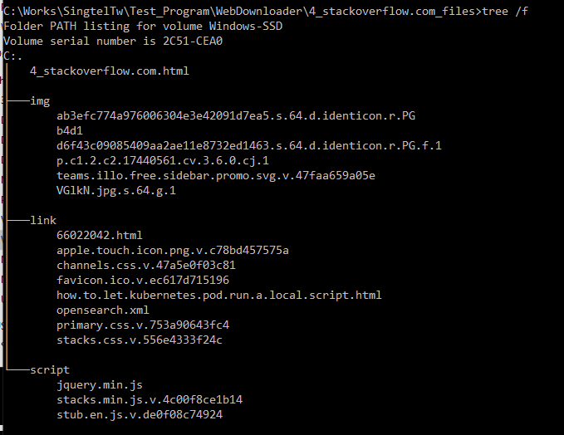
Web Downloader [19/11/2021]
Introduction
This module will provide API to download the webpage components : html file, image file, css file, xml file, javascript file, href link file based on the input url (the url must start with 'http' or 'https’ ).
Input
url list file
Web Downloader
Output
url domain folder
img
link
script
Main page
imgFlg: Set to "True" to download all the “<img>" tag files.
linkFlg: Set to "True" to download all the html section, image, icon, css file imported by “<href>"
scriptFlg: set to "True" to download all the .js file.

Slide 2
Web Downloader [22/11/2021]
Introduction
This module will provide API to download the webpage components : html file, image file, css file, xml file, javascript file, href link file based on the input url (the url must start with 'http' or 'https’ ).
Dataset
url list file
Browser driver API
OR
PhishperidaPKG
webScreenShoter
pyQT5 QtWebEngineWidgets
Phishpedia layout detector
url domain folder
Phishpedia
Result
phishpedia_classifier_logo
Screen shot img
Siamese (logo matcher)
imgFlg: Set to "True" to download all the “<img>" tag files.
linkFlg: Set to "True" to download all the html section, image, icon, css file imported by “<href>"
scriptFlg: set to "True" to download all the .js file.

Slide 3
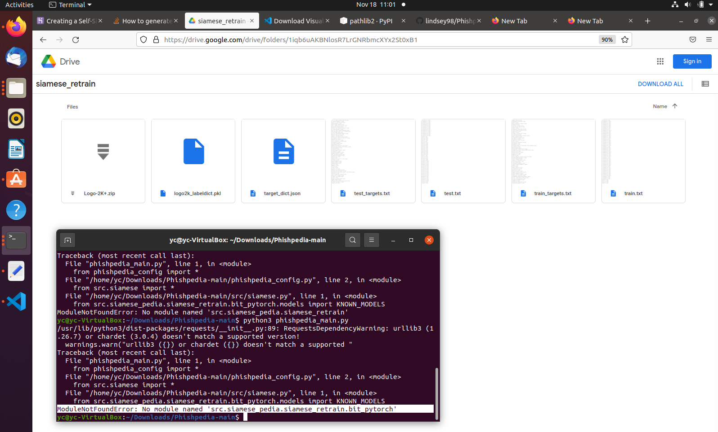
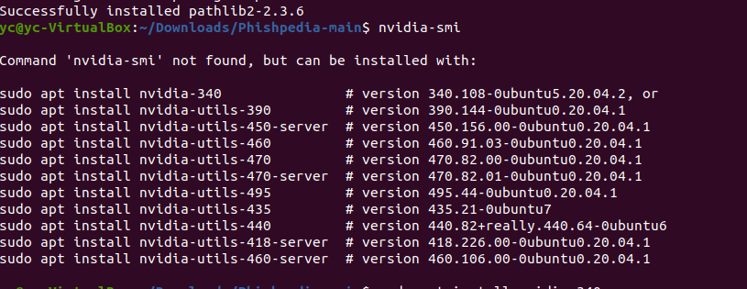
Phishpedia Integration
Modules missing
Progress
Setup the program execution environment : Ubuntu Finished , Windows got problem.
Problem 1 [fixed] : 2 libs: torch=1.6.0, pathlib 1.0.1 -> Windows compatible problem for 32 bit python.
Problem 2 [not fixed]: lib Detectron2 no more Windows support for torch > 1.6.0. pycocotool 64-bit Window install error.
2. Setup logo targetlist: Finished
3. Download model files: Finished
Problem 1 [Fixed]: Their document link doesn't contain the modules file they used in the program. As shown on the right side(Q: did they use the original version or they did any modify ? ):
4. Run experiment [Error]
- Problem 1[fixed] No nivida graph card and driver.
- Problem 2[not fixed]: only can install driver v-340 , then got error driver too old can not used by CUDA toolkit.
Q: Need I have a computer with real nivida graph card installed ?
Driver we tried

Slide 4
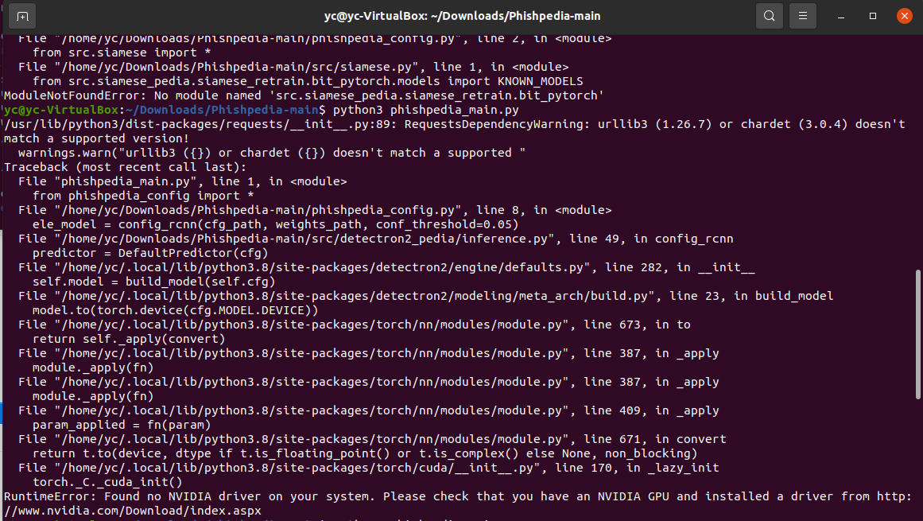
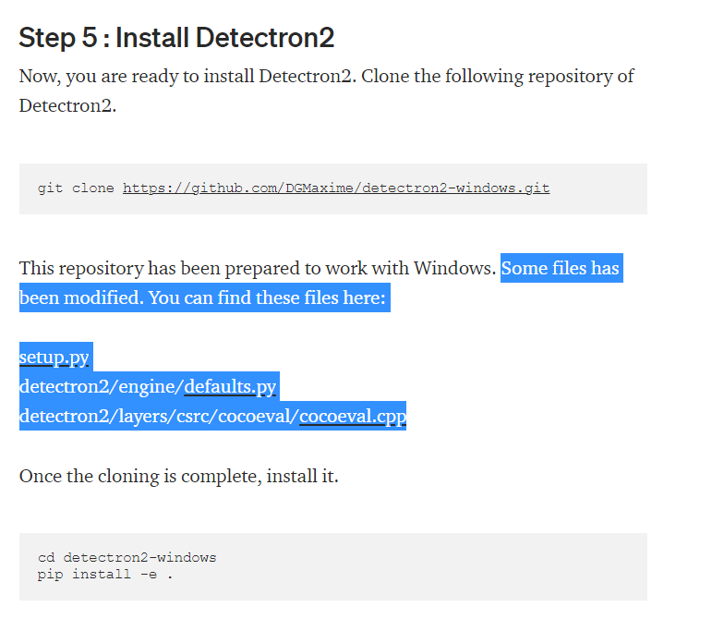
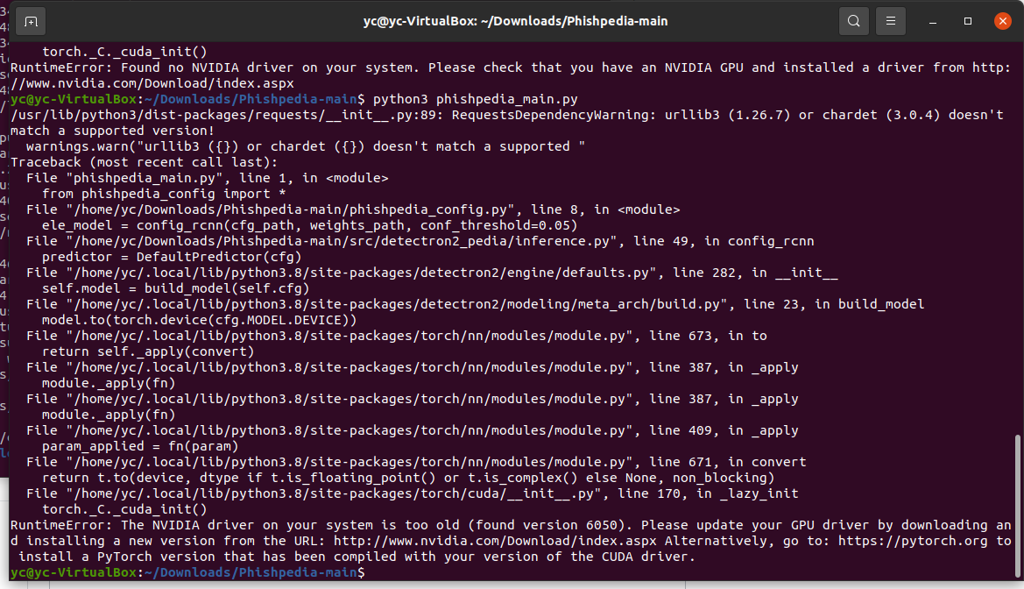
4. Problem 1
The lib Detectron2 git latest version has removed the part they can modify in the related file . The cocoeval.cpp is not used.
4. Problem 2
Problem: Ubuntu will not start after installed the nvidia driver n-375 and light-the-torch :
Solution:
1. Boot to a root shell
2. Uninstall all the nvidia drivers: sudo apt-get purge nvidia*

Slide 5
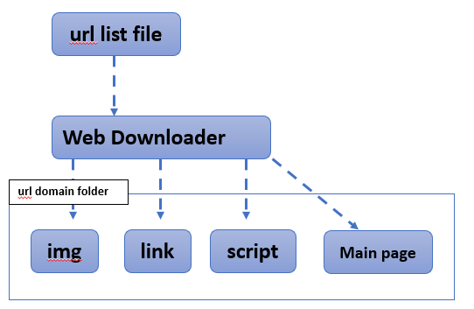
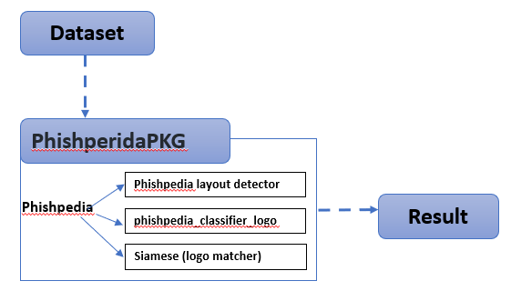
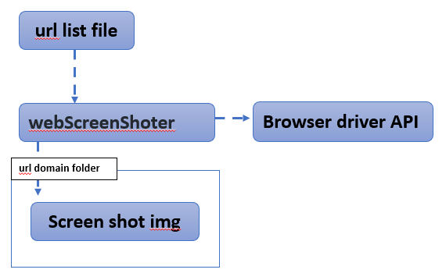
Web Attestation [25/11/2021]
Introduction
We want to check several batch of web URLs (1~100 K) and find the phishing website/URL among them. This module is designed to do the URL/web attestation by using the API from NUS-Phishperida-Project. The user can list all the URLs he wants to check in the file "urllist.txt" .
For each URL, the program will do below steps:
1. Use webDownloader module to download all the web components.
2. Use webScreenShoter module to get a webpage screenshot of the url.
3. Pass the web components and the screen shot to PhishperidaPKG to do the siamese checking.
WebDownloader: This module will provide API to download the webpage component: html file, image file, javascript file, href link file based on the input URL.
WebScreenShoter: This module will use different web browser's driver to capture the webpage's screen shot based on the given URL.
PhishperidaPKG : This module is used to encapsulate the NUS-Phishperida project (not OOP) as a black box API for other projects to use.

Slide 6
Web Attestation [25/11/2021]
Program Workflow
Web Attestation Program
url list file
pyQT5 QtWebEngineWidgets
OR
Web Downloader
Web Screenshoter
Browser driver API
url domain folder
img
link
script
Main page
Screen shot img
Logo img/icon
PhishperidaPKG
Result

Slide 7
Web Attestation [25/11/2021]
Execution Performance
Execution Env:
VM: Ubuntu 20.04, 3 cores, 4GB RAM
python 3.8.10 - 64 bit.
torch==1.8.1+cpu torchvision==0.8.2+cpu torchaudio==0.7.2 detectron2: detectron2/wheels/cpu/torch1.8
URL set :
1 X phishing URL
4 X normal URL
ScreenShot driver : ChromeDriver 96.0.4664.45
https://chromedriver.chromium.org/downloads
URL\module | Web Downloader | Web ScreenShoter (1000x1000) | PhishperidaPKG
https://accounts.g.cdcde.com/ServiceLogin?passive=1209600&osid=1&continue=https://plus.g.cdcde.com/&followup=https://plus.g.cdcde.com/ | 2 sec | 2+ sec | 8 min 30 sec
https://www.google.com | 0.3 sec | 1.5 sec | 5 sec
https://www.carousell.sg/ | 3+ sec | 2+ sec | 10 sec
https://www.google.com/search?q=github&sxsrf=AOaemvJh3t5_h8H85AE8Ajbb1IMnBrRISA%3A1636698503535&source=hp&ei=hwmOYY6mHdGkqtsPq8S9sAY&iflsig=ALs-wAMAAAAAYY4Xl7GLWS16_xc2Q9XrG0p3q277DpkL&oq=&gs_lcp=Cgdnd3Mtd2l6EAEYADIHCCMQ6gIQJzIHCCMQ6gIQJzIHCCMQ6gIQJzIHCCMQ6gIQJzIHCCMQ6gIQJzIHCCMQ6gIQJzINCC4QxwEQowIQ6gIQJzIHCCMQ6gIQJzIHCCMQ6gIQJzIHCCMQ6gIQJ1AAWABgjgdoAXAAeACAAQCIAQCSAQCYAQCwAQo&sclient=gws-wiz | <1sec | 1.8 sec | 19 sec
https://stackoverflow.com/questions/66022042/how-to-let-kubernetes-pod-run-a-local-script/66025424 | 1+ sec | 1+ sec | 24 sec

Slide 8
Web Attestation [25/11/2021]
Further Development
1. Add BgPool (Background execution controller , Multithread execution, task balancer[optional]) https://github.com/LiuYuancheng/ProgramTools/blob/master/library/BgCtrl.py
2. Add Logger(https://github.com/LiuYuancheng/ProgramTools/blob/master/library/Log.py ) for execution monitor and next step.
3. Add the recover method (StateRecorder). (If the program/thread crashed, the program will continuous its task after restarting: the processed url will be ingored -> remove the corrupted file -> continuous with not processed URLs )
4. Optional: use pyQT5 to replace the browsers driver in the webScreenShoter.
5. PhishperidaPKG: test GPU mode running on GPU server and add more web logo sample image in the logo folder(1.8G)
Bg Pool (4)
Bg Process
Worker thread
url list file
Web Attestation
Url set
Web downloader
Phishpedia
Url set
Result
Url set
Web ScreenShoter
Balancer
Expect Final Deign [not integrated to Airflow]

Slide 9
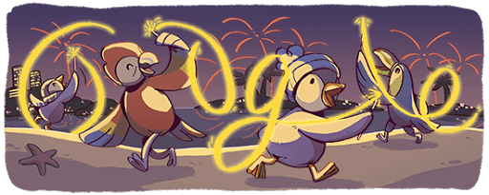
Web Attestation [25/11/2021]
Problem/Question and Solution
WebDownerloader: https://github.com/LiuYuancheng/WebDownloader
WebScreenshoter: Fail to capture url screen shot-> browserDriver not match browser version, web response timeout, web browser blocks the risky webpage.
PhishperidaPKG:
Project config steps and solution: https://github.com/LiuYuancheng/WebDownloader/blob/master/doc/Phishpedia_cfg.md
Phishing url not detected/result return None: logo sample not included in the logo folder.
Normal url detected as phishing web: Logo changed, such as google sometimes the logo may have a big change on holiday time (As shown below, if the change is very big it will be detected as phishing url) .
Question to Dr. Lin Yun (currently the answer is not necessary if they don’t have time)
Question 1: Is there any requirement about the screenshot file in dataset. The screenshot needs to have the logo of the website, is that correct ? For some of my test web, if I use different web browser to open the URL, the page shows up will got a little different. Will that make any influence of the result, or you prefer us to use Google-Chrome to do the screenshot.
Question 2: If we want to check some URL/web and its logo is not in the logo folder "Logo-2k"(As shown below), we should copy the logo files with different resolution in a folder and put it in the foler "Logo-2k", am I correct ?

Slide 10
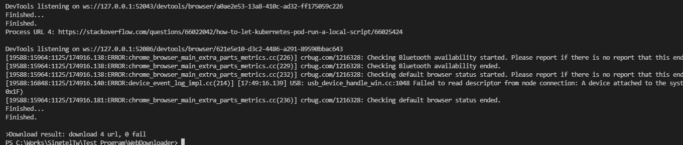
Web Attestation [25/11/2021]
Execution Result:
Execution log:
https://github.com/LiuYuancheng/WebDownloader/blob/master/doc/test_pedia.txt
Final result:
https://github.com/LiuYuancheng/WebDownloader/blob/master/doc/pedia_rlt.txt
Expect Final Deign [not integrated to Airflow]

Slide 11
Web Attestation [09/12/2021]
New Feature/Function added:
1. Web Attestation Module: Added Logger for execution monitor and next step.
2. Web Attestation Module: Added the recover method and data handling module (Dataset loader module ):
Data-Set-Loader function:
- Load URL from url source file and processed url file, find all the unprocessed urls and load into the attestation program.
- Save successful/checked processed url in resultPcdurl.txt
- Save failed processed url in resultErrurl.txt
4. WebScreenShoter Module: Added pyQT5-WebEngine and Google browsers driver selection in the webScreenShoter, Added the page capture file resolution config.
5. PhishperidaPKG: Uploaded the Phishing training data.
Detail info: https://github.com/LiuYuancheng/WebAttestation
Question to PhishingPedia Team: No Reply Yet.

Slide 12
Web Attestation [09/12/2021]
New Program Workflow
Web Attestation Program
URL list file
Processed URL record file
pyQT5 WebEngine
Data set Loader
OR
Un-processed URLs
Un-processed URLs
Browser driver API
Web Downloader
Web Screenshoter
URL domain folder
info
Img
link
script
Main page
Screen shot img
Logo Img/icon
PhishperidaPKG
Phishperida
ERR URL record file
Result

Slide 13
Web Attestation [09/12/2021]
Under Progress Work:
1. Multithreading Progress:
- Task Balancer: Finished.
- Background pool: Editing.
- Result merging module: not start yet.
- WebAttestation API two thread parallel running: Tested.
Problem/Question and Solution :
WebScreenshoter: Fail to capture url screen shot-> browserDriver not match browser version, web response timeout, web browser blocks the risky webpage. [Problem fixed if user select QT5 flag]

Slide 14



AWS Data Pipeline Integration Plan [23/12/2021]
Analysis result data
Graphql
URLs data
Analysis result
Analysis result [???]
Web WebScrapper
PhishingPedia
Randy’s AI/ML phishing detection module.
Web host [Angular]
Web components data.
Page screen shot, logo image, url
Needed web components [???]
WebPage dashboard
ceph
Telco Clusters

Slide 15
Development work [23/12/2021]
Web Attestation:
Result merge module: Added and tested.
Background pool: Added (tested 2 process running)
Problem: Web Screenshot capture module not work if the execute computer doesn’t have any graph API. [Still working on fixing this problem ]
Cryptoscam URLs Parse Module:
Added the yaml file parse script: https://github.com/LiuYuancheng/WebAttestation/blob/main/src/dataParser/yaml2csv.py

Slide 16
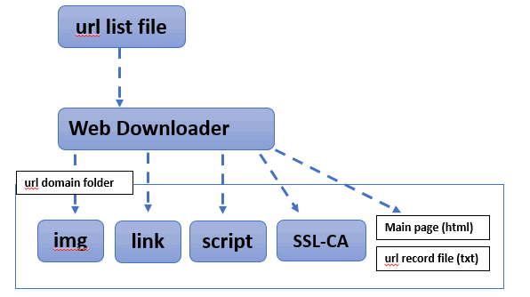
Development work [06/01/2022]
Web Attestation module: Added the URL’s host server parsing function.
Web Downloader module: Added the web(https) SSL certificate download function(As shown below).
Fixed the disk pressure problem of BDA-6.
Web Visualization: Started to build the data visualization list panel to show the web attestation result, list the phishing url, url check and % of phishing url. (under editing)

Slide 17
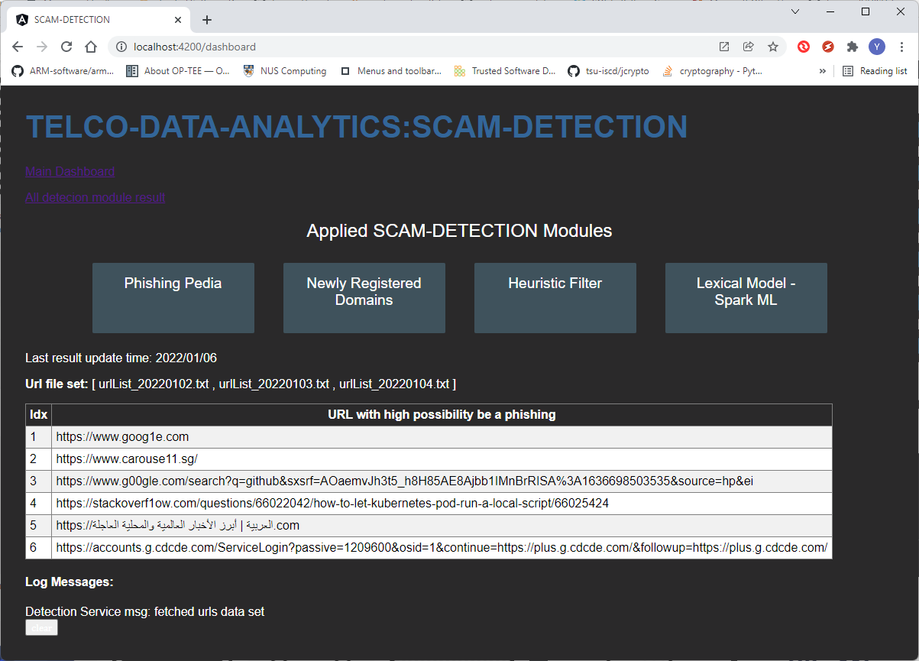
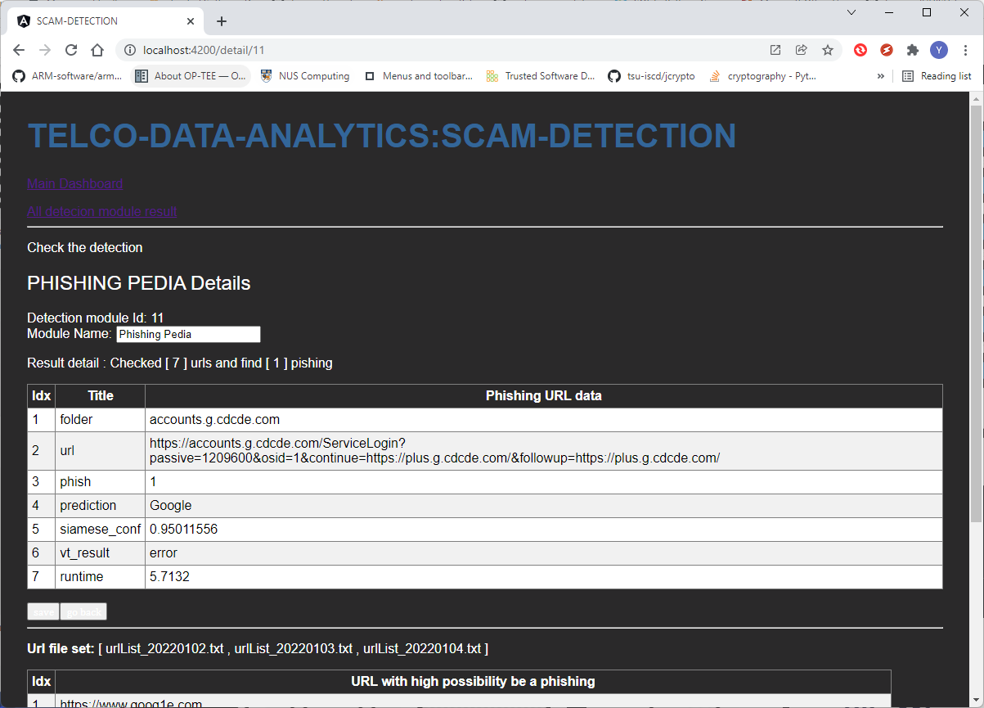
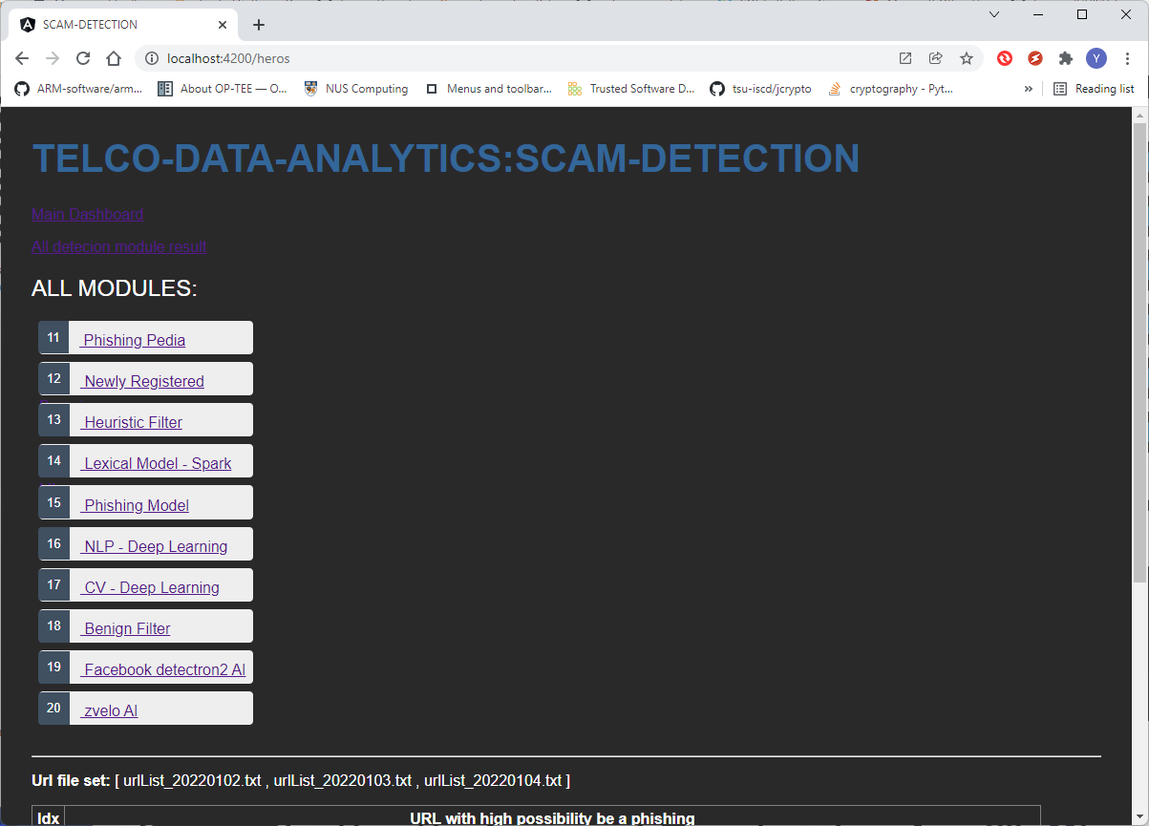
Development work [13/01/2022]
1. Cluster Accounts Review / Double Check for ex-Interns and NUS staff:
Confirmed all the un-used accounts and left people’s accounts are all removed.
2. Phishpedia driver problem solution (local tested):
2.1 Install a dummy graphic driver: sudo apt-get install xserver-xorg-video-dummy
2.2 Create the dummy display output config file to the driver (as shown in right file):
/usr/share/X11/xorg.conf.d/xorg.conf or /etc/X11/xorg.conf
3. Web visualization for the result :
3.1 Added the data loader module to load result from Json file or SQLite3 DB.
3.2 Panel screen shot:
Dummy driver config file:
Section "Device"
Identifier "Configured Video Device"
Driver "dummy"
EndSection
Section "Monitor"
Identifier "Configured Monitor"
HorizSync 31.5-48.5
VertRefresh 50-70
EndSection
Section "Screen"
Identifier "Default Screen"
Monitor "Configured Monitor"
Device "Configured Video Device"
DefaultDepth 24
SubSection "Display"
Depth 24
Modes "1024x800"
EndSubSection
EndSection

