Slide 1
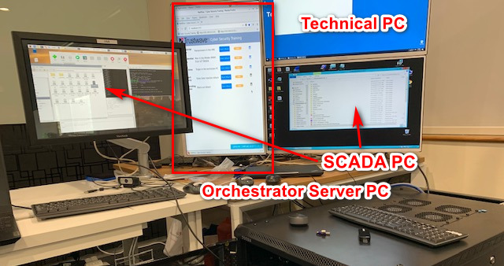
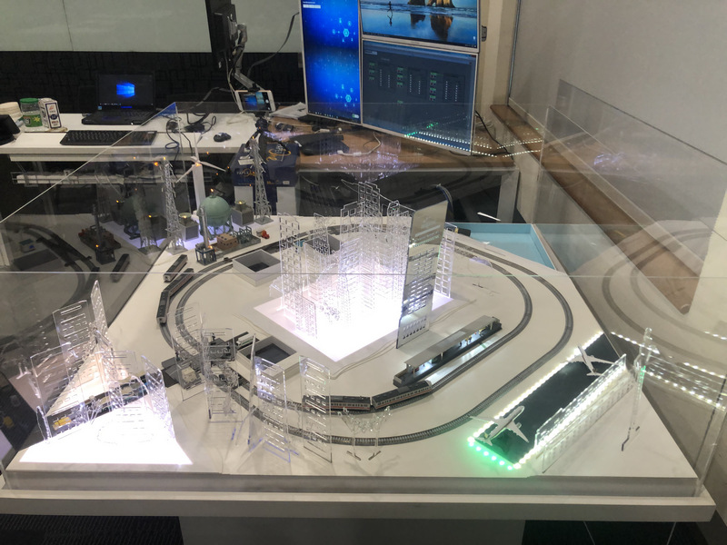

Slide 2
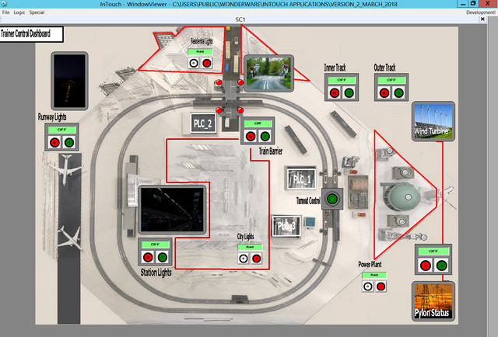
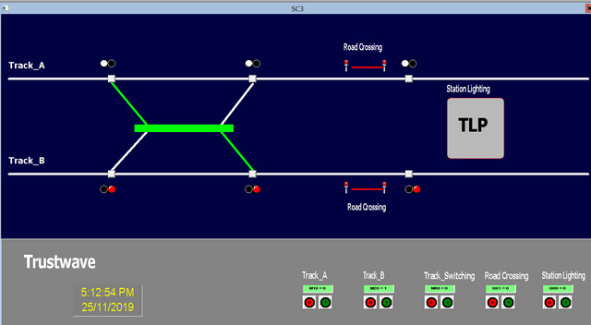
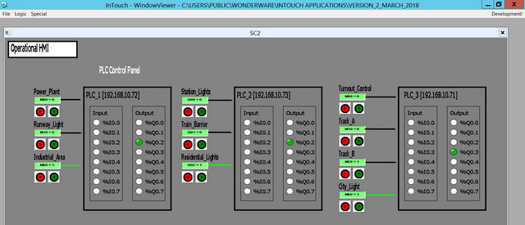
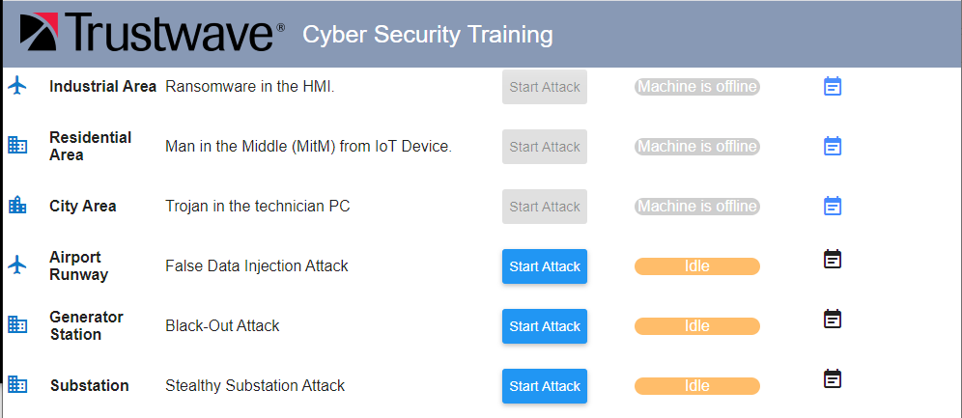
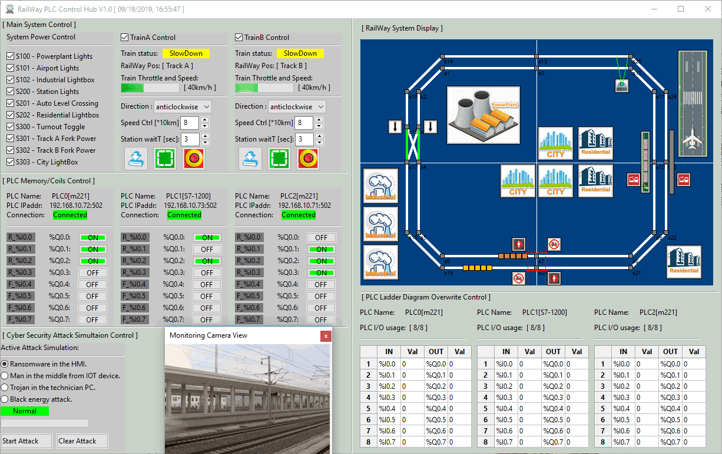
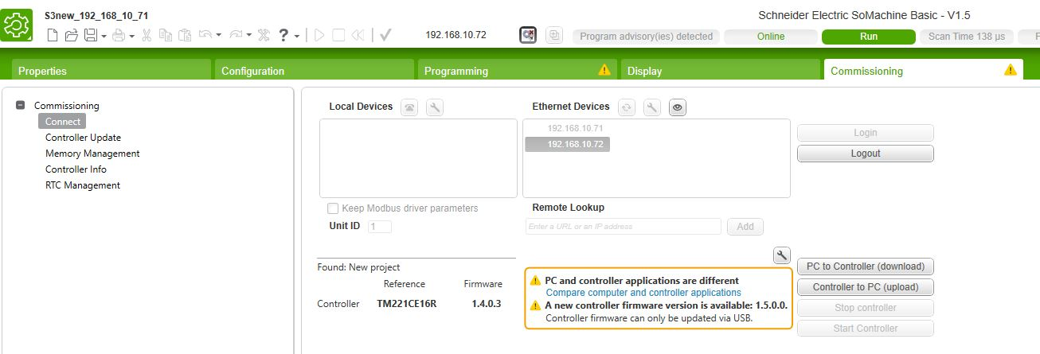
SCADA-PC [Training HMI]
OT-Training platform
Orchestrator-PC [Cyber Attack Control/Lecture Web]
Technical-PC [ Attack demo PC and PLC Control ]
Engineer-PC [ Engineer/Monitoring HMI ]

Slide 3
PLC1 M221 IP[192.168.10.71]
PLC3 M221 IP[192.168.10.73]
PLC2 S7-1200 IP[192.168.10.72]

