Slide 1
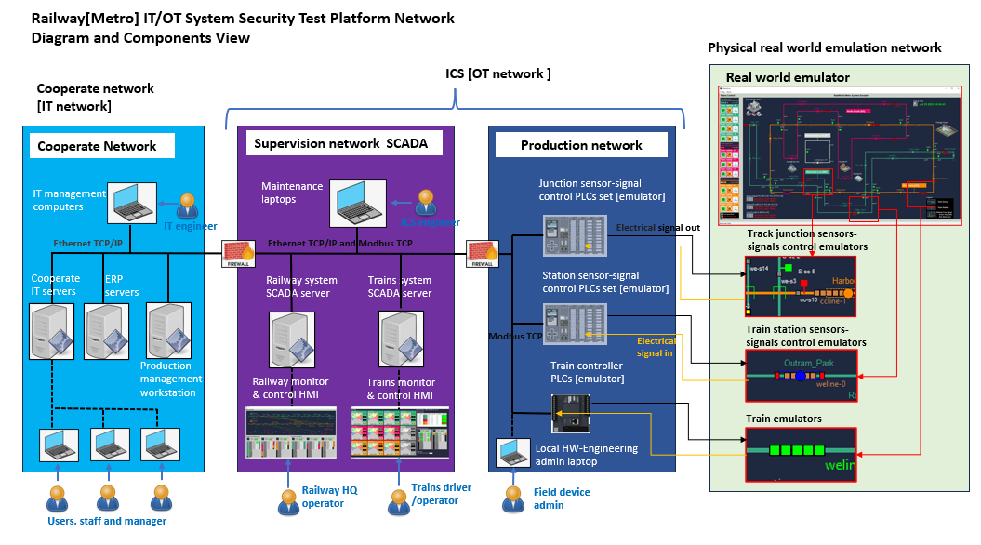



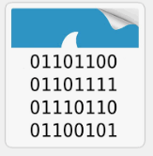



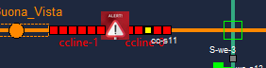
Attack Scenario 1: False command injection attack via phishing email and Backdoor Trojan
Phishing email
5
Back door trojan
3
4
5
Malware
3
1
2
Network traffic p-cap
4
6
Critical document and internal manual
Harmful Modbus command
6
Affected nodes
1
6
7
Trains collision accident happens
Attacker

