Slide 1
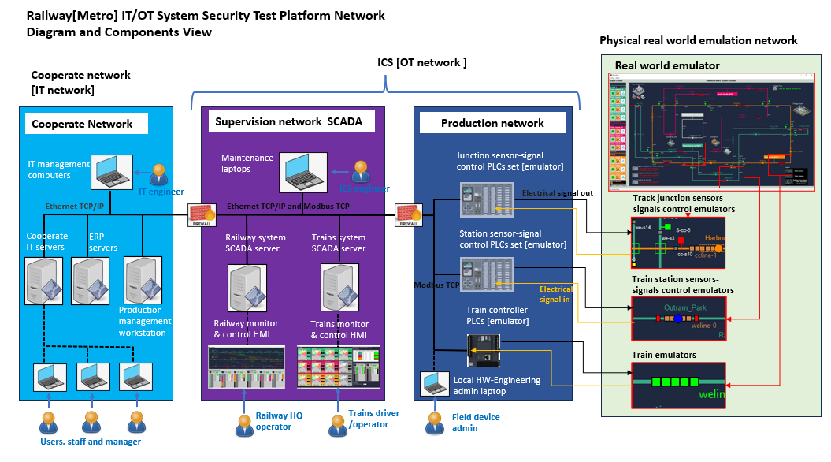







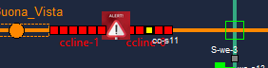
Attack Scenario 1: False command injection attack via phishing email and Backdoor Trojan
Phishing email
5
Back door trojan
3
4
5
Malware
3
1
2
Network traffic p-cap
4
6
Critical document and internal manual
Harmful Modbus command
6
Affected nodes
1
6
7
Trains collision accident happens
Attacker

Slide 2
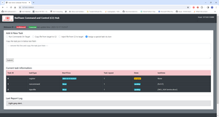

False command / data injector
False PLC electrical signal
Data flow between C2
False Modbus data flow
False command / data injector
Affected PLC nodes
Trains collision accident happens
Internet
Red Team C2
Red Team attacker

Slide 3
Packet Dropper
Data flow between C2
ARP Spoofing attack broadcast
Packet Dropper
Affected PLC and HMI nodes
All PLC lose connection
Internet
Red Team C2
Red Team attacker

Slide 4
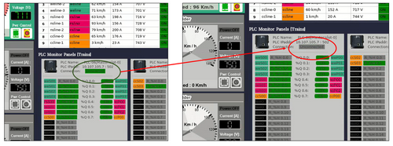
Interrupted HMI-PLC control channel
DDoS attacker 01
DDoS attacker 02
Data flow between C2
ARP Spoofing attack broadcast
Packet Dropper
Affected PLC and HMI nodes
DDoS attacker 03
Internet
Red Team C2
Red Team attacker
HMI data update hang, PLC connection interrupted and delay (time out)

Slide 5
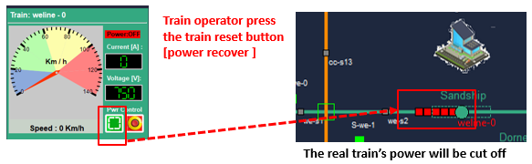
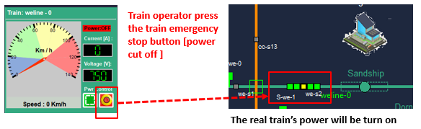
Interrupted normal HMI-PLC Modbus control channel
Mitm attacker
Power recover control signal is reversed
Data flow between RTC2 and malware
ARP Spoofing attack broadcast
Man in the middle attacker program with the data replacer
Affected PLC, HMI nodes and real-world components
Emergency stop control signal is reversed
RTC2 malware control web UI
Internet
Red Team C2 hub
Red Team attacker

Slide 6

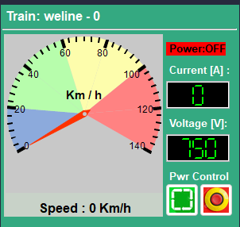
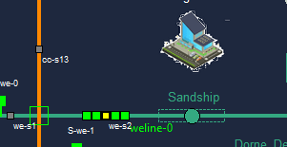
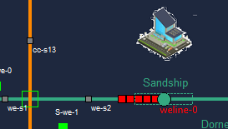
ARP Mitm Attack demo [Attack Scenario Introduction ]
ARP Man In The Middle Attack Observation
When the attack happens, the railway train HQ operator will observe below situation :
If the train operator press the train weline-0 “power on” button the train’s power will be cut off.
If the train operator press the train weline-0 “power off” button the train’s power will be turn on.
Under MitM attack (signal reverse):
Normal train control :
Train operator press the train emergency stop button [power cut off ]
The real train’s power will be turn on
Train operator press the train reset button [power recover ]
Normal HMI control state
The real train’s power will be cut off
Under Mitm attack HMI control state

Slide 7
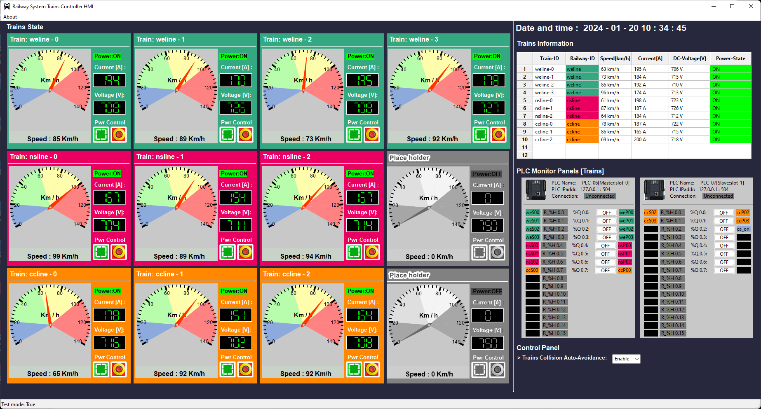
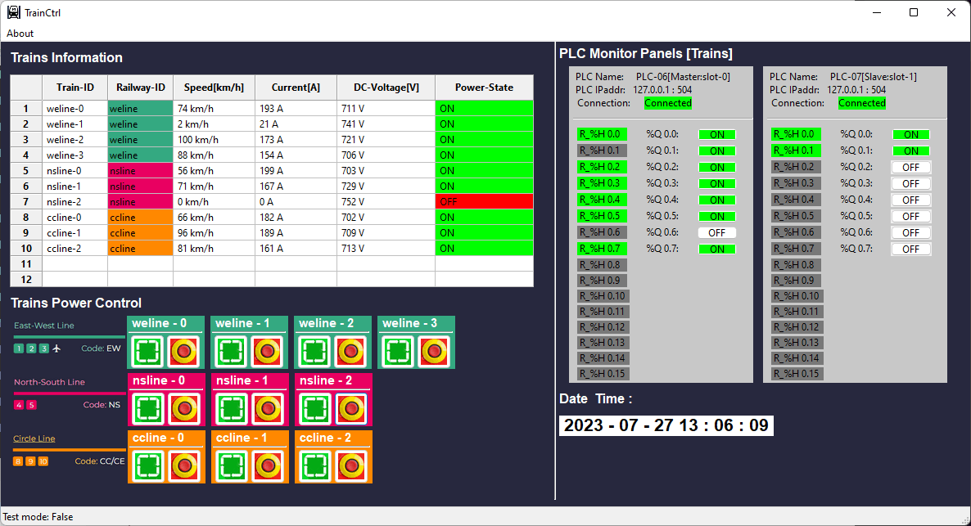

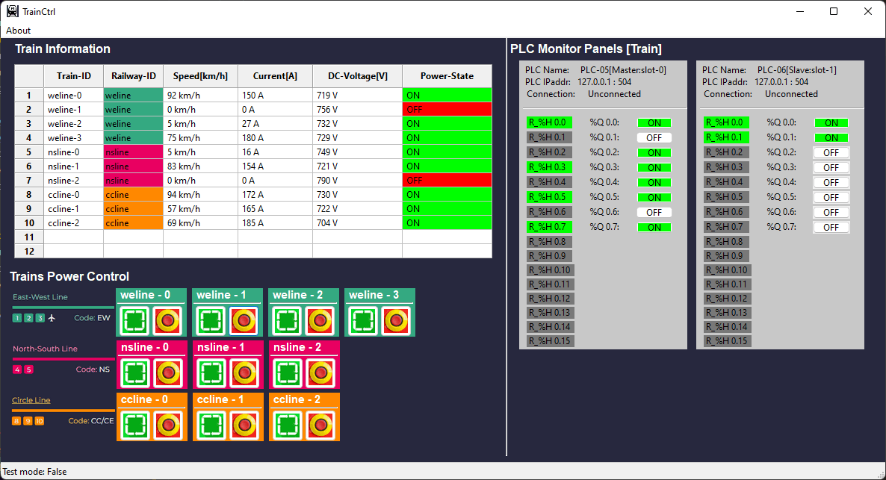
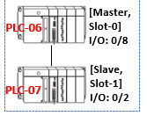

Train Control HMI (master mode)
Train Control HMI (slave mode)
Maintenance department engineer
HQ Operator or the train driver
Trains Control PLC set
Real world emulator
Train Control HMI [ slave ] ( only allow monitor)
Railway operation safety checker
Train control request
Train Control HMI [ master ] (monitor and control )
Train Control HMI [ slave ] (allow monitor and limit control)
Modbus PLC control request
Real world electrical signal control

Slide 8
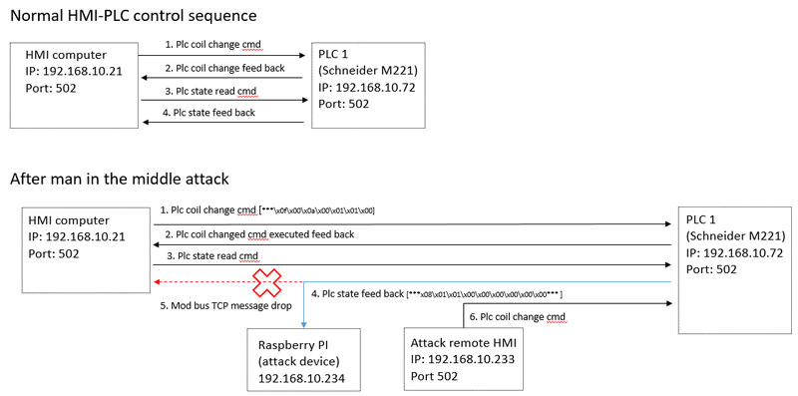
7. Modified HMI control request
7. Modified PLC feedback data

Slide 9
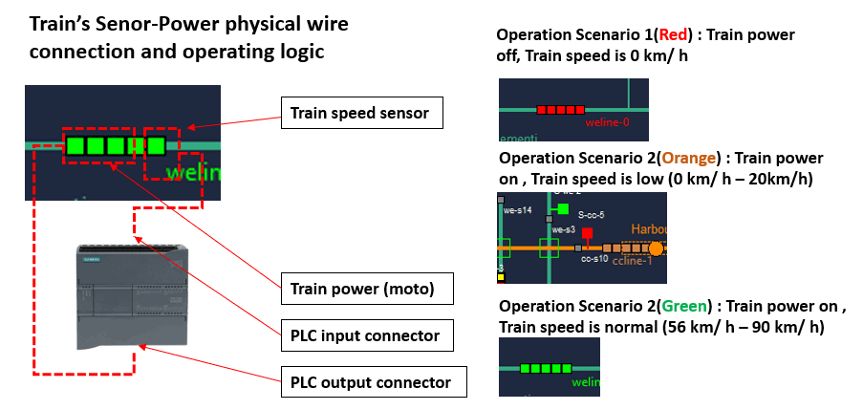
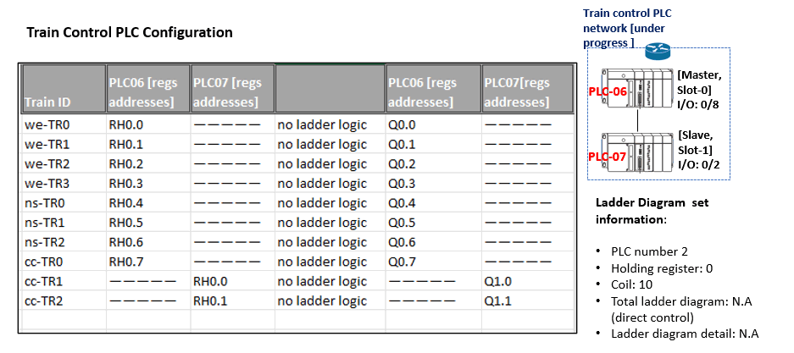
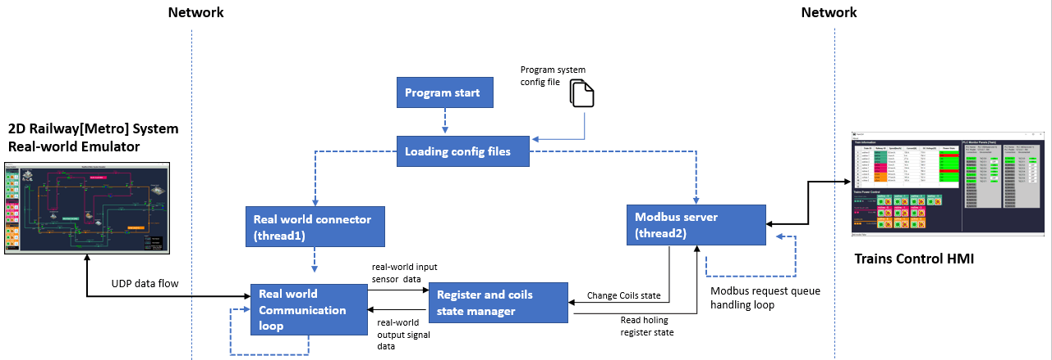

Slide 10
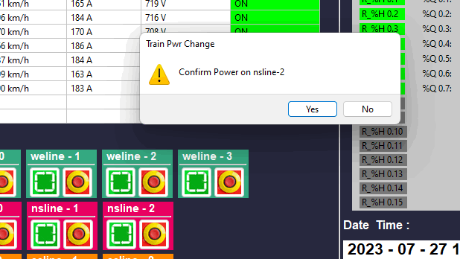
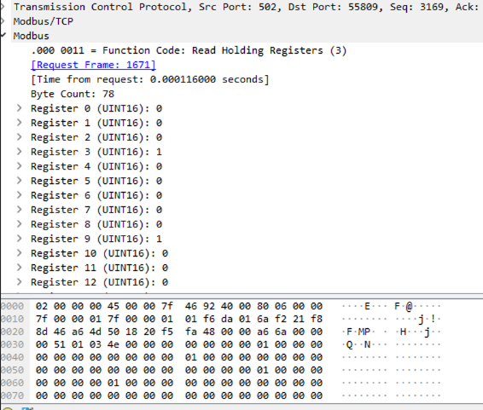

Slide 11



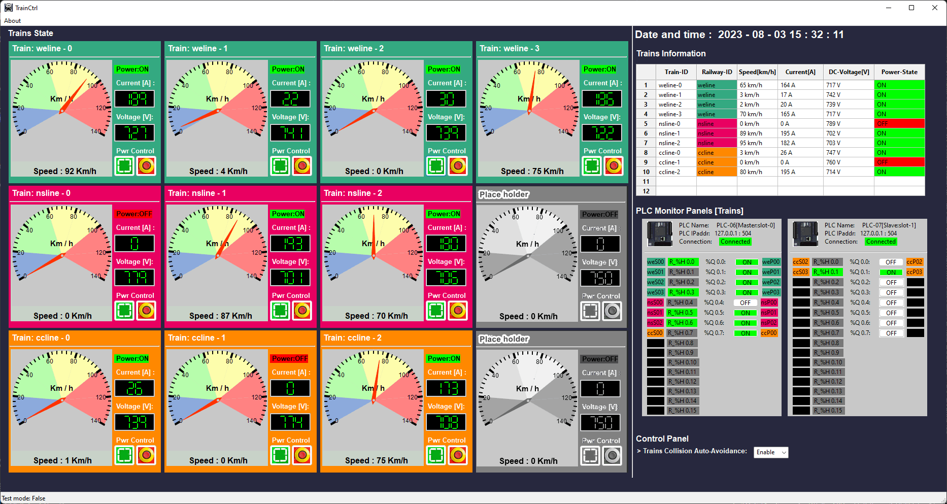



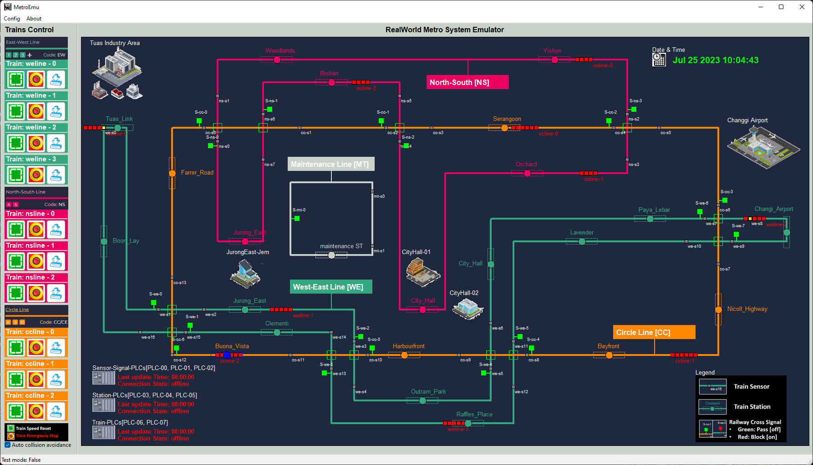

Crimsonian Railway Operational Room
VM_ID: rail-op-victim
Normal Modbus request and response
VM_ID: railway-op-trainhmi
Func: Trains drivers HMI
State: ready
10.107.X07.6
Data replaced Modbus packet after ARP man in the middle attack success
Normal electrical signal
Ettercap packet filter (data replacer)
10.107.107.5
VM_ID: fw1-rail
10.107.X04.1
Crimsonian Railway Engineer Department
10.107.X07.1
Production network [PLC mode bus]
Crimsonian Railway Maintenance Department
Physical real world emulation network[UDP]
10.107.X06.1
10.107.105.7
VM_ID:rail-ed-plc03
Func: Train Plc set
State: ready
VM_ID: rail-md-realworld
Func: Physical real-world emulator
State: ready

Slide 12



Normal states :
Normal Operation Scenario 2(Orange) : Train power on , Train speed is low (0 km/ h – 20km/h)
Normal Operation Scenario 1 (Green) : Train power on , Train speed is normal (56 km/ h – 90 km/ h)
Power: on
Throttle: Neutral
Break: on
Front sensor: detected
Speed sensor: 0
Power: on
Throttle: on
Break: off
Front sensor: no detection
Speed sensor: val
Exception states :
Operation Scenario 1(Red) : Train power off, Train speed is 0 km/ h, Train emergency stopped or accident
Power: off
Throttle: Neutral / On
Break: On/Off
Front sensor: detected / no detection
Speed sensor:0

Slide 13
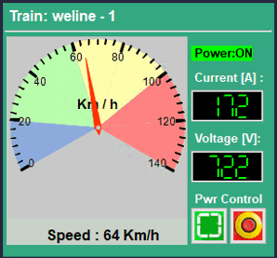

Throttle & break
Speed sensor
Front detection sensor
Overall train
power
Front sensor detection area
False Modbus cmd/data
Train HMI control panel
Front sensor state holding register
HR0
Coil output to throttle & break
Train Auto control logic
HR1
Speed sensor state holding register
Coil00
Modbus data
Coil01
Coil output to train power
Modbus cmd
In normal state, the front collision detection sensor is not allowed to be changed by any Modbus control cmd from HMI. It can only be set by the train’s electrical sensor (such as a radar).
Attack malware will use illegal cmd to overwrite the front collision sensor’s state to mess up the train’s auto control logic to cause the trains accident.

Slide 14
Crimsonian Railway Operational Room
VM_ID: railway-op-trainhmi
Func: Trains drivers HMI
State: ready
10.107.107.5
VM_ID: fw1-rail
Crimsonian Railway Engineer Department
10.107.X07.1
Production network [PLC mode bus]
Crimsonian Railway Maintenance Department
Attack target VM
10.107.X06.1
10.107.105.7
Physical real world emulation network[UDP]
VM_ID:rail-ed-plc03
Func: Train Plc set
State: ready
10.107.105.5
10.107.106.5
Normal Modbus data
Victim VM be compromised in previous IT attack,the command injector will run on it .
Normal electrical signal
VM_ID: rail-ed-victim
State: ready
False electrical signal generated by false data injection attack
VM_ID: rail-md-realworld
Func: Physical real-world emulator
State: ready
victim vm
False/illegal Modbus cmd

Slide 15
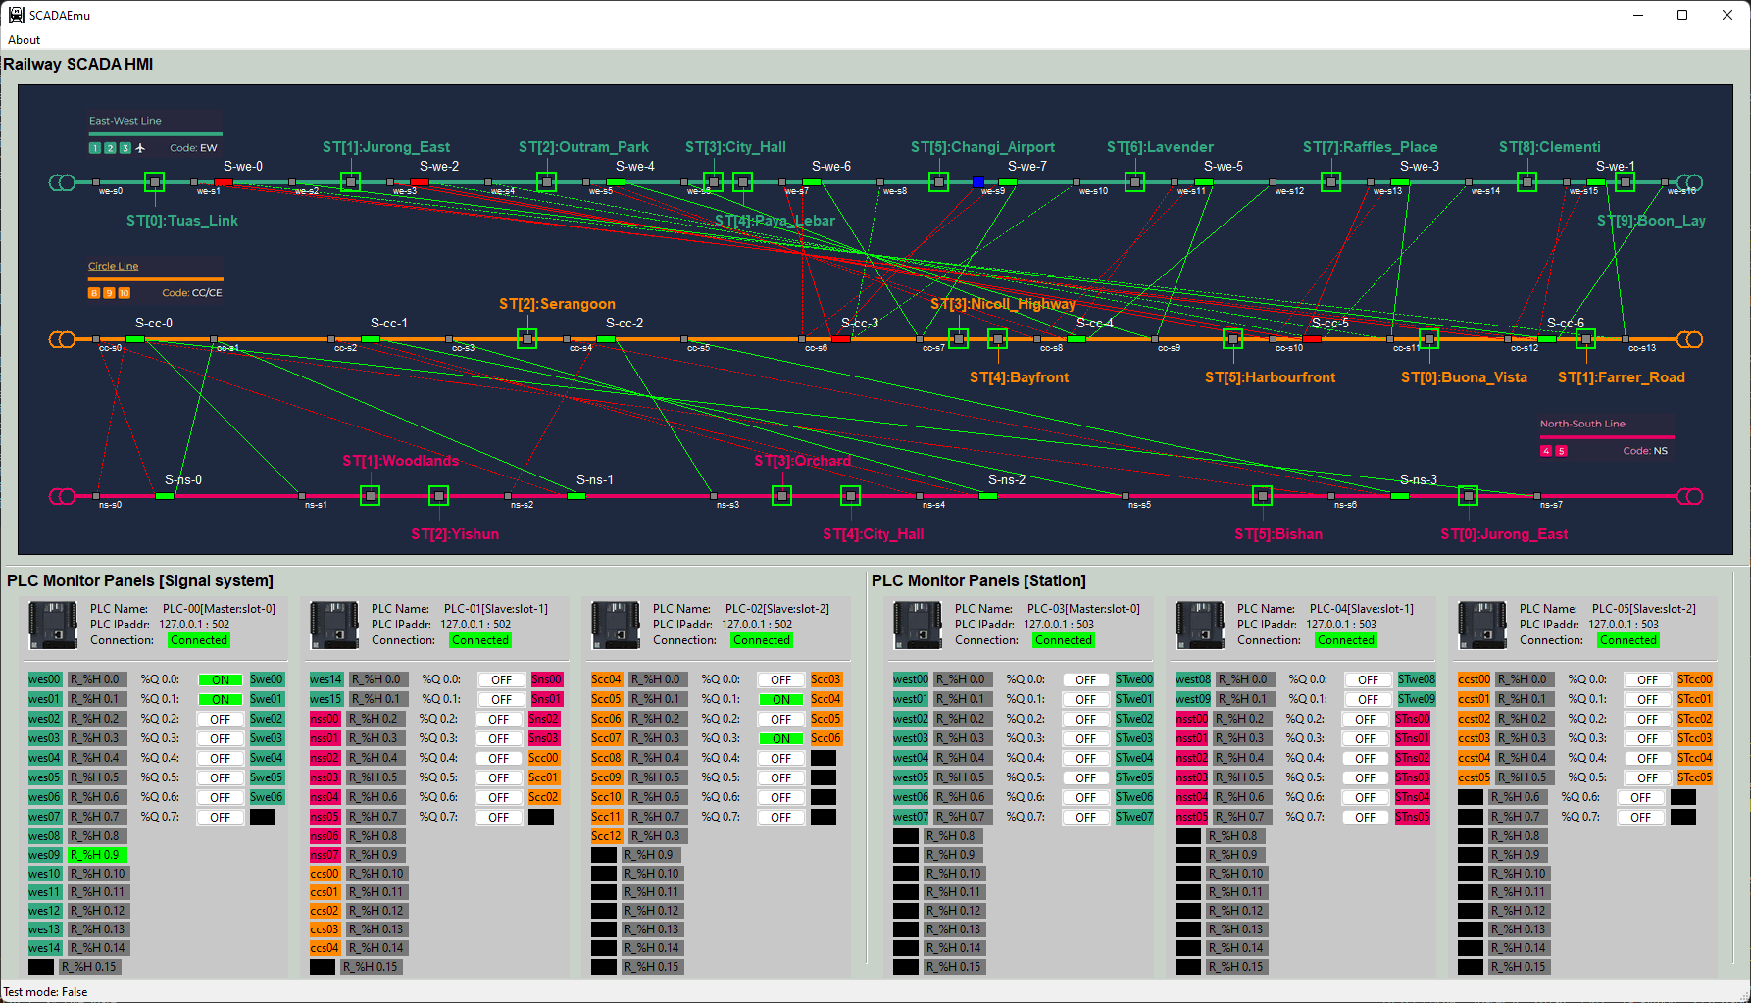
ARP Spoofing Attack (Packet drop) [ Attack Scenario Introduction ]
Crimsonian Railway Operational Room
victim vm1
Crimsonian Railway Engineer Department
Production network [PLC mode bus]
VM_ID: fw1-rail
10.107.X07.1
10.107.105.6
VM_ID: rail-op-victim
VM_ID:rail-ed-plc02
Func: Station Plc set
State: ready
10.107.107.4
10.107.X07.6
10.107.X04.1
10.107.105.5
VM_ID:rail-ed-plc01
Func: Junction Plc set
State: ready
VM_ID: railway-op-scadahmi
Func: Railway HQ HMI
State: ready
Normal Modbus comm request and response
Redirected Modbus communication after ARP spoofing success.
Traffic affected after ARP spoofing attack
Ettercap packet filter

Slide 16
DDoS Attack on PLC in OT-Network [Attack Scenario Introduction ]
Normal Modbus request and response
High frequency DDoS Modbus request
victim vm4
Railway IT department
Railway Engineer Department
victim vm1
Production network [PLC mode bus]
10.107.X04.1
10.107.105.7
Attack target VM
Railway Operational Room
victim vm1
VM_ID:rail-ed-plc03
Func: Train Plc set
State: ready
10.107.105.6
VM_ID: : OT-Eng-WS2
State: ready
10.107.107.5
10.107.X07.1
10.107.105.5
VM_ID: fw1-rail
victim vm3
VM_ID: OT-Eng-WS1
State: ready
VM_ID: railway-op-trainhmi
Func: Trains drivers HMI
State: ready
victim vm2

Slide 17
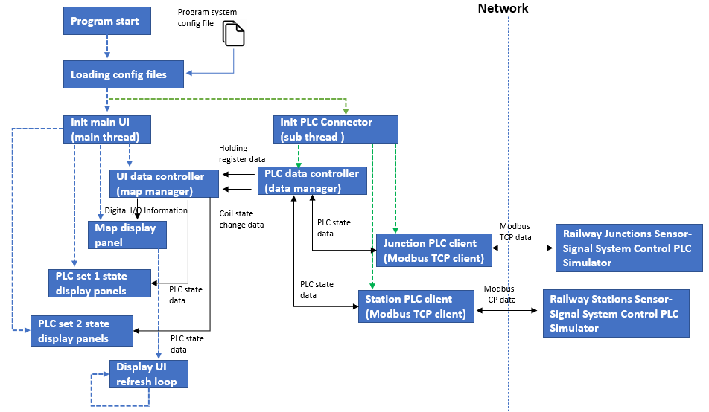
The Attack need to block the 2 PLC challenge traffic to denial the Sensor and signal control HMI service

Slide 18
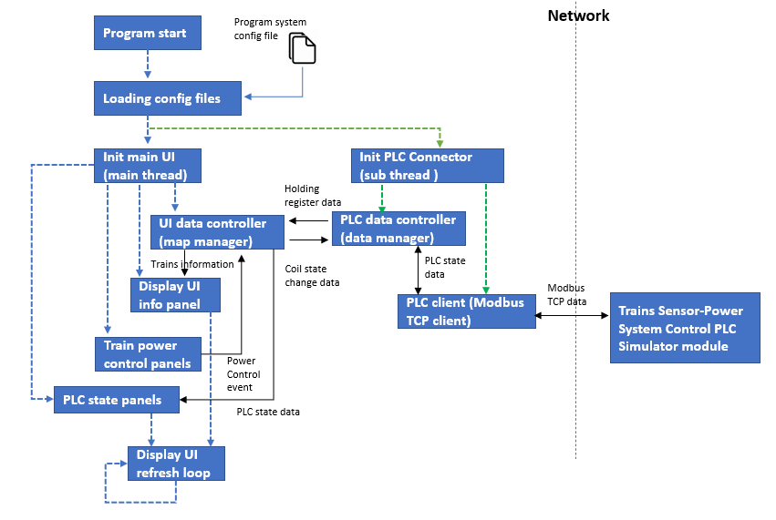
The Attack need to Jam the HMI-PLC challenge traffic to denial/interrupt the train control chain.

Slide 19
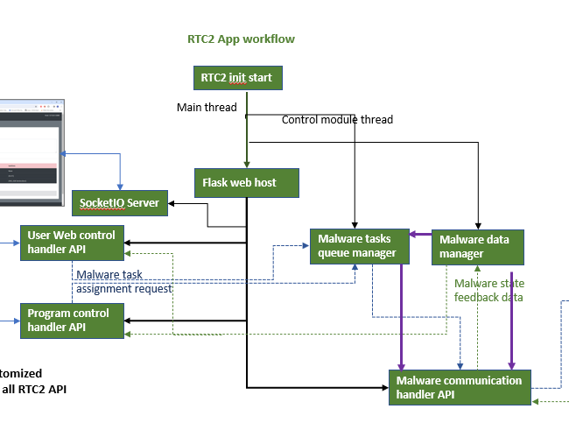
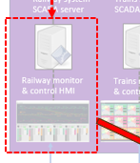

Red team user / program workflow
ARP spoofing attacker program workflow
RTC2 Web-UI
Malware init start
Main thread
Malware data manager
RTC2 client
Malware main functions
Targeted HMI service
Internet
Internet
Ettercap Wrapper
Filters Repo
User customized program all RTC2 API
Program execution flow
Red team communication
Malware tasks assignment flow
Malware state data flow
Internal function call

