Slide 1



Raspberry PI 3 [Firmware Attestation Trust Client ]
Trust Zone Secure World
Raspbian Normal World
Trust Storage
- Arm Chip UDID
- RSA encryption key list
- Attestation result data
TEE driver
Config file
Trust Client Init
TEE verify module
Arm Chip information
Trust Execution Environment
Arm Chip UDID
IoT Device Control Hub
IoT data load module
Encrypted Firmware attestation request
Arm UDID verification function
Encrypted seeds message
IoT hub communication module
network
Message decryption function
FA algo seeds
Mem Addresses
Encrypted Firmware attestation result
Firmware attestation algo function
Firmware program and memory prob module
Mem byte data
Result encryption function
Firmware
Memory
OPTEE
Encrypted attestation result message

Slide 2


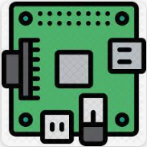

TrustZone Protected IoT Device
IoT sensors
Red team attacker
Raspberry PI 3
Firmware attack
IoT Control Hub
Raspbian Normal World
Cloud Server
Normal IoT data communication channel
Trust Zone Secure World
IoT Function Handling Service
Target IOT Firmware / Application
Trust Storage
Network
Trust Client
Encrypted firmware attestation data channel
Database
Trust Execution Environment
Trust Firmware Attestation Client
Red team attacker
Trust Firmware Attestation Service
Trust Execution Environment Driver
Replay attack

Slide 3
Raspberry PI
Trust Server Computer
Trust App [Trust Zone]
Trust Client [Normal world]
Server program
IoT device information
2. Accept OPTEE connection
0. Load config file
3. Accept the TCP connection
Config file
Arm Chip UDID
UDID match ?
No
Yes
1. OPTEE session
TCP Client
Arm Chip information
Device verified
Tee-supplicant service
Invalid Device
OPTEE driver
Internet

Slide 4

Raspberry PI
Trust Server Computer
Trust App [Trust Zone]
Internet
2048bits-RSA-key
256bits-Random#1
Trust Client [Normal world]
Verify result
Server program
Firmware info
Parse message
RSA encrypted verification data
Forward message to server
RSA[2048] encryption
Communication module
2048bits-RSA-key
Fetch RSA Key based on the IoT information
Forward message to TEE
Decrypt the message
Communication module
RSA encrypted firmware attestation request
Decrypt the message, get the Random#1, append Random#2 and PATT parameters
Verify server response Random#1 correct
RSA[2048] Encryption
OPTEE driver <=> Tee-supplicant service

Slide 5
Raspberry PI
Trust Server Computer
Internet
Trust App [Trust Zone]
Trust Client [Normal world]
Server program
Use the PATT to parameters get the random block/bytes memory address/file position.
Bytes address
Fetch the pre-saved Firmware from DB
Fetch related bytes data from the address
No
Finished iteration ?
Bytes data
Run Firmware in IoT emulation environment and calculate the PATT
Add bytes to SWATT checksum calculation
Communication module
Yes
RSA encrypted PATT message
Forward message to server
Decrypt the message to get the Random #2 and PATT value then verify whether both value can match.
Encrypt the PATT result, msg Idx, server Random #2
OPTEE driver <=> Tee-supplicant service

Slide 6
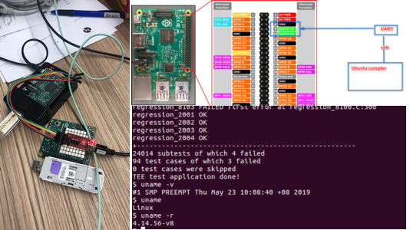
IoT sensors
TEE driver ready

Slide 7
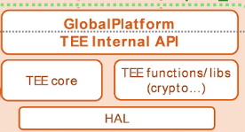
Load AES256 key + IV
OPTEE Trust Application [IoT firmware attestation workflow]
Internet
Main server start
Database
Secure World [OPTEE]
Normal World
Trust Server thread
0 . Init TCP client and load config file
Trust Application
TA-UUID[7aaaf200-2450-11e4-abe2-0002a5d5c51b]
Pre-stored Value:
RSA default Key
PATT Challenge String length
PATT calculation Iteration time [m]
Linear congruential random(BSD rand MAX and seed offset )
Raspberry PI Arm Chip UDID
File address block range.
Functions:
Accept the trustClient(normal word) connection.
Load default RSA-Key, decrypt msg, get session key. => Set RSA session key, decrypt msg and get challenge str.
Create first randomSeed and extract challenge string => random file byte’s address + state list.
Do PATT calculation for input byte, refresh all the TA(trustWorld) inside parameters.
Return to step 3, repeat n times.
Finished all and get the final PATT int/hex val.
Load RSA-session Key, encrypt PATT value.
Load RSA-session -Key, decrypt msg, get server verify result.
Client Application
Login request: F;Gateway_ID;Program_V;Key_Version;C_Len, m, n
1 - Start OPTEE session
2 – Log in to the trust server
2.1 confirm log in
2.1.1 Log in reject.
2.2 - Load AES256 key + IV
=> Create random 32B session key => Encrypt session key
3.1 Load file in memory and fetch bytes based on the Addr
2.3 Forward session key msg to TA(TrustZone)
2.3 Session key setup confirm
2.3 Create the random PATT Challenge string based on the C_len and encrypted the msg.
4. Forward new init state, Arm UDID, state[n], file bytes to TA
2.3 Forward challenge string msg to TA
2.3 Fetch Pre-saved program
5. Load the encrypted PATT parameters msg
5.1 Decrypt the PATT result feed back msg
2.4 Calculate the filep PATT
7. Forward encrypted feedback msg
TEE driver
7.1 Load verification result
- Verify success => Terminate
- Verify failed => Remove the checked program. ( or return to step 2 )
6. Verify the PATT value and create the report
6.1. RSA Encrypt the PATT value + verify result
8. Check the program running status , System library usage and (memory usage ), encrypt message
8. Decrypt the message and save the program running data.
1, 2, 3, 4, 5, 7
1
3 x m
Addr
4 x m
5
7
7.1
8
2
2
Trust Server
1, 2, 3, 4, 5, 7
OPTEE driver <=> Tee-supplicant service
Raspberry PI mode 3

Slide 8
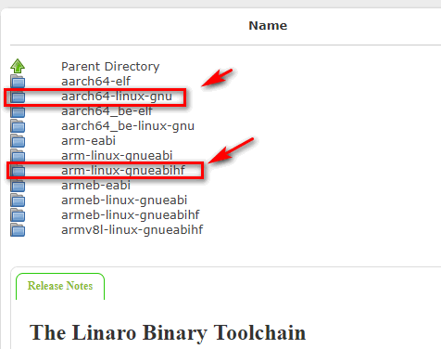
Config.mk:
export CROSS_COMPILE := /path/to/your/linaro/aarch32/bin/arm-linux-gnueabihf-
export CROSS_COMPILE_AARCH64 := /path/to/your/linaro/aarch64/bin/aarch64-linux-gnu-

