Slide 1
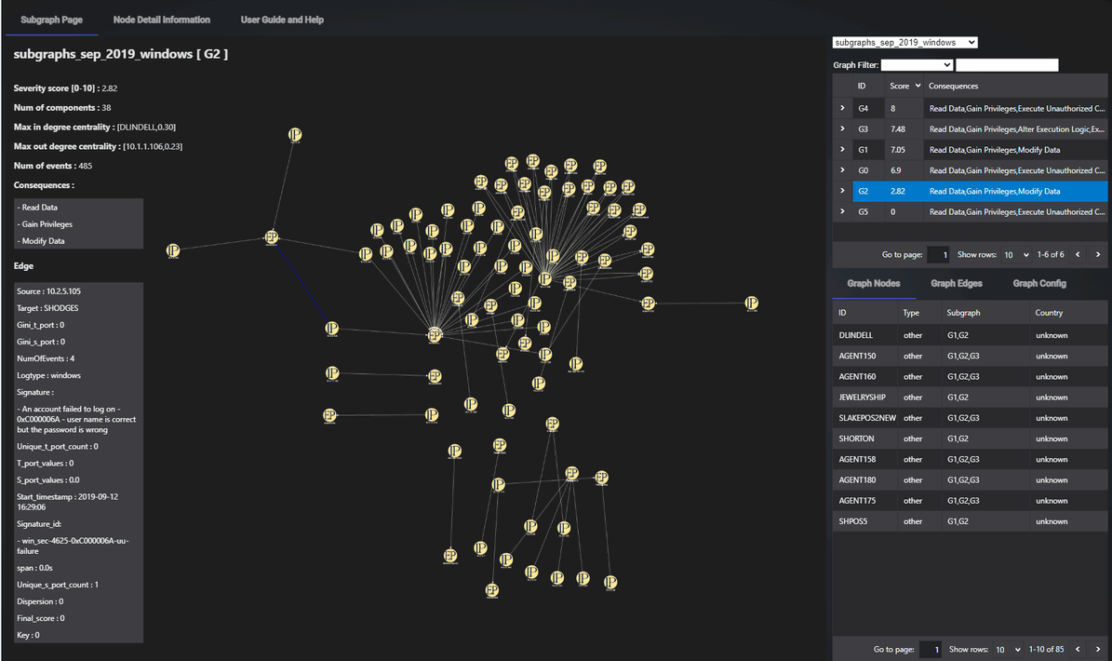







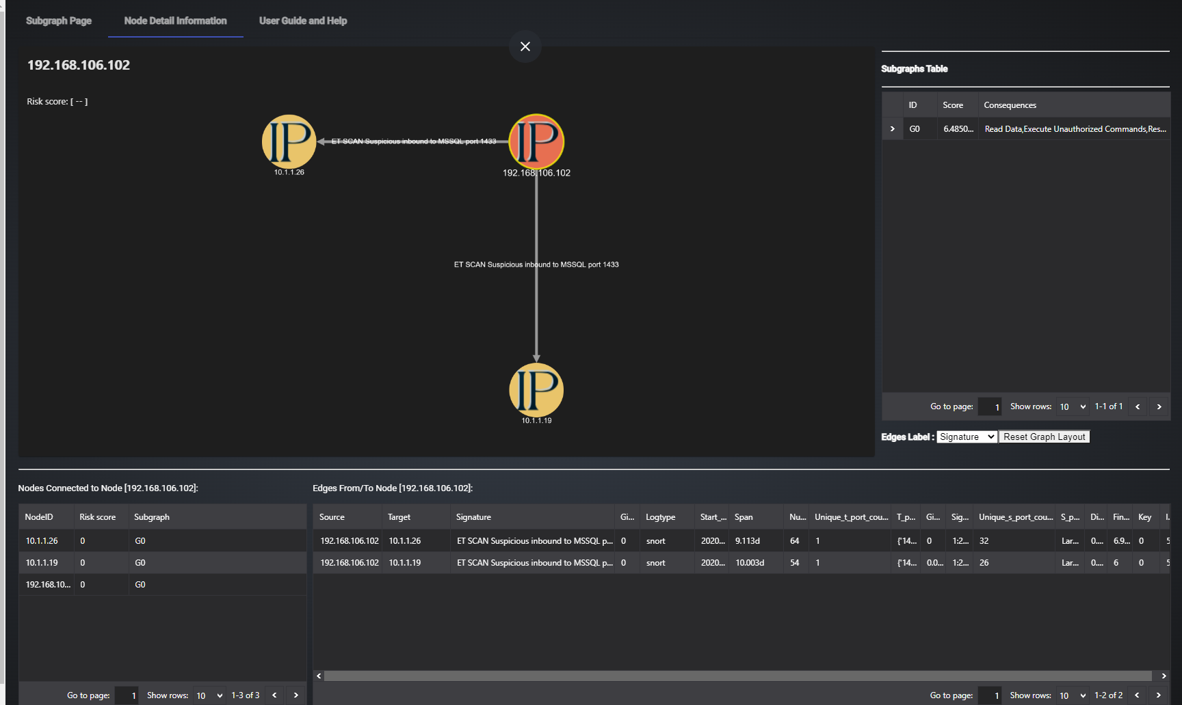
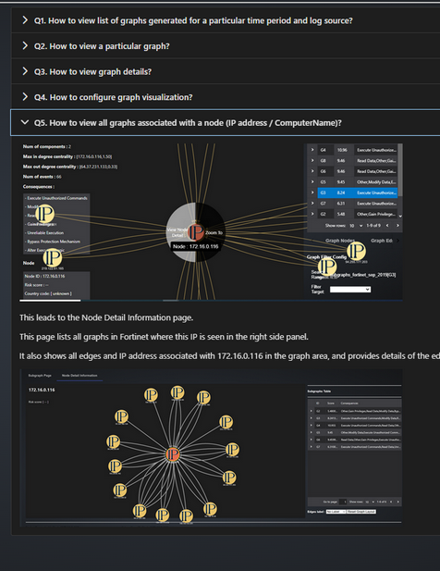




SIEM Big Data Visualization : Graph-Based SIEM Log Analysis Dashboard
Log Generation Device
Web Host Program [FE]
Fetch graph files and related information
Data graph view request
Network
File Server
Graph-Based SIEM Log Analysis Plugin
Log files
Cytoscape graph format data
Graph Convert module
Data analysis and graph creation module
User upload Graph files for visualization purpose
Graph files
Security Information and Event Management System Dashboard
Users, Security Managers

