Slide 1



Single account
Single thread
Single ssh tunnel
Use case: normal user access our testbed.
Single account
Multiple thread
Single ssh tunnel
Use case: one CTF team access their vms
jumphost1
jumphost2
targethost-N
…
jumphost1
jumphost2
targethost-N
…
Single account
Multiple thread
Multiple ssh tunnels
Use case: Check/turn on Openstack BM’s IMPI port one by one.
Multiple accounts
Multiple thread
Multiple ssh tunnels
Use case: simulate stress test for the CTFD cluster.
Jumphost1-N
Jumphost2-N
…
targethost-N
…
…
jumphost1
…
jumphost2
targethost-N
…
…
…
…
…
Jumphost1-N
…

Slide 2
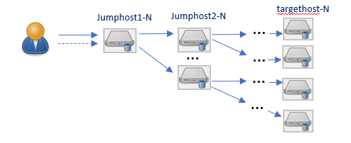

SSH connector API call
Parallel setting (dict)
Cmd (str)
Cmd handler (function reference )
SSH connector
SSH connector
Bind host info
Thread pool
SSH connector
SSH connector
Command queue [FIFO]
Thread
SSH connector
Children connector list
SSH connector [ 0 ]
SSH connector
SSH connector
SSH connector
SSH connector [n]
SSH connector
Children connector (dict)
SSH connector
Parallel cmds execution
Sequential cmd execution
Config loader
Connectors tree init
Cmd and response handler insert
Thread pool config
SSH tunnel tree init.
Start cmd execution.
Close all ssh session.

