Slide 1




SSH Connector(root)
Host Info
login
Jumphost1
Children SSH connectors reference list
Commands list
execute
result
SSH Connection Tool
Command result handling functions
Transport controller
Jumphost2
Login & execute& result
SSH Connector (lvl1)
Children SSH connectors reference list
Transport controller
Jumphost3
SSH Connector (lvl2)
Login & execute& result
Jumphost4
SSH Connector (lvl2)

Slide 2





Command set config
Jumphost1
Jumphost2
End/Target host
…
User or program
SSH credential
Run cmd set1
Run cmd set2
Run cmd set-N
Command set config
Jumphost1
Jumphost2
End/Target host
…
Run cmd set-N-0
Users or programs
Run cmd set1-0
Run cmd set2-0
Run cmd set-N-1
SSH credential
Run cmd set1-1
Run cmd set2-1
Run cmd set-N-2
…
Run cmd set1-2
Run cmd set-N-n

Slide 3

Command set config
Jumphost1
Jumphost2-0
End/Target host-0
…
Run cmd setN-0
Run cmd set2-0
End/Target host-1
Run cmd set1-0
…
Run cmd setN-1
User or program
Jumphost2-1
End/Target host-2
SSH credential
…
Run cmd setN-2
Run cmd set2-1
End/Target host-n
…
Run cmd setN-n
Command set config
End/Target host-0
Jumphost1-0
…
Run cmd setN-0
Gateway
End/Target host-n
Users or programs
SSH credential
…
Run cmd setN-n
Jumphost1-1
…
End/Target vms
Run cmd setN-n

Slide 4



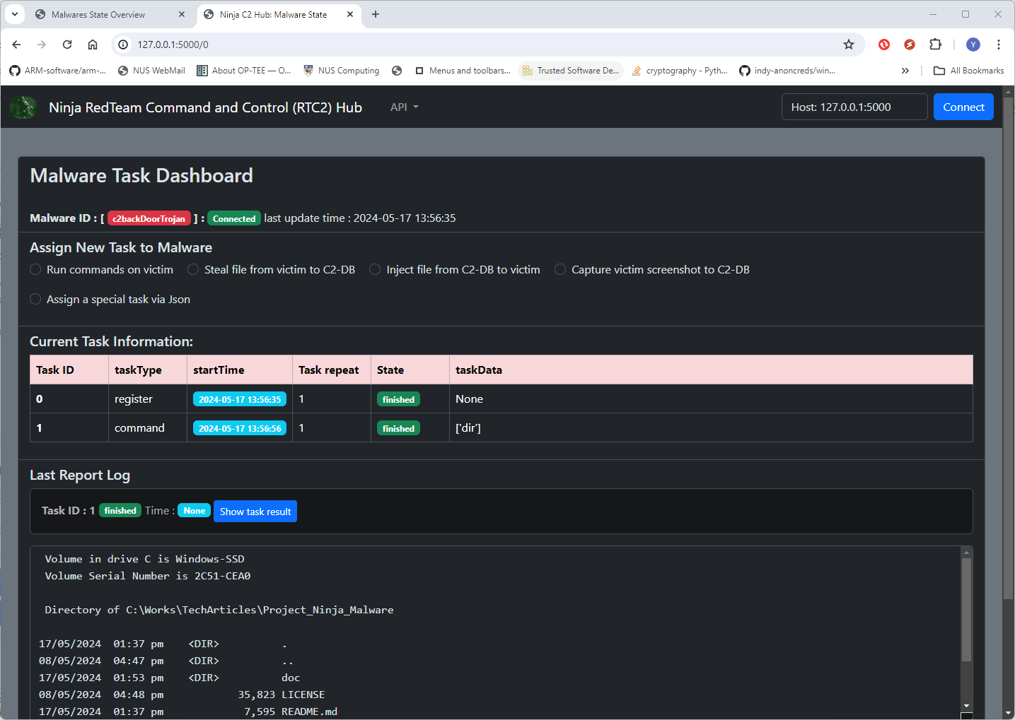
File upload
Jumphost1
End/Target host
SCP Connector
…
Download file request
User or program
SSH credential
SSH connection configuration
Web server
Jumphost1
SSH Forwarder
Port 22
…
Port 443
Port 8080
User or program
SSH credential
Local browser: http:127.0.0.1:8080

Slide 5

SSH Connection Tool Workflow Diagram
Jumphost1
Target host
SSH Connector
Gateway or firewall
SSH Command set config
Network
SCP Connector
Run cmd set1
Run cmd set2-0
SCP file download
File sever
SCP file upload
Run cmd set2-1
SSH Forwarder
Internal Web server
Port forwarding config
Local browser: http:127.0.0.1:8080
Jumphost2
Users and programs
SSH Command data flow
SCP file transfer data flow
SSH Port forward data flow

Slide 6
Single account
Single thread
Single ssh tunnel
Use case: normal user access ncl testbed.
Single account
Multiple thread
Single ssh tunnel
Use case: one CTF team access their vms
jumphost1
jumphost2
targethost-N
…
jumphost1
jumphost2
targethost-N
…
Single account
Multiple threads
Multiple ssh tunnels
Use case: Check/turn on Openstack BM’s IMPI port one by one.
Multiple accounts
Multiple thread
Multiple ssh tunnels
Use case: simulate stress test for the CTFD cluster.
Jumphost1-N
Jumphost2-N
…
targethost-N
…
…
jumphost1
…
jumphost2
targethost-N
…
…
…
…
…
Jumphost1-N
…
http:// 127.0.0.1:8080 <= … => RemoteWebHost-3: 80
https:// 127.0.0.1:8081 <= … => RemoteWebHost-1: 443
http:// 127.0.0.1:8082 <= … => RemoteWebHost-3: 8080
https:// 127.0.0.1:8083 <= … => RemoteWebHost-3: 623
jumphost1
jumphost2
Jumphost N
…
RemoteWebHost-3: 80
ssh
jumphostN
ServerIPMIweb: 623
FIREWALL (only port 22 is open)
BMCWebHost-1: 443
RemoteWebHost-2: 8080

Slide 7
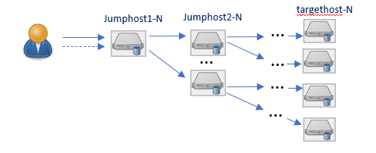

Parallel setting (dict)
Cmd (str)
SSH connector API call
Cmd handler (function reference )
SSH connector
SSH connector
Bind host info
Thread(bg) pool
SSH connector
…
Command queue [FIFO]
SSH connector
Thread
SSH connector
Children connector list
SSH connector [ 0 ]
SSH connector
SSH connector
SSH connector [n]
SSH connector
Children connector (dict)
SSH connector
SSH connector
Parallel ssh_connectors’ cmds execution
Sequential ssh_connectors’ cmds execution
Config loader
Connectors tree init
Cmd and response handler insert
Thread pool config
SSH tunnel tree init.
Start cmd execution.
Close all ssh session.

Slide 8
Threads Pool
NCL gateway
NCL firewall
NCL Server
Load tester
Team tester
User tester
…
…
…
…
Team tester
User tester
…
Threads Pool
User tester
…
…
User tester

