Slide 1

Web Video Host Test
AYE NoteBook
QSVPN Tunnel
Telepark NoteBook
videoHost.py
Google Chrome browser
Http web request
Load Video File
Video Stream by TCP
Buffer and display
Wg0: 10.0.0.2
172.31.103.202
Wg1: 10.0.0.1
172.31.103.201

Slide 2
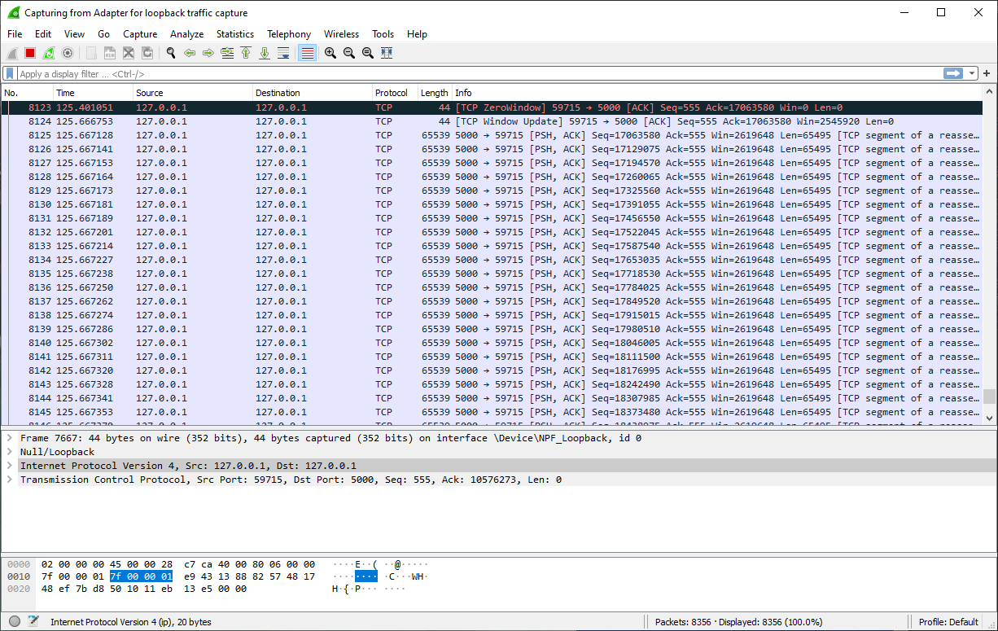

Slide 3


Echo Camera Video Test
Call time.time() get time1
AYE-NoteBook
QS_WGVPN Tunnel
Telepark-NoteBook
CamEchoClient.py
CamEchoServer.py
Send Video frame data to AYE-Notebook through UDP
Capture Video From Camera
Echo back image data
Echo video frame data back to Telepark-Notebook through UDP
Show Camera Image on Window_2
Show Camera Image on Window_1
Call time.time() get time2
Latency = time2 – time1
Wg0: 10.0.0.2
172.31.103.202
Wg1: 10.0.0.1
172.31.103.201

Slide 4
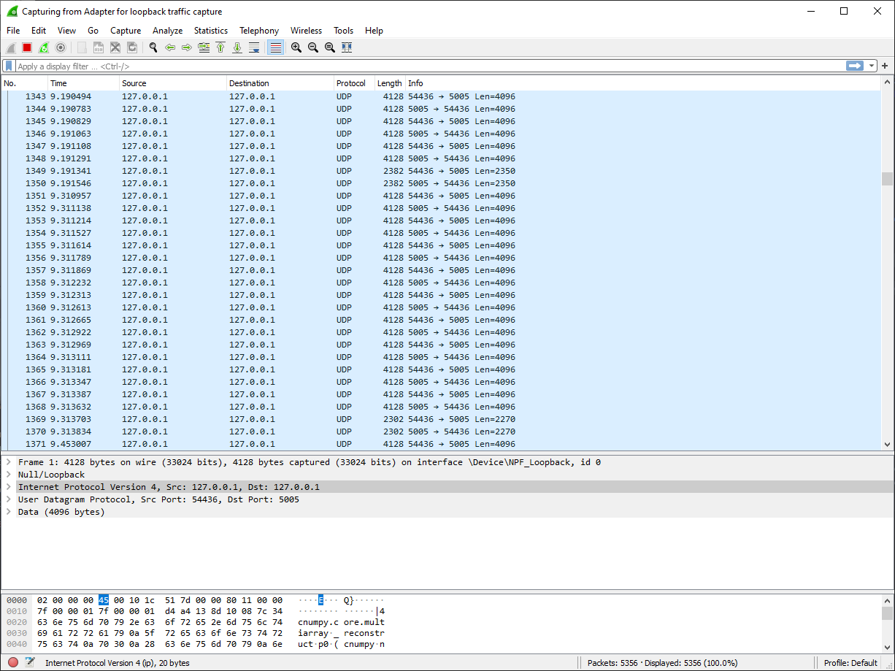

Slide 6
5G
5G Phone(172.31.123.201)
Telepark Notebook
(192.168.10.x)

