Slide 1

QS_WGVPN Echo Camera Video Test

Slide 2
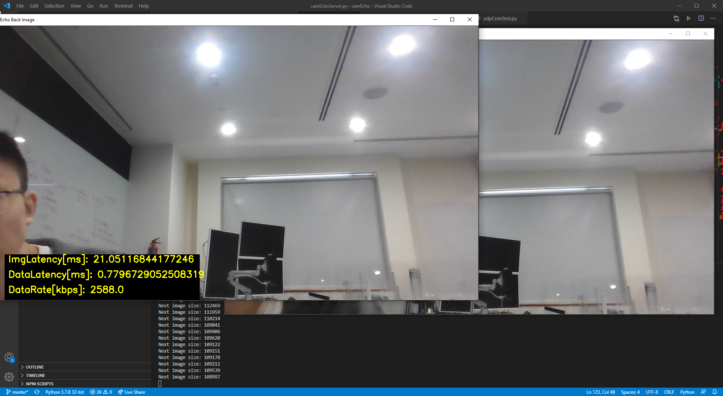
QS_WGVPN Echo Camera Video Test
User Interface:

Slide 3
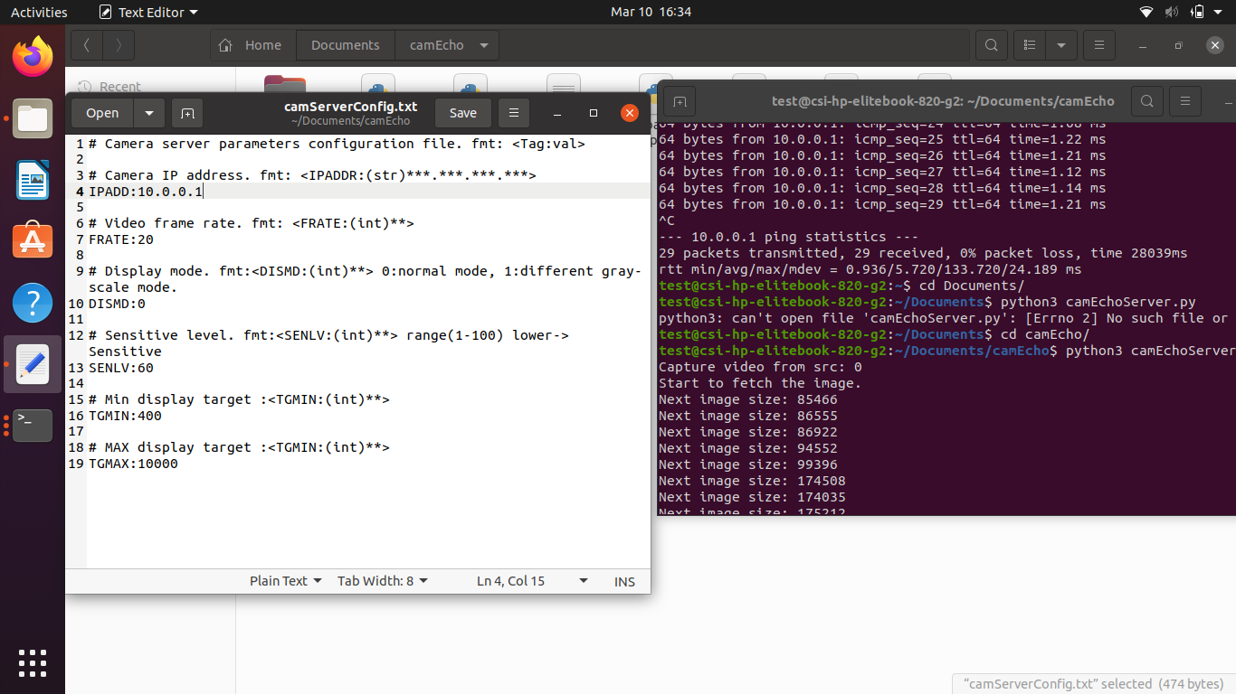
QS_WGVPN Echo Camera Video Test
Test configuration:
Camera resolution: 1600 X 900
Data transfer rate: 20 fps
Image format: JPEG (10% compression rate )
UDP buffer size: 4096 bits

Slide 4
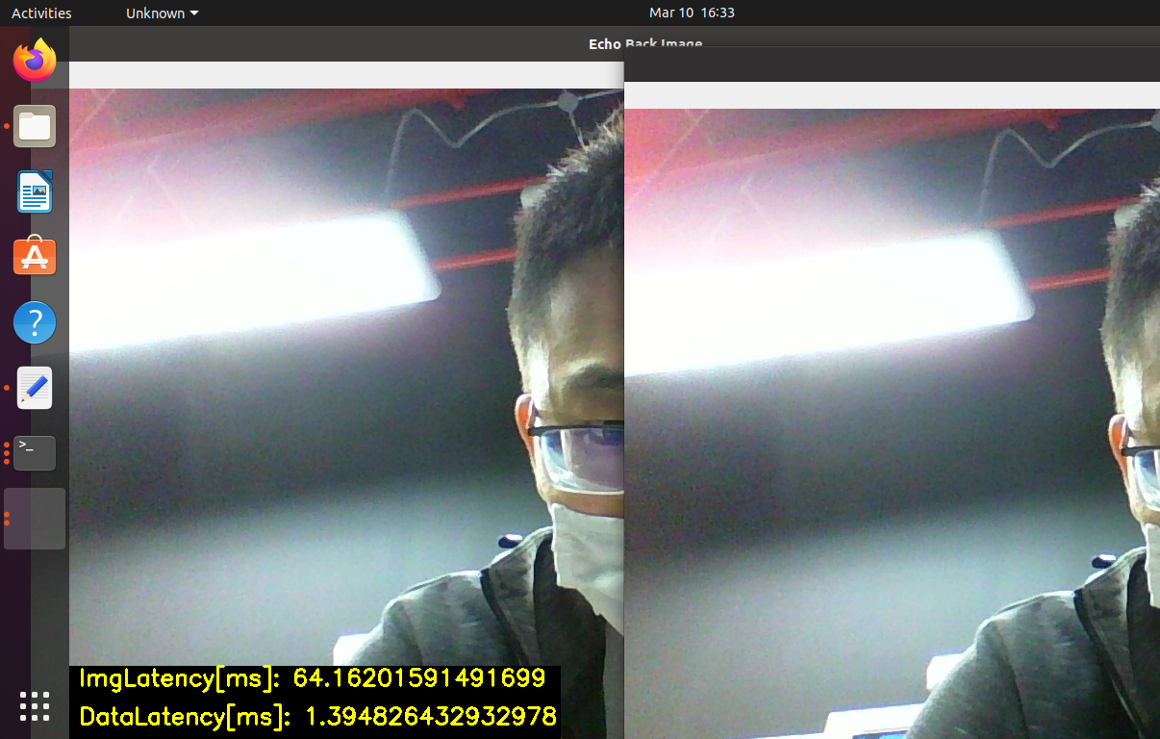
QS_WGVPN Echo Camera Video Test
Test Result:
Image Latency: 64 milliseconds
Data transfer rate: 1.3948 milliseconds
Data transfer rate: 1500 ~ 3000 kb

Slide 5
RTSP server A
Internet
Server B
Computer C
Network switch
Computer D
Local network

