Slide 1





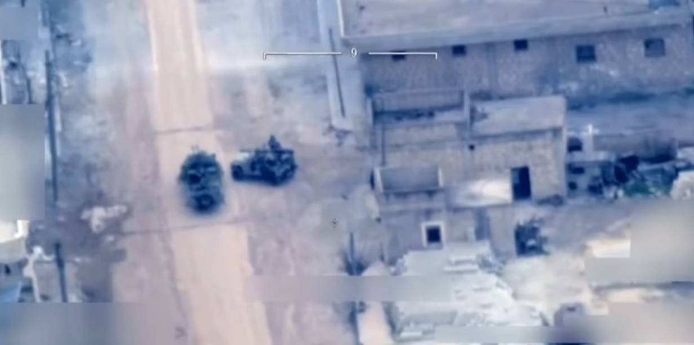
Video Web Host Demo (TCP video stream)
CQT lab laptop in Science (S15)
QSVPN Tunnel
CorpLab Laptop in I4.0
Video Web Host
Web Browser
Http Request
Load Video File
Video Stream by TCP
Network Interface
Pub_IP: 192.168.109.x
Wg0: 10.0.0.2
Network Interface
Pub_IP: 192.168.109.y
Wg1: 10.0.0.1
Buffer and display

Slide 2
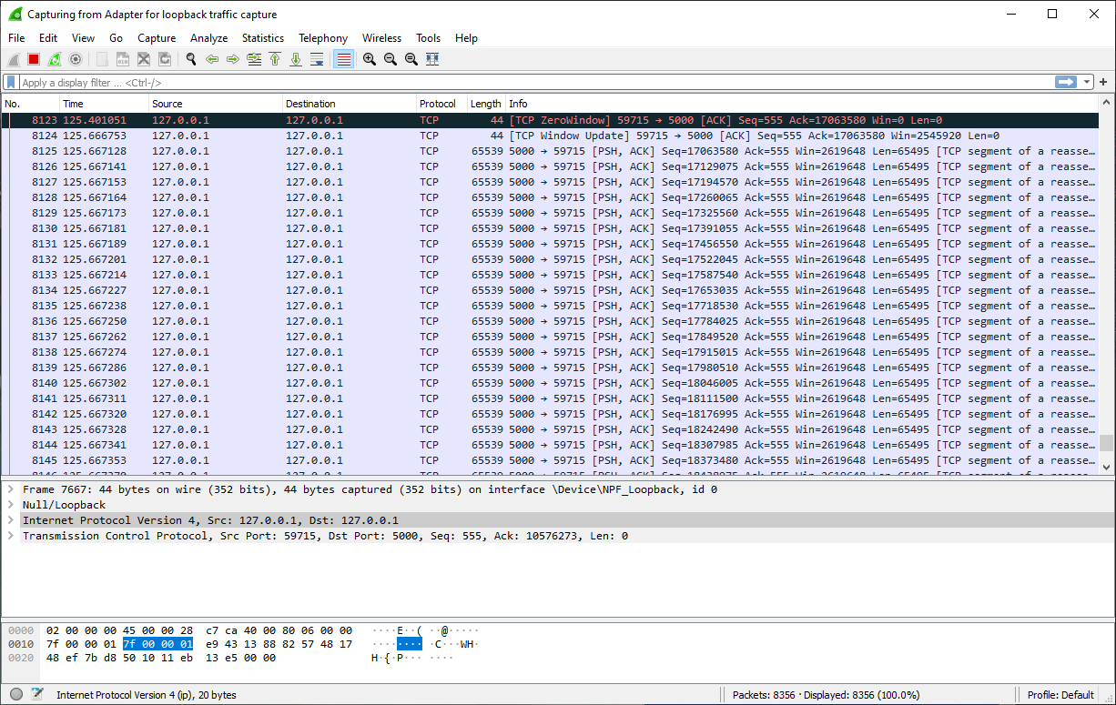

Slide 3



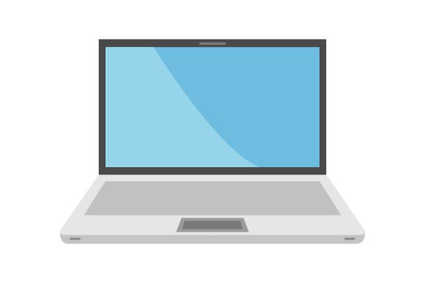
Echo Camera Video Demo (UDP Frame stream)
CQT lab laptop in Science (S15)
QS_WGVPN Tunnel
CorpLab Laptop in I4.0
CamEchoClient Application
CamEchoServer Application
Send Video frame data to through UDP
Time[1]
Capture Video From Camera
Echo back image data
Time[2]
Show Echo Image on Monitor TV screen
Show Camera Image on laptop screen
Echo video frame data back through UDP
Network Interface
Pub_IP: 192.168.109.x
Wg0: 10.0.0.2
Network Interface
Pub_IP: 192.168.109.y
Wg1: 10.0.0.1
Network latency = ( - ) /2

Slide 4
Echo Camera Video Demo (UDP Frame stream)
Call time.time() get time1
AYE-NoteBook
QS_WGVPN Tunnel
Telepark-NoteBook
CamEchoClient.py
CamEchoServer.py
Send Video frame data to AYE-Notebook through UDP
Capture Video From Camera
Echo back image data
Echo video frame data back to Telepark-Notebook through UDP
Show Camera Image on Window_2
Show Camera Image on Window_1
Call time.time() get time2
Latency = time2 – time1
Wg0: 10.0.0.2
172.31.103.202
Wg1: 10.0.0.1
172.31.103.201

Slide 5
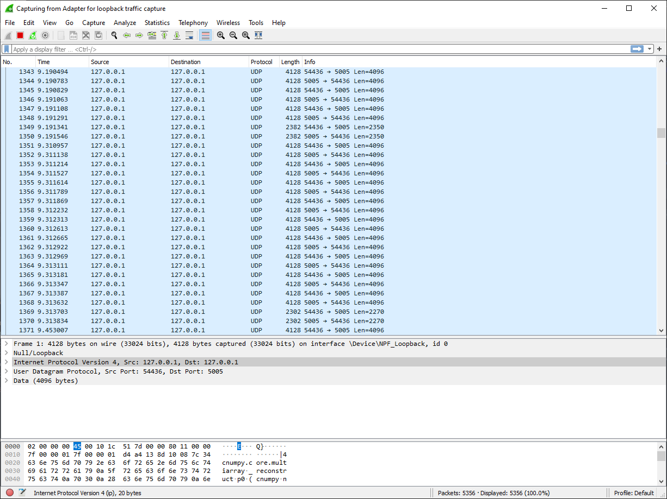

Slide 7
5G
5G Phone(172.31.123.201)
Telepark Notebook
(192.168.10.x)

