Slide 1




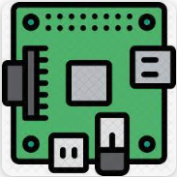
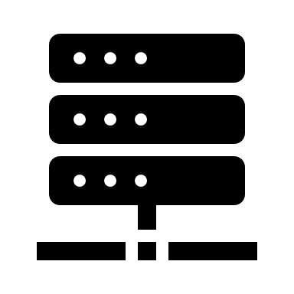
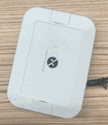


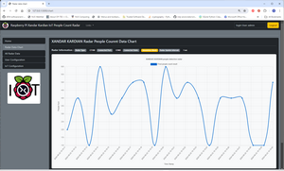


I
T
Xandar CT100 people detection sensor
Raspberry PI [Radar IOT]
IoT management hub
Internet
Radar Communication Module
Xandar CT500 people detection radar
GPIO
Database
HTTP(S) data report
User
COM
Data Management module
IoT Control Web
IoT Hub Report Module
Ethernet / Wi-Fi / 5G network
IOT Web Host Module
HTTP(S) request

Slide 2

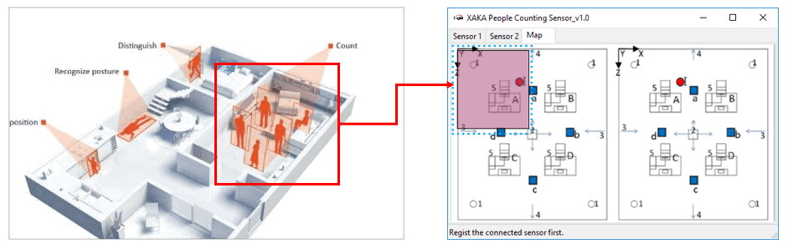
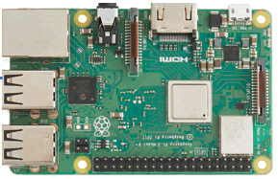
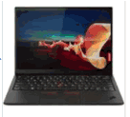
Network or Wi-Fi
Mini USB Com connection
GPIO 4 Pin connection [3.3+, GND, GPIO10, GPIO9]

Slide 3
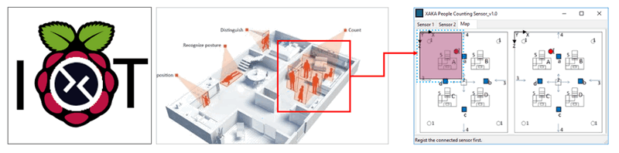
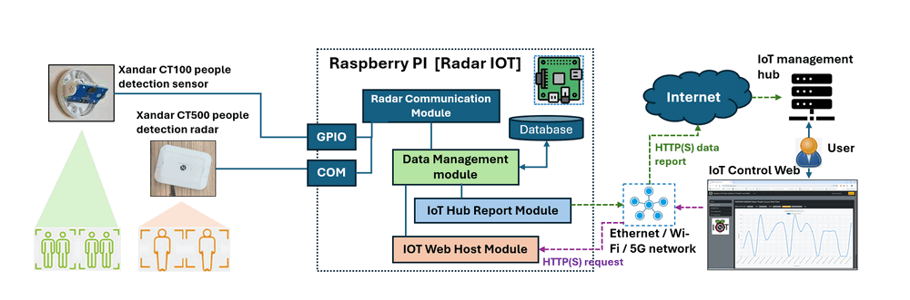
Raspberry PI Xandar Kardian IoT People Count Radar

