Slide 1
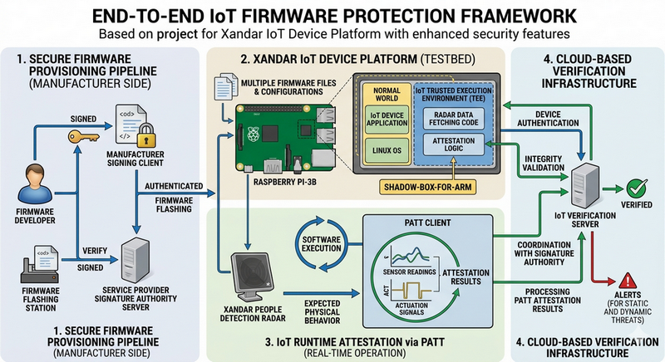
IoT Supply Chain Protection Case Study
Use Shadow-Box-For-Arm and PATT for Firmware Integrity Assurance

