Slide 1
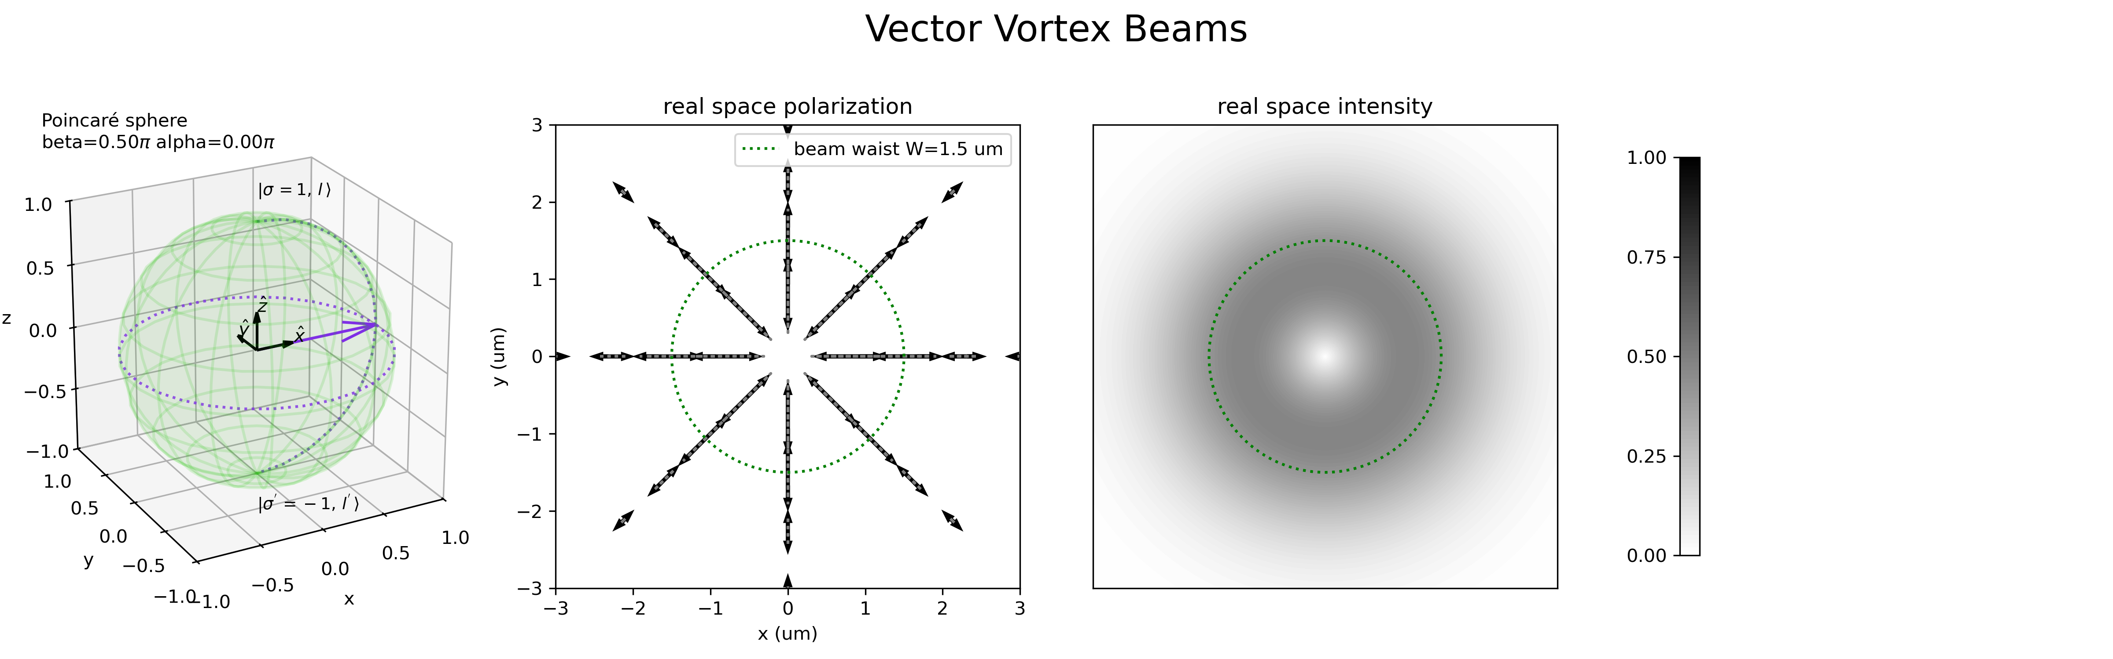
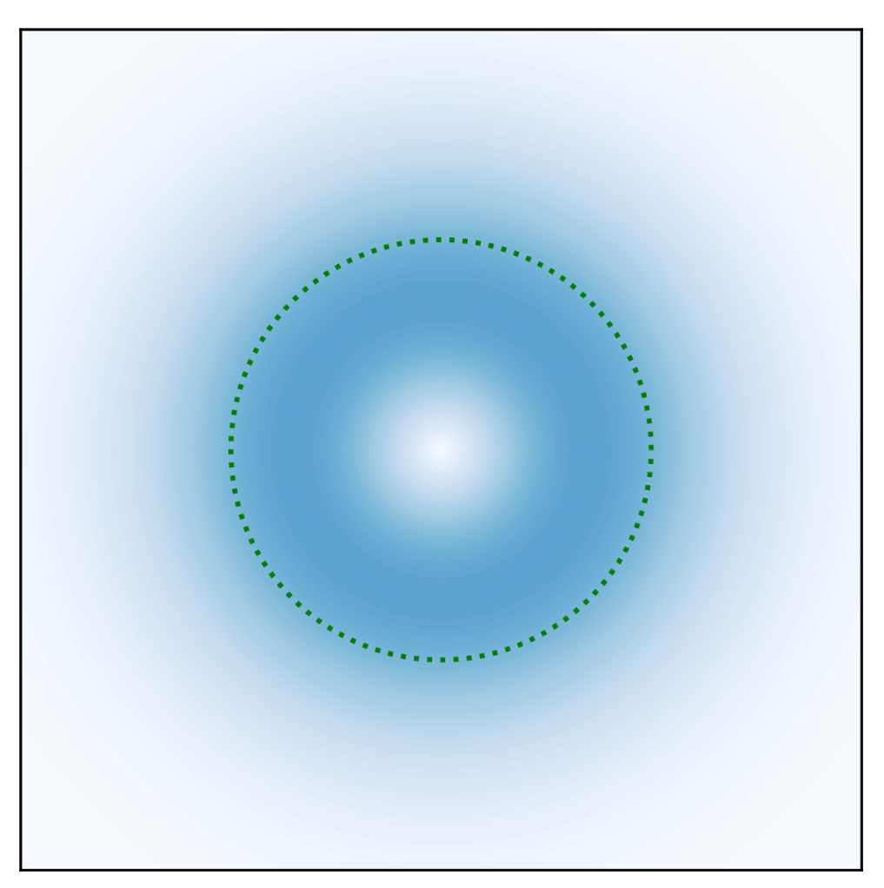
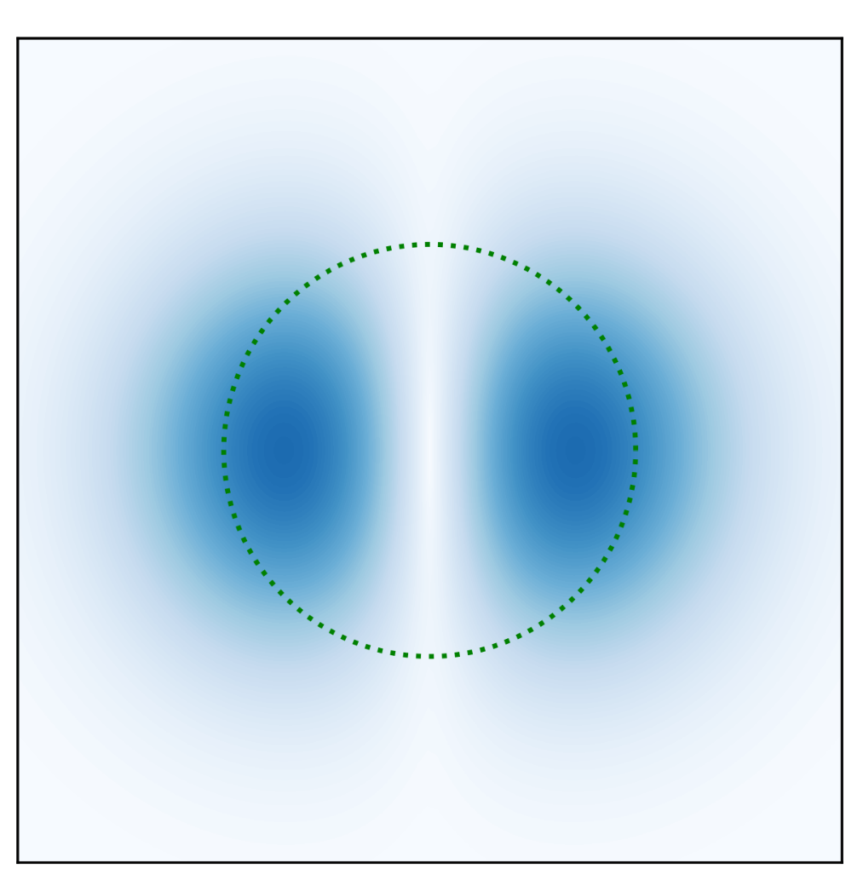
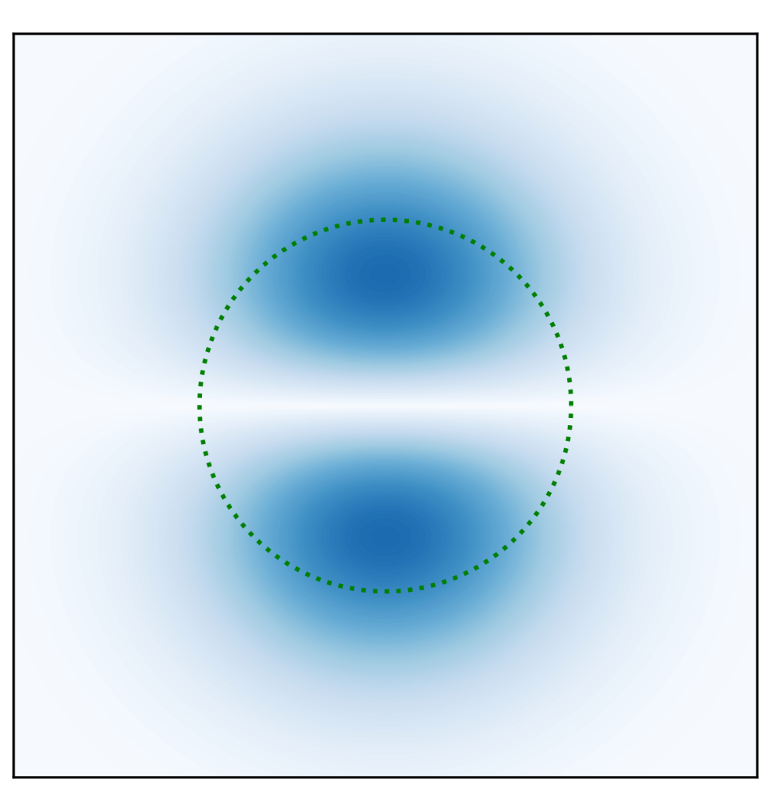
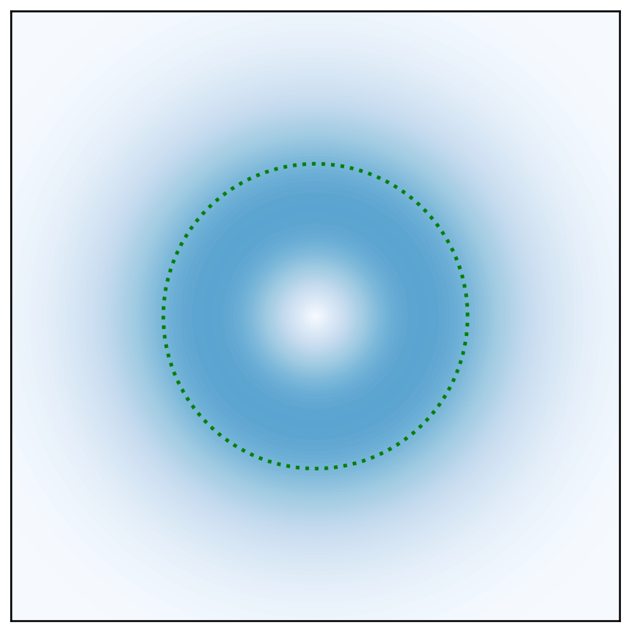








$$|\left.1, 0\right\rangle$$
$$|\left.1, 0\right\rangle$$
$$z$$
$$β$$
$$x$$
$$α$$
$$y$$
$$|\left.−1, 0\right\rangle$$

Slide 2
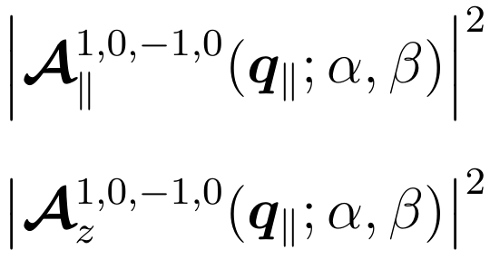
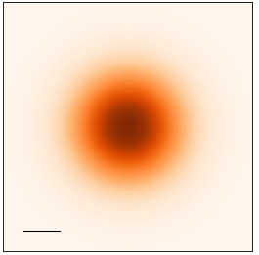
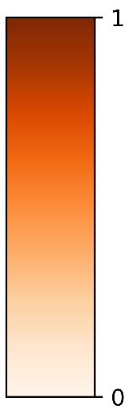
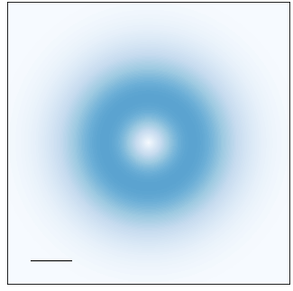
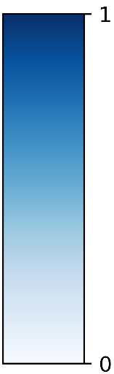
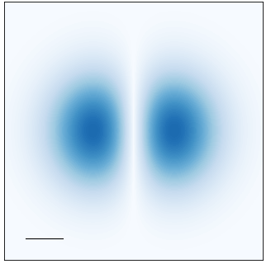
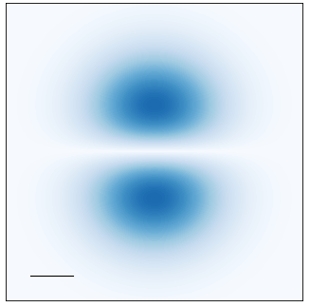
































Transverse component
Longitudinal component
$$\left(α, β\right)=\left(0, \text{0}\right)$$
$$\left(α, β\right)=\left(0, \text{0}\right)$$
$$q_{y}$$
$$q_{y}$$
$$q_{y}$$
$$q_{x}$$
$$q_{x}$$
$$q_{x}$$
$${0.1Q}_{c}$$
$${0.1Q}_{c}$$
$$a.u.$$
$$a.u.$$
$$|\left.1, 0\right\rangle$$
$$|\left.1, 0\right\rangle$$
$$z$$
$$z$$
$$\left(0, π/2\right)$$
$$\left(π,π/2\right)$$
$$\left(0, π/2\right)$$
$$\left(π,π/2\right)$$
$$β$$
$$β$$
$$x$$
$$α$$
$$y$$
$$x$$
$$y$$
$$α$$
$$|\left.−1, 0\right\rangle$$
$$|\left.−1, 0\right\rangle$$
$$\left(0,π\right)$$
$$\left(0,π\right)$$

