Slide 1
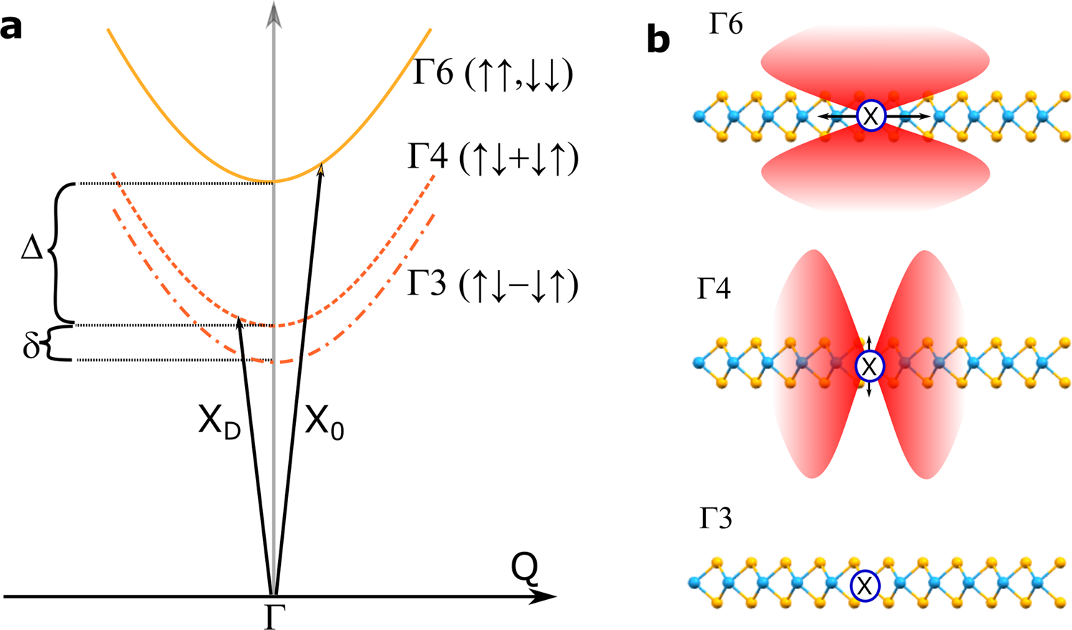
BXs
DXs
GXs

