Slide 1
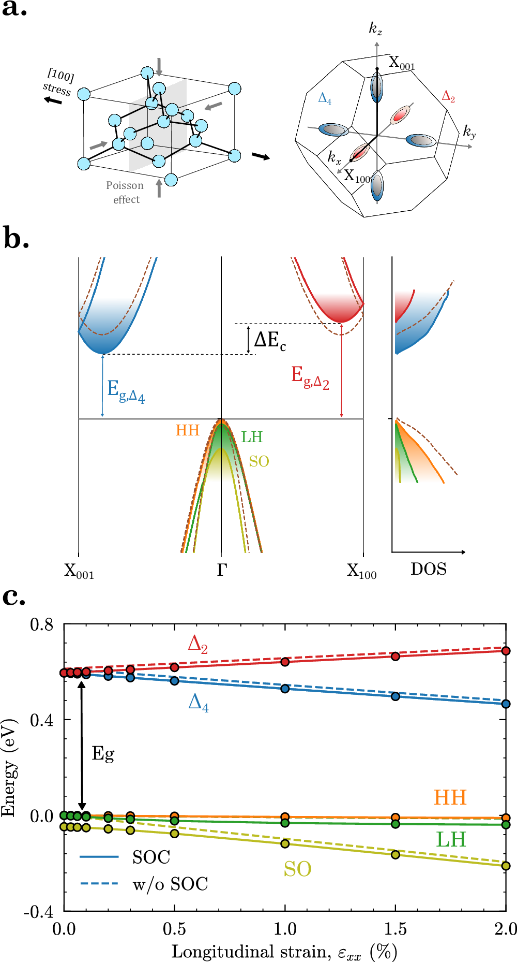
(a)
(b)
Fig. 1: Strain impact on the band structure. | npj Computational Materials

Slide 2
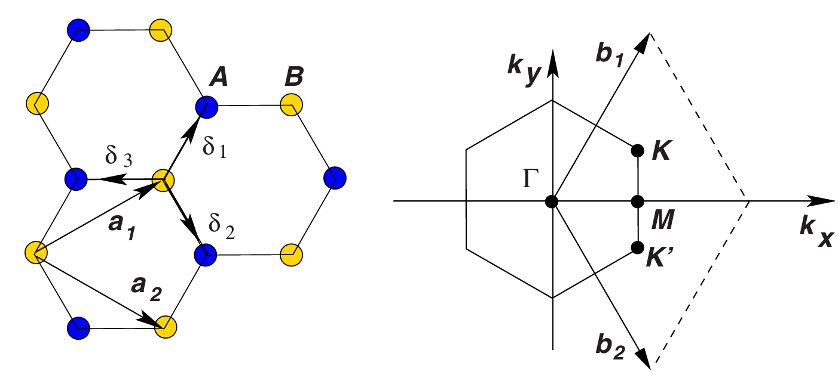
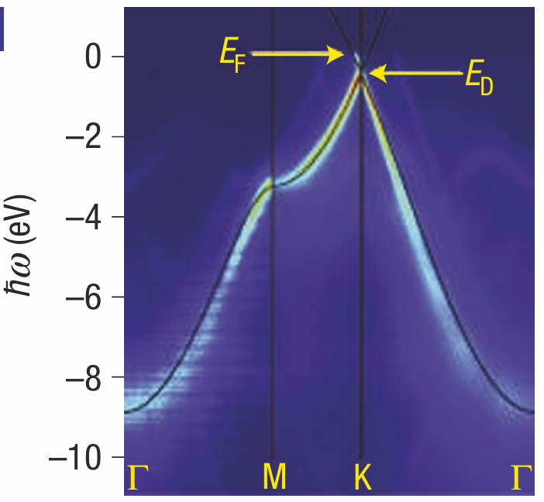


Quasiparticle dynamics in graphene | Nature Physics
(a)
(b)
$$k_{y}$$
$$k_{x}$$

Slide 3









(a)
(c)
$$K’$$
$$M$$
$$y$$
$$k_{y}$$
$$K$$
$$x$$
$$k_{x}$$
$$Γ$$
(b)
(d)
$$eV$$

