Slide 1
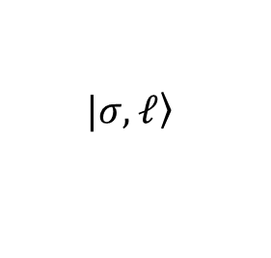
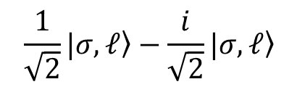

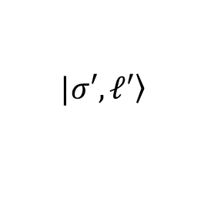
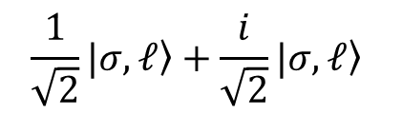


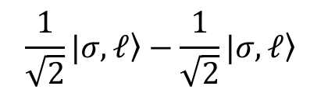

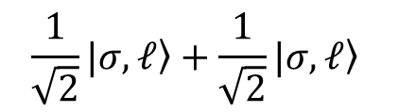


Poincaré sphere representation
$α$ in $[0, 2π]$ and $β$ in $[\text{0}, π]$
$$|\left.σ, ℓ\right\rangle$$
$$\frac{1}{\sqrt{2}}|\left.σ, ℓ\right\rangle −\frac{i}{\sqrt{2}}|\left.σ, ℓ\right\rangle$$
$$z$$
$$\frac{1}{\sqrt{2}}|\left.σ, ℓ\right\rangle −\frac{1}{\sqrt{2}}|\left.σ, ℓ\right\rangle$$
$$β$$
$$\frac{1}{\sqrt{2}}|\left.σ, ℓ\right\rangle +\frac{1}{\sqrt{2}}|\left.σ, ℓ\right\rangle$$
$$x$$
$$α$$
$$y$$
$$\frac{1}{\sqrt{2}}|\left.σ, ℓ\right\rangle +\frac{i}{\sqrt{2}}|\left.σ, ℓ\right\rangle$$
$$|\left.σ′, ℓ′\right\rangle$$

