Slide 1
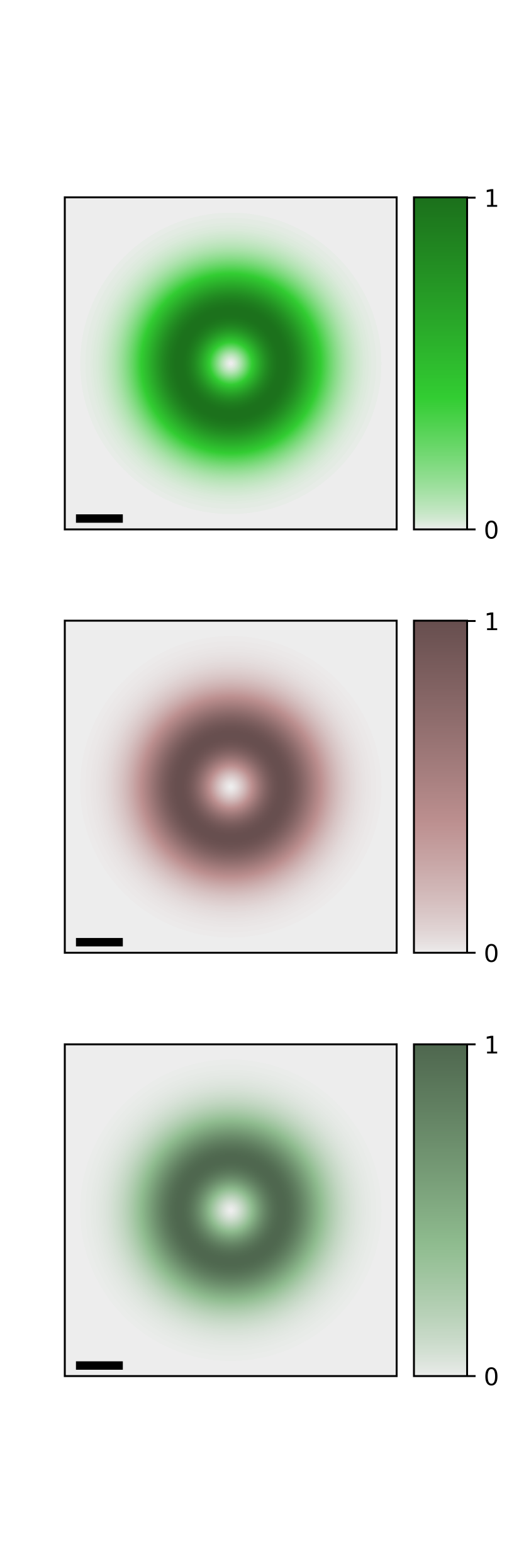




$$Q_{y}$$
$${\left|{\tilde{F}}_{1,0}\left(Q\right)e^{iℓφ_{Q}}\right|}^{2}$$
$$Q_{x}$$
$${0.1Q}_{c}$$

Slide 2
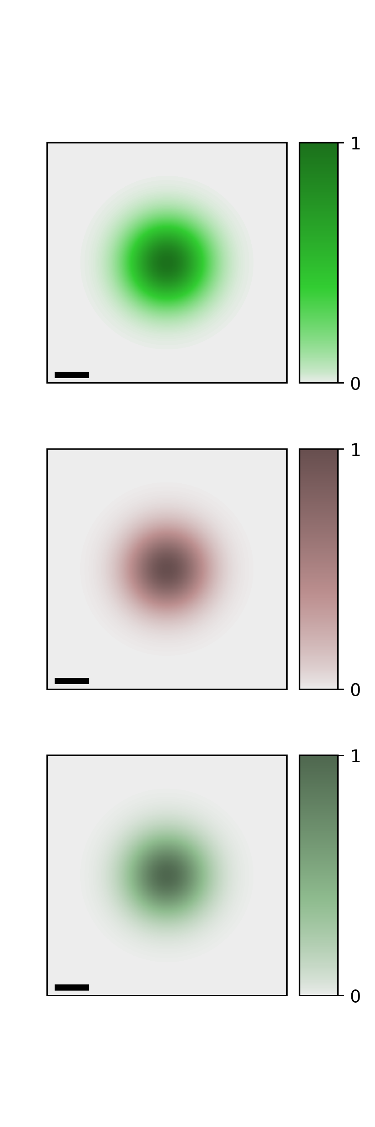
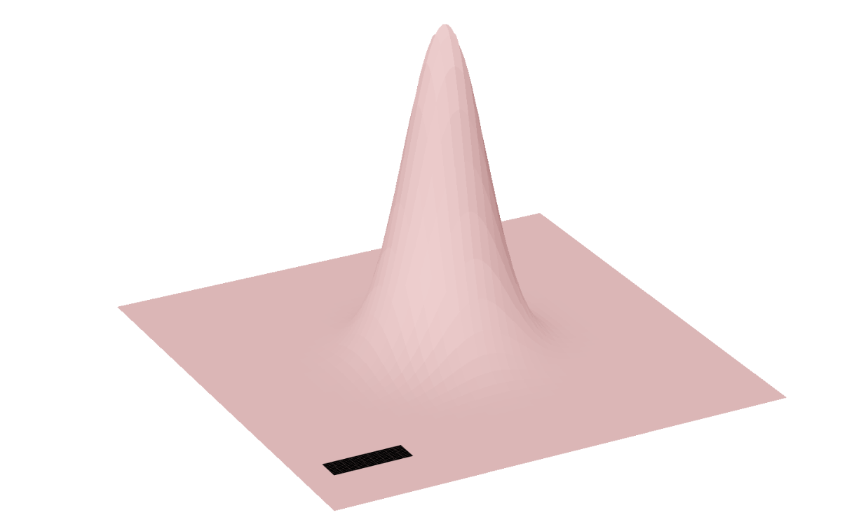











$${\left|\sum_{Q}^{ }{{\tilde{M}}_{S,Q}^{\hat{x}, 0,0}e^{iQ⋅R_{c}}}\right|}^{2}$$
$${\left|{\tilde{M}}_{S,Q}^{\hat{x},0}\right|}^{2}$$
$$Q_{y}$$
$$Q_{x}$$
$$S=K$$
$$y$$
$$W_{0}$$
$${0.1Q}_{c}$$
$$x$$
$$S=K′$$

Slide 3
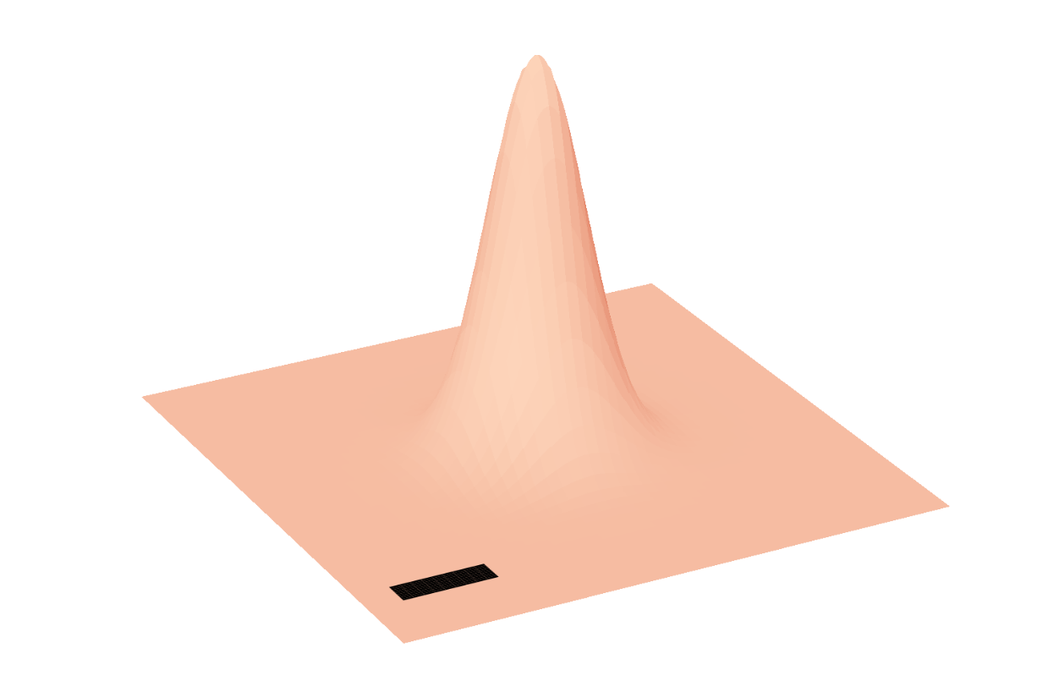
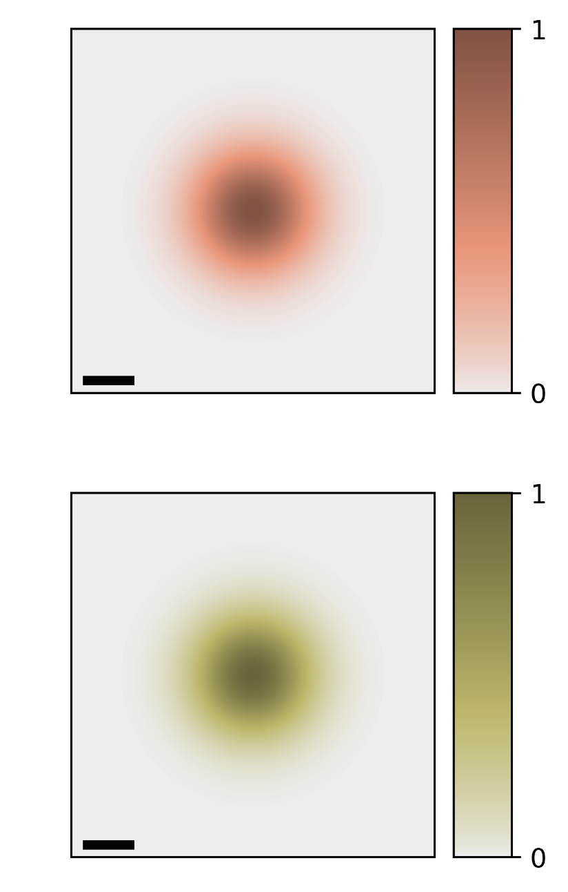





$${\left|\sum_{Q}^{ }{{\tilde{M}}_{S,Q}^{\hat{y}, 0,0}e^{iQ⋅R_{c}}}\right|}^{2}$$
$${\left|{\tilde{M}}_{S,Q}^{\hat{y},0}\right|}^{2}$$
$$S=K$$
$$S=K′$$

Slide 4
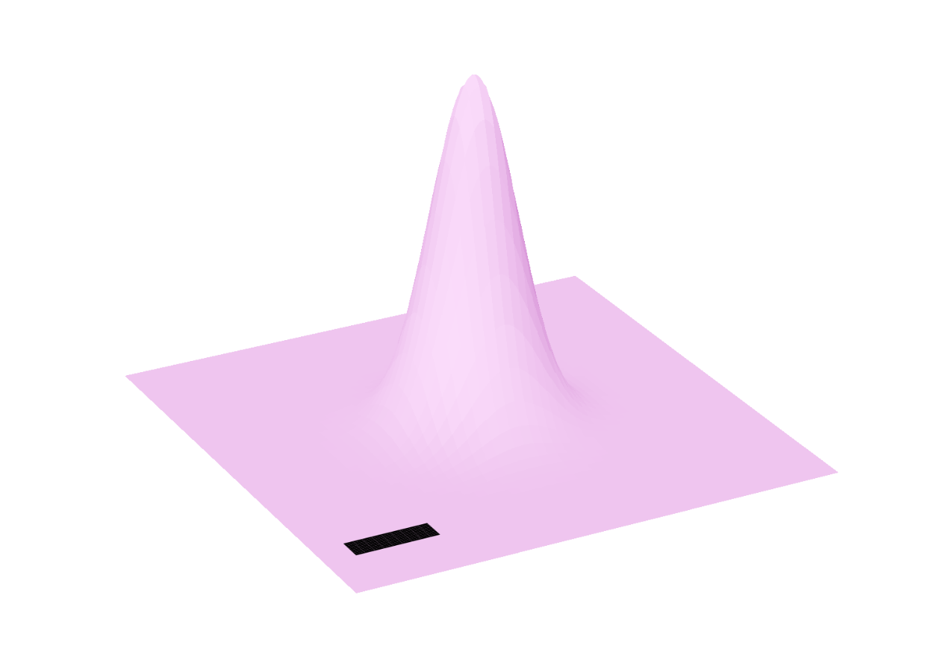
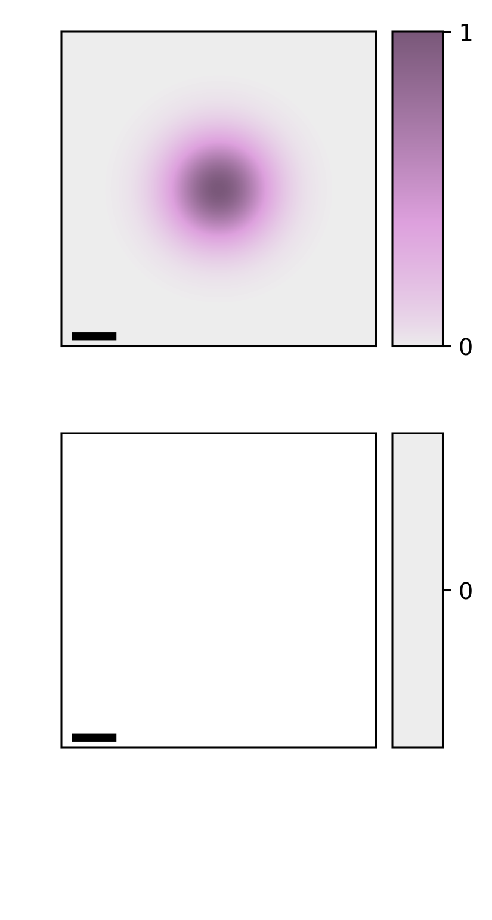


$${\left|\sum_{Q}^{ }{{\tilde{M}}_{S,Q}^{\hat{x}+i\hat{y}, 0,0}e^{iQ⋅R_{c}}}\right|}^{2}$$
$${\left|{\tilde{M}}_{S,Q}^{\hat{x}+i\hat{y},0}\right|}^{2}$$
$$S=K$$
No
Excitation
$$S=K′$$
No
Excitation

Slide 5
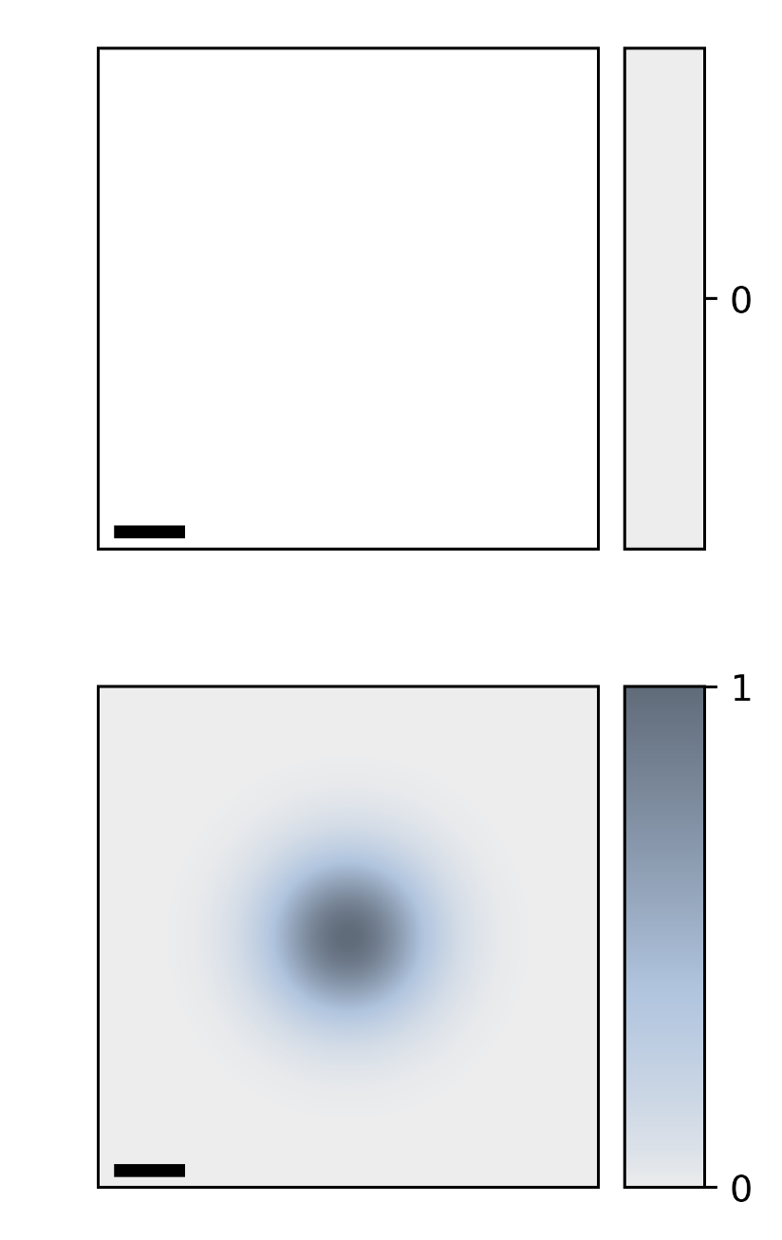
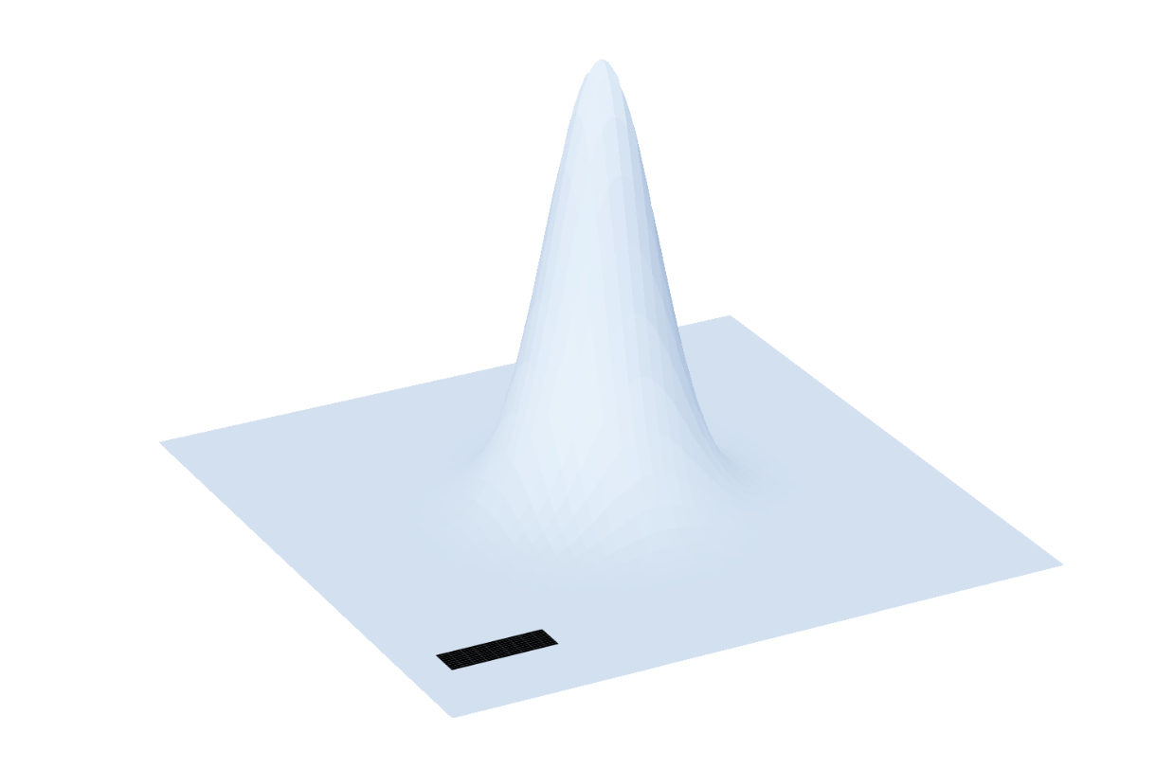


$${\left|\sum_{Q}^{ }{{\tilde{M}}_{S,Q}^{\hat{x}−i\hat{y}, 0,0}e^{iQ⋅R_{c}}}\right|}^{2}$$
$${\left|{\tilde{M}}_{S,Q}^{\hat{x}−i\hat{y},0}\right|}^{2}$$
No
Excitation
No
Excitation
$$S=K$$
$$S=K′$$

Slide 6

$$Q_{y}$$
$${\left|{\tilde{F}}_{±1,0}\left(Q\right)e^{iℓφ_{Q}}\right|}^{2}$$
$$Q_{x}$$
$${0.1Q}_{c}$$

Slide 7






$${\left|\sum_{Q}^{ }{{\tilde{M}}_{S,Q}^{\hat{x}, 1}e^{iQ⋅R_{c}}}\right|}^{2}$$
$${\left|{\tilde{M}}_{S,Q}^{\hat{x},1}\right|}^{2}$$
$$Q_{y}$$
$$Q_{x}$$
$$S=K$$
$$y$$
$$W_{0}$$
$${0.1Q}_{c}$$
$$x$$
$$S=K′$$

Slide 8
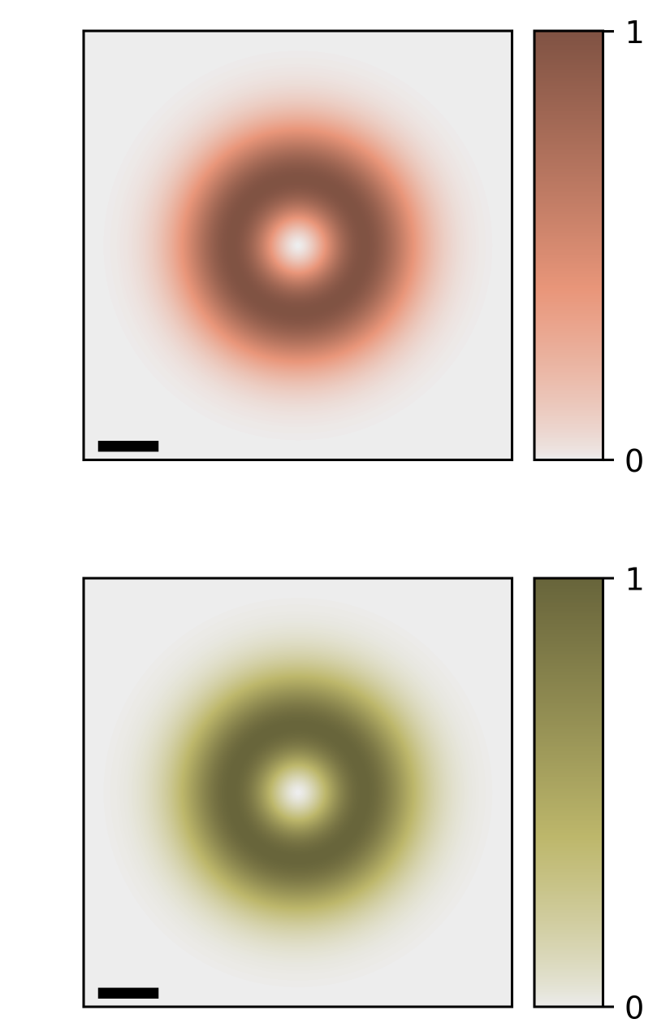


$${\left|\sum_{Q}^{ }{{\tilde{M}}_{S,Q}^{\hat{y}, 1}e^{iQ⋅R_{c}}}\right|}^{2}$$
$${\left|{\tilde{M}}_{S,Q}^{\hat{y},1}\right|}^{2}$$
$$S=K$$
$$S=K′$$

Slide 9
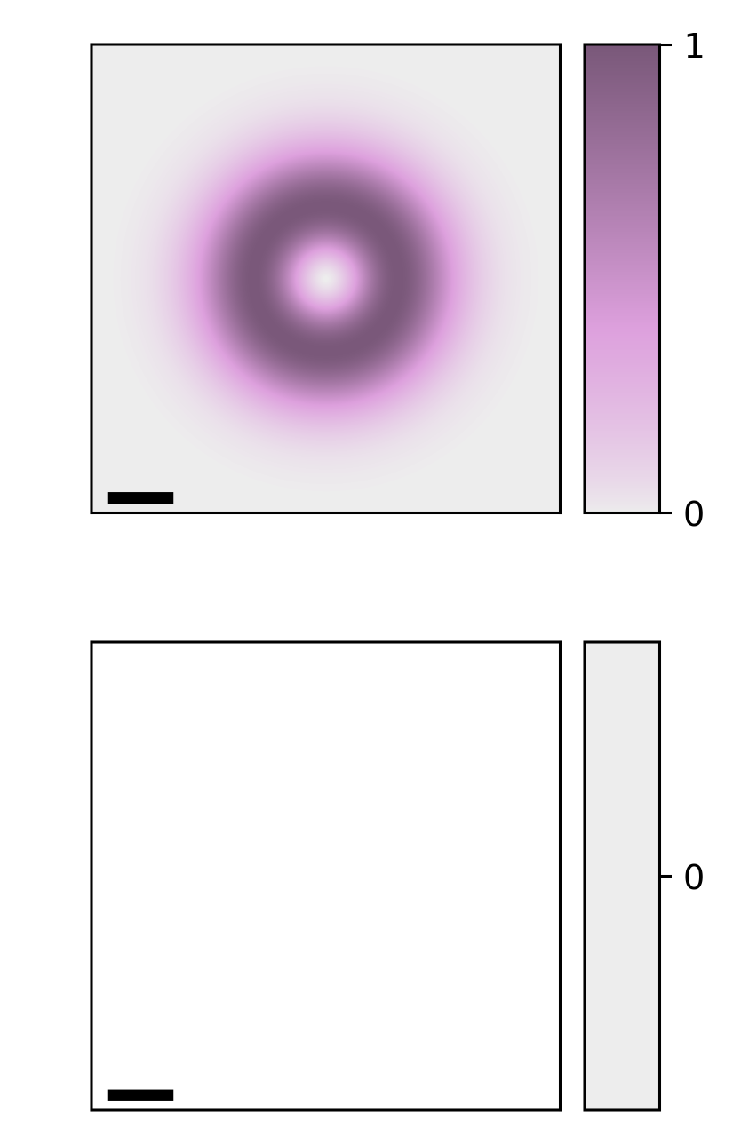


$${\left|\sum_{Q}^{ }{{\tilde{M}}_{S,Q}^{\hat{x}+i\hat{y}, 1}e^{iQ⋅R_{c}}}\right|}^{2}$$
$${\left|{\tilde{M}}_{S,Q}^{\hat{x}+i\hat{y},1}\right|}^{2}$$
$$S=K$$
No
Excitation
$$S=K′$$
No
Excitation

Slide 10
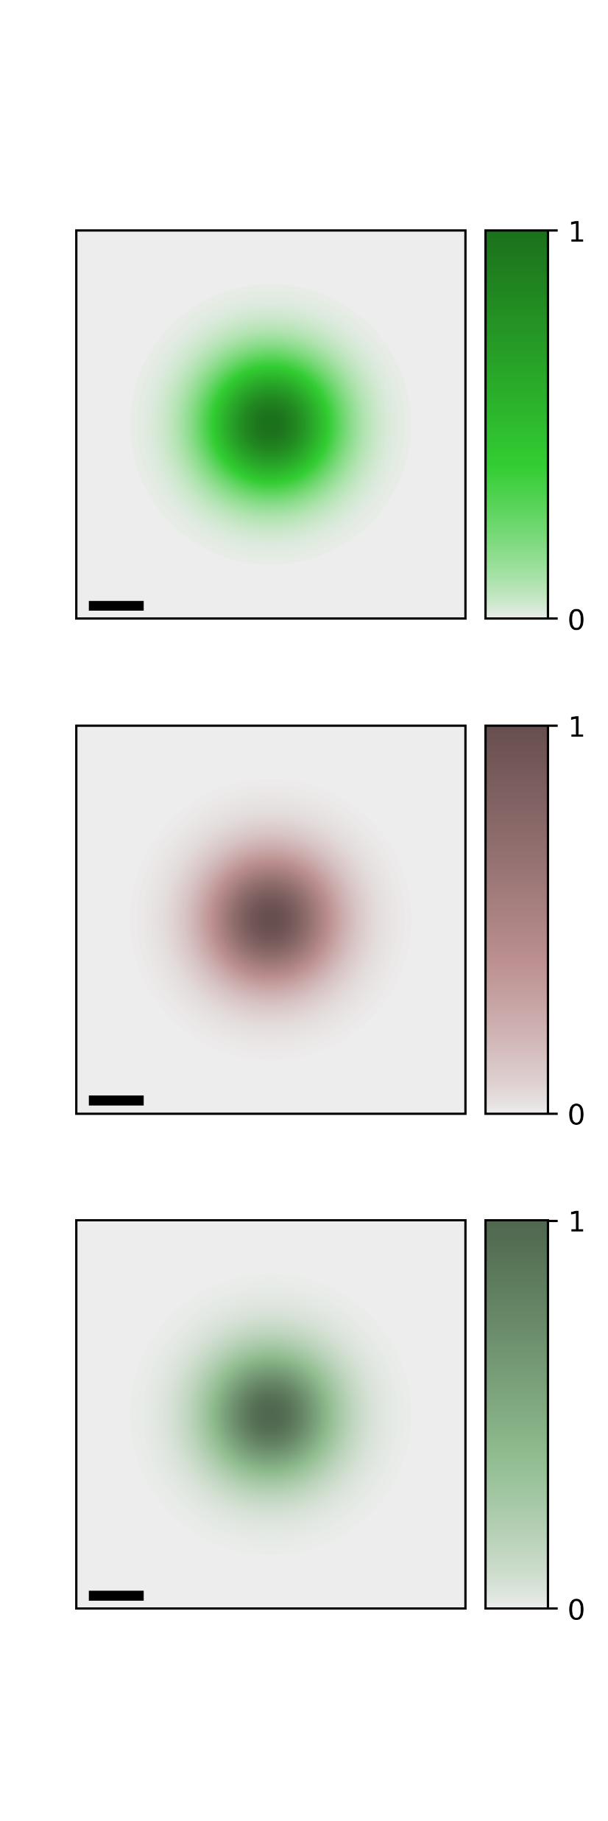
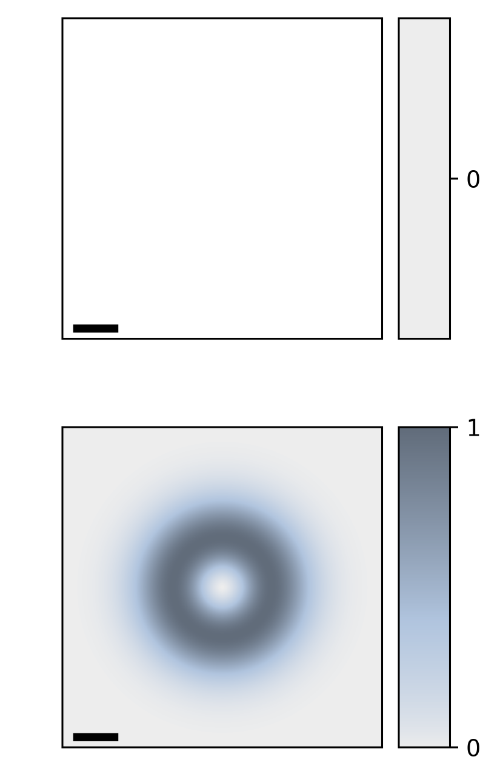


$${\left|\sum_{Q}^{ }{{\tilde{M}}_{S,Q}^{\hat{x}−i\hat{y}, 1}e^{iQ⋅R_{c}}}\right|}^{2}$$
$${\left|{\tilde{M}}_{S,Q}^{\hat{x}−i\hat{y},1}\right|}^{2}$$
No
Excitation
No
Excitation
$$S=K$$
$$S=K′$$

