Slide 1
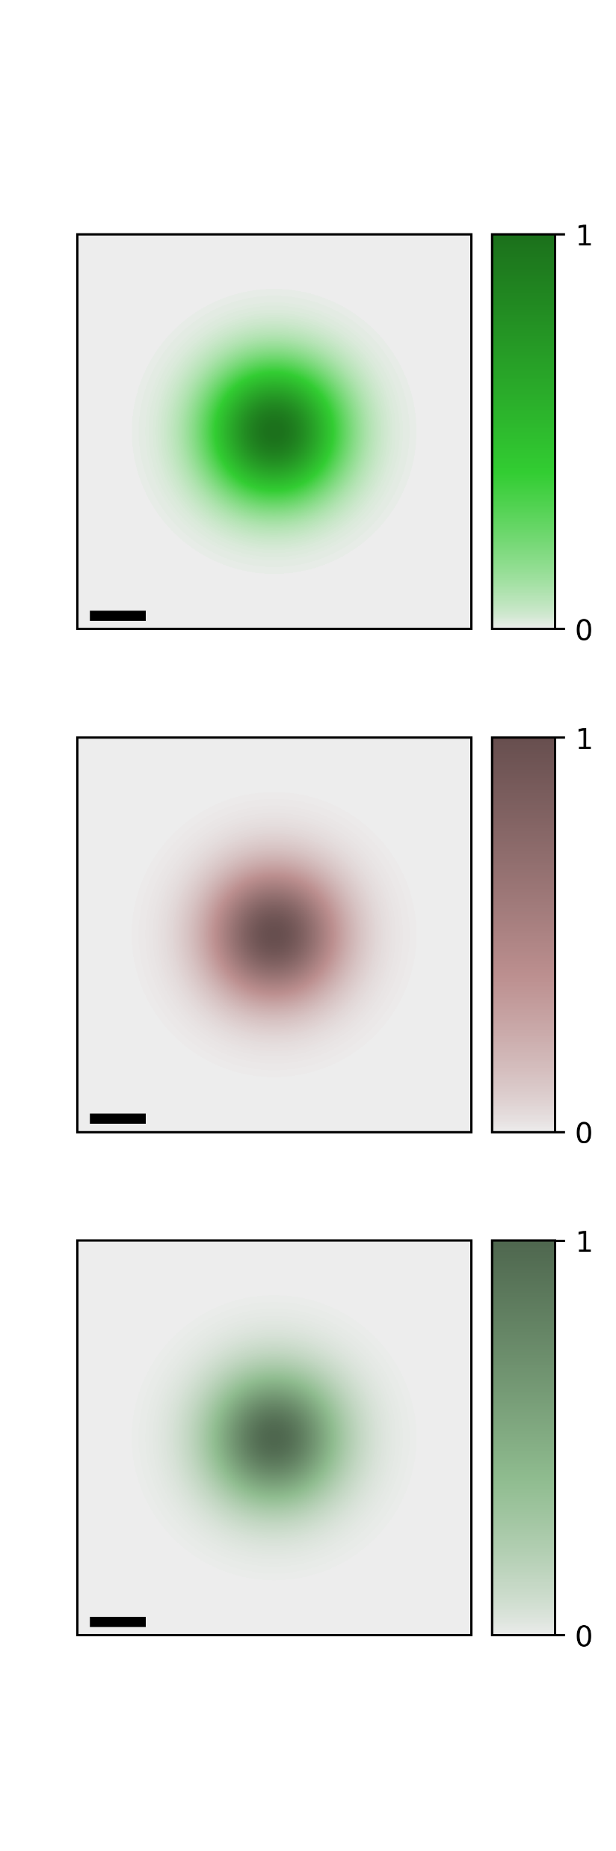




$$Q_{y}$$
$${\left|{\tilde{F}}_{0,0}\left(Q\right)e^{iℓφ_{Q}}\right|}^{2}$$
$$Q_{x}$$
$${0.1Q}_{c}$$

Slide 2
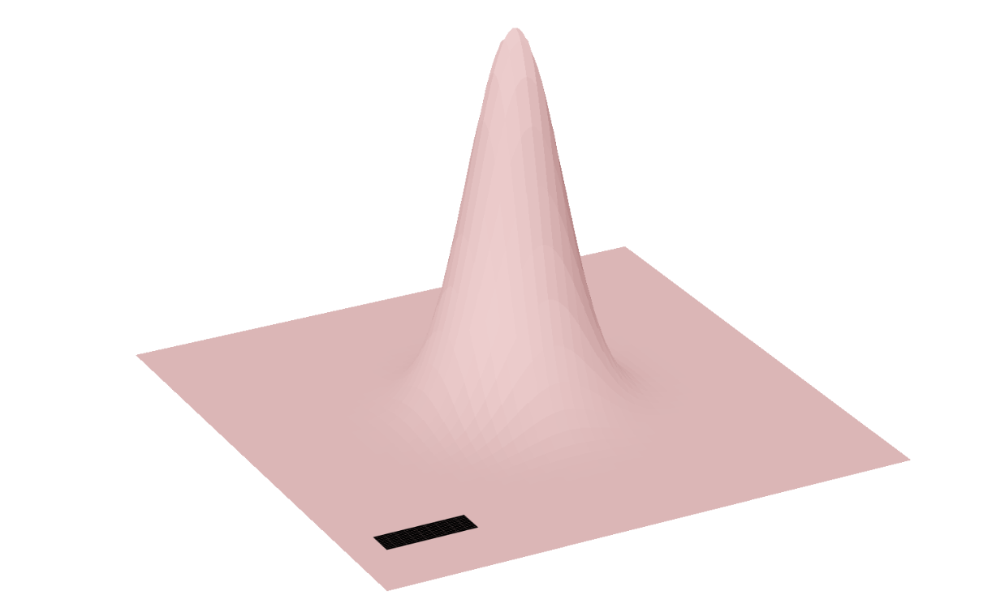







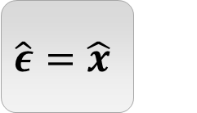




$$\hat{ε}=\hat{x}$$
$${\left|{\tilde{M}}_{S,Q}^{\hat{x},0}\right|}^{2}$$
$${\left|f_{S}^{\hat{x},0}\left(R_{c}, r=0\right)\right|}^{2}$$
$$Q_{y}$$
$$S=K$$
$$Q_{x}$$
$${0.1Q}_{c}$$
$$y$$
$$W_{0}$$
$$x$$
$$S=K′$$

Slide 3
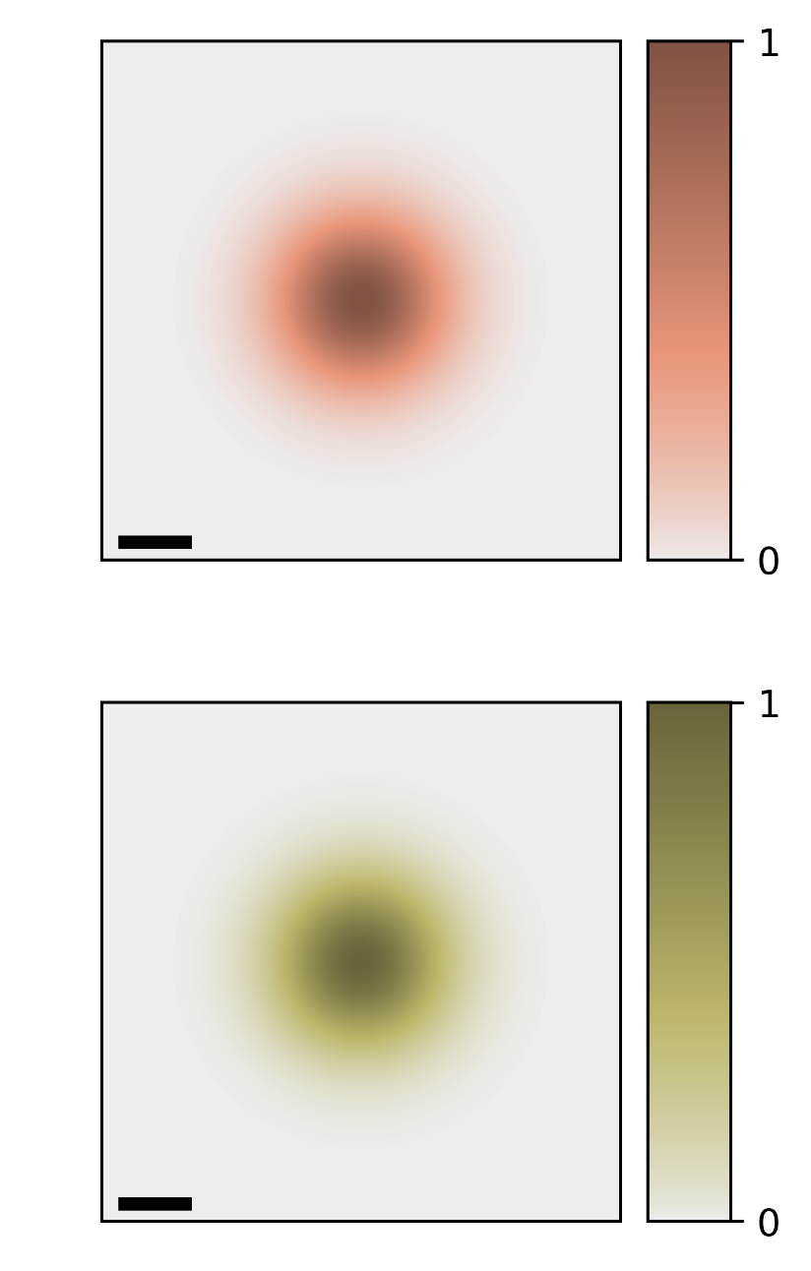
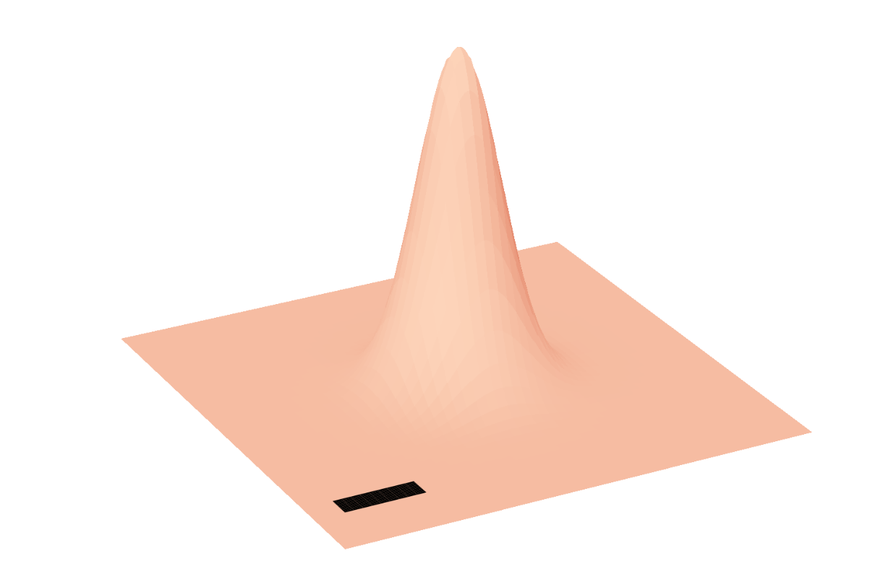

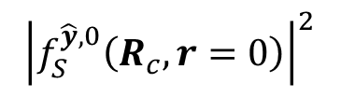


$$\hat{ε}=\hat{y}$$
$${\left|{\tilde{M}}_{S,Q}^{\hat{y},0}\right|}^{2}$$
$${\left|f_{S}^{\hat{y},0}\left(R_{c}, r=0\right)\right|}^{2}$$
$$S=K$$
$$S=K′$$

Slide 4
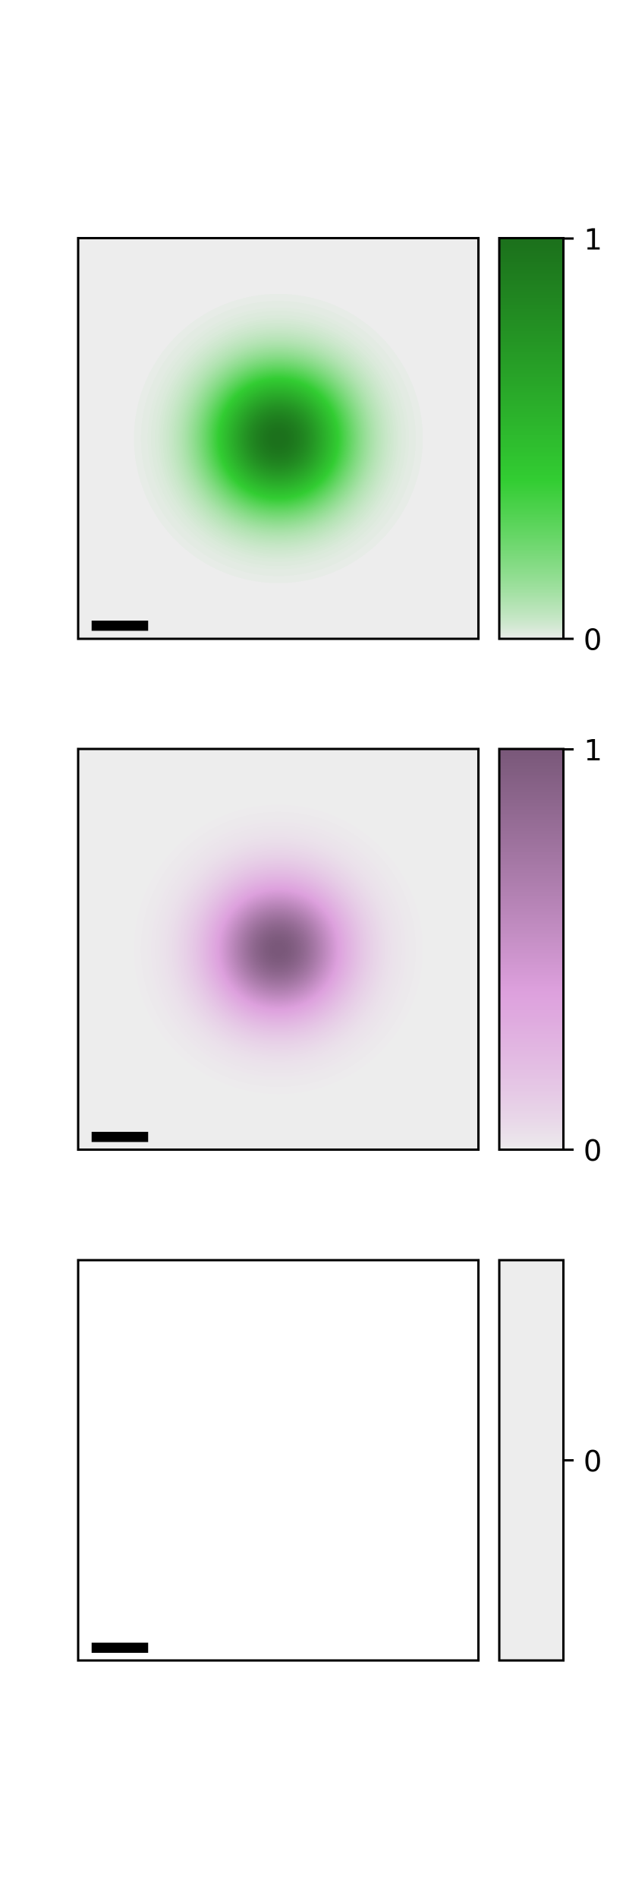
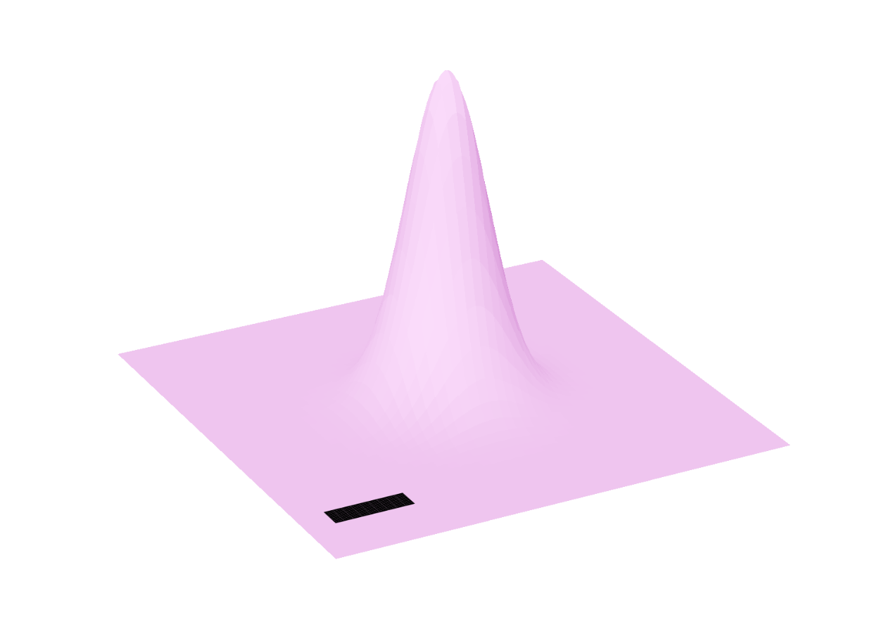
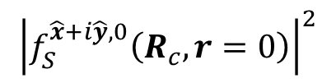

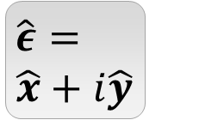
$$\hat{ε}=$$
$$\hat{x}+i\hat{y}$$
$${\left|{\tilde{M}}_{S,Q}^{\hat{x}+i\hat{y},0}\right|}^{2}$$
$${\left|f_{S}^{\hat{x}+i\hat{y},0}\left(R_{c}, r=0\right)\right|}^{2}$$
$$S=K$$
No
Excitation
No
Excitation
$$S=K′$$

Slide 5
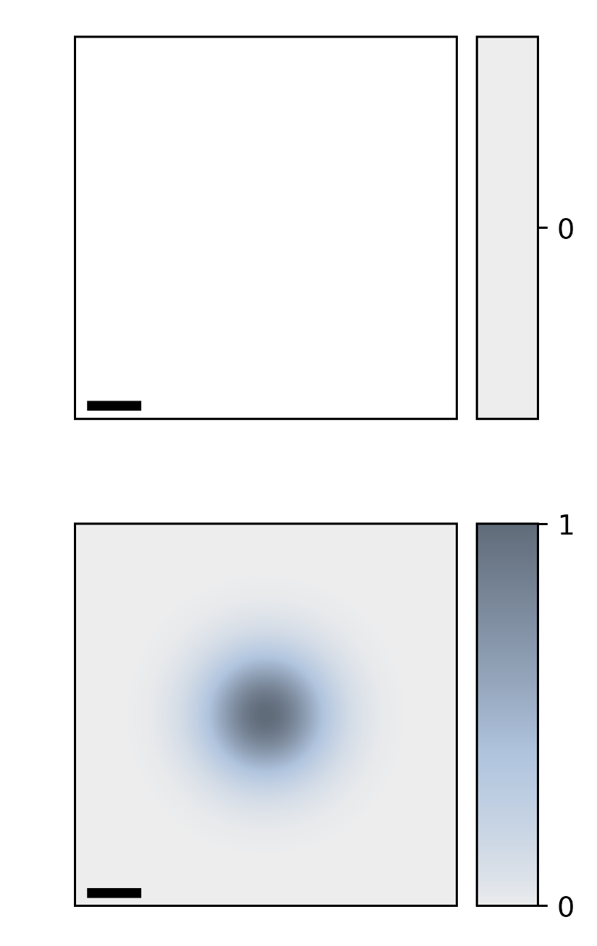
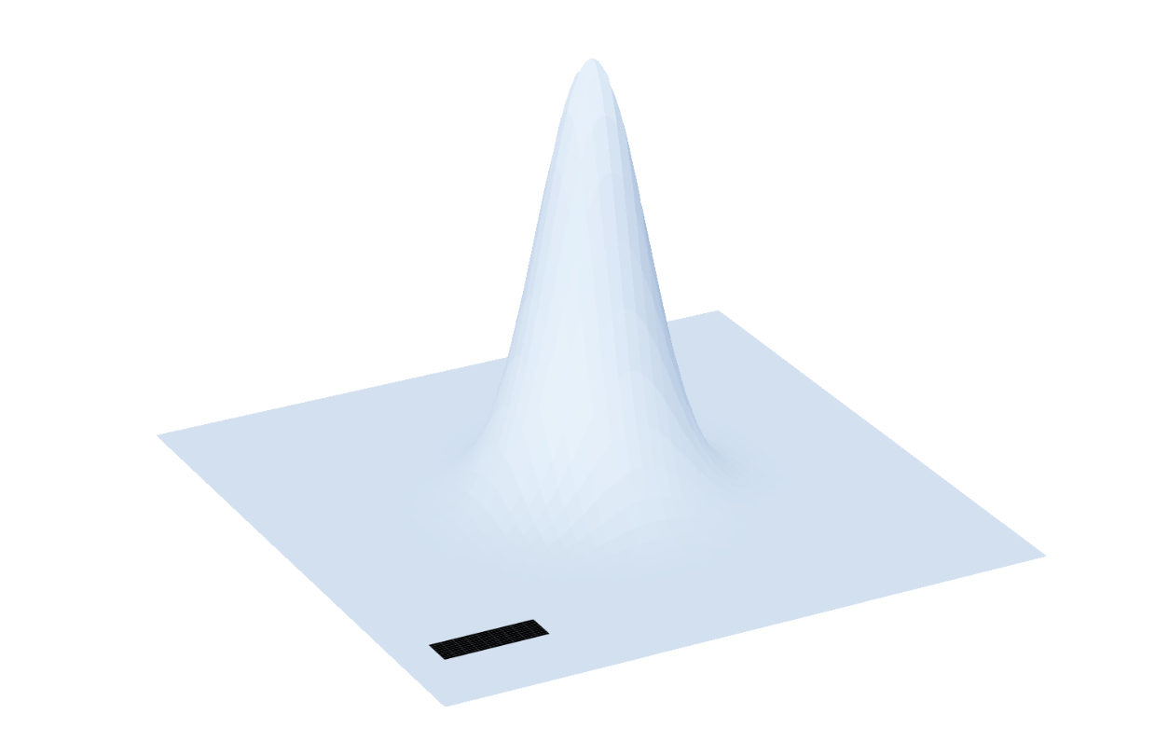



$$\hat{ε}=$$
$$\hat{x}−i\hat{y}$$
$${\left|{\tilde{M}}_{S,Q}^{\hat{ε},0}\right|}^{2}$$
$${\left|f_{S}^{\hat{ε},0}\left(R_{c}, r=0\right)\right|}^{2}$$
No
Excitation
No
Excitation
$$S=K$$
$$S=K′$$

Slide 6




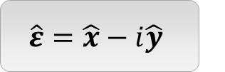








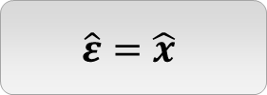



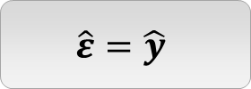






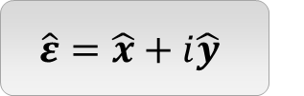

$$\hat{ε}=\hat{x}$$
$$\hat{ε}=\hat{y}$$
$${\left|{\tilde{M}}_{S,Q}^{\hat{ε},0}\right|}^{2}$$
$${\left|f_{S}^{\hat{ε},0}\left(R_{c}, r=0\right)\right|}^{2}$$
$${\left|{\tilde{M}}_{S,Q}^{\hat{ε},0}\right|}^{2}$$
$${\left|f_{S}^{\hat{ε},0}\left(R_{c}, r=0\right)\right|}^{2}$$
$$Q_{y}$$
$$S=K$$
$$Q_{x}$$
$$S=K$$
$${0.1Q}_{c}$$
$$y$$
$$W_{0}$$
$$x$$
$$S=K′$$
$$S=K′$$
$$\hat{ε}=\hat{x}+i\hat{y}$$
$$\hat{ε}=\hat{x}−i\hat{y}$$
$${\left|{\tilde{M}}_{S,Q}^{\hat{ε},0}\right|}^{2}$$
$${\left|f_{S}^{\hat{ε},0}\left(R_{c}, r=0\right)\right|}^{2}$$
$${\left|{\tilde{M}}_{S,Q}^{\hat{ε},0}\right|}^{2}$$
$${\left|f_{S}^{\hat{ε},0}\left(R_{c}, r=0\right)\right|}^{2}$$
No
Excitation
No
Excitation
$$S=K$$
$$S=K$$
$$S=K′$$
No
Excitation
No
Excitation
$$S=K′$$

Slide 7
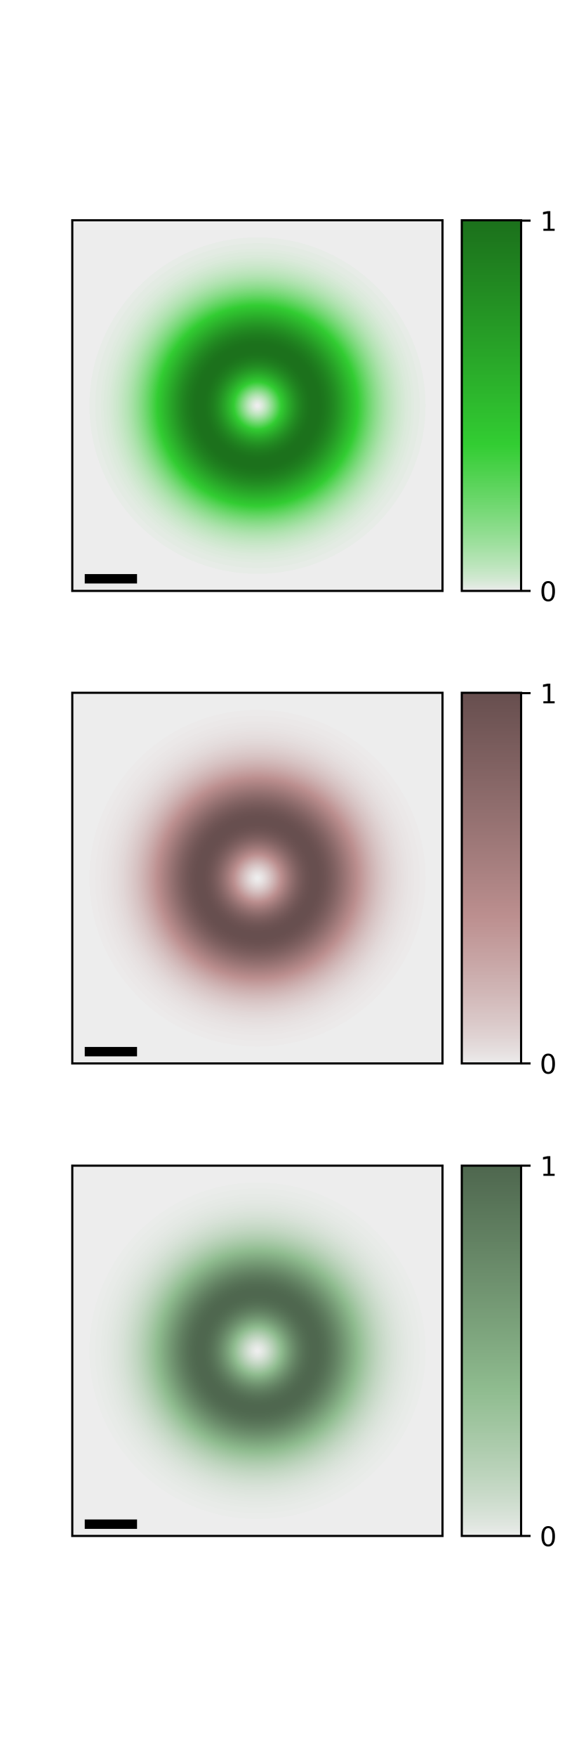




$$Q_{y}$$
$${\left|{\tilde{F}}_{1,0}\left(Q\right)e^{iℓφ_{Q}}\right|}^{2}$$
$$Q_{x}$$
$${0.1Q}_{c}$$

Slide 8
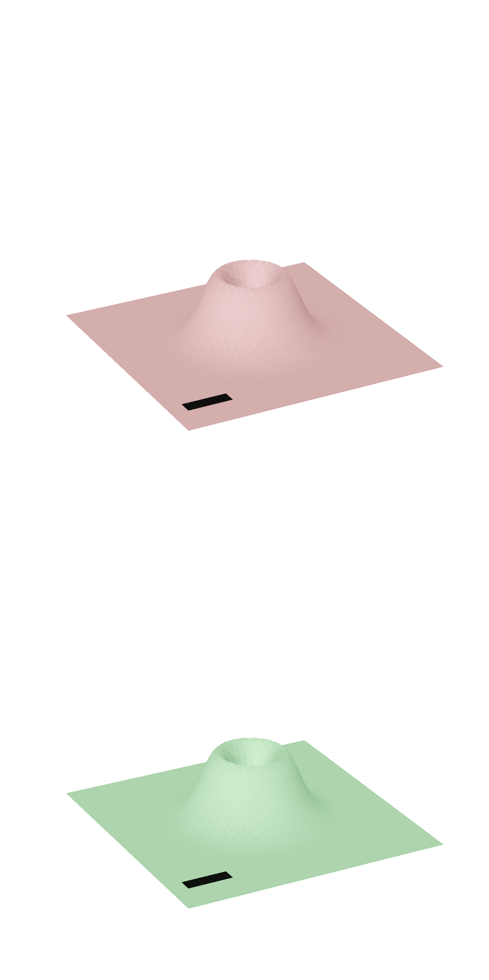








$${\left|{\tilde{M}}_{S,Q}^{\hat{x},1}\right|}^{2}$$
$${\left|\sum_{Q}^{ }{{\tilde{M}}_{S,Q}^{\hat{x}, 1}e^{iQ⋅R_{c}}}\right|}^{2}$$
$$Q_{y}$$
$$S=K$$
$$Q_{x}$$
$${0.1Q}_{c}$$
$$y$$
$$W_{0}$$
$$x$$
$$S=K′$$

Slide 9
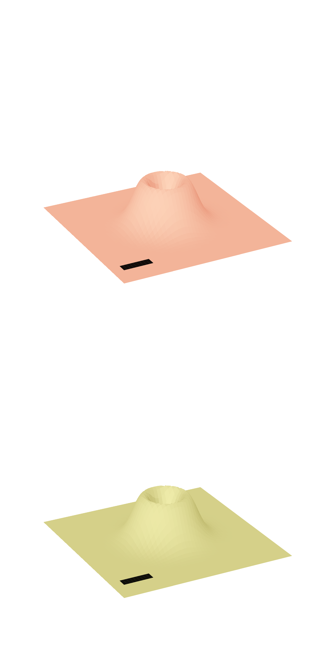
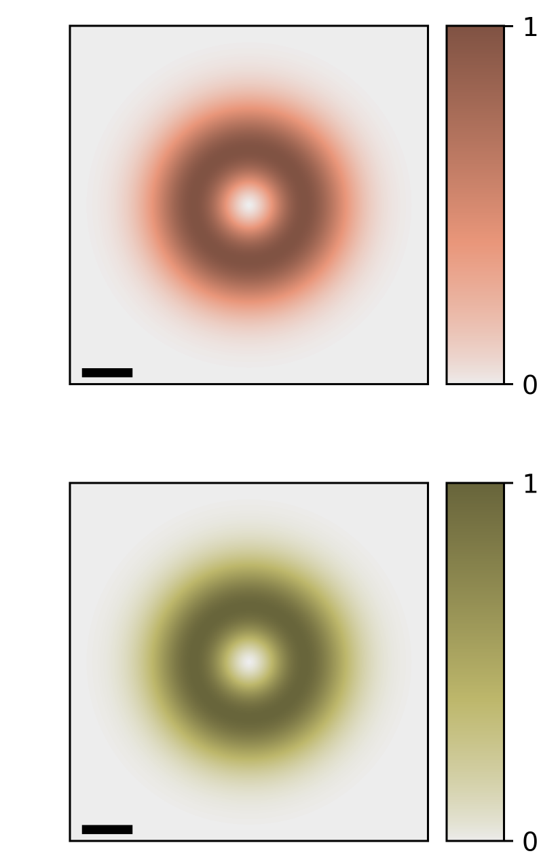


$${\left|{\tilde{M}}_{S,Q}^{\hat{y},1}\right|}^{2}$$
$${\left|\sum_{Q}^{ }{{\tilde{M}}_{S,Q}^{\hat{y}, 1}e^{iQ⋅R_{c}}}\right|}^{2}$$
$$S=K$$
$$S=K′$$

Slide 10
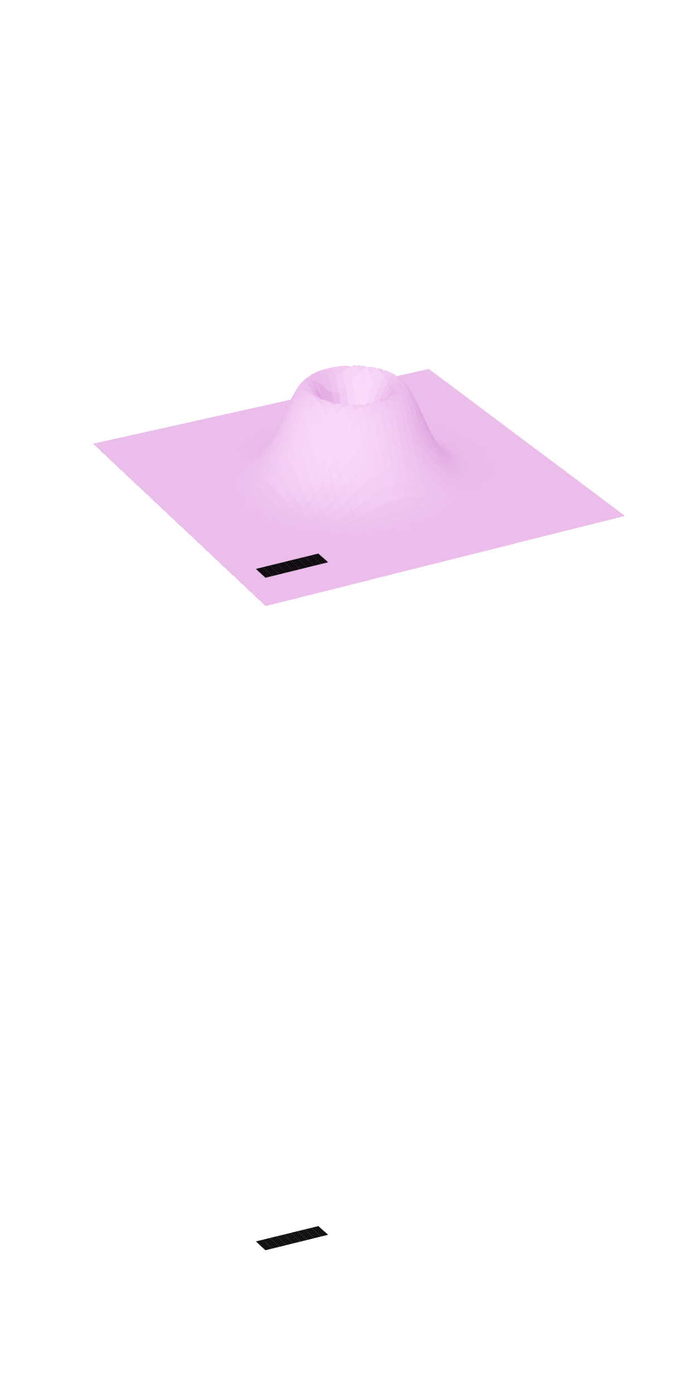
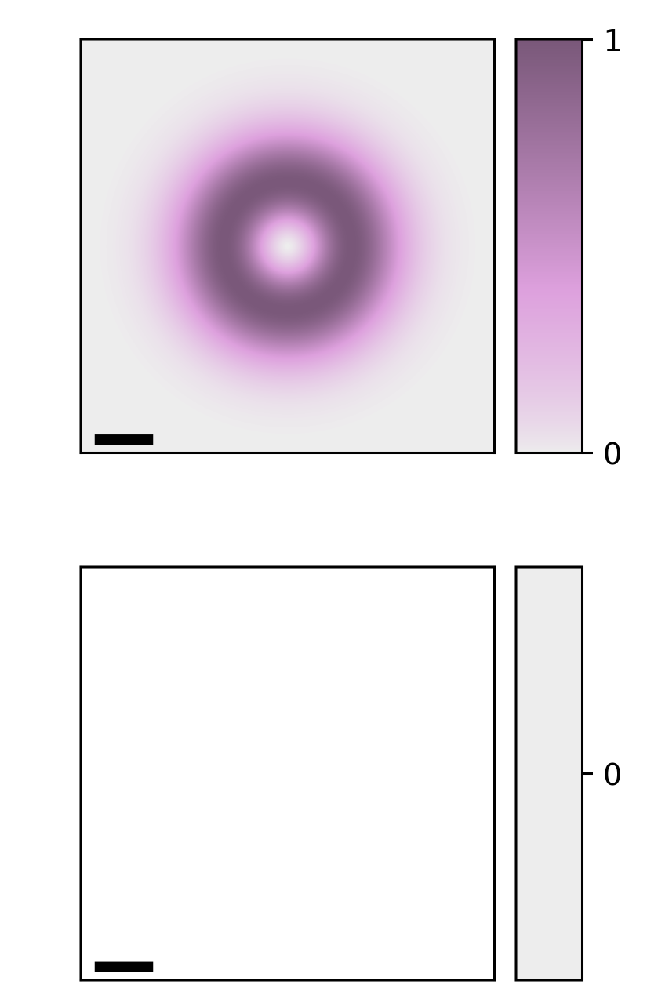


$${\left|{\tilde{M}}_{S,Q}^{\hat{x}+i\hat{y},1}\right|}^{2}$$
$${\left|\sum_{Q}^{ }{{\tilde{M}}_{S,Q}^{\hat{x}+i\hat{y}, 1}e^{iQ⋅R_{c}}}\right|}^{2}$$
$$S=K$$
No
Excitation
No
Excitation
$$S=K′$$

Slide 11
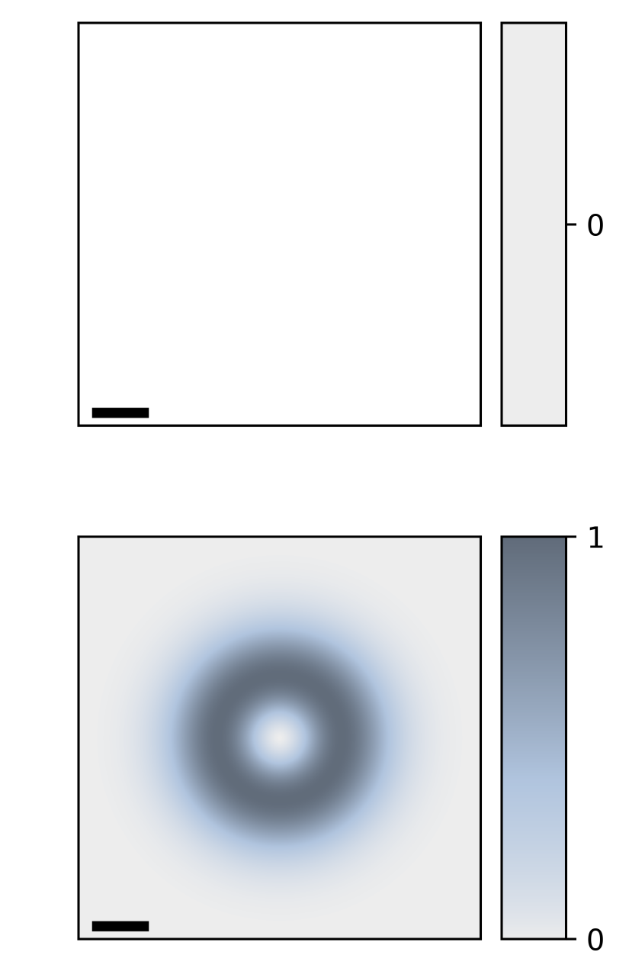
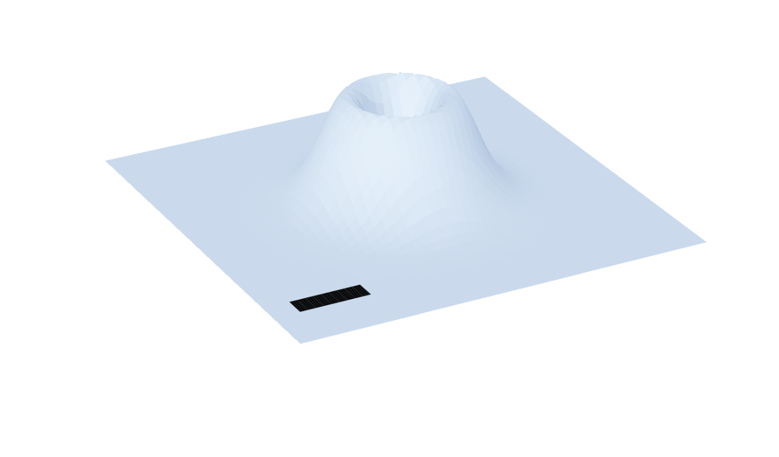


$${\left|{\tilde{M}}_{S,Q}^{\hat{x}−i\hat{y},1}\right|}^{2}$$
$${\left|\sum_{Q}^{ }{{\tilde{M}}_{S,Q}^{\hat{x}−i\hat{y}, 1}e^{iQ⋅R_{c}}}\right|}^{2}$$
No
Excitation
No
Excitation
$$S=K$$
$$S=K′$$

Slide 12





$$\hat{ε}=\hat{x}$$
$$\hat{ε}=\hat{y}$$
$${\left|{\tilde{M}}_{S,Q}^{\hat{ε},±1}\right|}^{2}$$
$${\left|f_{S}^{\hat{ε},±1}\left(R_{c}, r=0\right)\right|}^{2}$$
$${\left|{\tilde{M}}_{S,Q}^{\hat{ε},0}\right|}^{2}$$
$${\left|f_{S}^{\hat{ε},±1}\left(R_{c}, r=0\right)\right|}^{2}$$
$$Q_{y}$$
$$S=K$$
$$Q_{x}$$
$$S=K$$
$${0.1Q}_{c}$$
$$y$$
$$W_{0}$$
$$x$$
$$S=K′$$
$$S=K′$$
$$\hat{ε}=\hat{x}+i\hat{y}$$
$$\hat{ε}=\hat{x}−i\hat{y}$$
$${\left|{\tilde{M}}_{S,Q}^{\hat{ε},0}\right|}^{2}$$
$${\left|f_{S}^{\hat{ε},±1}\left(R_{c}, r=0\right)\right|}^{2}$$
$${\left|{\tilde{M}}_{S,Q}^{\hat{ε},0}\right|}^{2}$$
$${\left|f_{S}^{\hat{ε},±1}\left(R_{c}, r=0\right)\right|}^{2}$$
No
Excitation
No
Excitation
$$S=K$$
$$S=K$$
$$S=K′$$
No
Excitation
No
Excitation
$$S=K′$$

Slide 13
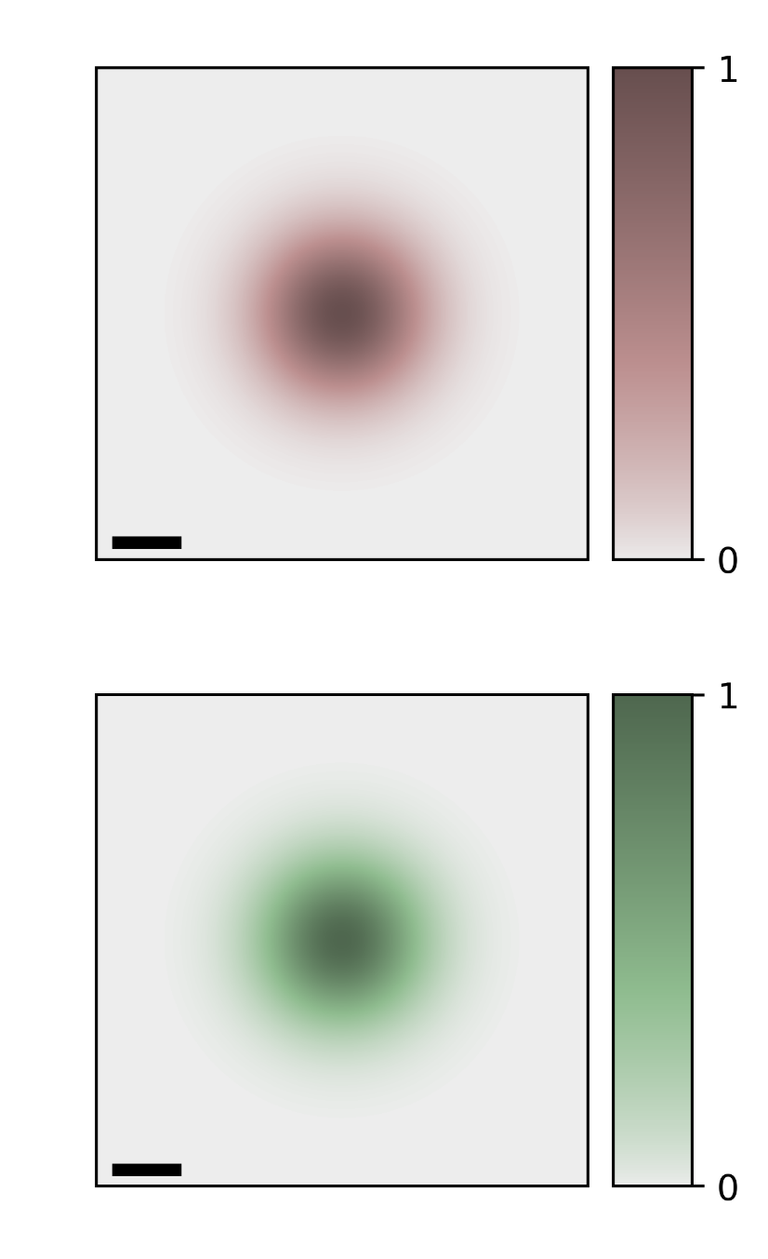
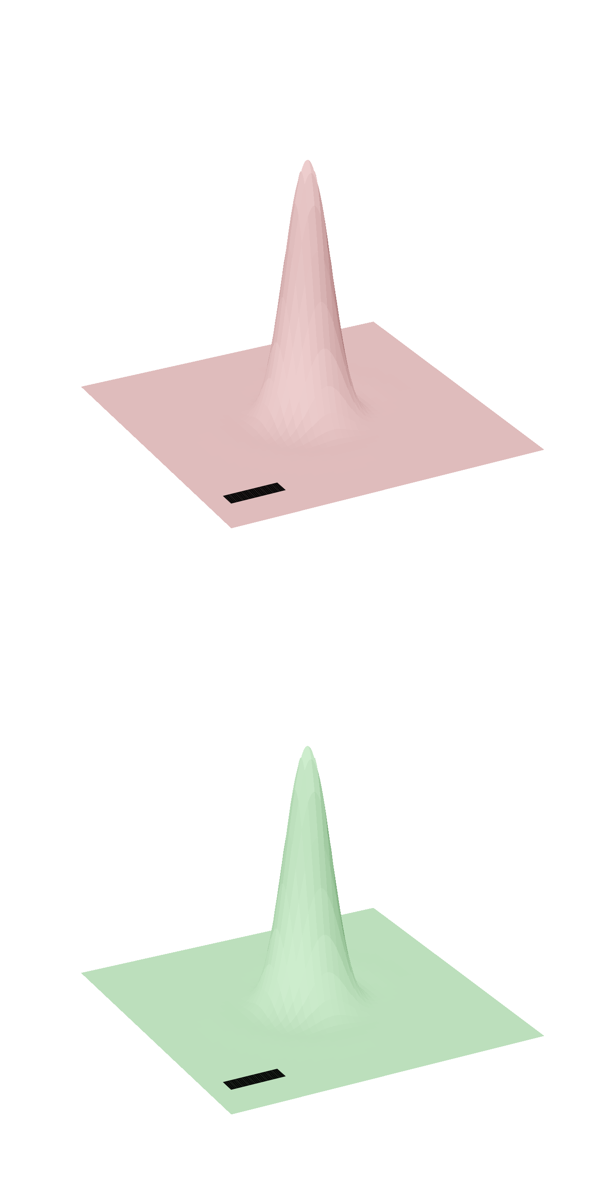


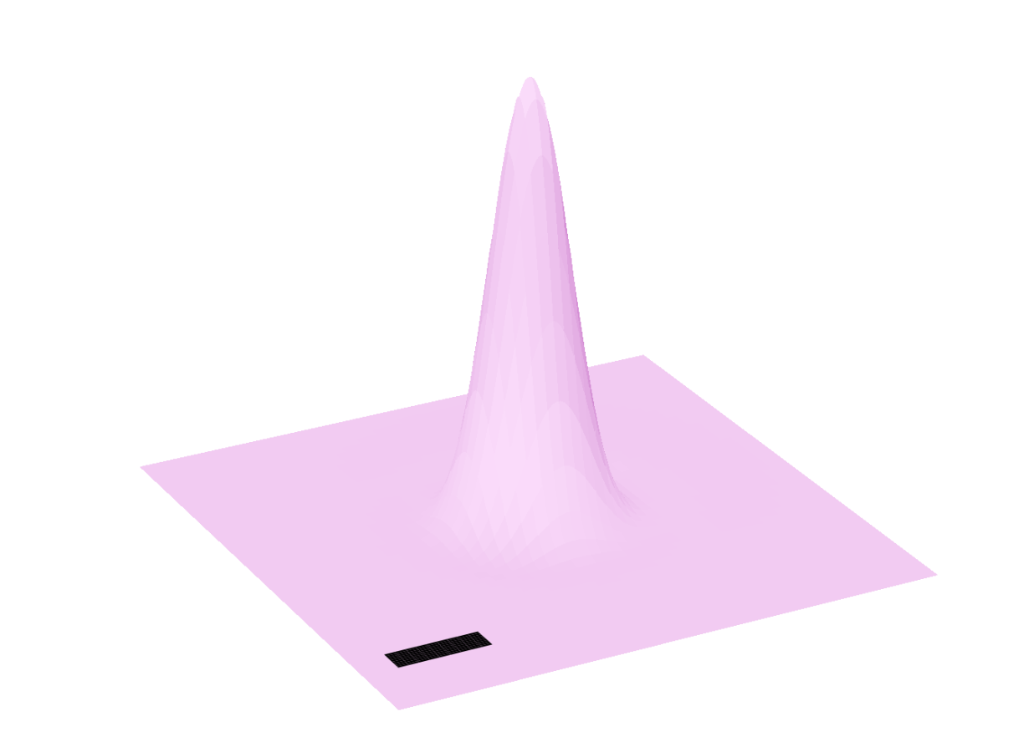





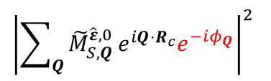














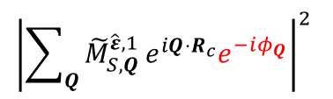
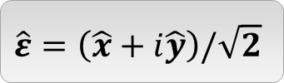

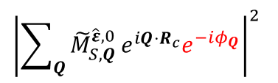







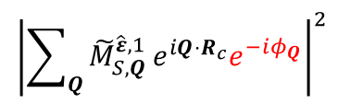
$$Q_{y}$$
$$Q_{y}$$
$${\left|{\tilde{F}}_{0,0}\left(Q\right)e^{iℓφ_{Q}}\right|}^{2}$$
$$Q_{x}$$
$${\left|{\tilde{F}}_{1,0}\left(Q\right)e^{iℓφ_{Q}}\right|}^{2}$$
$$Q_{x}$$
$${0.1Q}_{c}$$
$${0.1Q}_{c}$$
$$\hat{ε}=\hat{x}$$
$${\left|{\tilde{M}}_{S,Q}^{\hat{ε},0}e^{−iφ_{Q}}\right|}^{2}$$
$${\left|\sum_{Q}{{\tilde{M}}_{S,Q}^{\hat{ε},0}}e^{iQ⋅R_{c}}e^{−iφ_{Q}}\right|}^{2}$$
$${\left|{\tilde{M}}_{S,Q}^{\hat{ε},1}e^{−iφ_{Q}}\right|}^{2}$$
$${\left|\sum_{Q}{{\tilde{M}}_{S,Q}^{\hat{ε},1}}e^{iQ⋅R_{c}}e^{−iφ_{Q}}\right|}^{2}$$
$$Q_{y}$$
$$Q_{y}$$
$$Q_{x}$$
$$S=K$$
$$Q_{x}$$
$$S=K$$
$${0.1Q}_{c}$$
$$y$$
$$W_{0}$$
$${0.1Q}_{c}$$
$$x$$
$$S=K′$$
$$S=K′$$
$$\hat{ε}=\left(\hat{x}+i\hat{y}\right)/\sqrt{2}$$
$${\left|{\tilde{M}}_{S,Q}^{\hat{ε},0}e^{−iφ_{Q}}\right|}^{2}$$
$${\left|\sum_{Q}{{\tilde{M}}_{S,Q}^{\hat{ε},0}}e^{iQ⋅R_{c}}e^{−iφ_{Q}}\right|}^{2}$$
$${\left|{\tilde{M}}_{S,Q}^{\hat{ε},1}e^{−iφ_{Q}}\right|}^{2}$$
$${\left|\sum_{Q}{{\tilde{M}}_{S,Q}^{\hat{ε},1}}e^{iQ⋅R_{c}}e^{−iφ_{Q}}\right|}^{2}$$
$$S=K$$
$$S=K$$
$$S=K′$$
No
Excitation
No
Excitation
$$S=K′$$
No
Excitation
No
Excitation

