Slide 1
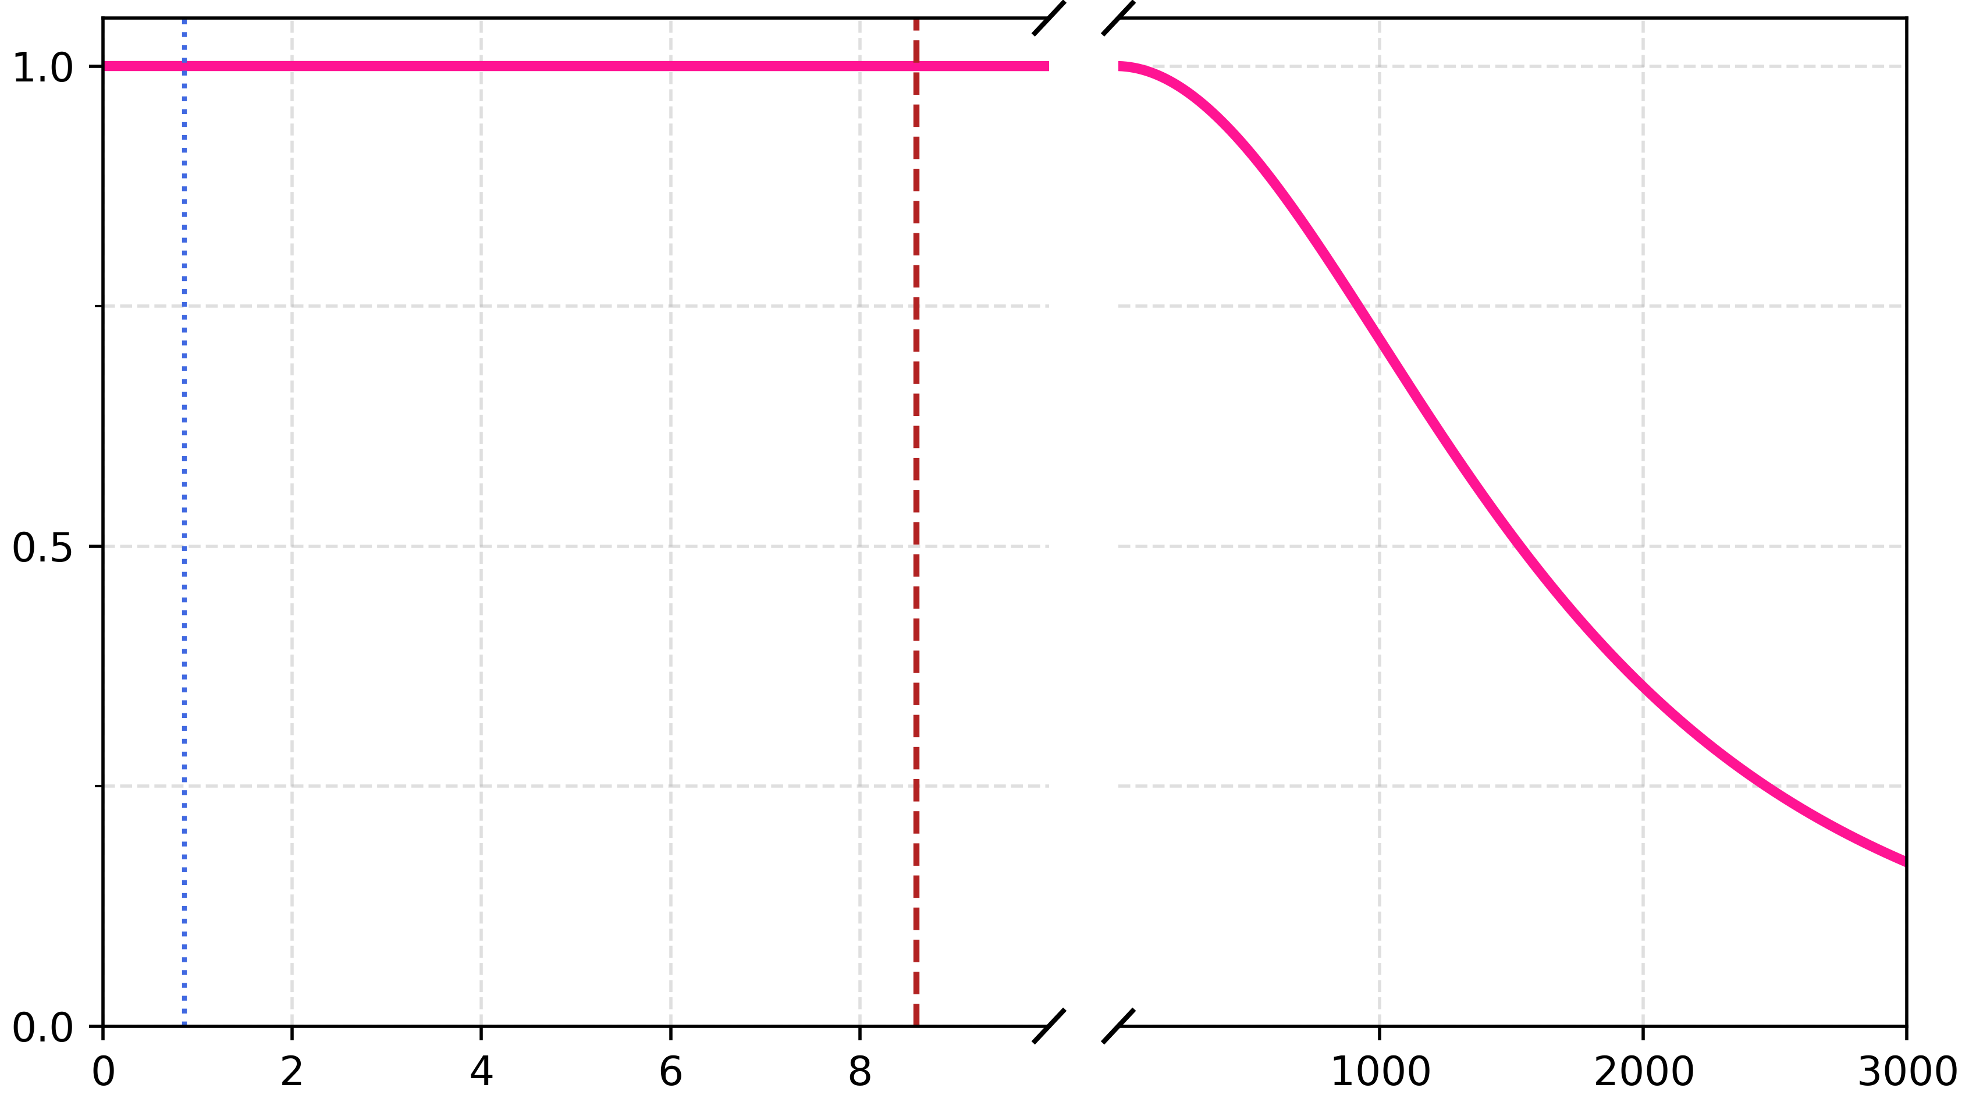
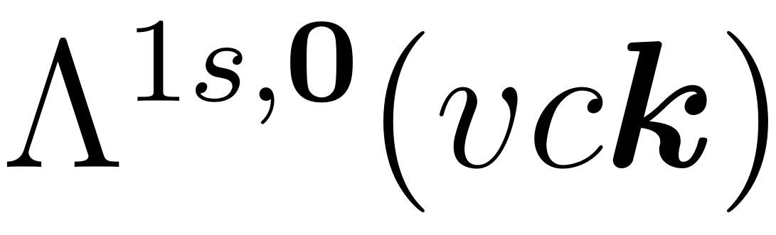




(unit : a.u.)
Normalized
$$0.1Q_{c}$$
$$Q_{c}$$
$$\left|k\right|$$
(unit : $1/1000a_{B}^{∗}$)

