Slide 1
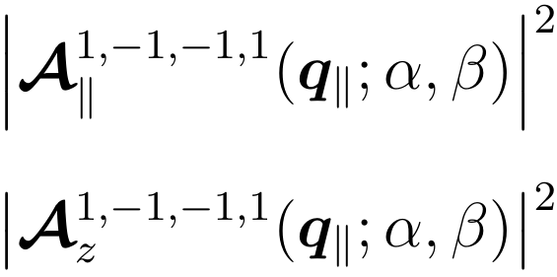
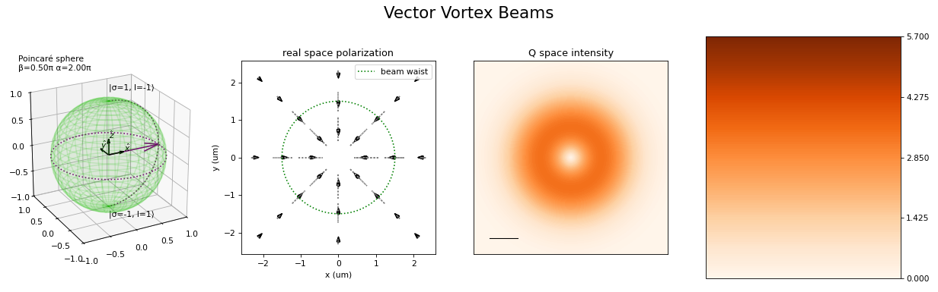
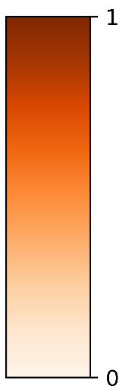
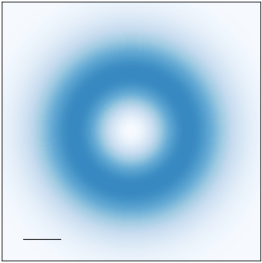
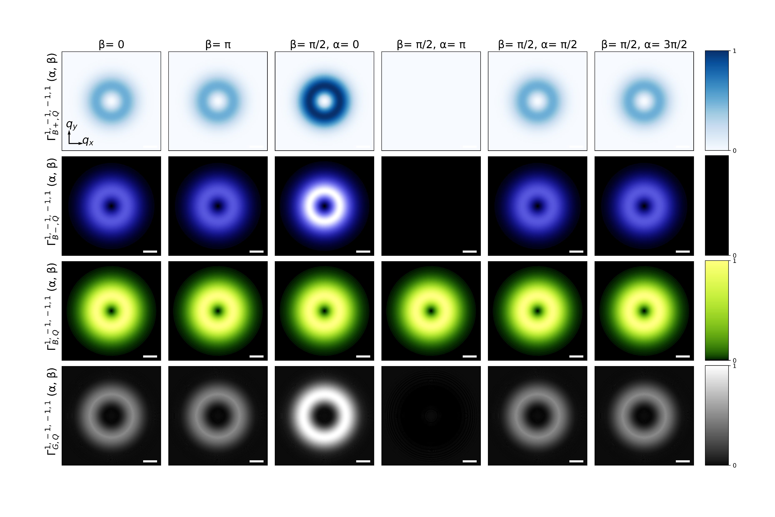
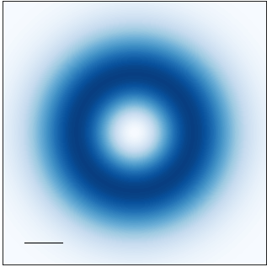
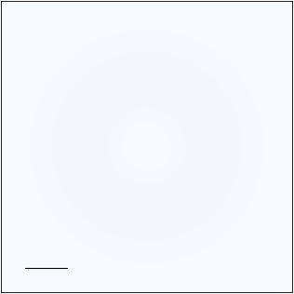

















Transverse component
Longitudinal component
$$\left(α, β\right)=\left(0, \text{0}\right)$$
$$\left(α, β\right)=\left(0, \text{0}\right)$$
$$q_{y}$$
$$q_{y}$$
$$q_{y}$$
$$q_{x}$$
$$q_{x}$$
$$q_{x}$$
$${0.1Q}_{c}$$
$${0.1Q}_{c}$$
$$a.u.$$
$$a.u.$$
$$|\left.1, −1\right\rangle$$
$$|\left.1, −1\right\rangle$$
$$z$$
$$z$$
$$\left(0, π/2\right)$$
$$β$$
$$\left(π,π/2\right)$$
$$\left(0, π/2\right)$$
$$β$$
$$\left(π,π/2\right)$$
$$x$$
$$α$$
$$y$$
$$x$$
$$y$$
$$α$$
$$|\left.−1, 1\right\rangle$$
$$|\left.−1, 1\right\rangle$$
$$\left(0, π\right)$$
$$\left(0,π\right)$$

Slide 2





























Transverse component
Longitudinal component
$$\left(α, β\right)=\left(0, \text{0}\right)$$
$$\left(α, β\right)=\left(0, \text{0}\right)$$
$$q_{y}$$
$$q_{y}$$
$$q_{x}$$
$$q_{x}$$
$${0.1Q}_{c}$$
$${0.1Q}_{c}$$
$$a.u.$$
$$a.u.$$
$$|\left.1, 0\right\rangle$$
$$|\left.1, 0\right\rangle$$
$$z$$
$$z$$
$$\left(0, π/2\right)$$
$$\left(π,π/2\right)$$
$$\left(0, π/2\right)$$
$$\left(π,π/2\right)$$
$$β$$
$$β$$
$$x$$
$$α$$
$$y$$
$$x$$
$$y$$
$$α$$
$$|\left.−1, 0\right\rangle$$
$$|\left.−1, 0\right\rangle$$
$$\left(0,π\right)$$
$$\left(0,π\right)$$

Slide 3































Transverse component
Longitudinal component
$$\left(α, β\right)=\left(0, \text{0}\right)$$
$$\left(α, β\right)=\left(0, \text{0}\right)$$
$$q_{y}$$
$$q_{y}$$
$$q_{y}$$
$$q_{x}$$
$$q_{x}$$
$$q_{x}$$
$${0.1Q}_{c}$$
$${0.1Q}_{c}$$
$$a.u.$$
$$a.u.$$
$$|\left.1, −1\right\rangle$$
$$|\left.1, −1\right\rangle$$
$$z$$
$$z$$
$$\left(0, π/2\right)$$
$$\left(π,π/2\right)$$
$$\left(0, π/2\right)$$
$$\left(π,π/2\right)$$
$$β$$
$$β$$
$$x$$
$$α$$
$$y$$
$$x$$
$$y$$
$$α$$
$$|\left.−1, 1\right\rangle$$
$$|\left.−1, 1\right\rangle$$
$$\left(0,π\right)$$
$$\left(0,π\right)$$

Slide 4

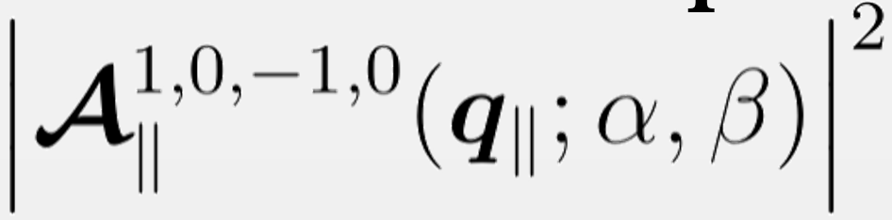

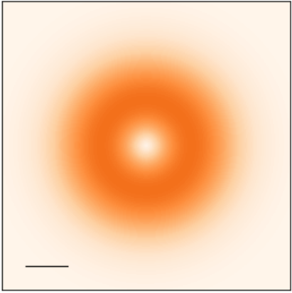
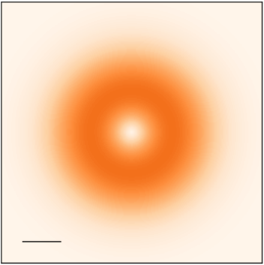















Transverse component
$$\left(α, β\right)=\left(0, \text{0}\right)$$
$$q_{y}$$
$$q_{y}$$
$$q_{x}$$
$$q_{x}$$
$${0.1Q}_{c}$$
$$a.u.$$
$$\left(3π/2,π/2\right)$$
$$|\left.1, −1\right\rangle$$
$$\left(π,π/2\right)$$
$$1, −1, −1, 1$$
$$z$$
$$β$$
$$x$$
$$α$$
$$y$$
$$\left(0, π/2\right)$$
$$\left(π/2,π/2\right)$$
$$|\left.−1, 1\right\rangle$$
$$\left(0,π\right)$$

Slide 5













Longitudinal component
$$\left(α, β\right)=\left(0, \text{0}\right)$$
$$q_{y}$$
$$q_{x}$$
$$\left(3π/2,π/2\right)$$
$${0.1Q}_{c}$$
$$\left(π,π/2\right)$$
$$a.u.$$
$$|\left.1, −1\right\rangle$$
$$z$$
$$β$$
$$x$$
$$α$$
$$y$$
$$\left(0, π/2\right)$$
$$\left(π/2,π/2\right)$$
$$|\left.−1, 1\right\rangle$$
$$\left(0,π\right)$$

Slide 6
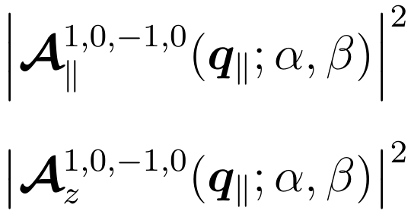
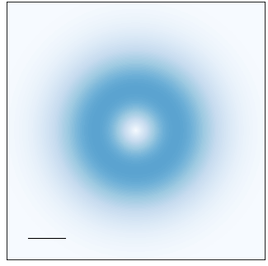
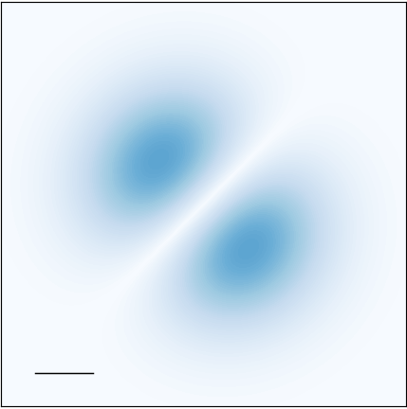
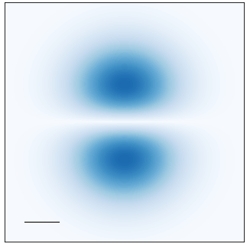
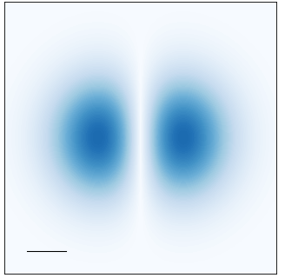
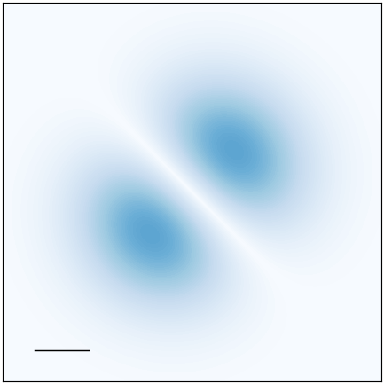


















Longitudinal component
$$\left(α, β\right)=\left(0, \text{0}\right)$$
$$q_{y}$$
$$q_{x}$$
$$\left(3π/2,π/2\right)$$
$${0.1Q}_{c}$$
$$\left(π,π/2\right)$$
$$a.u.$$
$$|\left.1, 0\right\rangle$$
$$z$$
$$β$$
$$x$$
$$α$$
$$y$$
$$\left(0, π/2\right)$$
$$\left(π/2,π/2\right)$$
$$|\left.−1, 0\right\rangle$$
$$\left(0,π\right)$$

Slide 7

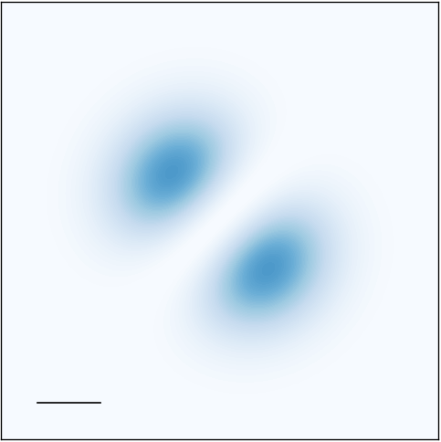
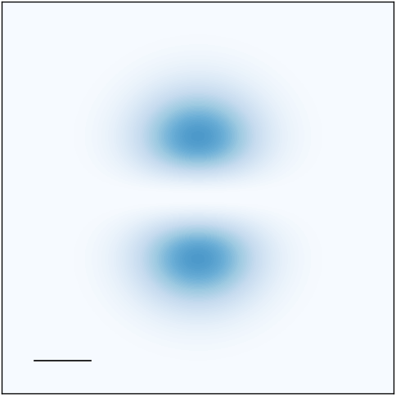

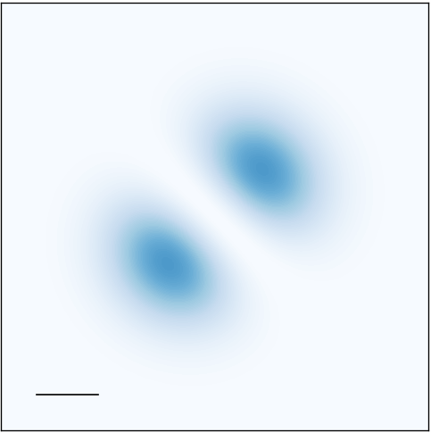

Longitudinal component
$$\left(α, β\right)=\left(0, \text{0}\right)$$
$$q_{y}$$
$$q_{x}$$
$$\left(3π/2,π/2\right)$$
$${0.1Q}_{c}$$
$$\left(π,π/2\right)$$
$$a.u.$$
$$|\left.1, 0\right\rangle$$
$$z$$
$$β$$
$$x$$
$$α$$
$$y$$
$$\left(0, π/2\right)$$
$$\left(π/2,π/2\right)$$
$$|\left.−1, 0\right\rangle$$
$$\left(0,π\right)$$

Slide 8

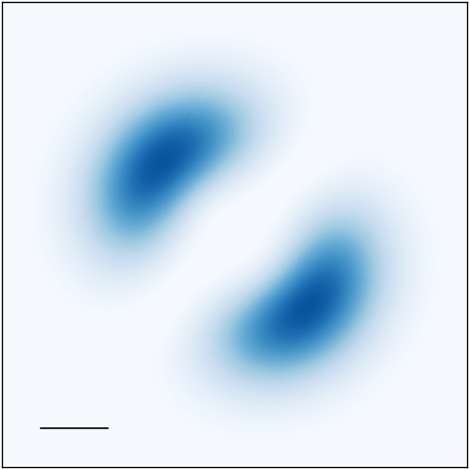
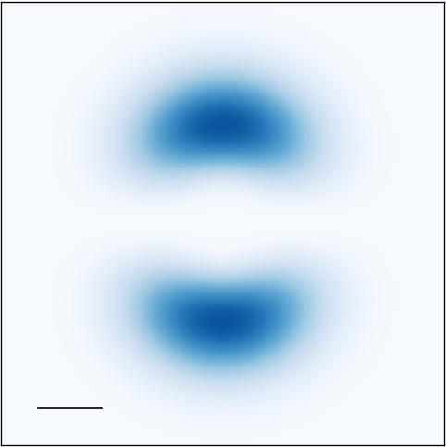
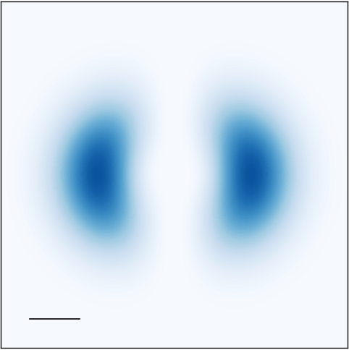
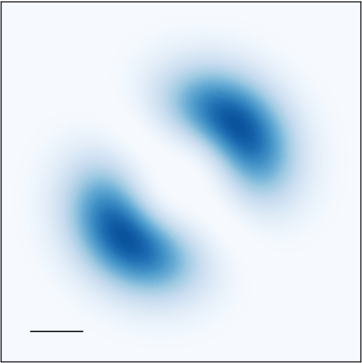



Longitudinal component
$$\left(α, β\right)=\left(0, \text{0}\right)$$
$$q_{y}$$
$$q_{x}$$
$$\left(3π/2,π/2\right)$$
$${0.1Q}_{c}$$
$$\left(π,π/2\right)$$
$$a.u.$$
$$|\left.1, −1\right\rangle$$
$$z$$
$$β$$
$$x$$
$$α$$
$$y$$
$$\left(0, π/2\right)$$
$$\left(π/2,π/2\right)$$
$$|\left.−1, −1\right\rangle$$
$$\left(0,π\right)$$

Slide 9

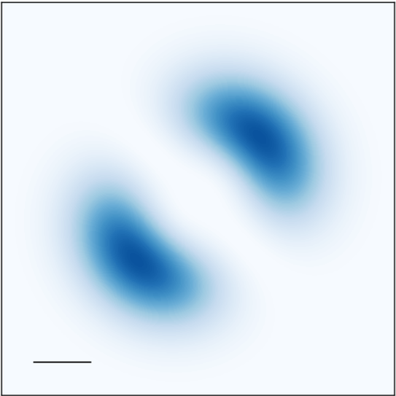
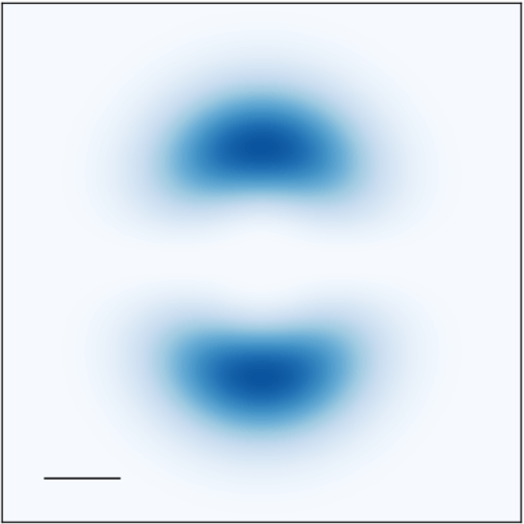

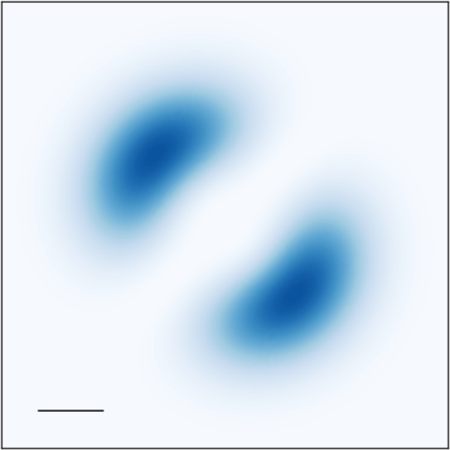


Longitudinal component
$$\left(α, β\right)=\left(0, \text{0}\right)$$
$$q_{y}$$
$$q_{x}$$
$$\left(3π/2,π/2\right)$$
$${0.1Q}_{c}$$
$$\left(π,π/2\right)$$
$$a.u.$$
$$|\left.1, −1\right\rangle$$
$$z$$
$$β$$
$$x$$
$$α$$
$$y$$
$$\left(0, π/2\right)$$
$$\left(π/2,π/2\right)$$
$$|\left.1, 1\right\rangle$$
$$\left(0,π\right)$$

Slide 10







Longitudinal component
$$\left(α, β\right)=\left(0, \text{0}\right)$$
$$q_{y}$$
$$q_{x}$$
$$\left(3π/2,π/2\right)$$
$${0.1Q}_{c}$$
$$\left(π,π/2\right)$$
$$a.u.$$
$$|\left.1, −1\right\rangle$$
$$z$$
$$β$$
$$x$$
$$α$$
$$y$$
$$\left(0, π/2\right)$$
$$\left(π/2,π/2\right)$$
$$|\left.−1, 1\right\rangle$$
$$\left(0,π\right)$$

Slide 11







Longitudinal component
$$\left(α, β\right)=\left(0, \text{0}\right)$$
$$q_{y}$$
$$q_{x}$$
$$\left(3π/2,π/2\right)$$
$${0.1Q}_{c}$$
$$\left(π,π/2\right)$$
$$a.u.$$
$$|\left.1, 0\right\rangle$$
$$z$$
$$β$$
$$x$$
$$α$$
$$y$$
$$\left(0, π/2\right)$$
$$\left(π/2,π/2\right)$$
$$|\left.1, 0\right\rangle$$
$$\left(0,π\right)$$

Slide 12







Longitudinal component
$$\left(α, β\right)=\left(0, \text{0}\right)$$
$$q_{y}$$
$$q_{x}$$
$$\left(3π/2,π/2\right)$$
$${0.1Q}_{c}$$
$$\left(π,π/2\right)$$
$$a.u.$$
$$|\left.1, −1\right\rangle$$
$$z$$
$$β$$
$$x$$
$$α$$
$$y$$
$$\left(0, π/2\right)$$
$$\left(π/2,π/2\right)$$
$$|\left.1, −1\right\rangle$$
$$\left(0,π\right)$$

Slide 13

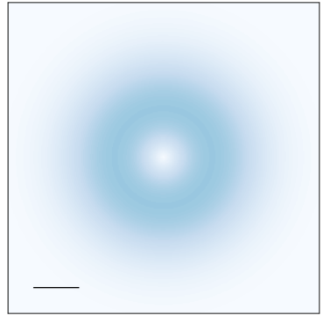

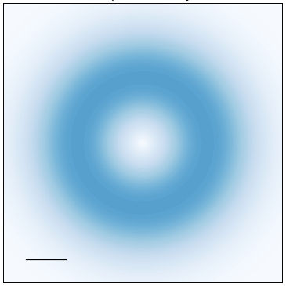
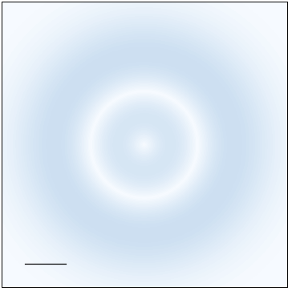



Longitudinal component
$$\left(α, β\right)=\left(0, \text{0}\right)$$
$$q_{y}$$
$$q_{x}$$
$$\left(3π/2,π/2\right)$$
$${0.1Q}_{c}$$
$$\left(π,π/2\right)$$
$$a.u.$$
$$|\left.1, 0\right\rangle$$
$$z$$
$$β$$
$$x$$
$$α$$
$$y$$
$$\left(0, π/2\right)$$
$$\left(π/2,π/2\right)$$
$$|\left.−1, 2\right\rangle$$
$$\left(0,π\right)$$

Slide 14
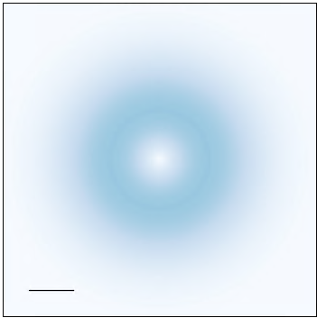



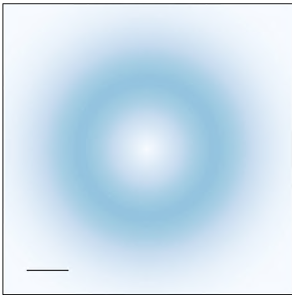























Longitudinal component
Longitudinal component
$$\left(α, β\right)=\left(0, \text{0}\right)$$
$$\left(α, β\right)=\left(0, \text{0}\right)$$
$$q_{y}$$
$$q_{y}$$
$$q_{x}$$
$$q_{x}$$
$$\left(3π/2,π/2\right)$$
$${0.1Q}_{c}$$
$$\left(π,π/2\right)$$
$$\left(3π/2,π/2\right)$$
$${0.1Q}_{c}$$
$$\left(π,π/2\right)$$
$$a.u.$$
$$a.u.$$
$$|\left.1, 0\right\rangle$$
$$|\left.1, 0\right\rangle$$
$$z$$
$$z$$
$$β$$
$$β$$
$$x$$
$$α$$
$$y$$
$$x$$
$$α$$
$$y$$
$$\left(0, π/2\right)$$
$$\left(π/2,π/2\right)$$
$$\left(0, π/2\right)$$
$$\left(π/2,π/2\right)$$
$$|\left.−1, 2\right\rangle$$
$$|\left.−1, 2\right\rangle$$
$$\left(0,π\right)$$
$$\left(0,π\right)$$

Slide 15














Longitudinal component
Longitudinal component
$$\left(α, β\right)=\left(0, \text{0}\right)$$
$$\left(α, β\right)=\left(0, \text{0}\right)$$
$$q_{y}$$
$$q_{y}$$
$$q_{x}$$
$$q_{x}$$
$$\left(3π/2,π/2\right)$$
$${0.1Q}_{c}$$
$$\left(π,π/2\right)$$
$$\left(3π/2,π/2\right)$$
$${0.1Q}_{c}$$
$$\left(π,π/2\right)$$
$$a.u.$$
$$a.u.$$
$$|\left.1, 0\right\rangle$$
$$|\left.1, 0\right\rangle$$
$$z$$
$$z$$
$$β$$
$$β$$
$$x$$
$$α$$
$$y$$
$$x$$
$$α$$
$$y$$
$$\left(0, π/2\right)$$
$$\left(π/2,π/2\right)$$
$$\left(0, π/2\right)$$
$$\left(π/2,π/2\right)$$
$$|\left.−1, 2\right\rangle$$
$$|\left.−1, 2\right\rangle$$
$$\left(0,π\right)$$
$$\left(0,π\right)$$

Slide 16







Longitudinal component
$$\left(α, β\right)=\left(0, \text{0}\right)$$
$$q_{y}$$
$$q_{x}$$
$$\left(3π/2,π/2\right)$$
$${0.1Q}_{c}$$
$$\left(π,π/2\right)$$
$$a.u.$$
$$|\left.1, −1\right\rangle$$
$$z$$
$$β$$
$$x$$
$$α$$
$$y$$
$$\left(0, π/2\right)$$
$$\left(π/2,π/2\right)$$
$$|\left.−1, 2\right\rangle$$
$$\left(0,π\right)$$

Slide 17





































Re[
$e^{−iwt}$]
Longitudinal component
For $\left(α, β\right)=\left(0, π/2\right)$
$$\left(α, β\right)=\left(0, \text{0}\right)$$
$$q_{y}$$
$$q_{y}$$
$$q_{x}$$
$$q_{x}$$
$$a.u.$$
$${0.1Q}_{c}$$
$$\left(3π/2,π/2\right)$$
$$a.u.$$
$$\left(π,π/2\right)$$
$${0.1Q}_{c}$$
$$|\left.1, −1\right\rangle$$
$$wt=0$$
$$0.25π$$
$$0.5π$$
$$0.75π$$
$$z$$
$$β$$
$$x$$
$$α$$
$$y$$
$$\left(0, π/2\right)$$
$$\left(π/2,π/2\right)$$
$$|\left.−1, 2\right\rangle$$
$$\left(0,π\right)$$
$$π$$
$$1.25π$$
$$1.5π$$
$$1.75π$$

Slide 18



























Re[
$e^{−iwt}$]
For $\left(α, β\right)=\left(0, π/2\right)$
$$1$$
$$q_{y}$$
$$q_{x}$$
$${0.1Q}_{c}$$
$$wt=0$$
$$0.2π$$
$$0.4π$$
$$0.6π$$
$$0.8π$$
$$a.u.$$
$$−1$$
$$π$$
$$1.2π$$
$$1.4π$$
$$1.6π$$
$$1.8π$$
$$2π$$

Slide 19










































$${\left| \right|}^{2}$$
$$\left(α, β\right)=\left(0, \text{0}\right)$$
$$q_{y}$$
$$q_{x}$$
$$\left(3π/2,π/2\right)$$
$$\left(π,π/2\right)$$
$$1$$
$${0.1Q}_{c}$$
$$a.u.$$
$$q_{y}$$
$$|\left.1, −1\right\rangle$$
$$q_{x}$$
$$a.u.$$
$$z$$
$${0.1Q}_{c}$$
$$wt=0$$
$$0.2π$$
$$0.4π$$
$$0.6π$$
$$0.8π$$
$$−1$$
$$β$$
$$\left(0, π/2\right)$$
$$x$$
$$α$$
$$y$$
$$\left(π/2,π/2\right)$$
$$|\left.−1, 2\right\rangle$$
$$\left(0,π\right)$$
$$π$$
$$1.2π$$
$$1.4π$$
$$1.6π$$
$$1.8π$$
$$2π$$

Slide 20









Longitudinal component
$$\left(α, β\right)=\left(0, \text{0}\right)$$
$$q_{y}$$
$$q_{x}$$
$$\left(3π/2,π/2\right)$$
$${0.1Q}_{c}$$
$$\left(π,π/2\right)$$
$$a.u.$$
$$|\left.1, −1\right\rangle$$
$$z$$
$$β$$
$$x$$
$$α$$
$$y$$
$$\left(0, π/2\right)$$
$$\left(π/2,π/2\right)$$
$$|\left.−1, 2\right\rangle$$
$$\left(0,π\right)$$

Slide 21

































Longitudinal component
Longitudinal component
1.0
$$\left(α, β\right)=\left(0, \text{0}\right)$$
$$\left(α, β\right)=\left(0, \text{0}\right)$$
$$q_{y}$$
$$q_{y}$$
$$q_{x}$$
$$q_{x}$$
0.2
$$\left(3π/2,π/2\right)$$
$${0.1Q}_{c}$$
$$\left(π,π/2\right)$$
$$\left(3π/2,π/2\right)$$
$${0.1Q}_{c}$$
$$\left(π,π/2\right)$$
$$a.u.$$
$$a.u.$$
0.0
$$|\left.1, 0\right\rangle$$
$$|\left.1, 0\right\rangle$$
$$z$$
$$z$$
$$β$$
$$β$$
$$a.u.$$
$$x$$
$$α$$
$$y$$
$$x$$
$$α$$
$$y$$
$$\left(0, π/2\right)$$
$$\left(π/2,π/2\right)$$
$$\left(0, π/2\right)$$
$$\left(π/2,π/2\right)$$
$$|\left.−1, 2\right\rangle$$
$$|\left.−1, 2\right\rangle$$
$$\left(0,π\right)$$
$$\left(0,π\right)$$

Slide 22








Longitudinal component
$$−1, −1, 1, 1$$
$$\left(α, β\right)=\left(0, \text{0}\right)$$
$$q_{y}$$
$$q_{x}$$
$$\left(3π/2,π/2\right)$$
$${0.1Q}_{c}$$
$$\left(π,π/2\right)$$
$$a.u.$$
$$|\left.−1, −1\right\rangle$$
$$z$$
$$β$$
$$x$$
$$α$$
$$y$$
$$\left(0, π/2\right)$$
$$\left(π/2,π/2\right)$$
$$|\left.1, 1\right\rangle$$
$$\left(0,π\right)$$

Slide 23








Longitudinal component
$$−1, −1, 1, 1$$
$$\left(α, β\right)=\left(0, \text{0}\right)$$
$$q_{y}$$
$$q_{x}$$
$$\left(3π/2,π/2\right)$$
$${0.1Q}_{c}$$
$$\left(π,π/2\right)$$
$$a.u.$$
$$|\left.1, 1\right\rangle$$
$$z$$
$$β$$
$$x$$
$$α$$
$$y$$
$$\left(0, π/2\right)$$
$$\left(π/2,π/2\right)$$
$$|\left.−1, −1\right\rangle$$
$$\left(0,π\right)$$

Slide 24







Longitudinal component
$$−1, −1, 1, 1$$
$$\left(α, β\right)=\left(0, \text{0}\right)$$
$$q_{y}$$
$$q_{x}$$
$$\left(3π/2,π/2\right)$$
$${0.1Q}_{c}$$
$$\left(π,π/2\right)$$
$$a.u.$$
$$|\left.1, −2\right\rangle$$
$$z$$
$$β$$
$$x$$
$$α$$
$$y$$
$$\left(0, π/2\right)$$
$$\left(π/2,π/2\right)$$
$$|\left.−1, 2\right\rangle$$
$$\left(0,π\right)$$

Slide 25







Longitudinal component
$$1, 0, −1, 1$$
$$\left(α, β\right)=\left(0, \text{0}\right)$$
$$q_{y}$$
$$q_{x}$$
$$\left(3π/2,π/2\right)$$
$${0.1Q}_{c}$$
$$\left(π,π/2\right)$$
$$a.u.$$
$$|\left.1, 0\right\rangle$$
$$z$$
$$β$$
$$x$$
$$α$$
$$y$$
$$\left(0, π/2\right)$$
$$\left(π/2,π/2\right)$$
$$|\left.−1, 1\right\rangle$$
$$\left(0,π\right)$$

Slide 26






Longitudinal component
$$1, 0, −1, 1$$
$$\left(α, β\right)=\left(0, \text{0}\right)$$
$$q_{y}$$
$$q_{x}$$
$$\left(3π/2,π/2\right)$$
$${0.1Q}_{c}$$
$$\left(π,π/2\right)$$
$$|\left.1, −1\right\rangle$$
$$z$$
$$β$$
$$x$$
$$α$$
$$y$$
$$a.u.$$
$$\left(0, π/2\right)$$
$$\left(π/2,π/2\right)$$
$$|\left.−1, 2\right\rangle$$
$$\left(0,π\right)$$

Slide 27






























Longitudinal component
$$1, 0, −1, 1$$
$${\left|−\frac{\sin{θ_{q}}}{2}cos\left[\frac{1}{2}\left(φ_{q_{∥}}−\frac{π}{2}+α\right)\right] G_{\left|−1\right|,\left|2\right|}\left(q_{∥}\right)\right|}^{2}$$
$${\left|\frac{\sin{θ_{q}}}{2}i sin\left[\frac{1}{2}\left(ΔJφ_{q_{∥}}−\frac{π}{2}+α\right)\right] H_{\left|−1\right|,\left|2\right|}\left(q_{∥}\right)\right|}^{2}$$
$$a.u.$$
$$\left(α, β\right)= \left(3π/2,π/2\right)$$
$$\left(π,π/2\right)$$
$$\left(α, β\right)= \left(3π/2,π/2\right)$$
$$\left(π,π/2\right)$$
$$q_{y}$$
$$|\left.1, −1\right\rangle$$
$$q_{y}$$
$$|\left.1, −1\right\rangle$$
$$q_{x}$$
$$q_{x}$$
$$z$$
$$z$$
$$a.u.$$
$${0.1Q}_{c}$$
$$β$$
$${0.1Q}_{c}$$
$$β$$
$$x$$
$$α$$
$$y$$
$$x$$
$$α$$
$$y$$
$$\left(0, π/2\right)$$
$$\left(π/2,π/2\right)$$
$$\left(0, π/2\right)$$
$$\left(π/2,π/2\right)$$
$$|\left.−1, 2\right\rangle$$
$$|\left.−1, 2\right\rangle$$

Slide 28

Longitudinal component
$$1,−1,−1, 2$$
$$\left(α, β\right)=\left(0, \text{0}\right)$$
$$q_{y}$$
$$q_{x}$$
$${0.1Q}_{c}$$
$$a.u.$$
$$|\left.1, 0\right\rangle$$
$$\left(0, π/2\right)$$
$$z$$
$$\left(π,π/2\right)$$
$$β$$
$$x$$
$$α$$
$$y$$
$$|\left.−1, 0\right\rangle$$
$$\left(0,π\right)$$

