Slide 1
Theoretical studies of excitonic transitions in two dimensional materials under photoexcitation of scalar and vector vortex beams

Slide 2
Outline
1. Introduction
2. Spin-orbital angular momentum interaction in light
3. Light-matter interaction
4. Exciton wave packet
Summary and outlook

Slide 3
Outline
1. Introduction
2. Spin-orbital angular momentum interaction in light
3. Light-matter interaction
4. Exciton wave packet
Summary and outlook

Slide 4
1. Introduction
What material ?

Slide 5
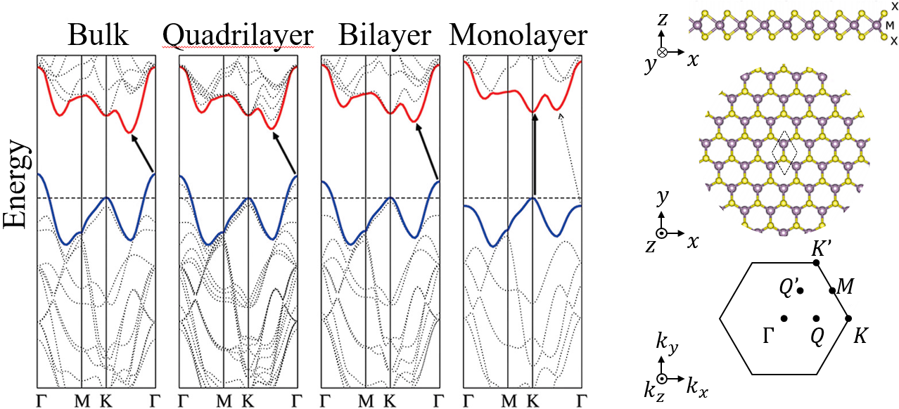
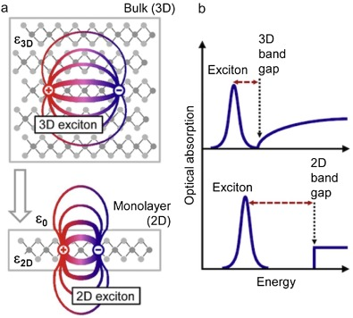

1. Introduction
Two dimensional (2D) Transition metal dichalcogenide (TMD)
Band structure that couple to light
Structures of a typicle 2D TMD material
A. Krasnok & A. Alù, Appl. Sci. 8, 1157 (2018)
${MoS}_{2}$, calculated band structure
A. Splendiani et al., Nano Lett. 10, 1271 (2010)
Screening in materials
M. Velický & P. S. Toth, Appl. Mater. Today 8, 68 (2017)
Luminance property is dominant by exciton

Slide 6
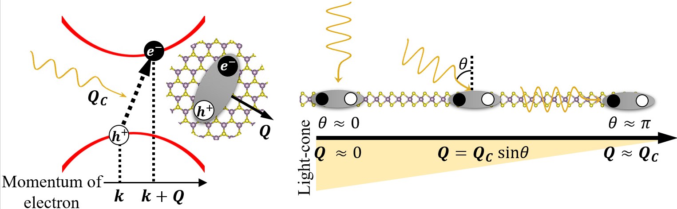
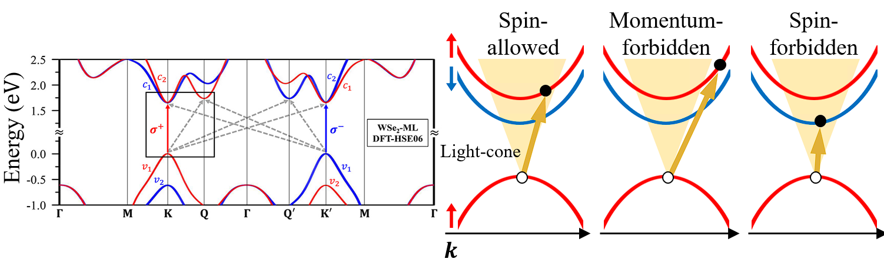

1. Introduction
Two dimensional (2D) Transition metal dichalcogenide (TMD)
Structures of a typicle 2D TMD material
A. Krasnok & A. Alù, Appl. Sci. 8, 1157 (2018)
${MoS}_{2}$, calculated band structure
A. Splendiani et al., Nano Lett. 10, 1271 (2010)
Screening in materials
M. Velický & P. S. Toth, Appl. Mater. Today 8, 68 (2017)
Exciton in 2D TMD
${WSe}_{2}$, calculated band structure
G.-H. Peng et al., Nano Lett. 19, 2299 (2019)

Slide 7
1. Introduction
Two dimensional (2D) Transition metal dichalcogenide (TMD)
Structures of a typicle 2D TMD material
A. Krasnok & A. Alù, Appl. Sci. 8, 1157 (2018)
${MoS}_{2}$, calculated band structure
A. Splendiani et al., Nano Lett. 10, 1271 (2010)
Screening in materials
M. Velický & P. S. Toth, Appl. Mater. Today 8, 68 (2017)
Exciton in 2D TMD

Slide 8
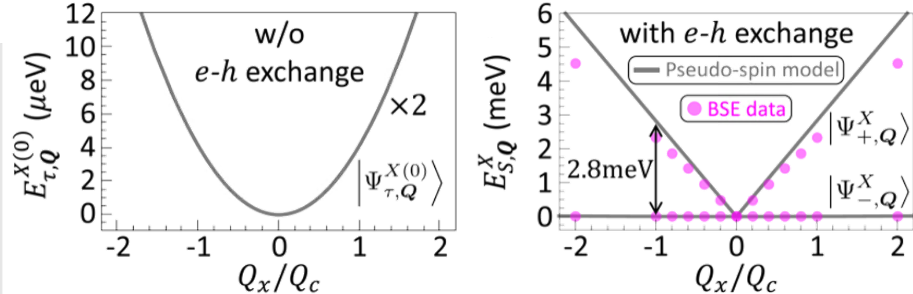
1. Introduction
Two dimensional (2D) Transition metal dichalcogenide (TMD)
Structures of a typicle 2D TMD material
A. Krasnok & A. Alù, Appl. Sci. 8, 1157 (2018)
${MoS}_{2}$, calculated band structure
A. Splendiani et al., Nano Lett. 10, 1271 (2010)
Screening in materials
M. Velický & P. S. Toth, Appl. Mater. Today 8, 68 (2017)
Exciton in 2D TMD
Exciton types
Bright excitons degenerate
G.-H. Peng et al., Phys. Rev. B 106, 155304 (2022)

Slide 9
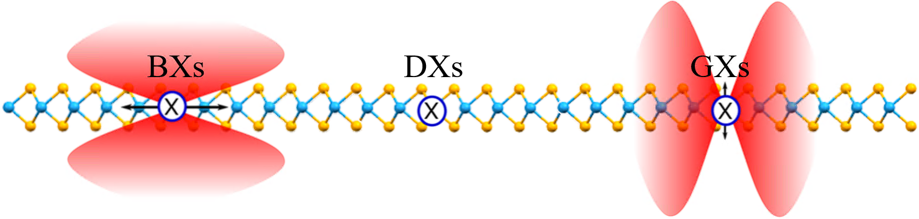
1. Introduction
Two dimensional (2D) Transition metal dichalcogenide (TMD)
Structures of a typicle 2D TMD material
A. Krasnok & A. Alù, Appl. Sci. 8, 1157 (2018)
${MoS}_{2}$, calculated band structure
A. Splendiani et al., Nano Lett. 10, 1271 (2010)
Screening in materials
M. Velický & P. S. Toth, Appl. Mater. Today 8, 68 (2017)
Exciton in 2D TMD
Exciton types
Bright excitons degenerate
G.-H. Peng et al., Phys. Rev. B 106, 155304 (2022)
Excitons categorized by radiation patterns
L. M. Schneider et al., Sci. Rep. 10, 8091 (2020)

Slide 10
1. Introduction
What light information ?

Slide 11
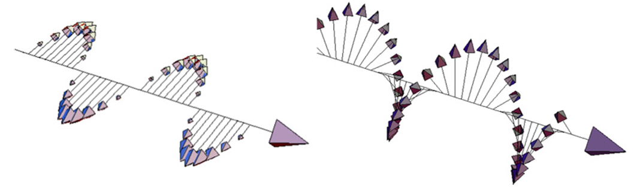
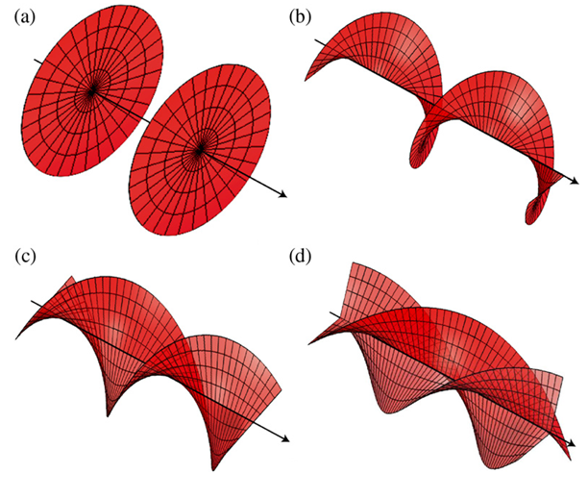
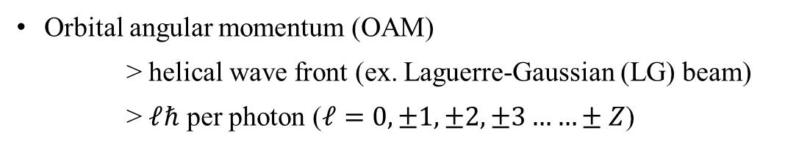

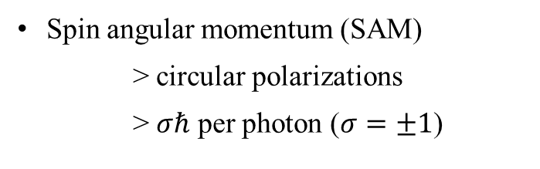
1. Introduction
Angular momentum in light
Spin angular momentum (SAM)
> circular polarizations
> $σℏ$ per photon ($σ=±1$)
Orbital angular momentum (OAM)
> helical wave front (ex. Laguerre-Gaussian (LG) beam)
> $ℓℏ$ per photon ($ℓ=0, ±1, ±2, ±3……±Z$)
Polarization of light / Helical phase fronts for $ℓ=0, 1, 2, 3$
A. M. Yao & M. J. Padgett, Adv. Opt. Photonics 3, 161 (2011)
1909 theoretical work by Poynting
----- J. H. Poynting, Proc. R. Soc. Lond. A 82, 560
1936 first experimental evidence of spin angular momentum (SAM)
----- R. A. Beth, Phys. Rev. 50, 115
1992 Experimental demonstration of orbital angular momentum (OAM) in Laguerre-Gaussian (LG) Beam
----- L. Allen et al., Phys. Rev. A 45, 8185

Slide 12




1. Introduction
Angular momentum in light
Spin angular momentum (SAM)
> circular polarizations
> $σℏ$ per photon ($σ=±1$)
Orbital angular momentum (OAM)
> helical wave front (ex. Laguerre-Gaussian (LG) beam)
> $ℓℏ$ per photon ($ℓ=0, ±1, ±2, ±3……±Z$)
Polarization of light / Helical phase fronts for $ℓ=0, 1, 2, 3$
A. M. Yao & M. J. Padgett, Adv. Opt. Photonics 3, 161 (2011)
$$E$$
$$B$$
$$S≡E×B$$
$$θ=0$$
1909 theoretical work by Poynting
----- J. H. Poynting, Proc. R. Soc. Lond. A 82, 560
1936 first experimental evidence of spin angular momentum (SAM)
----- R. A. Beth, Phys. Rev. 50, 115
1992 Experimental demonstration of orbital angular momentum (OAM) in Laguerre-Gaussian (LG) Beam
----- L. Allen et al., Phys. Rev. A 45, 8185

Slide 13




1. Introduction
Angular momentum in light
Spin angular momentum (SAM)
> circular polarizations
> $σℏ$ per photon ($σ=±1$)
Orbital angular momentum (OAM)
> helical wave front (ex. Laguerre-Gaussian (LG) beam)
> $ℓℏ$ per photon ($ℓ=0, ±1, ±2, ±3……±Z$)
Polarization of light / Helical phase fronts for $ℓ=0, 1, 2, 3$
A. M. Yao & M. J. Padgett, Adv. Opt. Photonics 3, 161 (2011)
$$E$$
$$E$$
$$θ≠0$$
$$B$$
$$S≡E×B$$
$$B$$
$$θ=0$$
$$S$$
1909 theoretical work by Poynting
----- J. H. Poynting, Proc. R. Soc. Lond. A 82, 560
1936 first experimental evidence of spin angular momentum (SAM)
----- R. A. Beth, Phys. Rev. 50, 115
1992 Experimental demonstration of orbital angular momentum (OAM) in Laguerre-Gaussian (LG) Beam
----- L. Allen et al., Phys. Rev. A 45, 8185

Slide 14
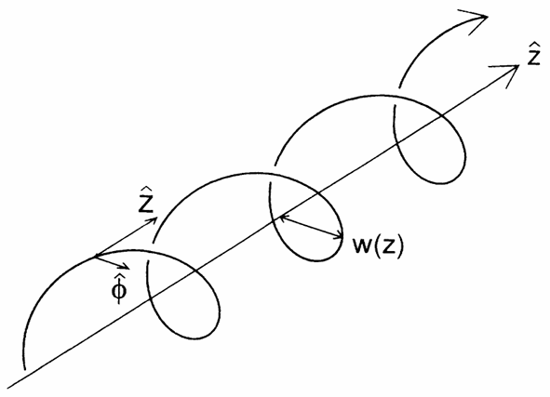
1. Introduction
Angular momentum in light
Spin angular momentum (SAM)
> circular polarizations
> $σℏ$ per photon ($σ=±1$)
Orbital angular momentum (OAM)
> helical wave front (ex. Laguerre-Gaussian (LG) beam)
> $ℓℏ$ per photon ($ℓ=0, ±1, ±2, ±3……±Z$)
Polarization of light / Helical phase fronts for $ℓ=0, 1, 2, 3$
A. M. Yao & M. J. Padgett, Adv. Opt. Photonics 3, 161 (2011)
$$E$$
$$E$$
$$θ≠0$$
$$B$$
$$S≡E×B$$
$$B$$
$$θ=0$$
$$S$$
Spiraling Poynting vector
L. Allen et al., Phys. Rev. A 45, 8185 (1992)
1909 theoretical work by Poynting
----- J. H. Poynting, Proc. R. Soc. Lond. A 82, 560
1936 first experimental evidence of spin angular momentum (SAM)
----- R. A. Beth, Phys. Rev. 50, 115
1992 Experimental demonstration of orbital angular momentum (OAM) in Laguerre-Gaussian (LG) Beam
----- L. Allen et al., Phys. Rev. A 45, 8185

Slide 15
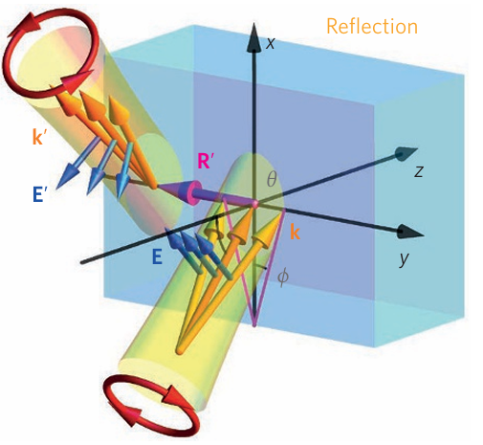
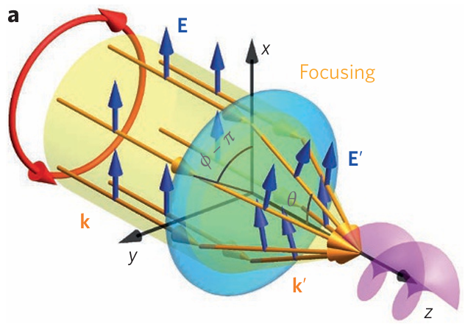
1. Introduction
Angular momentum in light
Spin angular momentum (SAM)
> circular polarizations
> $σℏ$ per photon ($σ=±1$)
Orbital angular momentum (OAM)
> helical wave front (ex. Laguerre-Gaussian (LG) beam)
> $ℓℏ$ per photon ($ℓ=0, ±1, ±2, ±3……±Z$)
Polarization of light / Helical phase fronts for $ℓ=0, 1, 2, 3$
A. M. Yao & M. J. Padgett, Adv. Opt. Photonics 3, 161 (2011)
Spin & Orbital angular momentum interaction (SOI)
> circularly polarized laser beam reflected or refracted by medium inhomogeneity
> Tight focusing of a paraxial beam
> paraxial beam propagates in optical fibres
> other ……
Some cases for SOI
K. Y. Bliokh et al., Nat. Photonics 9, 796 (2015).
1909 theoretical work by Poynting
----- J. H. Poynting, Proc. R. Soc. Lond. A 82, 560
1936 first experimental evidence of spin angular momentum (SAM)
----- R. A. Beth, Phys. Rev. 50, 115
1992 Experimental demonstration of orbital angular momentum (OAM) in Laguerre-Gaussian (LG) Beam
----- L. Allen et al., Phys. Rev. A 45, 8185

Slide 16
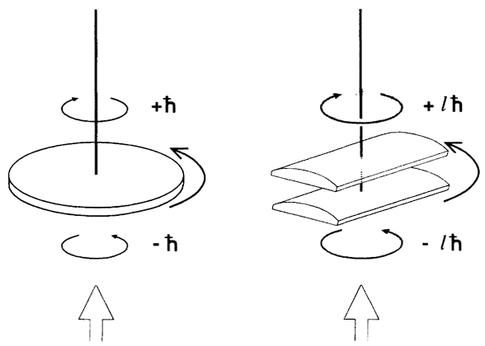
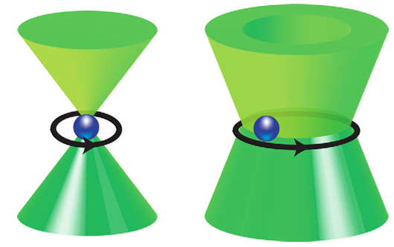
1. Introduction
Angular momentum in light
Spin angular momentum (SAM)
> circular polarizations
> $σℏ$ per photon ($σ=±1$)
Orbital angular momentum (OAM)
> helical wave front (ex. Laguerre-Gaussian (LG) beam)
> $ℓℏ$ per photon ($ℓ=0, ±1, ±2, ±3……±Z$)
Polarization of light / Helical phase fronts for $ℓ=0, 1, 2, 3$
A. M. Yao & M. J. Padgett, Adv. Opt. Photonics 3, 161 (2011)
Light matter interaction
Measurements of SAM and OAM
R. A. Beth, Phys. Rev. 50, 115 (1936)/L. Allen et al., Phys. Rev. A 45, 8185 (1992)
Transfer of SAM and OAM in optical tweezers
A. M. Yao & M. J. Padgett, Adv. Opt. Photonics 3, 161 (2011)
1909 theoretical work by Poynting
----- J. H. Poynting, Proc. R. Soc. Lond. A 82, 560
1936 first experimental evidence of spin angular momentum (SAM)
----- R. A. Beth, Phys. Rev. 50, 115
1992 Experimental demonstration of orbital angular momentum (OAM) in Laguerre-Gaussian (LG) Beam
----- L. Allen et al., Phys. Rev. A 45, 8185

Slide 17
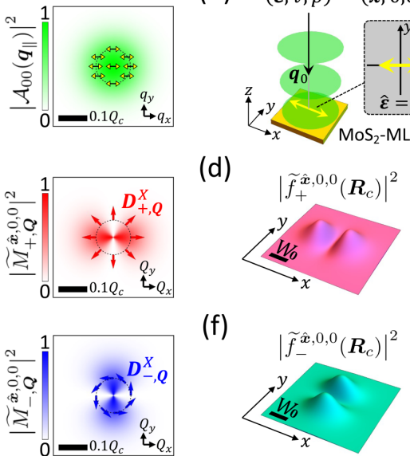
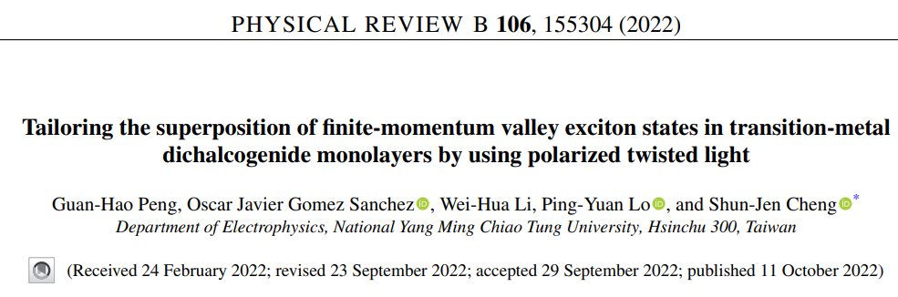
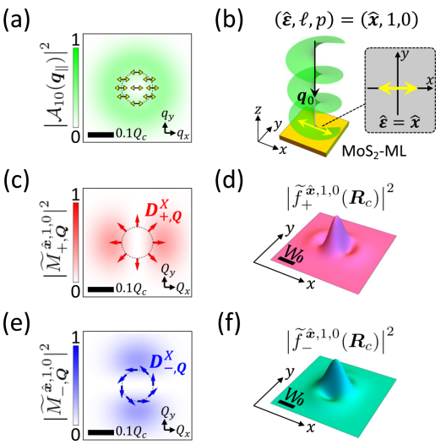


1. Introduction
Angular momentum in light
Spin angular momentum (SAM)
> circular polarizations
> $σℏ$ per photon ($σ=±1$)
Orbital angular momentum (OAM)
> helical wave front (ex. Laguerre-Gaussian (LG) beam)
> $ℓℏ$ per photon ($ℓ=0, ±1, ±2, ±3……±Z$)
Polarization of light / Helical phase fronts for $ℓ=0, 1, 2, 3$
A. M. Yao & M. J. Padgett, Adv. Opt. Photonics 3, 161 (2011)
Light matter interaction
$$⇒$$
$$⇒$$
OAM can influence exciton’s wave packet structures
1909 theoretical work by Poynting
----- J. H. Poynting, Proc. R. Soc. Lond. A 82, 560
1936 first experimental evidence of spin angular momentum (SAM)
----- R. A. Beth, Phys. Rev. 50, 115
1992 Experimental demonstration of orbital angular momentum (OAM) in Laguerre-Gaussian (LG) Beam
----- L. Allen et al., Phys. Rev. A 45, 8185

Slide 18
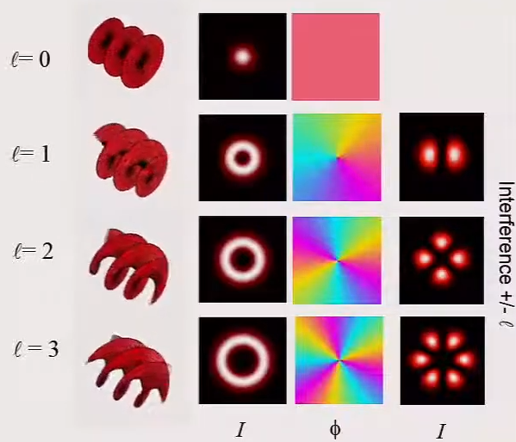
1. Introduction
Angular momentum in light
LG beams and vector vortex beams (transverse plane)
Reproduced from Miles J. Padgett, International School on Parametric Nonlinear Optics (2015)
Polarization of light / Helical phase fronts for $ℓ=0, 1, 2, 3$
A. M. Yao & M. J. Padgett, Adv. Opt. Photonics 3, 161 (2011)
Light matter interaction
Information in the phase are likely lost when calculating optical transition rates in 2D TMD
1909 theoretical work by Poynting
----- J. H. Poynting, Proc. R. Soc. Lond. A 82, 560
1936 first experimental evidence of spin angular momentum (SAM)
----- R. A. Beth, Phys. Rev. 50, 115
1992 Experimental demonstration of orbital angular momentum (OAM) in Laguerre-Gaussian (LG) Beam
----- L. Allen et al., Phys. Rev. A 45, 8185

Slide 19
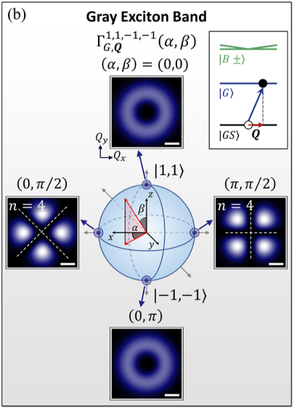
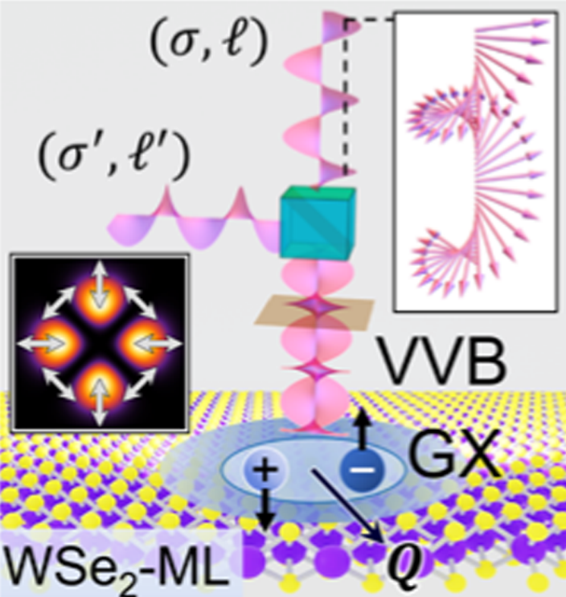
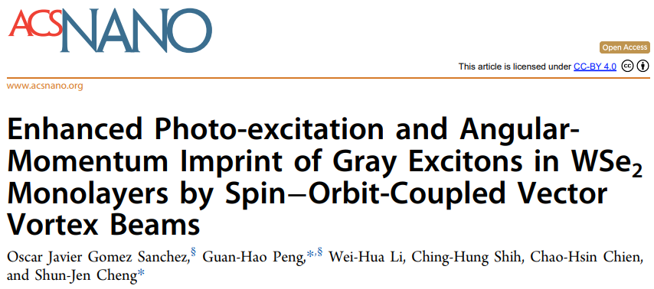
1. Introduction
Angular momentum in light
LG beams and vector vortex beams (transverse plane)
Reproduced from Miles J. Padgett, International School on Parametric Nonlinear Optics (2015)
Polarization of light / Helical phase fronts for $ℓ=0, 1, 2, 3$
A. M. Yao & M. J. Padgett, Adv. Opt. Photonics 3, 161 (2011)
Light matter interaction
SOI influence optical transition rate through vector vortex beam
O. J. G. Sanchez, G.-H. Peng et al., ACS Nano 18, 11425 (2024)
1909 theoretical work by Poynting
----- J. H. Poynting, Proc. R. Soc. Lond. A 82, 560
1936 first experimental evidence of spin angular momentum (SAM)
----- R. A. Beth, Phys. Rev. 50, 115
1992 Experimental demonstration of orbital angular momentum (OAM) in Laguerre-Gaussian (LG) Beam
----- L. Allen et al., Phys. Rev. A 45, 8185

Slide 20


1. Introduction
Angular momentum in light
LG beams and vector vortex beams (transverse plane)
Reproduced from Miles J. Padgett, International School on Parametric Nonlinear Optics (2015)
Polarization of light / Helical phase fronts for $ℓ=0, 1, 2, 3$
A. M. Yao & M. J. Padgett, Adv. Opt. Photonics 3, 161 (2011)
Light matter interaction
$$⇒$$
$$⇒$$
OAM can influence exciton’s wave packet structures
G.-H. Peng et al., Nano Lett. 19, 2299 (2019)
SOI influence optical transition rate through vector vortex beam
O. J. G. Sanchez, G.-H. Peng et al., ACS Nano 18, 11425 (2024)
1909 theoretical work by Poynting
----- J. H. Poynting, Proc. R. Soc. Lond. A 82, 560
1936 first experimental evidence of spin angular momentum (SAM)
----- R. A. Beth, Phys. Rev. 50, 115
1992 Experimental demonstration of orbital angular momentum (OAM) in Laguerre-Gaussian (LG) Beam
----- L. Allen et al., Phys. Rev. A 45, 8185

Slide 21
1. Introduction
Spin of electron
Polarization of light
Optical spin
Exciton with spin
Bright*2/dark/gray
${WSe}_{2}$, calculated band structure
G.-H. Peng et al., Nano Lett. 19, 2299 (2019)
dipole
OAM
COM of exciton

Slide 22
1. Introduction

Slide 23
Outline
1. Introduction
2. Spin-orbital angular momentum interaction (SOI) in light
Laguerre-Gaussian beams
Longitudinal component : SOI effect
Longitudinal component : Vector vortex beams
3. Light-matter interaction
4. Exciton wave packet
Summary and outlook

Slide 24
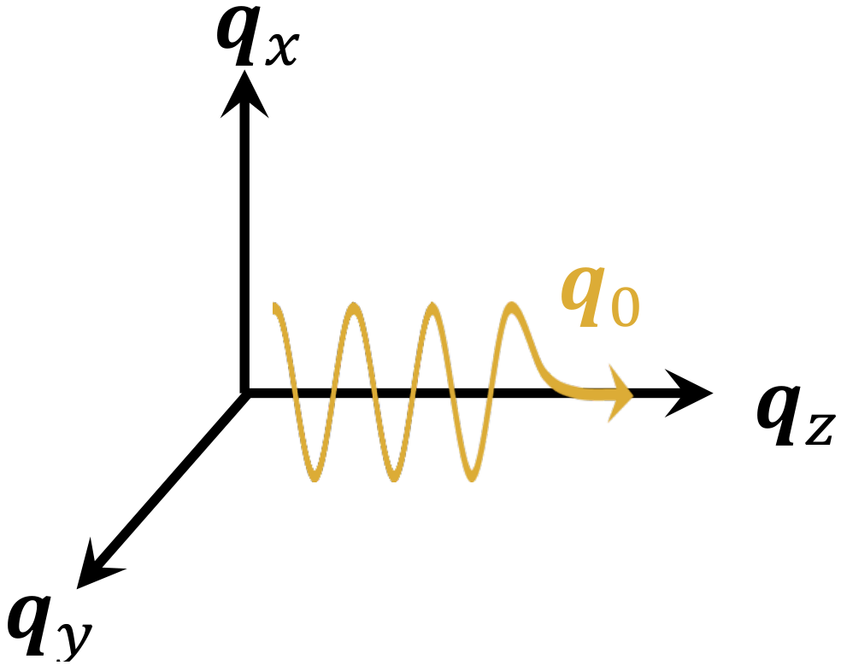












2. Laguerre-Gaussian (LG) beam : Derivation
LG beam is solved as vector potential $A\left(r\right)$ from paraxial Helmholtz equation within Lorentz gauge.
Maxwell equations
Paraxial wave
scalar Helmholtz equation
$$A\left(r\right)=U\left(r\right)e^{iq_{0}z}$$
$$\left(∇_{ }^{2}+q_{0}^{2}\right)A\left(r\right)= 0$$
paraxial approximation
Ansatz
wave vector ${q_{z}≈q}_{0}$
$\left(∇_{∥}^{2}+ \frac{∂^{2}}{∂ z^{2}}+2iq_{0}^{ }\frac{∂}{∂ z}\right)U\left(r\right)= 0$
$\left|\frac{∂^{2}}{∂ z^{2}}U\left(r\right)\right|≪q_{0}^{ }\left|\frac{∂}{∂ z}U\left(r\right)\right|$
Coulomb gauge condition
Approx.
$$∇⋅A^{C}\left(r\right)={\hat{ε}}_{σ}⋅∇_{∥}A^{C}\left(r\right)$$
$\left|\frac{∂^{2}}{∂ z^{2}}U\left(r\right)\right|≪\left|∇_{∥}^{2}U\left(r\right)\right|$
$=\left(\frac{∂}{∂ x}+iσ\frac{∂}{∂ y}\right)A^{C}\left(r\right)=0$,
for ${\hat{ε}}_{σ}=\hat{x}+iσ\hat{y}$
paraxial Helmholtz equation
Fail
$$σ=±1$$
eventually constraint the transverse component
$\left(∇_{∥}^{2}+2iq_{0}^{ }\frac{∂}{∂ z}\right)U\left(r\right)≈ 0$
$∇_{∥}^{2}A^{C}\left(r\right)=\left(\frac{∂}{∂ x}+i\frac{∂}{∂ y}\right)\left(\frac{∂}{∂ x}−i\frac{∂}{∂ y}\right)A^{C}\left(r\right)=0$.

Slide 25
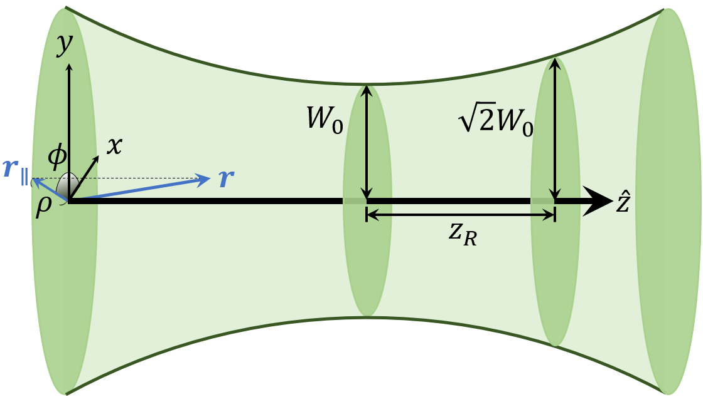
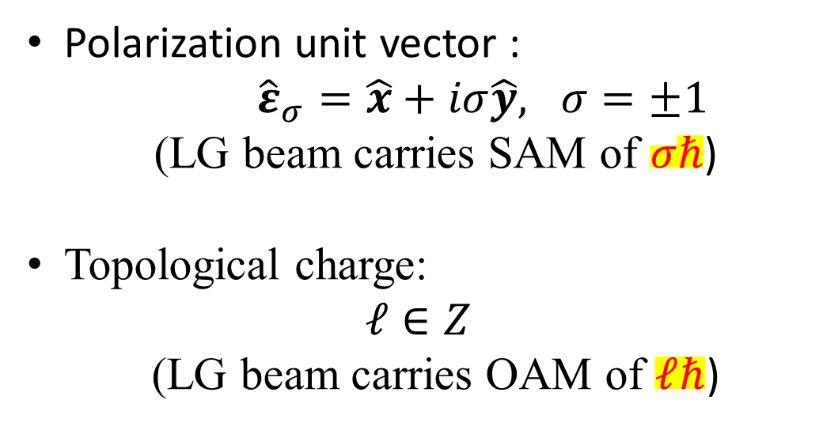
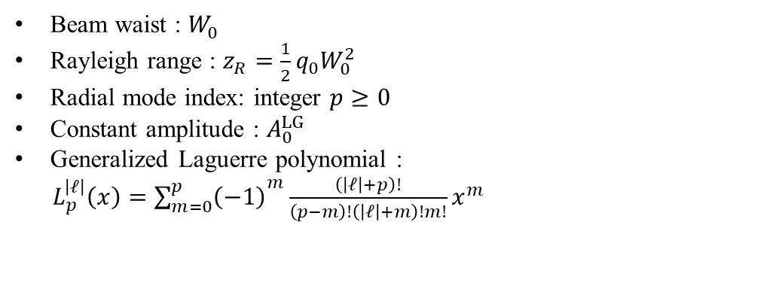
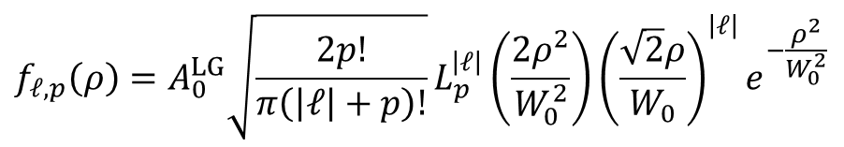
2. Laguerre-Gaussian (LG) beam : Distribution
LG beam is solved as vector potential $A\left(r\right)$ from paraxial Helmholtz equation within Lorentz gauge.
With long Rayleigh range approximation :
$$A_{σ,ℓ,p}^{L}\left(r\right)={\hat{ε}}_{σ} A_{ℓ,p}^{L}\left(r\right)≈{\hat{ε}}_{σ} f_{ℓ,p}\left(ρ\right)e^{iℓφ}e^{iq_{0}z}$$
Polarization unit vector :
${\hat{ε}}_{σ}=\hat{x}+iσ\hat{y}, σ=±1$
(LG beam carries SAM of $σℏ$)
Topological charge:
$$ℓ∈Z$$
(LG beam carries OAM of $ℓℏ$)
$$f_{ℓ,p}\left(ρ\right)=A_{0}^{LG}\sqrt{\frac{2p!}{π\left(\left|ℓ\right|+p\right)!}}L_{p}^{\left|ℓ\right|}\left(\frac{2ρ^{2}}{W_{0}^{2}}\right){\left(\frac{\sqrt{2}ρ}{W_{0}}\right)}^{\left|ℓ\right|}e^{−\frac{ρ^{2}}{W_{0}^{2}}}$$
Beam waist : $W_{0}^{ }$
Rayleigh range : $z_{R}=\frac{1}{2}q_{0}W_{0}^{2}$
Radial mode index: integer $p≥0$
Constant amplitude : $A_{0}^{LG}$
Generalized Laguerre polynomial :
$L_{p}^{\left|ℓ\right|}\left(x\right)={\sum_{m=0}^{p}{\left(−1\right)}}^{m}\frac{\left(\left|ℓ\right|+p\right)!}{\left(p−m\right)!\left(\left|ℓ\right|+m\right)!m!}x^{m}$
Rayleigh range

Slide 26
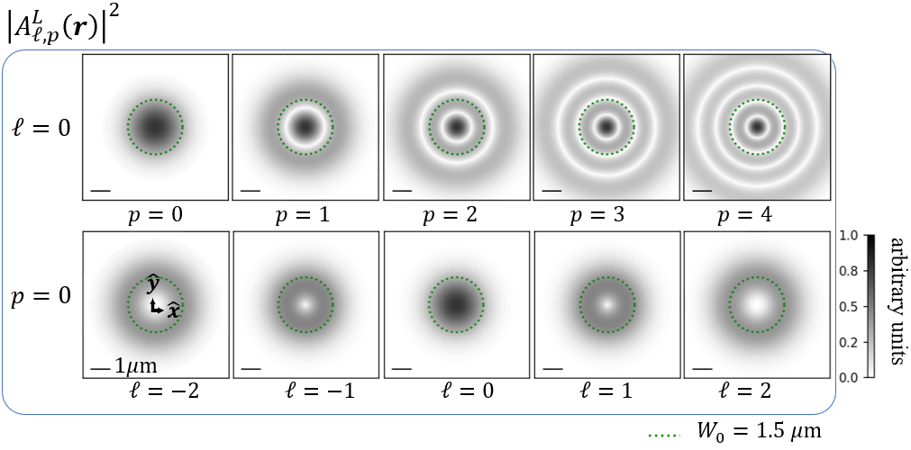
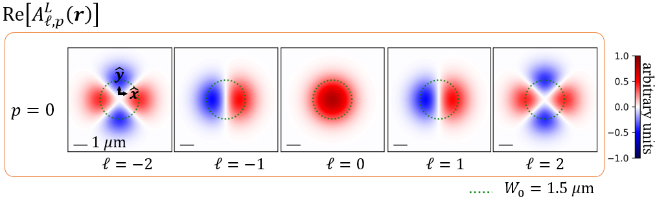
2. Laguerre-Gaussian (LG) beam : Distribution
LG beam is solved as vector potential $A\left(r\right)$ from paraxial Helmholtz equation within Lorentz gauge.
With long Rayleigh range approximation :
$$A_{σ,ℓ,p}^{L}\left(r\right)={\hat{ε}}_{σ} A_{ℓ,p}^{L}\left(r\right)≈{\hat{ε}}_{σ} f_{ℓ,p}\left(ρ\right)e^{iℓφ}e^{iq_{0}z}$$
$$f_{ℓ,p}\left(ρ\right)=A_{0}^{LG}\sqrt{\frac{2p!}{π\left(\left|ℓ\right|+p\right)!}}L_{p}^{\left|ℓ\right|}\left(\frac{2ρ^{2}}{W_{0}^{2}}\right){\left(\frac{\sqrt{2}ρ}{W_{0}}\right)}^{\left|ℓ\right|}e^{−\frac{ρ^{2}}{W_{0}^{2}}}$$
Helical wave front carrying OAM

Slide 27


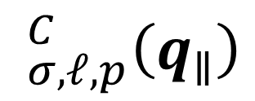
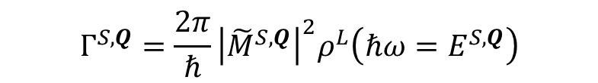

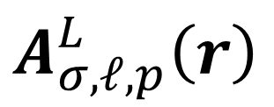
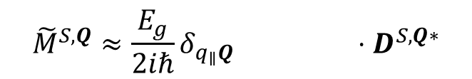
2. Laguerre-Gaussian (LG) beam : Requirement
$$A_{σ,ℓ,p}^{L}\left(r\right)$$
LG beam in real space / Lorentz gauge :
$$_{σ,ℓ,p}^{C}\left(q_{∥}\right)$$
LG beam in angular spectrum / Coulomb gauge :
What we really need
Theory of light matter interaction
$$Γ_{ }^{S,Q}=\frac{2π}{ℏ}{\left|{\tilde{M}}_{ }^{S,Q}\right|}^{2}ρ^{L}\left(ℏω=E_{ }^{S,Q}\right)$$
$${\tilde{M}}_{ }^{S,Q}≈\frac{E_{g}}{2iℏ}δ_{q_{∥}Q} ⋅D_{ }^{S,Q∗}$$
$$_{ }^{C}\left(q_{∥}\right)$$

Slide 28
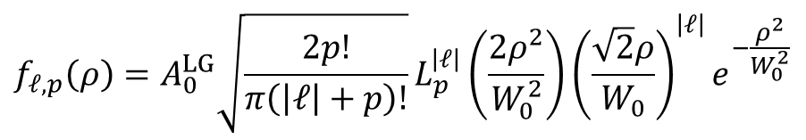
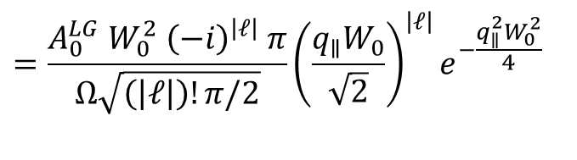
2. Laguerre-Gaussian (LG) beam : Angular spectrum
LG beam in Lorentz gauge / real space :
$$A_{σ,ℓ,p}^{L}\left(r\right)={\hat{ε}}_{σ} A_{ℓ,p}^{L}\left(r\right)≈{\hat{ε}}_{σ} f_{ℓ,p}\left(ρ\right)e^{iℓφ}e^{iq_{0}z}$$
$$f_{ℓ,p}\left(ρ\right)=A_{0}^{LG}\sqrt{\frac{2p!}{π\left(\left|ℓ\right|+p\right)!}}L_{p}^{\left|ℓ\right|}\left(\frac{2ρ^{2}}{W_{0}^{2}}\right){\left(\frac{\sqrt{2}ρ}{W_{0}}\right)}^{\left|ℓ\right|}e^{−\frac{ρ^{2}}{W_{0}^{2}}}$$
$$=\frac{A_{0}^{LG} W_{0}^{2} {\left(−i\right)}^{\left|ℓ\right|} π}{Ω\sqrt{\left(\left|ℓ\right|\right)!π/2}}{\left(\frac{q_{∥}W_{0}}{\sqrt{2}}\right)}^{\left|ℓ\right|}e^{−\frac{q_{∥}^{2}W_{0}^{2}}{4} }$$

Slide 29



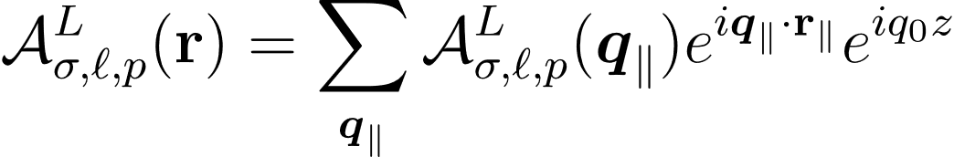
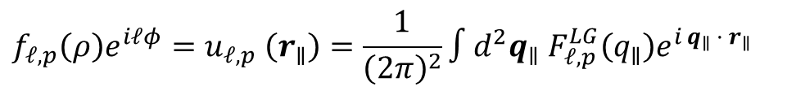



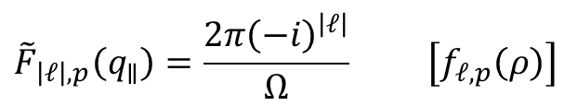

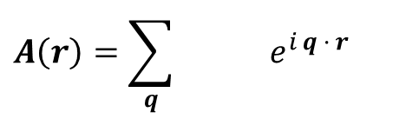
2. Laguerre-Gaussian (LG) beam : Angular spectrum
LG beam in Lorentz gauge / real space :
Method
$$A_{σ,ℓ,p}^{L}\left(r\right)={\hat{ε}}_{σ} A_{ℓ,p}^{L}\left(r\right)≈{\hat{ε}}_{σ} f_{ℓ,p}\left(ρ\right)e^{iℓφ}e^{iq_{0}z}$$
Expanded in plane-wave basis
$$A\left(r\right)=\sum_{q}{ e^{i q · r}}$$
$$f_{ℓ,p}\left(ρ\right)=A_{0}^{LG}\sqrt{\frac{2p!}{π\left(\left|ℓ\right|+p\right)!}}L_{p}^{\left|ℓ\right|}\left(\frac{2ρ^{2}}{W_{0}^{2}}\right){\left(\frac{\sqrt{2}ρ}{W_{0}}\right)}^{\left|ℓ\right|}e^{−\frac{ρ^{2}}{W_{0}^{2}}}$$
Define Fourier transformation
$$f_{ℓ,p}\left(ρ\right)e^{iℓφ}=u_{ℓ,p} \left(r_{∥}\right)=\frac{1}{{\left(2π\right)}^{2}}∫d^{2}q_{∥} F_{ℓ,p}^{LG}\left(q_{∥}\right)e^{i q_{∥} · r_{∥}}$$
LG beam in Lorentz gauge / angular spectrum :
$$F_{ℓ,p}^{LG}\left(q_{∥}\right)=∫d^{2}r_{∥} u_{ℓ,p}\left(r_{∥}\right)e^{−i q_{∥} · r_{∥}}$$
$$={\hat{ε}}_{σ}$$
$$≈{\hat{ε}}_{σ}{\tilde{F}}_{\left|ℓ\right|,p}\left(q_{∥}\right)e^{iℓφ_{q_{∥}}}$$
$${\tilde{F}}_{\left|ℓ\right|,p}\left(q_{∥}\right)=\frac{2π{\left(−i\right)}^{\left|ℓ\right|}}{Ω} \left[f_{ℓ,p}\left(ρ\right)\right]$$
Results
Hankel transform of order $\left|ℓ\right|$
$$=\frac{A_{0}^{LG} W_{0}^{2} {\left(−i\right)}^{\left|ℓ\right|} π}{Ω\sqrt{\left(\left|ℓ\right|\right)!π/2}}{\left(\frac{q_{∥}W_{0}}{\sqrt{2}}\right)}^{\left|ℓ\right|}e^{−\frac{q_{∥}^{2}W_{0}^{2}}{4} }$$

Slide 30
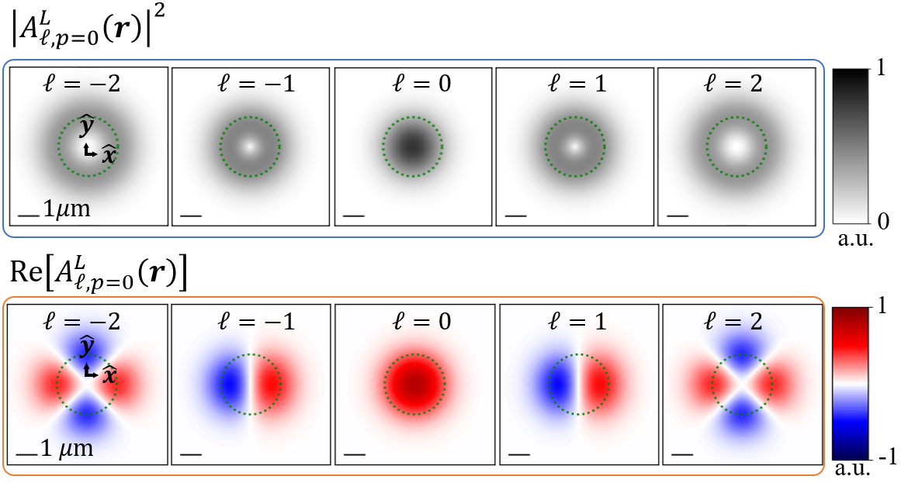
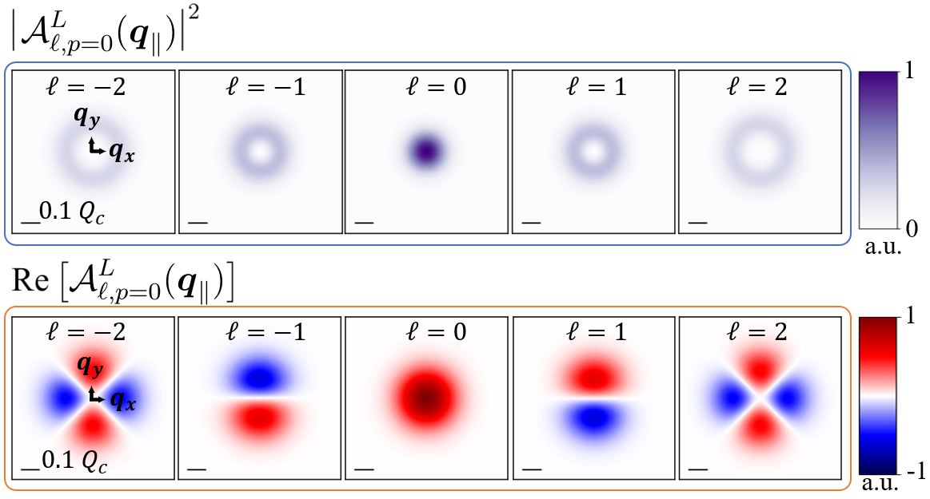
2. Laguerre-Gaussian (LG) beam : Angular spectrum
LG beam in Lorentz gauge / real space :
$$A_{σ,ℓ,p}^{L}\left(r\right)={\hat{ε}}_{σ} A_{ℓ,p}^{L}\left(r\right)≈{\hat{ε}}_{σ} f_{ℓ,p}\left(ρ\right)e^{iℓφ}e^{iq_{0}z}$$
$$f_{ℓ,p}\left(ρ\right)=A_{0}^{LG}\sqrt{\frac{2p!}{π\left(\left|ℓ\right|+p\right)!}}L_{p}^{\left|ℓ\right|}\left(\frac{2ρ^{2}}{W_{0}^{2}}\right){\left(\frac{\sqrt{2}ρ}{W_{0}}\right)}^{\left|ℓ\right|}e^{−\frac{ρ^{2}}{W_{0}^{2}}}$$
LG beam in Lorentz gauge / angular spectrum :
Similar structure
$$={\hat{ε}}_{σ}$$
$$≈{\hat{ε}}_{σ}{\tilde{F}}_{\left|ℓ\right|,p}\left(q_{∥}\right)e^{iℓφ_{q_{∥}}}$$
$${\tilde{F}}_{\left|ℓ\right|,p}\left(q_{∥}\right)=\frac{2π{\left(−i\right)}^{\left|ℓ\right|}}{Ω} \left[f_{ℓ,p}\left(ρ\right)\right]$$
Hankel transform of order $\left|ℓ\right|$
$$=\frac{A_{0}^{LG} W_{0}^{2} {\left(−i\right)}^{\left|ℓ\right|} π}{Ω\sqrt{\left(\left|ℓ\right|\right)!π/2}}{\left(\frac{q_{∥}W_{0}}{\sqrt{2}}\right)}^{\left|ℓ\right|}e^{−\frac{q_{∥}^{2}W_{0}^{2}}{4} }$$

Slide 31
2. Laguerre-Gaussian (LG) beam : Coulomb gauge
LG beam in Lorentz gauge / real space :
$$A_{σ,ℓ,p}^{L}\left(r\right)={\hat{ε}}_{σ} A_{ℓ,p}^{L}\left(r\right)≈{\hat{ε}}_{σ} f_{ℓ,p}\left(ρ\right)e^{iℓφ}e^{iq_{0}z}$$
$$f_{ℓ,p}\left(ρ\right)=A_{0}^{LG}\sqrt{\frac{2p!}{π\left(\left|ℓ\right|+p\right)!}}L_{p}^{\left|ℓ\right|}\left(\frac{2ρ^{2}}{W_{0}^{2}}\right){\left(\frac{\sqrt{2}ρ}{W_{0}}\right)}^{\left|ℓ\right|}e^{−\frac{ρ^{2}}{W_{0}^{2}}}$$

Slide 32
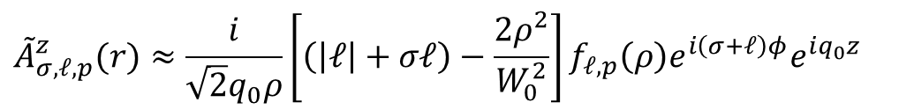
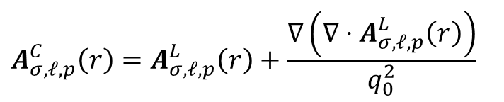
2. Laguerre-Gaussian (LG) beam : Coulomb gauge
LG beam in Lorentz gauge / real space :
LG beam in Coulomb gauge / real space:
$$A_{σ,ℓ,p}^{L}\left(r\right)={\hat{ε}}_{σ} A_{ℓ,p}^{L}\left(r\right)≈{\hat{ε}}_{σ} f_{ℓ,p}\left(ρ\right)e^{iℓφ}e^{iq_{0}z}$$
$$A_{σ,ℓ,p}\left(r\right)≡A_{σ,ℓ,p}^{C}\left(r\right)≈ {\tilde{A}}_{ℓ,p}^{∥}(r){\hat{ε}}_{σ}+{\tilde{A}}_{σ,ℓ,p}^{z}(r)\hat{z}$$
Transverse component :
$$f_{ℓ,p}\left(ρ\right)=A_{0}^{LG}\sqrt{\frac{2p!}{π\left(\left|ℓ\right|+p\right)!}}L_{p}^{\left|ℓ\right|}\left(\frac{2ρ^{2}}{W_{0}^{2}}\right){\left(\frac{\sqrt{2}ρ}{W_{0}}\right)}^{\left|ℓ\right|}e^{−\frac{ρ^{2}}{W_{0}^{2}}}$$
$${\tilde{A}}_{ℓ,p}^{∥}\left(r\right)≈f_{ℓ,p}\left(ρ\right)e^{iℓφ}e^{iq_{0}z}$$
Longitudinal component :
$${\tilde{A}}_{σ,ℓ,p}^{z}(r)≈\frac{i}{\sqrt{2}q_{0}ρ}\left[\left(\left|ℓ\right|+σℓ\right)−\frac{2ρ^{2}}{W_{0}^{2}}\right]f_{ℓ,p}\left(ρ\right)e^{i\left(σ+ℓ\right)φ}e^{iq_{0}z}$$
Additional component
Method
Relation from Maxwell’s equations
$$A_{σ,ℓ,p}^{C}\left(r\right)=A_{σ,ℓ,p}^{L}\left(r\right)+\frac{∇\left(∇⋅A_{σ,ℓ,p}^{L}\left(r\right)\right)}{q_{0}^{2}}$$

Slide 33
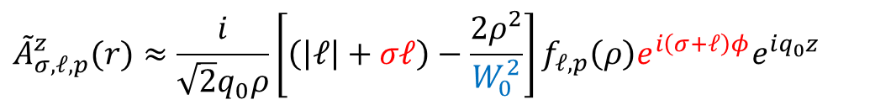
2. Laguerre-Gaussian (LG) beam : Coulomb gauge
LG beam in Lorentz gauge / real space :
LG beam in Coulomb gauge / real space:
$$A_{σ,ℓ,p}^{L}\left(r\right)={\hat{ε}}_{σ} A_{ℓ,p}^{L}\left(r\right)≈{\hat{ε}}_{σ} f_{ℓ,p}\left(ρ\right)e^{iℓφ}e^{iq_{0}z}$$
$$A_{σ,ℓ,p}\left(r\right)≡A_{σ,ℓ,p}^{C}\left(r\right)≈ {\tilde{A}}_{ℓ,p}^{∥}(r){\hat{ε}}_{σ}+{\tilde{A}}_{σ,ℓ,p}^{z}(r)\hat{z}$$
Transverse component :
$$f_{ℓ,p}\left(ρ\right)=A_{0}^{LG}\sqrt{\frac{2p!}{π\left(\left|ℓ\right|+p\right)!}}L_{p}^{\left|ℓ\right|}\left(\frac{2ρ^{2}}{W_{0}^{2}}\right){\left(\frac{\sqrt{2}ρ}{W_{0}}\right)}^{\left|ℓ\right|}e^{−\frac{ρ^{2}}{W_{0}^{2}}}$$
$${\tilde{A}}_{ℓ,p}^{∥}\left(r\right)≈f_{ℓ,p}\left(ρ\right)e^{iℓφ}e^{iq_{0}z}$$
Longitudinal component :
SOI
$${\tilde{A}}_{σ,ℓ,p}^{z}(r)≈\frac{i}{\sqrt{2}q_{0}ρ}\left[\left(\left|ℓ\right|+σℓ\right)−\frac{2ρ^{2}}{W_{0}^{2}}\right]f_{ℓ,p}\left(ρ\right)e^{i\left(σ+ℓ\right)φ}e^{iq_{0}z}$$

Slide 34

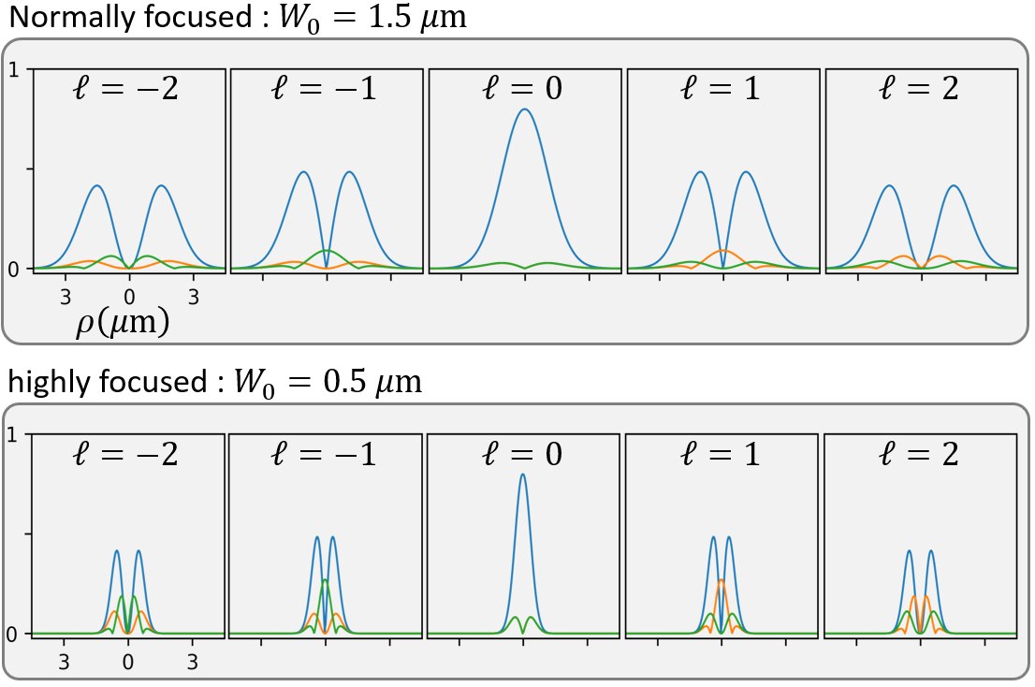



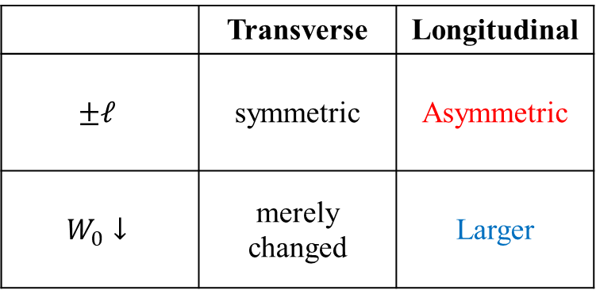
2. Laguerre-Gaussian (LG) beam : SOI appear
LG beam in Lorentz gauge / real space :
LG beam in Coulomb gauge / real space:
$$A_{σ,ℓ,p}^{L}\left(r\right)={\hat{ε}}_{σ} A_{ℓ,p}^{L}\left(r\right)≈{\hat{ε}}_{σ} f_{ℓ,p}\left(ρ\right)e^{iℓφ}e^{iq_{0}z}$$
$$A_{σ,ℓ,p}\left(r\right)≡A_{σ,ℓ,p}^{C}\left(r\right)≈ {\tilde{A}}_{ℓ,p}^{∥}(r){\hat{ε}}_{σ}+{\tilde{A}}_{σ,ℓ,p}^{z}(r)\hat{z}$$
Transverse component :
$$f_{ℓ,p}\left(ρ\right)=A_{0}^{LG}\sqrt{\frac{2p!}{π\left(\left|ℓ\right|+p\right)!}}L_{p}^{\left|ℓ\right|}\left(\frac{2ρ^{2}}{W_{0}^{2}}\right){\left(\frac{\sqrt{2}ρ}{W_{0}}\right)}^{\left|ℓ\right|}e^{−\frac{ρ^{2}}{W_{0}^{2}}}$$
$${\tilde{A}}_{ℓ,p}^{∥}\left(r\right)≈f_{ℓ,p}\left(ρ\right)e^{iℓφ}e^{iq_{0}z}$$
Longitudinal component :
SOI
$${\tilde{A}}_{σ,ℓ,p}^{z}(r)≈\frac{i}{\sqrt{2}q_{0}ρ}\left[\left(\left|ℓ\right|+σℓ\right)−\frac{2ρ^{2}}{W_{0}^{2}}\right]f_{ℓ,p}\left(ρ\right)e^{i\left(σ+ℓ\right)φ}e^{iq_{0}z}$$
$$\left|{\tilde{A}}_{ℓ, p=0}^{∥}\left(r\right)\right|$$
$$\left|{\tilde{A}}_{σ=1,ℓ, p=0}^{z}\left(r\right)\right|$$
$$\left|{\tilde{A}}_{σ=−1,ℓ, p=0}^{z}\left(r\right)\right|$$
$$W_{0}=1.5μm$$
a.u.
 | Transverse | Longitudinal
$$±ℓ$$ | symmetric | Asymmetric
$$W_{0}↓$$ | merely changed | Larger
$$W_{0}=0.5μm$$
SOI

Slide 35


2. Longitudinal component : SOI effect
LG beam solutions:
Real / Lorentz :
$$A_{σ,ℓ,p}^{L}\left(r\right)={\hat{ε}}_{σ} A_{ℓ,p}^{L}\left(r\right)≈{\hat{ε}}_{σ} f_{ℓ,p}\left(ρ\right)e^{iℓφ}e^{iq_{0}z}$$
Angular / Lorentz :
$$={\hat{ε}}_{σ}$$
$$≈{\hat{ε}}_{σ}{\tilde{F}}_{\left|ℓ\right|,p}\left(q_{∥}\right)e^{iℓφ_{q_{∥}}}$$
Real / Coulomb :
$$A_{σ,ℓ,p}\left(r\right)≡A_{σ,ℓ,p}^{C}\left(r\right)≈ {\tilde{A}}_{ℓ,p}^{∥}(r){\hat{ε}}_{σ}+{\tilde{A}}_{σ,ℓ,p}^{z}(r)\hat{z}$$

Slide 36

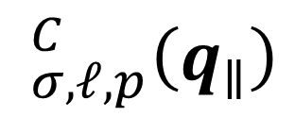
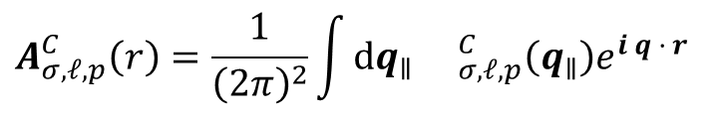
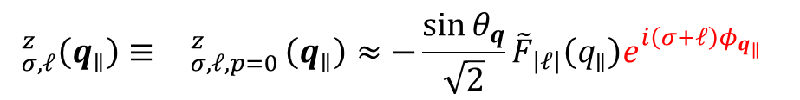
2. Longitudinal component : SOI effect
LG beam solutions:
Real / Lorentz :
$$_{σ,ℓ,p}^{C}\left(q_{∥}\right)$$
$$A_{σ,ℓ,p}^{L}\left(r\right)={\hat{ε}}_{σ} A_{ℓ,p}^{L}\left(r\right)≈{\hat{ε}}_{σ} f_{ℓ,p}\left(ρ\right)e^{iℓφ}e^{iq_{0}z}$$
What we really need
Angular / Lorentz :
LG beam in angular spectrum / Coulomb gauge :
$$={\hat{ε}}_{σ}$$
$$≈{\hat{ε}}_{σ}{\tilde{F}}_{\left|ℓ\right|,p}\left(q_{∥}\right)e^{iℓφ_{q_{∥}}}$$
$$_{σ,ℓ}\left(q_{∥}\right)≡ _{σ,ℓ,p=0}^{C}\left(q_{∥}\right)≈{ }_{ℓ,p}^{∥}(q_{∥}){\hat{ε}}_{σ}+{ }_{σ,ℓ,p}^{z}(q_{∥})\hat{z}$$
Real / Coulomb :
$$A_{σ,ℓ,p}\left(r\right)≡A_{σ,ℓ,p}^{C}\left(r\right)≈ {\tilde{A}}_{ℓ,p}^{∥}(r){\hat{ε}}_{σ}+{\tilde{A}}_{σ,ℓ,p}^{z}(r)\hat{z}$$
Transverse component :
$$_{ℓ}^{∥}\left(q_{∥}\right)≡ _{ℓ,p=0}^{∥}\left(q_{∥}\right)≈{\tilde{F}}_{\left|ℓ\right|}\left(q_{∥}\right)e^{iℓφ_{q_{∥}}}$$
Longitudinal component :
Method
$$_{σ,ℓ}^{z}\left(q_{∥}\right)≡ _{σ,ℓ,p=0}^{z}\left(q_{∥}\right)≈−\frac{\sin{θ_{q}}}{\sqrt{2}}{\tilde{F}}_{\left|ℓ\right|}\left(q_{∥}\right)e^{i\left(σ+ℓ\right)φ_{q_{∥}}}$$
Expanded in plane-wave basis
SOI
$$A_{σ,ℓ,p}^{C}\left(r\right)=\frac{1}{{\left(2π\right)}^{2}}\int_{ }^{ }{dq_{∥} _{σ,ℓ,p}^{C}\left(q_{∥}\right)e^{i q · r}}$$

Slide 37


2. Longitudinal component : SOI effect
Transverse component :
$$_{σ,ℓ,p}^{C}\left(q_{∥}\right)$$
LG beam in angular spectrum / Coulomb gauge :
$$_{σ,ℓ}\left(q_{∥}\right)≡ _{σ,ℓ,p=0}^{C}\left(q_{∥}\right)≈{ }_{ℓ,p}^{∥}(q_{∥}){\hat{ε}}_{σ}+{ }_{σ,ℓ,p}^{z}(q_{∥})\hat{z}$$
Longitudinal component :
Transverse component :
$$_{ℓ}^{∥}\left(q_{∥}\right)≡ _{ℓ,p=0}^{∥}\left(q_{∥}\right)≈{\tilde{F}}_{\left|ℓ\right|}\left(q_{∥}\right)e^{iℓφ_{q_{∥}}}$$
Longitudinal component :
$$_{σ,ℓ}^{z}\left(q_{∥}\right)≡ _{σ,ℓ,p=0}^{z}\left(q_{∥}\right)≈−\frac{\sin{θ_{q}}}{\sqrt{2}}{\tilde{F}}_{\left|ℓ\right|}\left(q_{∥}\right)e^{i\left(σ+ℓ\right)φ_{q_{∥}}}$$
SOI

Slide 38
2. Longitudinal component : SOI effect
Transverse component :
$$_{σ,ℓ,p}^{C}\left(q_{∥}\right)$$
LG beam in angular spectrum / Coulomb gauge :
$$_{σ,ℓ}\left(q_{∥}\right)≡ _{σ,ℓ,p=0}^{C}\left(q_{∥}\right)≈{ }_{ℓ,p}^{∥}(q_{∥}){\hat{ε}}_{σ}+{ }_{σ,ℓ,p}^{z}(q_{∥})\hat{z}$$
Longitudinal component :
Transverse component :
$$_{ℓ}^{∥}\left(q_{∥}\right)≡ _{ℓ,p=0}^{∥}\left(q_{∥}\right)≈{\tilde{F}}_{\left|ℓ\right|}\left(q_{∥}\right)e^{iℓφ_{q_{∥}}}$$
Longitudinal component :
$$_{σ,ℓ}^{z}\left(q_{∥}\right)≡ _{σ,ℓ,p=0}^{z}\left(q_{∥}\right)≈−\frac{\sin{θ_{q}}}{\sqrt{2}}{\tilde{F}}_{\left|ℓ\right|}\left(q_{∥}\right)e^{i\left(σ+ℓ\right)φ_{q_{∥}}}$$
SOI

Slide 39













2. Vector vortex beams (VVB)
Forming vector vortex beams (VVB) by Superimposing LG beams
$$_{σ,ℓ,σ^{′},ℓ^{′}}\left(q_{∥};α,β\right)=\cos\left(\frac{β}{2}\right){ }_{σ,ℓ}\left(q_{∥}\right)+e^{iα}\sin\left(\frac{β}{2}\right){ }_{σ^{′},ℓ^{′}}\left(q_{∥}\right)$$
$${ }_{σ,ℓ}\left(q_{∥}\right)$$
LG beams and vector vortex beams
F. Steinlechner et al., Sci. Rep. 6, 21390 (2016)
$$\frac{1}{\sqrt{2}}{ }_{σ,ℓ}\left(q_{∥}\right)−\frac{i}{\sqrt{2}}{ }_{σ^{′},ℓ^{′}}\left(q_{∥}\right)$$
$$z$$
$$\frac{1}{\sqrt{2}}{ }_{σ,ℓ}\left(q_{∥}\right)+\frac{1}{\sqrt{2}}{ }_{σ^{′},ℓ^{′}}\left(q_{∥}\right)$$
$$β$$
$$\frac{1}{\sqrt{2}}{ }_{σ,ℓ}\left(q_{∥}\right)−\frac{1}{\sqrt{2}}{ }_{σ^{′},ℓ^{′}}\left(q_{∥}\right)$$
$$x$$
$$α$$
LG beams and vector vortex beams (transverse plane)
Reproduced from Miles J. Padgett, International School on Parametric Nonlinear Optics (2015)
$$y$$
$$\frac{1}{\sqrt{2}}{ }_{σ,ℓ}\left(q_{∥}\right)+\frac{i}{\sqrt{2}}{ }_{σ^{′},ℓ^{′}}\left(q_{∥}\right)$$
$${ }_{σ^{′},ℓ^{′}}\left(q_{∥}\right)$$
Poincaré sphere for VVB states

Slide 40

2. Vector vortex beams (VVB)
Forming vector vortex beams (VVB) by Superimposing LG beams
$$_{σ,ℓ,σ^{′},ℓ^{′}}\left(q_{∥};α,β\right)=\cos\left(\frac{β}{2}\right){ }_{σ,ℓ}\left(q_{∥}\right)+e^{iα}\sin\left(\frac{β}{2}\right){ }_{σ^{′},ℓ^{′}}\left(q_{∥}\right)$$
$$={ }_{σ,ℓ,σ^{′},ℓ^{′}}^{∥}\left(q_{∥};α, β\right)+{ }_{σ,ℓ,σ^{′},ℓ^{′}}^{z}\left(q_{∥};α, β\right)$$
LG beams and vector vortex beams
F. Steinlechner et al., Sci. Rep. 6, 21390 (2016)
LG beams and vector vortex beams (transverse plane)
Reproduced from Miles J. Padgett, International School on Parametric Nonlinear Optics (2015)

Slide 41





2. Vector vortex beams (VVB)
Forming vector vortex beams (VVB) by Superimposing LG beams
$$_{σ,ℓ,σ^{′},ℓ^{′}}\left(q_{∥};α,β\right)=\cos\left(\frac{β}{2}\right){ }_{σ,ℓ}\left(q_{∥}\right)+e^{iα}\sin\left(\frac{β}{2}\right){ }_{σ^{′},ℓ^{′}}\left(q_{∥}\right)$$
$$={ }_{σ,ℓ,σ^{′},ℓ^{′}}^{∥}\left(q_{∥};α, β\right)+{ }_{σ,ℓ,σ^{′},ℓ^{′}}^{z}\left(q_{∥};α, β\right)$$
Define $Δℓ≡ℓ^{′}−ℓ$
$$2\overline{ℓ}≡ℓ^{′}+ℓ$$
$Δσ≡σ^{′}−σ$
$$2\overline{σ}≡σ^{′}+σ$$
LG beams and vector vortex beams
F. Steinlechner et al., Sci. Rep. 6, 21390 (2016)
$$={ }_{Δℓ,\overline{ℓ},Δσ,\overline{σ}}^{∥}\left(q_{∥};α, β\right)+{ }_{Δℓ,\overline{ℓ},Δσ,\overline{σ}}^{z}\left(q_{∥};α, β\right)$$
LG beams and vector vortex beams (transverse plane)
Reproduced from Miles J. Padgett, International School on Parametric Nonlinear Optics (2015)

Slide 42
2. Transverse component : Vector vortex beams (VVB)
Transverse component of VVB:
$${ }_{Δℓ,\overline{ℓ},Δσ,\overline{σ}}^{∥}\left(q_{∥};α, β\right)={ }_{Δℓ,\overline{ℓ} }^{x}\left(q_{∥};α, β\right)\hat{x}+{ }_{Δℓ,\overline{ℓ},Δσ,\overline{σ}}^{y}\left(q_{∥};α, β\right)\hat{y}$$

Slide 43

2. Transverse component : Vector vortex beams (VVB)
Transverse component of VVB:
$${ }_{Δℓ,\overline{ℓ},Δσ,\overline{σ}}^{∥}\left(q_{∥};α, β\right)={ }_{Δℓ,\overline{ℓ} }^{x}\left(q_{∥};α, β\right)\hat{x}+{ }_{Δℓ,\overline{ℓ},Δσ,\overline{σ}}^{y}\left(q_{∥};α, β\right)\hat{y}$$
Transverse component of VVB: $Δσ=−2,\overline{σ}=0$/ $β=\frac{π}{2}$
$${ }_{Δℓ,\overline{ℓ},−2,0 }^{∥}\left(q_{∥};α, β=\frac{π}{2}\right)$$
$$=\frac{1}{2}e^{i\left(\overline{ℓ}φ_{q_{∥}}+\frac{α}{2}\right)}\left\{cos\left[\frac{1}{2}\left(Δℓφ_{q_{∥}}+α\right)\right]\left[{\tilde{F}}_{\left|\overline{ℓ}−\frac{Δℓ}{2}\right|}\left(q_{∥}\right)+{\tilde{F}}_{\left|\overline{ℓ}+\frac{Δℓ}{2}\right|}\left(q_{∥}\right)\right]−i sin\left[\frac{1}{2}\left(Δℓφ_{q_{∥}}+α\right)\right]\left[{\tilde{F}}_{\left|\overline{ℓ}−\frac{Δℓ}{2}\right|}\left(q_{∥}\right)−{\tilde{F}}_{\left|\overline{ℓ}+\frac{Δℓ}{2}\right|}\left(q_{∥}\right)\right]\right\}\hat{x}$$
$$+\frac{1}{2}e^{i\left(\overline{ℓ}φ_{q_{∥}}+\frac{α}{2}\right)}\left\{sin\left[\frac{1}{2}\left(Δℓφ_{q_{∥}}+α\right)\right]\left[{\tilde{F}}_{\left|\overline{ℓ}−\frac{Δℓ}{2}\right|}\left(q_{∥}\right)+{\tilde{F}}_{\left|\overline{ℓ}+\frac{Δℓ}{2}\right|}\left(q_{∥}\right)\right]+i sin\left[\frac{1}{2}\left(Δℓφ_{q_{∥}}+α+π\right)\right]\left[{\tilde{F}}_{\left|\overline{ℓ}−\frac{Δℓ}{2}\right|}\left(q_{∥}\right)−{\tilde{F}}_{\left|\overline{ℓ}+\frac{Δℓ}{2}\right|}\left(q_{∥}\right)\right]\right\}\hat{y}$$

Slide 44

2. Transverse component : Vector vortex beams (VVB)
Transverse component of VVB:
$${ }_{Δℓ,\overline{ℓ},Δσ,\overline{σ}}^{∥}\left(q_{∥};α, β\right)={ }_{Δℓ,\overline{ℓ} }^{x}\left(q_{∥};α, β\right)\hat{x}+{ }_{Δℓ,\overline{ℓ},Δσ,\overline{σ}}^{y}\left(q_{∥};α, β\right)\hat{y}$$
Transverse component of VVB: $Δσ=−2,\overline{σ}=0$/ $β=\frac{π}{2}$
$${ }_{Δℓ,\overline{ℓ},−2,0 }^{∥}\left(q_{∥};α, β=\frac{π}{2}\right)$$
$$=\frac{1}{2}e^{i\left(\overline{ℓ}φ_{q_{∥}}+\frac{α}{2}\right)}\left\{cos\left[\frac{1}{2}\left(Δℓφ_{q_{∥}}+α\right)\right]\left[{\tilde{F}}_{\left|\overline{ℓ}−\frac{Δℓ}{2}\right|}\left(q_{∥}\right)+{\tilde{F}}_{\left|\overline{ℓ}+\frac{Δℓ}{2}\right|}\left(q_{∥}\right)\right]−i sin\left[\frac{1}{2}\left(Δℓφ_{q_{∥}}+α\right)\right]\left[{\tilde{F}}_{\left|\overline{ℓ}−\frac{Δℓ}{2}\right|}\left(q_{∥}\right)−{\tilde{F}}_{\left|\overline{ℓ}+\frac{Δℓ}{2}\right|}\left(q_{∥}\right)\right]\right\}\hat{x}$$
$$+\frac{1}{2}e^{i\left(\overline{ℓ}φ_{q_{∥}}+\frac{α}{2}\right)}\left\{sin\left[\frac{1}{2}\left(Δℓφ_{q_{∥}}+α\right)\right]\left[{\tilde{F}}_{\left|\overline{ℓ}−\frac{Δℓ}{2}\right|}\left(q_{∥}\right)+{\tilde{F}}_{\left|\overline{ℓ}+\frac{Δℓ}{2}\right|}\left(q_{∥}\right)\right]+i sin\left[\frac{1}{2}\left(Δℓφ_{q_{∥}}+α+π\right)\right]\left[{\tilde{F}}_{\left|\overline{ℓ}−\frac{Δℓ}{2}\right|}\left(q_{∥}\right)−{\tilde{F}}_{\left|\overline{ℓ}+\frac{Δℓ}{2}\right|}\left(q_{∥}\right)\right]\right\}\hat{y}$$
If ${\tilde{F}}_{\left|\overline{ℓ}−\frac{Δℓ}{2}\right|}\left(q_{∥}\right)={\tilde{F}}_{\left|\overline{ℓ}+\frac{Δℓ}{2}\right|}\left(q_{∥}\right)$
$${ }_{Δℓ,\overline{ℓ},−2,0}^{∥}\left(q_{∥};α, β=\frac{π}{2}\right)={\tilde{F}}_{\left|\overline{ℓ}±\frac{Δℓ}{2}\right|}\left(q_{∥}\right) e^{i\left(\overline{ℓ}φ_{q_{∥}}+\frac{α}{2}\right)}\left\{cos\left[\frac{1}{2}\left(Δℓφ_{q_{∥}}+α\right)\right]\hat{x}+sin\left[\frac{1}{2}\left(Δℓφ_{q_{∥}}+α\right)\right]\hat{y}\right\}$$
Doughnut shape
Linear polarization

Slide 45



2. Transverse component : Vector vortex beams (VVB)
Transverse component of VVB:
$${ }_{Δℓ,\overline{ℓ},−2,0}^{∥}\left(q_{∥};α, β=\frac{π}{2}\right)={\tilde{F}}_{\left|\overline{ℓ}±\frac{Δℓ}{2}\right|}\left(q_{∥}\right) e^{i\left(\overline{ℓ}φ_{q_{∥}}+\frac{α}{2}\right)}\left\{cos\left[\frac{1}{2}\left(Δℓφ_{q_{∥}}+α\right)\right]\hat{x}+sin\left[\frac{1}{2}\left(Δℓφ_{q_{∥}}+α\right)\right]\hat{y}\right\}$$
Doughnut shape
Linear polarization
$$\left|\overline{ℓ}−\frac{Δℓ}{2}\right|=\left|ℓ\right|=\left|ℓ^{′}\right|=\left|\overline{ℓ}+\frac{Δℓ}{2}\right|$$
Conditions for ${\tilde{F}}_{\left|\overline{ℓ}−\frac{Δℓ}{2}\right|}\left(q_{∥}\right)={\tilde{F}}_{\left|\overline{ℓ}+\frac{Δℓ}{2}\right|}\left(q_{∥}\right)$ in LG beams
$ℓ=ℓ^{′}$
$ℓ=−ℓ′$

Slide 46

















2. Transverse component : Vector vortex beams (VVB)
First case : $ℓ=ℓ^{′}$
$${ }_{0,ℓ,−2,0}^{∥}\left(q_{∥};α, β=\frac{π}{2}\right)={\tilde{F}}_{\left|ℓ\right|}\left(q_{∥}\right) e^{i\left(ℓφ_{q_{∥}}+\frac{α}{2}\right)}\left\{cos\left(\frac{α}{2}\right)\hat{x}+sin\left(\frac{α}{2}\right)\hat{y}\right\}$$
Doughnut shape
Linear polarization changed with $α$
$$ℓ=0$$
$$ℓ=−1$$
$$ℓ=2$$
$$σ, ℓ,σ^{′},ℓ^{′}=1, 2, −1, 2$$
$$−1, −1$$
$${ }_{0,2,−2,0 }^{∥}$$

Slide 47








2. Transverse component : Vector vortex beams (VVB)
Second case : $ℓ=−ℓ^{′}$
$${ }_{−2ℓ,0,−2,0}^{∥}\left(q_{∥};α, β=\frac{π}{2}\right)={\tilde{F}}_{\left|ℓ\right|}\left(q_{∥}\right) e^{i\frac{α}{2}}\left\{cos\left(−ℓφ_{q_{∥}}+\frac{α}{2}\right)\hat{x}+sin\left(−ℓφ_{q_{∥}}+\frac{α}{2}\right)\hat{y}\right\}$$
Doughnut shape
Linear polarization changed with $α$ and$ℓ$
$$ℓ=0$$
$$ℓ=−1$$
$$ℓ=2$$
$${ }_{−4,0,−2,0 }^{∥}$$

Slide 48


2. Longitudinal component : Vector vortex beams (VVB)
Longitudinal component of VVB:
$${ }_{Δℓ,\overline{ℓ},Δσ,\overline{σ}}^{z}\left(q_{∥};α, β\right)$$
$$=−\frac{\sin{θ_{q}}}{\sqrt{2}}e^{i\left(\left(\overline{ℓ}+\overline{σ}\right)φ_{q_{∥}}+\frac{α}{2}\right)}\left\{cos\left[\frac{1}{2}\left(\left(Δℓ+Δσ\right)φ_{q_{∥}}+α\right)\right]\left[\cos\left(\frac{β}{2}\right){\tilde{F}}_{\left|\overline{ℓ}−\frac{Δℓ}{2}\right|}\left(q_{∥}\right)+\sin\left(\frac{β}{2}\right){\tilde{F}}_{\left|\overline{ℓ}+\frac{Δℓ}{2}\right|}\left(q_{∥}\right)\right]−i sin\left[\frac{1}{2}\left(\left(Δℓ+Δσ\right)φ_{q_{∥}}+α\right)\right]\left[\cos\left(\frac{β}{2}\right){\tilde{F}}_{\left|\overline{ℓ}−\frac{Δℓ}{2}\right|}\left(q_{∥}\right)−\sin\left(\frac{β}{2}\right){\tilde{F}}_{\left|\overline{ℓ}+\frac{Δℓ}{2}\right|}\left(q_{∥}\right)\right]\right\}\hat{z}$$

Slide 49



2. Longitudinal component : Vector vortex beams (VVB)
Longitudinal component of VVB:
$${ }_{Δℓ,\overline{ℓ},Δσ,\overline{σ}}^{z}\left(q_{∥};α, β\right)$$
$$=−\frac{\sin{θ_{q}}}{\sqrt{2}}e^{i\left(\left(\overline{ℓ}+\overline{σ}\right)φ_{q_{∥}}+\frac{α}{2}\right)}\left\{cos\left[\frac{1}{2}\left(\left(Δℓ+Δσ\right)φ_{q_{∥}}+α\right)\right]\left[\cos\left(\frac{β}{2}\right){\tilde{F}}_{\left|\overline{ℓ}−\frac{Δℓ}{2}\right|}\left(q_{∥}\right)+\sin\left(\frac{β}{2}\right){\tilde{F}}_{\left|\overline{ℓ}+\frac{Δℓ}{2}\right|}\left(q_{∥}\right)\right]−i sin\left[\frac{1}{2}\left(\left(Δℓ+Δσ\right)φ_{q_{∥}}+α\right)\right]\left[\cos\left(\frac{β}{2}\right){\tilde{F}}_{\left|\overline{ℓ}−\frac{Δℓ}{2}\right|}\left(q_{∥}\right)−\sin\left(\frac{β}{2}\right){\tilde{F}}_{\left|\overline{ℓ}+\frac{Δℓ}{2}\right|}\left(q_{∥}\right)\right]\right\}\hat{z}$$
Define $ΔJ≡Δℓ+Δσ$
$$\overline{J}≡\overline{ℓ}+\overline{σ}$$
Longitudinal component of VVB: $β=\frac{π}{2}$
$${ }_{Δℓ,\overline{ℓ},ΔJ,\overline{J}}^{z}\left(q_{∥};α, β=\frac{π}{2}\right)$$
$$=−\frac{\sin{θ_{q}}}{2}e^{i\left(\overline{J}φ_{q_{∥}}+\frac{α}{2}\right)}\left\{cos\left[\frac{1}{2}\left(ΔJφ_{q_{∥}}+α\right)\right]\left[{\tilde{F}}_{\left|\overline{ℓ}−\frac{Δℓ}{2}\right|}\left(q_{∥}\right)+{\tilde{F}}_{\left|\overline{ℓ}+\frac{Δℓ}{2}\right|}\left(q_{∥}\right)\right]−i sin\left[\frac{1}{2}\left(ΔJφ_{q_{∥}}+α\right)\right]\left[{\tilde{F}}_{\left|\overline{ℓ}−\frac{Δℓ}{2}\right|}\left(q_{∥}\right)−{\tilde{F}}_{\left|\overline{ℓ}+\frac{Δℓ}{2}\right|}\left(q_{∥}\right)\right]\right\}\hat{z}$$

Slide 50
2. Longitudinal component : Vector vortex beams (VVB)
Longitudinal component of VVB:
$${ }_{Δℓ,\overline{ℓ},Δσ,\overline{σ}}^{z}\left(q_{∥};α, β\right)$$
$$=−\frac{\sin{θ_{q}}}{\sqrt{2}}e^{i\left(\left(\overline{ℓ}+\overline{σ}\right)φ_{q_{∥}}+\frac{α}{2}\right)}\left\{cos\left[\frac{1}{2}\left(\left(Δℓ+Δσ\right)φ_{q_{∥}}+α\right)\right]\left[\cos\left(\frac{β}{2}\right){\tilde{F}}_{\left|\overline{ℓ}−\frac{Δℓ}{2}\right|}\left(q_{∥}\right)+\sin\left(\frac{β}{2}\right){\tilde{F}}_{\left|\overline{ℓ}+\frac{Δℓ}{2}\right|}\left(q_{∥}\right)\right]−i sin\left[\frac{1}{2}\left(\left(Δℓ+Δσ\right)φ_{q_{∥}}+α\right)\right]\left[\cos\left(\frac{β}{2}\right){\tilde{F}}_{\left|\overline{ℓ}−\frac{Δℓ}{2}\right|}\left(q_{∥}\right)−\sin\left(\frac{β}{2}\right){\tilde{F}}_{\left|\overline{ℓ}+\frac{Δℓ}{2}\right|}\left(q_{∥}\right)\right]\right\}\hat{z}$$
Define $ΔJ≡Δℓ+Δσ$
$$\overline{J}≡\overline{ℓ}+\overline{σ}$$
Longitudinal component of VVB: $β=\frac{π}{2}$
$${ }_{Δℓ,\overline{ℓ},ΔJ,\overline{J}}^{z}\left(q_{∥};α, β=\frac{π}{2}\right)$$
$$=−\frac{\sin{θ_{q}}}{2}e^{i\left(\overline{J}φ_{q_{∥}}+\frac{α}{2}\right)}\left\{cos\left[\frac{1}{2}\left(ΔJφ_{q_{∥}}+α\right)\right]\left[{\tilde{F}}_{\left|\overline{ℓ}−\frac{Δℓ}{2}\right|}\left(q_{∥}\right)+{\tilde{F}}_{\left|\overline{ℓ}+\frac{Δℓ}{2}\right|}\left(q_{∥}\right)\right]−i sin\left[\frac{1}{2}\left(ΔJφ_{q_{∥}}+α\right)\right]\left[{\tilde{F}}_{\left|\overline{ℓ}−\frac{Δℓ}{2}\right|}\left(q_{∥}\right)−{\tilde{F}}_{\left|\overline{ℓ}+\frac{Δℓ}{2}\right|}\left(q_{∥}\right)\right]\right\}\hat{z}$$
If ${\tilde{F}}_{\left|\overline{ℓ}−\frac{Δℓ}{2}\right|}\left(q_{∥}\right)={\tilde{F}}_{\left|\overline{ℓ}+\frac{Δℓ}{2}\right|}\left(q_{∥}\right)$
$${ }_{Δℓ,\overline{ℓ},ΔJ,\overline{J}}^{z}\left(q_{∥};α, β=\frac{π}{2}\right)=−\frac{\sin{θ_{q}}}{2}{\tilde{F}}_{\left|\overline{ℓ}±\frac{Δℓ}{2}\right|}\left(q_{∥}\right) e^{i\left(\overline{J}φ_{q_{∥}}+\frac{α}{2}\right)} cos\left[\frac{1}{2}\left(ΔJφ_{q_{∥}}+α\right)\right] \hat{z}$$
Doughnut shape
Azimuthal structure

Slide 51


















2. Longitudinal component : Vector vortex beams (VVB)
First case : $ℓ=ℓ^{′}$
$${ }_{0,ℓ,Δσ, ℓ+\overline{σ}}^{z}\left(q_{∥};α, β=\frac{π}{2}\right)=−\frac{\sin{θ_{q}}}{2}{\tilde{F}}_{\left|ℓ\right|}\left(q_{∥}\right) e^{i\left(\left(ℓ+\overline{σ}\right)φ_{q_{∥}}+\frac{α}{2}\right)} cos\left[\frac{1}{2}\left(Δσφ_{q_{∥}}+α\right)\right] \hat{z}$$
Doughnut shape
Azimuthal structure
Same spin : $Δσ=0$
$⇒$0 node
Opposite spin : $Δσ=−2$
$⇒ 2$ nodes
$$ℓ=0$$
$$ℓ=−1$$
$$ℓ=0$$
$$ℓ=−1$$
$${ }_{0,ℓ,Δσ, ℓ+\overline{σ}}^{z}$$
$${ }_{0,−1,−2,−1 }^{z}$$

Slide 52
















2. Longitudinal component : Vector vortex beams (VVB)
Second case : $ℓ=−ℓ^{′}$
$${ }_{−2ℓ,0,−2ℓ+Δσ, \overline{σ}}^{z}\left(q_{∥};α, β=\frac{π}{2}\right)=−\frac{\sin{θ_{q}}}{2}{\tilde{F}}_{\left|ℓ\right|}\left(q_{∥}\right) e^{i\left(\overline{σ}φ_{q_{∥}}+\frac{α}{2}\right)} cos\left\{\frac{1}{2}\left[\left(−2ℓ+Δσ\right)φ_{q_{∥}}+α\right]\right\} \hat{z}$$
Doughnut shape
Azimuthal structure
Total AM difference: $ΔJ=−2ℓ+Δσ$
$⇒$even number of nodes
$$ΔJ=−4$$
$$ΔJ=−2$$
$$ΔJ=0$$
$$ΔJ=2$$
$${ }_{−2ℓ,0,ΔJ=−2ℓ+Δσ,\overline{J}=\overline{σ}}^{z}$$
$${ }_{−2,0,−4,0 }^{z}$$
$${ }_{−2ℓ,0,−2ℓ−2,0}^{z}$$

Slide 53
2. Longitudinal component : Vector vortex beams (VVB)
Can we have odd numbers of nodes ?

Slide 54

2. Longitudinal component : Vector vortex beams (VVB)
Can we have odd numbers of nodes ?
Longitudinal component of VVB: $β=\frac{π}{2}$
$${ }_{Δℓ,\overline{ℓ},ΔJ,\overline{J}}^{z}\left(q_{∥};α, β=\frac{π}{2}\right)$$
$$=−\frac{\sin{θ_{q}}}{2}e^{i\left(\overline{J}φ_{q_{∥}}+\frac{α}{2}\right)}\left\{cos\left[\frac{1}{2}\left(ΔJφ_{q_{∥}}+α\right)\right]\left[{\tilde{F}}_{\left|ℓ\right|}\left(q_{∥}\right)+{\tilde{F}}_{\left|ℓ^{′}\right|}\left(q_{∥}\right)\right]−i sin\left[\frac{1}{2}\left(ΔJφ_{q_{∥}}+α\right)\right]\left[{\tilde{F}}_{\left|ℓ\right|}\left(q_{∥}\right)−{\tilde{F}}_{\left|ℓ^{′}\right|}\left(q_{∥}\right)\right]\right\}\hat{z}$$

Slide 55

2. Longitudinal component : Vector vortex beams (VVB)
Can we have odd numbers of nodes ?
Longitudinal component of VVB: $β=\frac{π}{2}$
$${ }_{Δℓ,\overline{ℓ},ΔJ,\overline{J}}^{z}\left(q_{∥};α, β=\frac{π}{2}\right)$$
$$=−\frac{\sin{θ_{q}}}{2}e^{i\left(\overline{J}φ_{q_{∥}}+\frac{α}{2}\right)}\left\{cos\left[\frac{1}{2}\left(ΔJφ_{q_{∥}}+α\right)\right]\left[{\tilde{F}}_{\left|ℓ\right|}\left(q_{∥}\right)+{\tilde{F}}_{\left|ℓ^{′}\right|}\left(q_{∥}\right)\right]−i sin\left[\frac{1}{2}\left(ΔJφ_{q_{∥}}+α\right)\right]\left[{\tilde{F}}_{\left|ℓ\right|}\left(q_{∥}\right)−{\tilde{F}}_{\left|ℓ^{′}\right|}\left(q_{∥}\right)\right]\right\}\hat{z}$$
Substitute ${\tilde{F}}_{\left|ℓ\right|}\left(q_{∥}\right)={\left(−i\right)}^{\left|ℓ\right|}F_{\left|ℓ\right|}\left(q_{∥}\right)$, and define $\overline{\left|ℓ\right|}≡\left(\left|ℓ′\right|+\left|ℓ\right|\right)/2$, $Δ\left|ℓ\right|≡\left|ℓ′\right|−\left|ℓ\right|$
$${ }_{Δℓ,\overline{ℓ},ΔJ,\overline{J}}^{z}\left(q_{∥};α, β=\frac{π}{2}\right)$$
$$=−\frac{\sin{θ_{q}}}{2}e^{i\left(\overline{J}φ_{q_{∥}}−\frac{π}{2}\overline{\left|ℓ\right|}+\frac{α}{2}\right)}\left\{cos\left[\frac{1}{2}\left(ΔJφ_{q_{∥}}−\frac{π}{2}Δ\left|ℓ\right|+α\right)\right]\left[F_{\left|ℓ\right|}\left(q_{∥}\right)+F_{\left|ℓ^{′}\right|}\left(q_{∥}\right)\right]+i sin\left[\frac{1}{2}\left(ΔJφ_{q_{∥}}−\frac{π}{2}Δ\left|ℓ\right|+α\right)\right]\left[F_{\left|ℓ\right|}\left(q_{∥}\right)−F_{\left|ℓ^{′}\right|}\left(q_{∥}\right)\right]\right\}\hat{z}$$

Slide 56



2. Longitudinal component : Vector vortex beams (VVB)
Can we have odd numbers of nodes ?
Longitudinal component of VVB: $β=\frac{π}{2}$
$${ }_{Δℓ,\overline{ℓ},ΔJ,\overline{J}}^{z}\left(q_{∥};α, β=\frac{π}{2}\right)$$
$$=−\frac{\sin{θ_{q}}}{2}e^{i\left(\overline{J}φ_{q_{∥}}+\frac{α}{2}\right)}\left\{cos\left[\frac{1}{2}\left(ΔJφ_{q_{∥}}+α\right)\right]\left[{\tilde{F}}_{\left|ℓ\right|}\left(q_{∥}\right)+{\tilde{F}}_{\left|ℓ^{′}\right|}\left(q_{∥}\right)\right]−i sin\left[\frac{1}{2}\left(ΔJφ_{q_{∥}}+α\right)\right]\left[{\tilde{F}}_{\left|ℓ\right|}\left(q_{∥}\right)−{\tilde{F}}_{\left|ℓ^{′}\right|}\left(q_{∥}\right)\right]\right\}\hat{z}$$
Substitute ${\tilde{F}}_{\left|ℓ\right|}\left(q_{∥}\right)={\left(−i\right)}^{\left|ℓ\right|}F_{\left|ℓ\right|}\left(q_{∥}\right)$, and define $\overline{\left|ℓ\right|}≡\left(\left|ℓ′\right|+\left|ℓ\right|\right)/2$, $Δ\left|ℓ\right|≡\left|ℓ′\right|−\left|ℓ\right|$
$${ }_{Δℓ,\overline{ℓ},ΔJ,\overline{J}}^{z}\left(q_{∥};α, β=\frac{π}{2}\right)$$
$$=−\frac{\sin{θ_{q}}}{2}e^{i\left(\overline{J}φ_{q_{∥}}−\frac{π}{2}\overline{\left|ℓ\right|}+\frac{α}{2}\right)}\left\{cos\left[\frac{1}{2}\left(ΔJφ_{q_{∥}}−\frac{π}{2}Δ\left|ℓ\right|+α\right)\right]\left[F_{\left|ℓ\right|}\left(q_{∥}\right)+F_{\left|ℓ^{′}\right|}\left(q_{∥}\right)\right]−i sin\left[\frac{1}{2}\left(ΔJφ_{q_{∥}}−\frac{π}{2}Δ\left|ℓ\right|+α\right)\right]\left[F_{\left|ℓ\right|}\left(q_{∥}\right)−F_{\left|ℓ^{′}\right|}\left(q_{∥}\right)\right]\right\}\hat{z}$$
Define $G_{\left|ℓ\right|,\left|ℓ^{′}\right|}\left(q_{∥}\right)≡\left[F_{\left|ℓ\right|}\left(q_{∥}\right)+F_{\left|ℓ^{′}\right|}\left(q_{∥}\right)\right]$
$$H_{\left|ℓ\right|,\left|ℓ^{′}\right|}\left(q_{∥}\right)≡\left[F_{\left|ℓ\right|}\left(q_{∥}\right)−F_{\left|ℓ^{′}\right|}\left(q_{∥}\right)\right]$$
$${ }_{Δℓ,\overline{ℓ},ΔJ,\overline{J}}^{z}\left(q_{∥};α, β=\frac{π}{2}\right)$$
$$=−\frac{\sin{θ_{q}}}{2}e^{i\left(\overline{J}φ_{q_{∥}}−\frac{π}{2}\overline{\left|ℓ\right|}+\frac{α}{2}\right)}\left\{ cos\left[\frac{1}{2}\left(ΔJφ_{q_{∥}}−\frac{π}{2}Δ\left|ℓ\right|+α\right)\right] G_{\left|ℓ\right|,\left|ℓ^{′}\right|}\left(q_{∥}\right)− i sin\left[\frac{1}{2}\left(ΔJφ_{q_{∥}}−\frac{π}{2}Δ\left|ℓ\right|+α\right)\right] H_{\left|ℓ\right|,\left|ℓ^{′}\right|}\left(q_{∥}\right) \right\}\hat{z}$$
$$=−\frac{\sin{θ_{q}}}{\sqrt{2}}e^{i\left(\overline{J}φ_{q_{∥}}−\frac{π}{2}\overline{\left|ℓ\right|}+\frac{α}{2}\right)}\left\{cos\left[\frac{1}{2}\left(ΔJφ_{q_{∥}}−\frac{π}{2}Δ\left|ℓ\right|+α\right)\right]\left[\cos\left(\frac{β}{2}\right)F_{\left|\overline{ℓ}−\frac{Δℓ}{2}\right|}\left(q_{∥}\right)+\sin\left(\frac{β}{2}\right)F_{\left|\overline{ℓ}+\frac{Δℓ}{2}\right|}\left(q_{∥}\right)\right]\right\}\hat{z}$$
$$−\frac{\sin{θ_{q}}}{\sqrt{2}}e^{i\left(\overline{J}φ_{q_{∥}}−\frac{π}{2}\overline{\left|ℓ\right|}+\frac{α}{2}\right)}\left\{i cos\left[\frac{1}{2}\left(ΔJφ_{q_{∥}}−\frac{π}{2}Δ\left|ℓ\right|+α+π\right)\right]\left[\cos\left(\frac{β}{2}\right)F_{\left|\overline{ℓ}−\frac{Δℓ}{2}\right|}\left(q_{∥}\right)−\sin\left(\frac{β}{2}\right)F_{\left|\overline{ℓ}+\frac{Δℓ}{2}\right|}\left(q_{∥}\right)\right]\right\}\hat{z}$$

Slide 57











2. Longitudinal component : Vector vortex beams (VVB)
Longitudinal component of VVB: $β=\frac{π}{2}$
$${ }_{Δℓ,\overline{ℓ},ΔJ,\overline{J}}^{z}\left(q_{∥};α, β=\frac{π}{2}\right)$$
$$=−\frac{\sin{θ_{q}}}{2}e^{i\left(\overline{J}φ_{q_{∥}}−\frac{π}{2}\overline{\left|ℓ\right|}+\frac{α}{2}\right)}\left\{ cos\left[\frac{1}{2}\left(ΔJφ_{q_{∥}}−\frac{π}{2}Δ\left|ℓ\right|+α\right)\right] G_{\left|ℓ\right|,\left|ℓ^{′}\right|}\left(q_{∥}\right)− i sin\left[\frac{1}{2}\left(ΔJφ_{q_{∥}}−\frac{π}{2}Δ\left|ℓ\right|+α\right)\right] H_{\left|ℓ\right|,\left|ℓ^{′}\right|}\left(q_{∥}\right) \right\}\hat{z}$$
Example for odd number $ΔJ$: $σ,ℓ,σ^{′},ℓ^{′}=1, −1, −1, 2$
$1$
$$ΔJ=1$$
$⇒$one node
$$a.u.$$
$0$
$${ }_{−2ℓ,0,ΔJ=−2ℓ+Δσ,\overline{J}=\overline{σ}}^{z}$$
$${ }_{3,\frac{1}{2},1,\frac{1}{4}}^{z}$$

Slide 58






2. Longitudinal component : Vector vortex beams (VVB)
Longitudinal component of VVB: $β=\frac{π}{2}$
$${ }_{Δℓ,\overline{ℓ},ΔJ,\overline{J}}^{z}\left(q_{∥};α, β=\frac{π}{2}\right)$$
$$=−\frac{\sin{θ_{q}}}{2}e^{i\left(\overline{J}φ_{q_{∥}}−\frac{π}{2}\overline{\left|ℓ\right|}+\frac{α}{2}\right)}\left\{ cos\left[\frac{1}{2}\left(ΔJφ_{q_{∥}}−\frac{π}{2}Δ\left|ℓ\right|+α\right)\right] G_{\left|ℓ\right|,\left|ℓ^{′}\right|}\left(q_{∥}\right)− i sin\left[\frac{1}{2}\left(ΔJφ_{q_{∥}}−\frac{π}{2}Δ\left|ℓ\right|+α\right)\right] H_{\left|ℓ\right|,\left|ℓ^{′}\right|}\left(q_{∥}\right) \right\}\hat{z}$$
$1$
$$\left(α, β\right)=\left(0, π/2\right)$$
But ! For $α=0$, node appear when $φ_{q_{∥}}=\frac{3π}{2}$
$$cos\left[\frac{1}{2}\left(ΔJφ_{q_{∥}}−\frac{π}{2}Δ\left|ℓ\right|+α\right)\right]=cos\left[\frac{π}{2}\right]=0$$
here
$$sin\left[\frac{1}{2}\left(ΔJφ_{q_{∥}}−\frac{π}{2}Δ\left|ℓ\right|+α\right)\right] =sin\left[\frac{π}{2}\right] =1$$
Maximum value !?
$$a.u.$$
$0$
$σ,ℓ,σ^{′},ℓ^{′}=1, −1, −1, 2$
$${ }_{−2ℓ,0,ΔJ=−2ℓ+Δσ,\overline{J}=\overline{σ}}^{z}$$
$${ }_{3,\frac{1}{2},1,\frac{1}{4}}^{z}$$

Slide 59








2. Longitudinal component : Vector vortex beams (VVB)
Longitudinal component of VVB: $β=\frac{π}{2}$
$${ }_{Δℓ,\overline{ℓ},ΔJ,\overline{J}}^{z}\left(q_{∥};α, β=\frac{π}{2}\right)$$
$$=−\frac{\sin{θ_{q}}}{2}e^{i\left(\overline{J}φ_{q_{∥}}−\frac{π}{2}\overline{\left|ℓ\right|}+\frac{α}{2}\right)}\left\{ cos\left[\frac{1}{2}\left(ΔJφ_{q_{∥}}−\frac{π}{2}Δ\left|ℓ\right|+α\right)\right] G_{\left|ℓ\right|,\left|ℓ^{′}\right|}\left(q_{∥}\right)− i sin\left[\frac{1}{2}\left(ΔJφ_{q_{∥}}−\frac{π}{2}Δ\left|ℓ\right|+α\right)\right] H_{\left|ℓ\right|,\left|ℓ^{′}\right|}\left(q_{∥}\right) \right\}\hat{z}$$
$1$
$1$
$0$.05
$$a.u.$$
$0$
$$a.u.$$
$0$
$$a.u.$$
$0$
$$G_{\left|ℓ\right|,\left|ℓ^{′}\right|}\left(q_{∥}\right)≡\left[F_{\left|ℓ\right|}\left(q_{∥}\right)+F_{\left|ℓ^{′}\right|}\left(q_{∥}\right)\right]$$
$$H_{\left|ℓ\right|,\left|ℓ^{′}\right|}\left(q_{∥}\right)≡\left[F_{\left|ℓ\right|}\left(q_{∥}\right)−F_{\left|ℓ^{′}\right|}\left(q_{∥}\right)\right]$$
$σ,ℓ,σ^{′},ℓ^{′}=1, −1, −1, 2$
Nearly zero

Slide 60

2. Longitudinal component : Vector vortex beams (VVB)
Longitudinal component of VVB: $β=\frac{π}{2}$
$${ }_{Δℓ,\overline{ℓ},ΔJ,\overline{J}}^{z}\left(q_{∥};α, β=\frac{π}{2}\right)$$
$$=−\frac{\sin{θ_{q}}}{2}e^{i\left(\overline{J}φ_{q_{∥}}−\frac{π}{2}\overline{\left|ℓ\right|}+\frac{α}{2}\right)}\left\{ cos\left[\frac{1}{2}\left(ΔJφ_{q_{∥}}−\frac{π}{2}Δ\left|ℓ\right|+α\right)\right] G_{\left|ℓ\right|,\left|ℓ^{′}\right|}\left(q_{∥}\right)− i sin\left[\frac{1}{2}\left(ΔJφ_{q_{∥}}−\frac{π}{2}Δ\left|ℓ\right|+α\right)\right] H_{\left|ℓ\right|,\left|ℓ^{′}\right|}\left(q_{∥}\right) \right\}\hat{z}$$
$1$
What does it means to have a horseshoe shape light?
$$a.u.$$
$0$
$σ,ℓ,σ^{′},ℓ^{′}=1, −1, −1, 2$

Slide 61

2. Longitudinal component : Vector vortex beams (VVB)
Longitudinal component of VVB: $β=\frac{π}{2}$
$${ }_{Δℓ,\overline{ℓ},ΔJ,\overline{J}}^{z}\left(q_{∥};α, β=\frac{π}{2}\right)$$
$$=−\frac{\sin{θ_{q}}}{2}e^{i\left(\overline{J}φ_{q_{∥}}−\frac{π}{2}\overline{\left|ℓ\right|}+\frac{α}{2}\right)}\left\{ cos\left[\frac{1}{2}\left(ΔJφ_{q_{∥}}−\frac{π}{2}Δ\left|ℓ\right|+α\right)\right] G_{\left|ℓ\right|,\left|ℓ^{′}\right|}\left(q_{∥}\right)− i sin\left[\frac{1}{2}\left(ΔJφ_{q_{∥}}−\frac{π}{2}Δ\left|ℓ\right|+α\right)\right] H_{\left|ℓ\right|,\left|ℓ^{′}\right|}\left(q_{∥}\right) \right\}\hat{z}$$
Find the real field !
$$Re\left[{ }_{Δℓ,\overline{ℓ},ΔJ,\overline{J}}^{z}\left(q_{∥};α, β=\frac{π}{2}\right)e^{−iωt}\right]$$
$1$
$$a.u.$$
$0$
$σ,ℓ,σ^{′},ℓ^{′}=1, −1, −1, 2$

Slide 62

2. Longitudinal component : Vector vortex beams (VVB)
Longitudinal component of VVB: $β=\frac{π}{2}$
$${ }_{Δℓ,\overline{ℓ},ΔJ,\overline{J}}^{z}\left(q_{∥};α, β=\frac{π}{2}\right)$$
$$=−\frac{\sin{θ_{q}}}{2}e^{i\left(\overline{J}φ_{q_{∥}}−\frac{π}{2}\overline{\left|ℓ\right|}+\frac{α}{2}\right)}\left\{ cos\left[\frac{1}{2}\left(ΔJφ_{q_{∥}}−\frac{π}{2}Δ\left|ℓ\right|+α\right)\right] G_{\left|ℓ\right|,\left|ℓ^{′}\right|}\left(q_{∥}\right)− i sin\left[\frac{1}{2}\left(ΔJφ_{q_{∥}}−\frac{π}{2}Δ\left|ℓ\right|+α\right)\right] H_{\left|ℓ\right|,\left|ℓ^{′}\right|}\left(q_{∥}\right) \right\}\hat{z}$$
Find the real field !
$$Re\left[{ }_{Δℓ,\overline{ℓ},ΔJ,\overline{J}}^{z}\left(q_{∥};α, β=\frac{π}{2}\right)e^{−iωt}\right]$$
$1$
$$a.u.$$
$0$
$σ,ℓ,σ^{′},ℓ^{′}=1, −1, −1, 2$

Slide 63
Outline
1. Introduction
2. Spin-orbital angular momentum interaction in light
3. Light-matter interaction
Selective excitation
Encoding SOI information
4. Exciton wave packet
Summary and outlook

Slide 64
3. Light-matter interaction

Slide 65
Outline
1. Introduction
2. Spin-orbital angular momentum interaction in light
3. Light-matter interaction
4. Exciton wave packet
Summary and outlook

Slide 66
4. Exciton wave packet

Slide 67
Summary and outlook
Summary and outlook

