Slide 1
Theoretical studies of excitonic transitions in two dimensional materials under photoexcitation of scalar and vector vortex beams

Slide 2
Outline
1. Introduction
2. Spin-orbital angular momentum interaction in light
3. Light-matter interaction
4. Exciton wave packet
Summary and outlook

Slide 3
Outline
1. Introduction
2. Spin-orbital angular momentum interaction in light
3. Light-matter interaction
4. Exciton wave packet
Summary and outlook

Slide 4
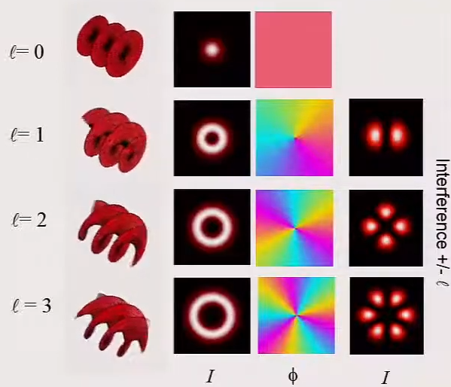
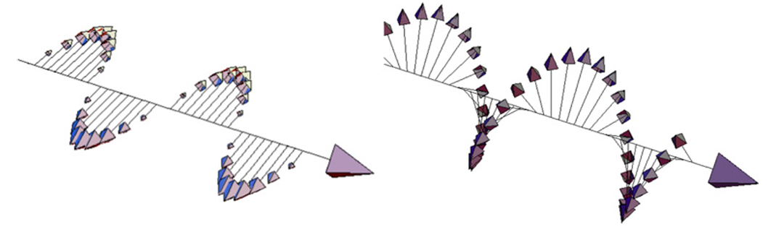
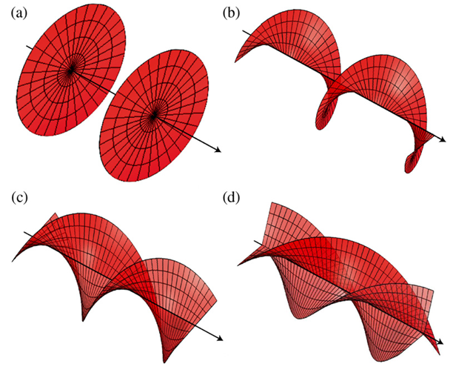
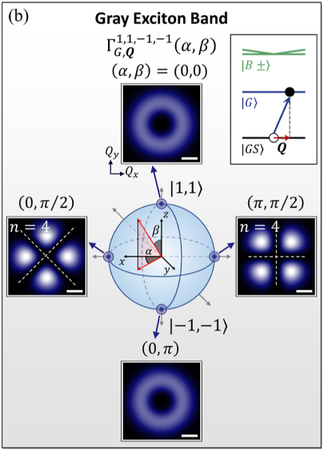
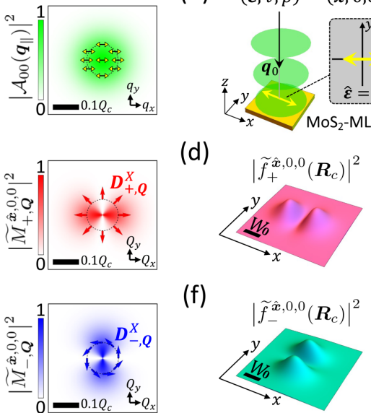
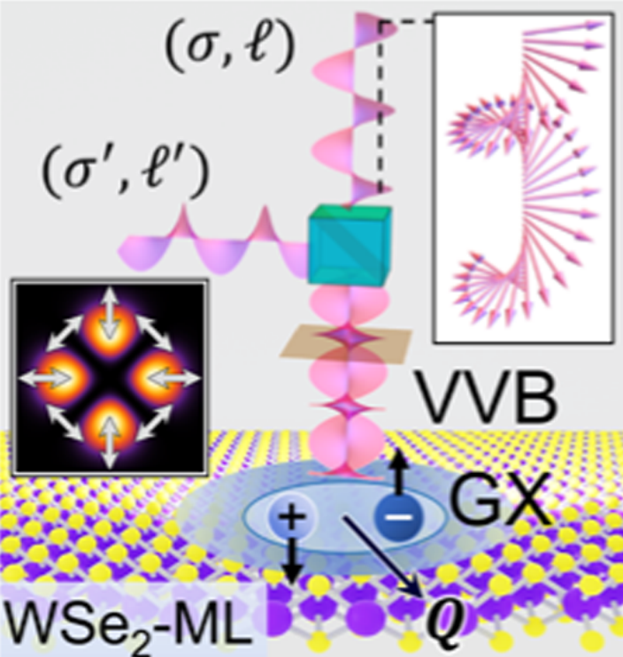
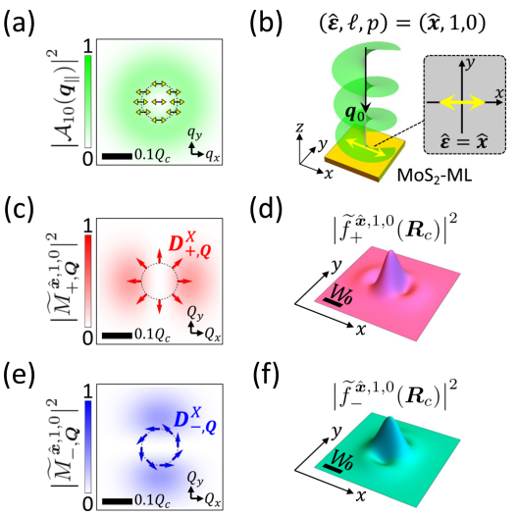



1. Introduction
Angular momentum in light
LG beams and vector vortex beams (transverse plane)
Reproduced from Miles J. Padgett, International School on Parametric Nonlinear Optics (2015)
Polarization of light / Helical phase fronts for $ℓ=0, 1, 2, 3$
A. M. Yao & M. J. Padgett, Adv. Opt. Photonics 3, 161 (2011)
Light matter interaction
$$⇒$$
$$⇒$$
OAM can influence exciton’s wave packet structures
G.-H. Peng et al., Nano Lett. 19, 2299 (2019)
SOI influence optical transition rate through vector vortex beam
O. J. G. Sanchez, G.-H. Peng et al., ACS Nano 18, 11425 (2024)
1909 theoretical work by Poynting
----- J. H. Poynting, Proc. R. Soc. Lond. A 82, 560
1936 first experimental evidence of spin angular momentum (SAM)
----- R. A. Beth, Phys. Rev. 50, 115
1992 Experimental demonstration of orbital angular momentum (OAM) in Laguerre-Gaussian (LG) Beam
----- L. Allen et al., Phys. Rev. A 45, 8185

Slide 5
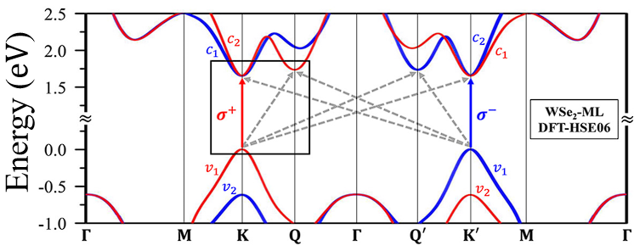

1. Introduction
Spin of electron
Polarization of light
Optical spin
Exciton with spin
Bright*2/dark/gray
${WSe}_{2}$, calculated band structure
G.-H. Peng et al., Nano Lett. 19, 2299 (2019)
dipole
OAM
COM of exciton

Slide 6
1. Introduction

Slide 7
Outline
1. Introduction
2. Spin-orbital angular momentum interaction (SOI) in light
Laguerre-Gaussian beams
Longitudinal component : SOI effect
Longitudinal component : Vector vortex beams
3. Light-matter interaction
4. Exciton wave packet
Summary and outlook

Slide 8
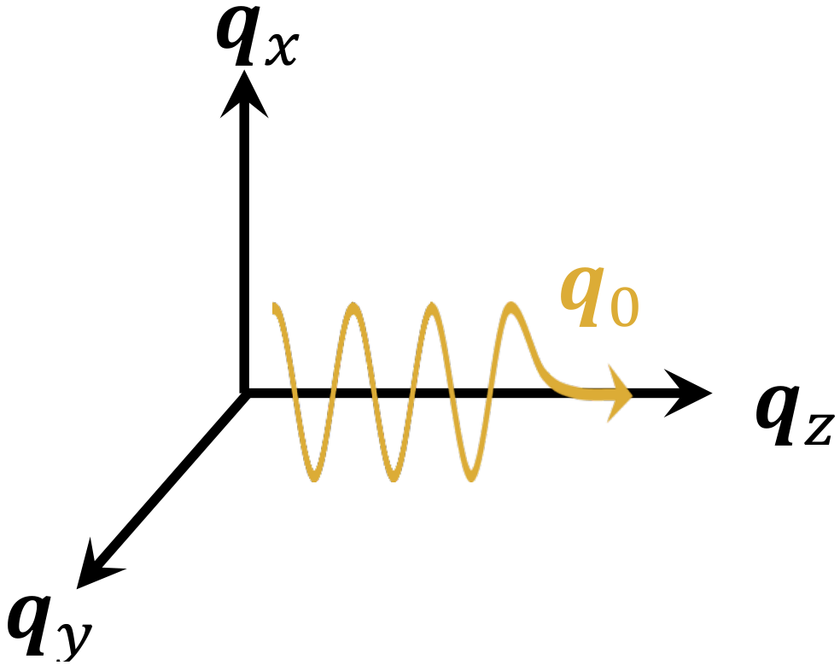












2. Laguerre-Gaussian (LG) beam : Derivation
LG beam is solved as vector potential $A\left(r\right)$ from paraxial Helmholtz equation within Lorentz gauge.
Maxwell equations
Paraxial wave
scalar Helmholtz equation
$$A\left(r\right)=U\left(r\right)e^{iq_{0}z}$$
$$\left(∇_{ }^{2}+q_{0}^{2}\right)A\left(r\right)= 0$$
paraxial approximation
Ansatz
wave vector ${q_{z}≈q}_{0}$
$\left(∇_{∥}^{2}+ \frac{∂^{2}}{∂ z^{2}}+2iq_{0}^{ }\frac{∂}{∂ z}\right)U\left(r\right)= 0$
$\left|\frac{∂^{2}}{∂ z^{2}}U\left(r\right)\right|≪q_{0}^{ }\left|\frac{∂}{∂ z}U\left(r\right)\right|$
Coulomb gauge condition
Approx.
$$∇⋅A^{C}\left(r\right)={\hat{ε}}_{σ}⋅∇_{∥}A^{C}\left(r\right)$$
$\left|\frac{∂^{2}}{∂ z^{2}}U\left(r\right)\right|≪\left|∇_{∥}^{2}U\left(r\right)\right|$
$=\left(\frac{∂}{∂ x}+iσ\frac{∂}{∂ y}\right)A^{C}\left(r\right)=0$,
for ${\hat{ε}}_{σ}=\hat{x}+iσ\hat{y}$
paraxial Helmholtz equation
Fail
$$σ=±1$$
eventually constraint the transverse component
$\left(∇_{∥}^{2}+2iq_{0}^{ }\frac{∂}{∂ z}\right)U\left(r\right)≈ 0$
$∇_{∥}^{2}A^{C}\left(r\right)=\left(\frac{∂}{∂ x}+i\frac{∂}{∂ y}\right)\left(\frac{∂}{∂ x}−i\frac{∂}{∂ y}\right)A^{C}\left(r\right)=0$.

Slide 9
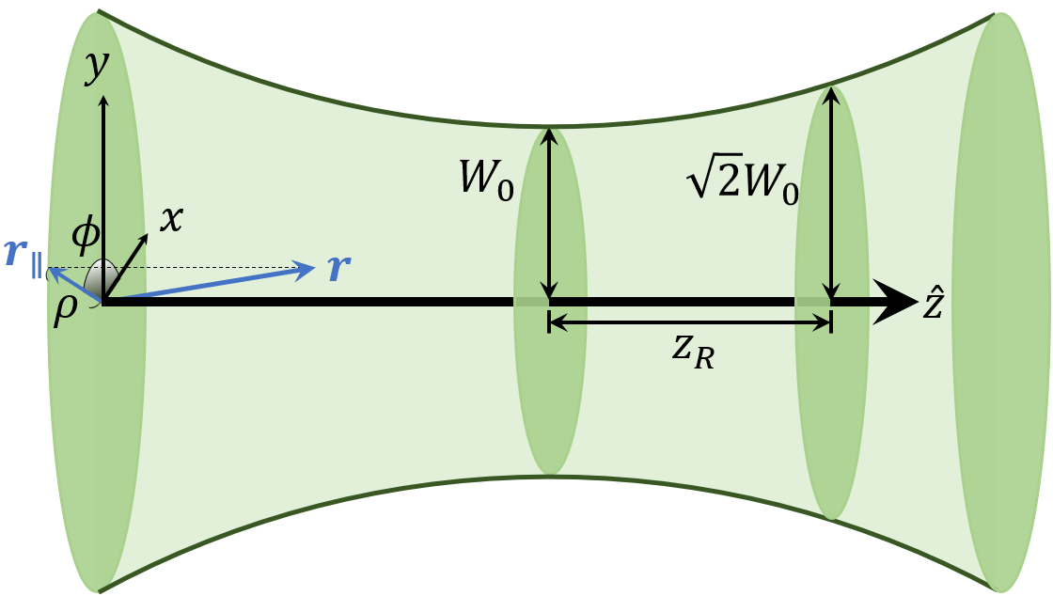
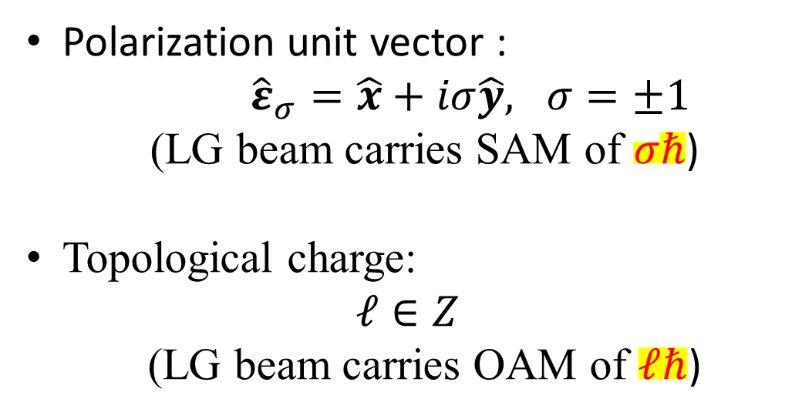
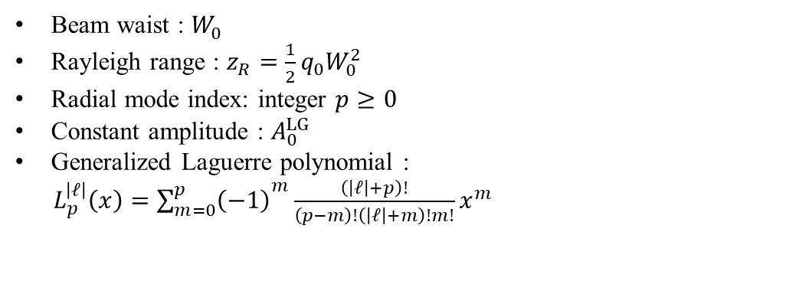
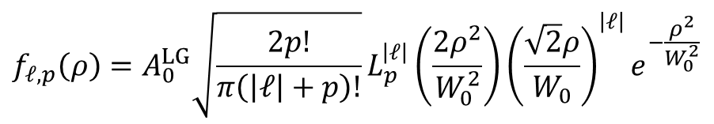
2. Laguerre-Gaussian (LG) beam : Distribution
LG beam is solved as vector potential $A\left(r\right)$ from paraxial Helmholtz equation within Lorentz gauge.
With long Rayleigh range approximation :
$$A_{σ,ℓ,p}^{L}\left(r\right)={\hat{ε}}_{σ} A_{ℓ,p}^{L}\left(r\right)≈{\hat{ε}}_{σ} f_{ℓ,p}\left(ρ\right)e^{iℓφ}e^{iq_{0}z}$$
Polarization unit vector :
${\hat{ε}}_{σ}=\hat{x}+iσ\hat{y}, σ=±1$
(LG beam carries SAM of $σℏ$)
Topological charge:
$$ℓ∈Z$$
(LG beam carries OAM of $ℓℏ$)
$$f_{ℓ,p}\left(ρ\right)=A_{0}^{LG}\sqrt{\frac{2p!}{π\left(\left|ℓ\right|+p\right)!}}L_{p}^{\left|ℓ\right|}\left(\frac{2ρ^{2}}{W_{0}^{2}}\right){\left(\frac{\sqrt{2}ρ}{W_{0}}\right)}^{\left|ℓ\right|}e^{−\frac{ρ^{2}}{W_{0}^{2}}}$$
Beam waist : $W_{0}^{ }$
Rayleigh range : $z_{R}=\frac{1}{2}q_{0}W_{0}^{2}$
Radial mode index: integer $p≥0$
Constant amplitude : $A_{0}^{LG}$
Generalized Laguerre polynomial :
$L_{p}^{\left|ℓ\right|}\left(x\right)={\sum_{m=0}^{p}{\left(−1\right)}}^{m}\frac{\left(\left|ℓ\right|+p\right)!}{\left(p−m\right)!\left(\left|ℓ\right|+m\right)!m!}x^{m}$
Rayleigh range

Slide 10
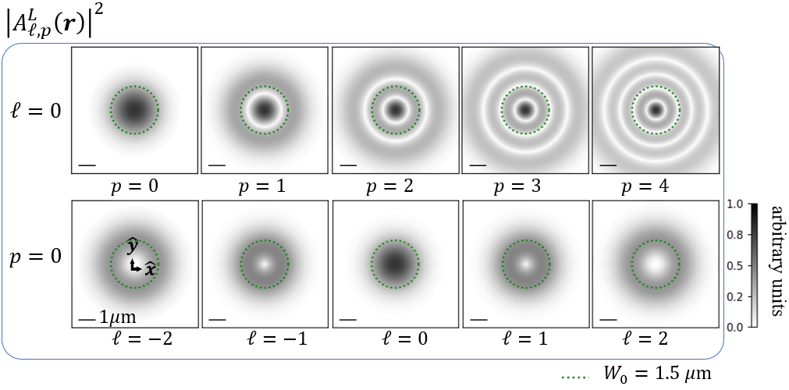
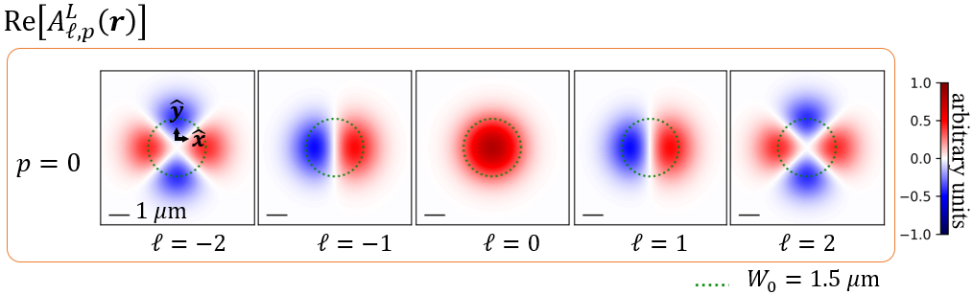
2. Laguerre-Gaussian (LG) beam : Distribution
LG beam is solved as vector potential $A\left(r\right)$ from paraxial Helmholtz equation within Lorentz gauge.
With long Rayleigh range approximation :
$$A_{σ,ℓ,p}^{L}\left(r\right)={\hat{ε}}_{σ} A_{ℓ,p}^{L}\left(r\right)≈{\hat{ε}}_{σ} f_{ℓ,p}\left(ρ\right)e^{iℓφ}e^{iq_{0}z}$$
$$f_{ℓ,p}\left(ρ\right)=A_{0}^{LG}\sqrt{\frac{2p!}{π\left(\left|ℓ\right|+p\right)!}}L_{p}^{\left|ℓ\right|}\left(\frac{2ρ^{2}}{W_{0}^{2}}\right){\left(\frac{\sqrt{2}ρ}{W_{0}}\right)}^{\left|ℓ\right|}e^{−\frac{ρ^{2}}{W_{0}^{2}}}$$
Helical wave front carrying OAM

Slide 11


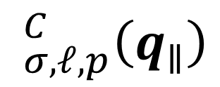
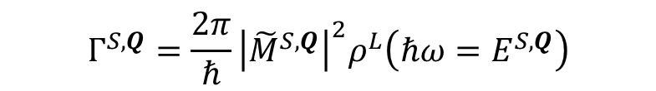

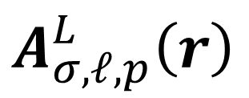
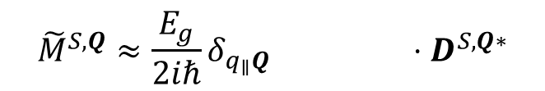
2. Laguerre-Gaussian (LG) beam : Requirement
$$A_{σ,ℓ,p}^{L}\left(r\right)$$
LG beam in real space / Lorentz gauge :
$$_{σ,ℓ,p}^{C}\left(q_{∥}\right)$$
LG beam in angular spectrum / Coulomb gauge :
What we really need
Theory of light matter interaction
$$Γ_{ }^{S,Q}=\frac{2π}{ℏ}{\left|{\tilde{M}}_{ }^{S,Q}\right|}^{2}ρ^{L}\left(ℏω=E_{ }^{S,Q}\right)$$
$${\tilde{M}}_{ }^{S,Q}≈\frac{E_{g}}{2iℏ}δ_{q_{∥}Q} ⋅D_{ }^{S,Q∗}$$
$$_{ }^{C}\left(q_{∥}\right)$$

Slide 12
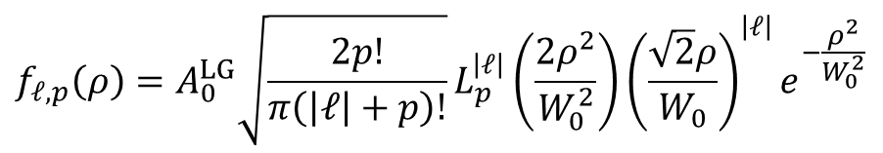
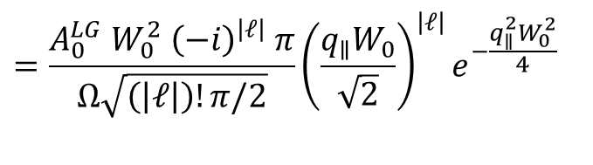
2. Laguerre-Gaussian (LG) beam : Angular spectrum
LG beam in Lorentz gauge / real space :
$$A_{σ,ℓ,p}^{L}\left(r\right)={\hat{ε}}_{σ} A_{ℓ,p}^{L}\left(r\right)≈{\hat{ε}}_{σ} f_{ℓ,p}\left(ρ\right)e^{iℓφ}e^{iq_{0}z}$$
$$f_{ℓ,p}\left(ρ\right)=A_{0}^{LG}\sqrt{\frac{2p!}{π\left(\left|ℓ\right|+p\right)!}}L_{p}^{\left|ℓ\right|}\left(\frac{2ρ^{2}}{W_{0}^{2}}\right){\left(\frac{\sqrt{2}ρ}{W_{0}}\right)}^{\left|ℓ\right|}e^{−\frac{ρ^{2}}{W_{0}^{2}}}$$
$$=\frac{A_{0}^{LG} W_{0}^{2} {\left(−i\right)}^{\left|ℓ\right|} π}{Ω\sqrt{\left(\left|ℓ\right|\right)!π/2}}{\left(\frac{q_{∥}W_{0}}{\sqrt{2}}\right)}^{\left|ℓ\right|}e^{−\frac{q_{∥}^{2}W_{0}^{2}}{4} }$$

Slide 13



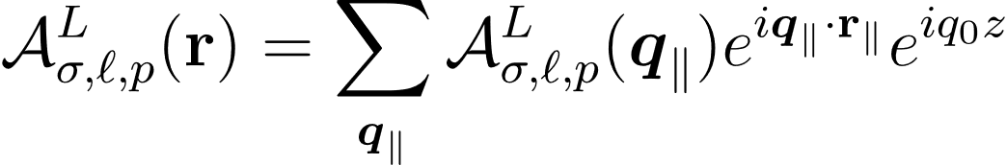
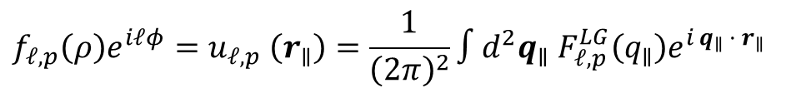



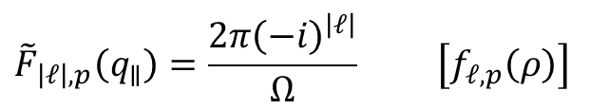

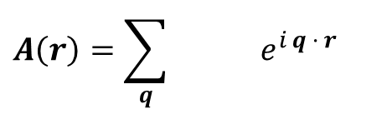
2. Laguerre-Gaussian (LG) beam : Angular spectrum
LG beam in Lorentz gauge / real space :
Method
$$A_{σ,ℓ,p}^{L}\left(r\right)={\hat{ε}}_{σ} A_{ℓ,p}^{L}\left(r\right)≈{\hat{ε}}_{σ} f_{ℓ,p}\left(ρ\right)e^{iℓφ}e^{iq_{0}z}$$
Expanded in plane-wave basis
$$A\left(r\right)=\sum_{q}{ e^{i q · r}}$$
$$f_{ℓ,p}\left(ρ\right)=A_{0}^{LG}\sqrt{\frac{2p!}{π\left(\left|ℓ\right|+p\right)!}}L_{p}^{\left|ℓ\right|}\left(\frac{2ρ^{2}}{W_{0}^{2}}\right){\left(\frac{\sqrt{2}ρ}{W_{0}}\right)}^{\left|ℓ\right|}e^{−\frac{ρ^{2}}{W_{0}^{2}}}$$
Define Fourier transformation
$$f_{ℓ,p}\left(ρ\right)e^{iℓφ}=u_{ℓ,p} \left(r_{∥}\right)=\frac{1}{{\left(2π\right)}^{2}}∫d^{2}q_{∥} F_{ℓ,p}^{LG}\left(q_{∥}\right)e^{i q_{∥} · r_{∥}}$$
LG beam in Lorentz gauge / angular spectrum :
$$F_{ℓ,p}^{LG}\left(q_{∥}\right)=∫d^{2}r_{∥} u_{ℓ,p}\left(r_{∥}\right)e^{−i q_{∥} · r_{∥}}$$
$$={\hat{ε}}_{σ}$$
$$≈{\hat{ε}}_{σ}{\tilde{F}}_{\left|ℓ\right|,p}\left(q_{∥}\right)e^{iℓφ_{q_{∥}}}$$
$${\tilde{F}}_{\left|ℓ\right|,p}\left(q_{∥}\right)=\frac{2π{\left(−i\right)}^{\left|ℓ\right|}}{Ω} \left[f_{ℓ,p}\left(ρ\right)\right]$$
Results
Hankel transform of order $\left|ℓ\right|$
$$=\frac{A_{0}^{LG} W_{0}^{2} {\left(−i\right)}^{\left|ℓ\right|} π}{Ω\sqrt{\left(\left|ℓ\right|\right)!π/2}}{\left(\frac{q_{∥}W_{0}}{\sqrt{2}}\right)}^{\left|ℓ\right|}e^{−\frac{q_{∥}^{2}W_{0}^{2}}{4} }$$

Slide 14
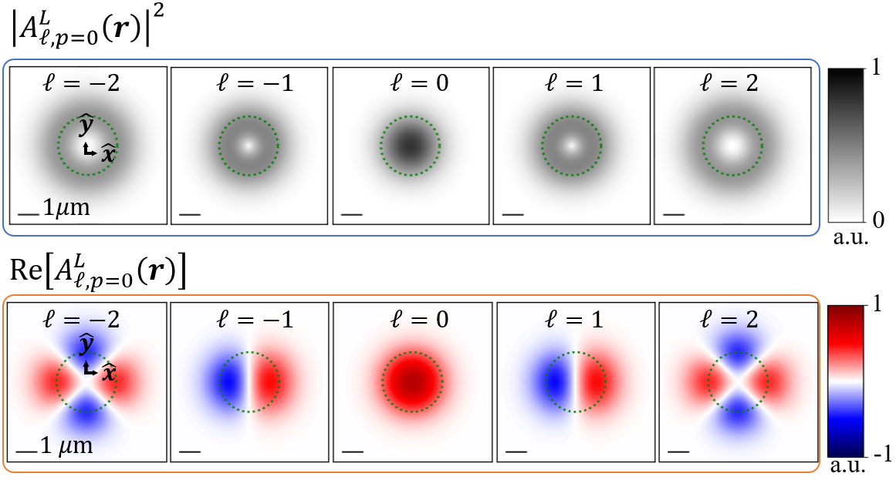
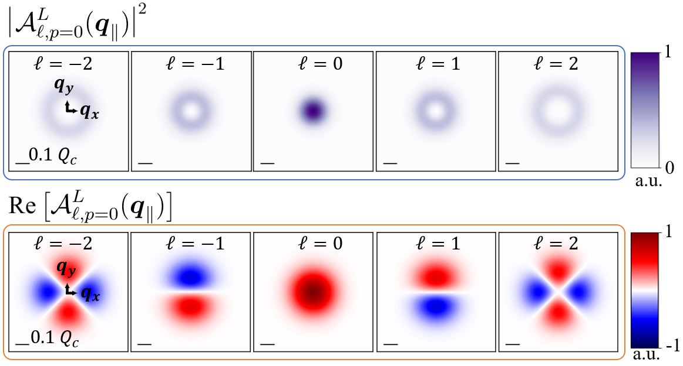
2. Laguerre-Gaussian (LG) beam : Angular spectrum
LG beam in Lorentz gauge / real space :
$$A_{σ,ℓ,p}^{L}\left(r\right)={\hat{ε}}_{σ} A_{ℓ,p}^{L}\left(r\right)≈{\hat{ε}}_{σ} f_{ℓ,p}\left(ρ\right)e^{iℓφ}e^{iq_{0}z}$$
$$f_{ℓ,p}\left(ρ\right)=A_{0}^{LG}\sqrt{\frac{2p!}{π\left(\left|ℓ\right|+p\right)!}}L_{p}^{\left|ℓ\right|}\left(\frac{2ρ^{2}}{W_{0}^{2}}\right){\left(\frac{\sqrt{2}ρ}{W_{0}}\right)}^{\left|ℓ\right|}e^{−\frac{ρ^{2}}{W_{0}^{2}}}$$
LG beam in Lorentz gauge / angular spectrum :
Similar structure
$$={\hat{ε}}_{σ}$$
$$≈{\hat{ε}}_{σ}{\tilde{F}}_{\left|ℓ\right|,p}\left(q_{∥}\right)e^{iℓφ_{q_{∥}}}$$
$${\tilde{F}}_{\left|ℓ\right|,p}\left(q_{∥}\right)=\frac{2π{\left(−i\right)}^{\left|ℓ\right|}}{Ω} \left[f_{ℓ,p}\left(ρ\right)\right]$$
Hankel transform of order $\left|ℓ\right|$
$$=\frac{A_{0}^{LG} W_{0}^{2} {\left(−i\right)}^{\left|ℓ\right|} π}{Ω\sqrt{\left(\left|ℓ\right|\right)!π/2}}{\left(\frac{q_{∥}W_{0}}{\sqrt{2}}\right)}^{\left|ℓ\right|}e^{−\frac{q_{∥}^{2}W_{0}^{2}}{4} }$$

Slide 15
2. Laguerre-Gaussian (LG) beam : Coulomb gauge
LG beam in Lorentz gauge / real space :
$$A_{σ,ℓ,p}^{L}\left(r\right)={\hat{ε}}_{σ} A_{ℓ,p}^{L}\left(r\right)≈{\hat{ε}}_{σ} f_{ℓ,p}\left(ρ\right)e^{iℓφ}e^{iq_{0}z}$$
$$f_{ℓ,p}\left(ρ\right)=A_{0}^{LG}\sqrt{\frac{2p!}{π\left(\left|ℓ\right|+p\right)!}}L_{p}^{\left|ℓ\right|}\left(\frac{2ρ^{2}}{W_{0}^{2}}\right){\left(\frac{\sqrt{2}ρ}{W_{0}}\right)}^{\left|ℓ\right|}e^{−\frac{ρ^{2}}{W_{0}^{2}}}$$

Slide 16
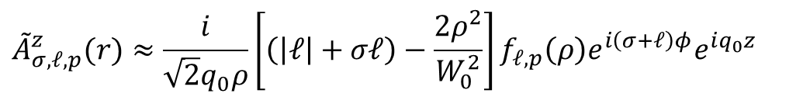
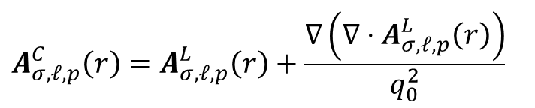
2. Laguerre-Gaussian (LG) beam : Coulomb gauge
LG beam in Lorentz gauge / real space :
LG beam in Coulomb gauge / real space:
$$A_{σ,ℓ,p}^{L}\left(r\right)={\hat{ε}}_{σ} A_{ℓ,p}^{L}\left(r\right)≈{\hat{ε}}_{σ} f_{ℓ,p}\left(ρ\right)e^{iℓφ}e^{iq_{0}z}$$
$$A_{σ,ℓ,p}\left(r\right)≡A_{σ,ℓ,p}^{C}\left(r\right)≈ {\tilde{A}}_{ℓ,p}^{∥}(r){\hat{ε}}_{σ}+{\tilde{A}}_{σ,ℓ,p}^{z}(r)\hat{z}$$
Transverse component :
$$f_{ℓ,p}\left(ρ\right)=A_{0}^{LG}\sqrt{\frac{2p!}{π\left(\left|ℓ\right|+p\right)!}}L_{p}^{\left|ℓ\right|}\left(\frac{2ρ^{2}}{W_{0}^{2}}\right){\left(\frac{\sqrt{2}ρ}{W_{0}}\right)}^{\left|ℓ\right|}e^{−\frac{ρ^{2}}{W_{0}^{2}}}$$
$${\tilde{A}}_{ℓ,p}^{∥}\left(r\right)≈f_{ℓ,p}\left(ρ\right)e^{iℓφ}e^{iq_{0}z}$$
Longitudinal component :
$${\tilde{A}}_{σ,ℓ,p}^{z}(r)≈\frac{i}{\sqrt{2}q_{0}ρ}\left[\left(\left|ℓ\right|+σℓ\right)−\frac{2ρ^{2}}{W_{0}^{2}}\right]f_{ℓ,p}\left(ρ\right)e^{i\left(σ+ℓ\right)φ}e^{iq_{0}z}$$
Additional component
Method
Relation from Maxwell’s equations
$$A_{σ,ℓ,p}^{C}\left(r\right)=A_{σ,ℓ,p}^{L}\left(r\right)+\frac{∇\left(∇⋅A_{σ,ℓ,p}^{L}\left(r\right)\right)}{q_{0}^{2}}$$

Slide 17
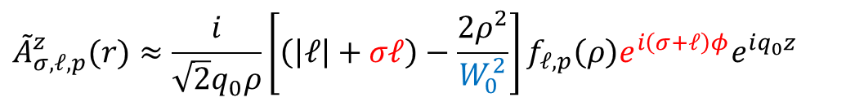
2. Laguerre-Gaussian (LG) beam : Coulomb gauge
LG beam in Lorentz gauge / real space :
LG beam in Coulomb gauge / real space:
$$A_{σ,ℓ,p}^{L}\left(r\right)={\hat{ε}}_{σ} A_{ℓ,p}^{L}\left(r\right)≈{\hat{ε}}_{σ} f_{ℓ,p}\left(ρ\right)e^{iℓφ}e^{iq_{0}z}$$
$$A_{σ,ℓ,p}\left(r\right)≡A_{σ,ℓ,p}^{C}\left(r\right)≈ {\tilde{A}}_{ℓ,p}^{∥}(r){\hat{ε}}_{σ}+{\tilde{A}}_{σ,ℓ,p}^{z}(r)\hat{z}$$
Transverse component :
$$f_{ℓ,p}\left(ρ\right)=A_{0}^{LG}\sqrt{\frac{2p!}{π\left(\left|ℓ\right|+p\right)!}}L_{p}^{\left|ℓ\right|}\left(\frac{2ρ^{2}}{W_{0}^{2}}\right){\left(\frac{\sqrt{2}ρ}{W_{0}}\right)}^{\left|ℓ\right|}e^{−\frac{ρ^{2}}{W_{0}^{2}}}$$
$${\tilde{A}}_{ℓ,p}^{∥}\left(r\right)≈f_{ℓ,p}\left(ρ\right)e^{iℓφ}e^{iq_{0}z}$$
Longitudinal component :
SOI
$${\tilde{A}}_{σ,ℓ,p}^{z}(r)≈\frac{i}{\sqrt{2}q_{0}ρ}\left[\left(\left|ℓ\right|+σℓ\right)−\frac{2ρ^{2}}{W_{0}^{2}}\right]f_{ℓ,p}\left(ρ\right)e^{i\left(σ+ℓ\right)φ}e^{iq_{0}z}$$

Slide 18

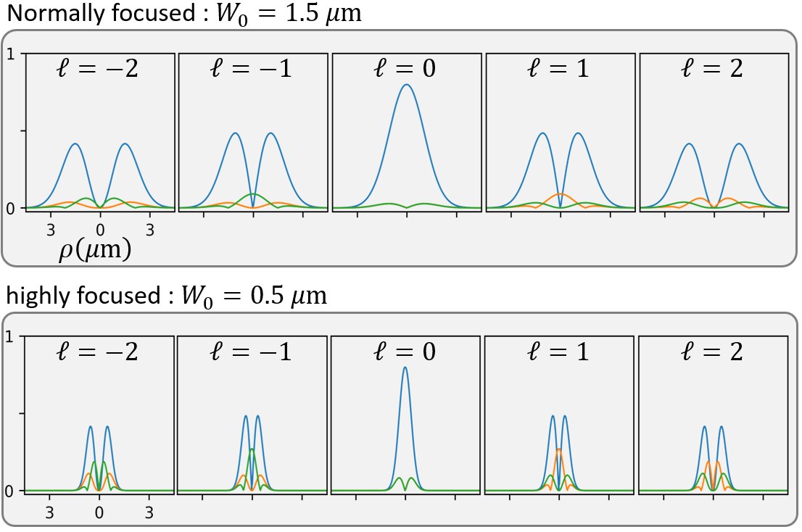



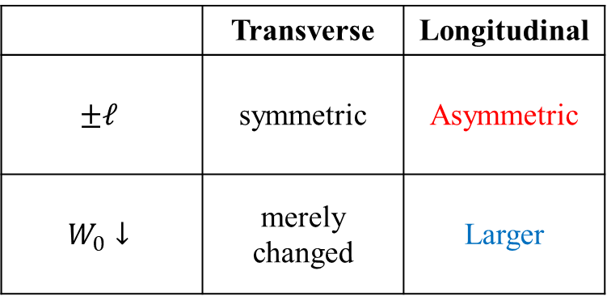
2. Laguerre-Gaussian (LG) beam : SOI appear
LG beam in Lorentz gauge / real space :
LG beam in Coulomb gauge / real space:
$$A_{σ,ℓ,p}^{L}\left(r\right)={\hat{ε}}_{σ} A_{ℓ,p}^{L}\left(r\right)≈{\hat{ε}}_{σ} f_{ℓ,p}\left(ρ\right)e^{iℓφ}e^{iq_{0}z}$$
$$A_{σ,ℓ,p}\left(r\right)≡A_{σ,ℓ,p}^{C}\left(r\right)≈ {\tilde{A}}_{ℓ,p}^{∥}(r){\hat{ε}}_{σ}+{\tilde{A}}_{σ,ℓ,p}^{z}(r)\hat{z}$$
Transverse component :
$$f_{ℓ,p}\left(ρ\right)=A_{0}^{LG}\sqrt{\frac{2p!}{π\left(\left|ℓ\right|+p\right)!}}L_{p}^{\left|ℓ\right|}\left(\frac{2ρ^{2}}{W_{0}^{2}}\right){\left(\frac{\sqrt{2}ρ}{W_{0}}\right)}^{\left|ℓ\right|}e^{−\frac{ρ^{2}}{W_{0}^{2}}}$$
$${\tilde{A}}_{ℓ,p}^{∥}\left(r\right)≈f_{ℓ,p}\left(ρ\right)e^{iℓφ}e^{iq_{0}z}$$
Longitudinal component :
SOI
$${\tilde{A}}_{σ,ℓ,p}^{z}(r)≈\frac{i}{\sqrt{2}q_{0}ρ}\left[\left(\left|ℓ\right|+σℓ\right)−\frac{2ρ^{2}}{W_{0}^{2}}\right]f_{ℓ,p}\left(ρ\right)e^{i\left(σ+ℓ\right)φ}e^{iq_{0}z}$$
$$\left|{\tilde{A}}_{ℓ, p=0}^{∥}\left(r\right)\right|$$
$$\left|{\tilde{A}}_{σ=1,ℓ, p=0}^{z}\left(r\right)\right|$$
$$\left|{\tilde{A}}_{σ=−1,ℓ, p=0}^{z}\left(r\right)\right|$$
$$W_{0}=1.5μm$$
a.u.
 | Transverse | Longitudinal
$$±ℓ$$ | symmetric | Asymmetric
$$W_{0}↓$$ | merely changed | Larger
$$W_{0}=0.5μm$$
SOI

Slide 19


2. Longitudinal component : SOI effect
LG beam solutions:
Real / Lorentz :
$$A_{σ,ℓ,p}^{L}\left(r\right)={\hat{ε}}_{σ} A_{ℓ,p}^{L}\left(r\right)≈{\hat{ε}}_{σ} f_{ℓ,p}\left(ρ\right)e^{iℓφ}e^{iq_{0}z}$$
Angular / Lorentz :
$$={\hat{ε}}_{σ}$$
$$≈{\hat{ε}}_{σ}{\tilde{F}}_{\left|ℓ\right|,p}\left(q_{∥}\right)e^{iℓφ_{q_{∥}}}$$
Real / Coulomb :
$$A_{σ,ℓ,p}\left(r\right)≡A_{σ,ℓ,p}^{C}\left(r\right)≈ {\tilde{A}}_{ℓ,p}^{∥}(r){\hat{ε}}_{σ}+{\tilde{A}}_{σ,ℓ,p}^{z}(r)\hat{z}$$

Slide 20

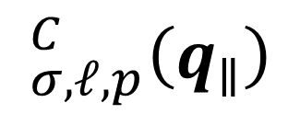
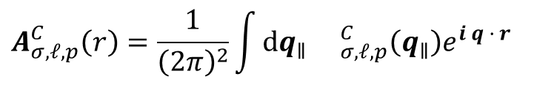
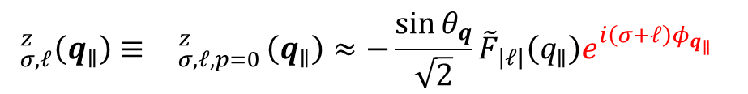
2. Longitudinal component : SOI effect
LG beam solutions:
Real / Lorentz :
$$_{σ,ℓ,p}^{C}\left(q_{∥}\right)$$
$$A_{σ,ℓ,p}^{L}\left(r\right)={\hat{ε}}_{σ} A_{ℓ,p}^{L}\left(r\right)≈{\hat{ε}}_{σ} f_{ℓ,p}\left(ρ\right)e^{iℓφ}e^{iq_{0}z}$$
What we really need
Angular / Lorentz :
LG beam in angular spectrum / Coulomb gauge :
$$={\hat{ε}}_{σ}$$
$$≈{\hat{ε}}_{σ}{\tilde{F}}_{\left|ℓ\right|,p}\left(q_{∥}\right)e^{iℓφ_{q_{∥}}}$$
$$_{σ,ℓ}\left(q_{∥}\right)≡ _{σ,ℓ,p=0}^{C}\left(q_{∥}\right)≈{ }_{ℓ,p}^{∥}(q_{∥}){\hat{ε}}_{σ}+{ }_{σ,ℓ,p}^{z}(q_{∥})\hat{z}$$
Real / Coulomb :
$$A_{σ,ℓ,p}\left(r\right)≡A_{σ,ℓ,p}^{C}\left(r\right)≈ {\tilde{A}}_{ℓ,p}^{∥}(r){\hat{ε}}_{σ}+{\tilde{A}}_{σ,ℓ,p}^{z}(r)\hat{z}$$
Transverse component :
$$_{ℓ}^{∥}\left(q_{∥}\right)≡ _{ℓ,p=0}^{∥}\left(q_{∥}\right)≈{\tilde{F}}_{\left|ℓ\right|}\left(q_{∥}\right)e^{iℓφ_{q_{∥}}}$$
Longitudinal component :
Method
$$_{σ,ℓ}^{z}\left(q_{∥}\right)≡ _{σ,ℓ,p=0}^{z}\left(q_{∥}\right)≈−\frac{\sin{θ_{q}}}{\sqrt{2}}{\tilde{F}}_{\left|ℓ\right|}\left(q_{∥}\right)e^{i\left(σ+ℓ\right)φ_{q_{∥}}}$$
Expanded in plane-wave basis
SOI
$$A_{σ,ℓ,p}^{C}\left(r\right)=\frac{1}{{\left(2π\right)}^{2}}\int_{ }^{ }{dq_{∥} _{σ,ℓ,p}^{C}\left(q_{∥}\right)e^{i q · r}}$$

Slide 21
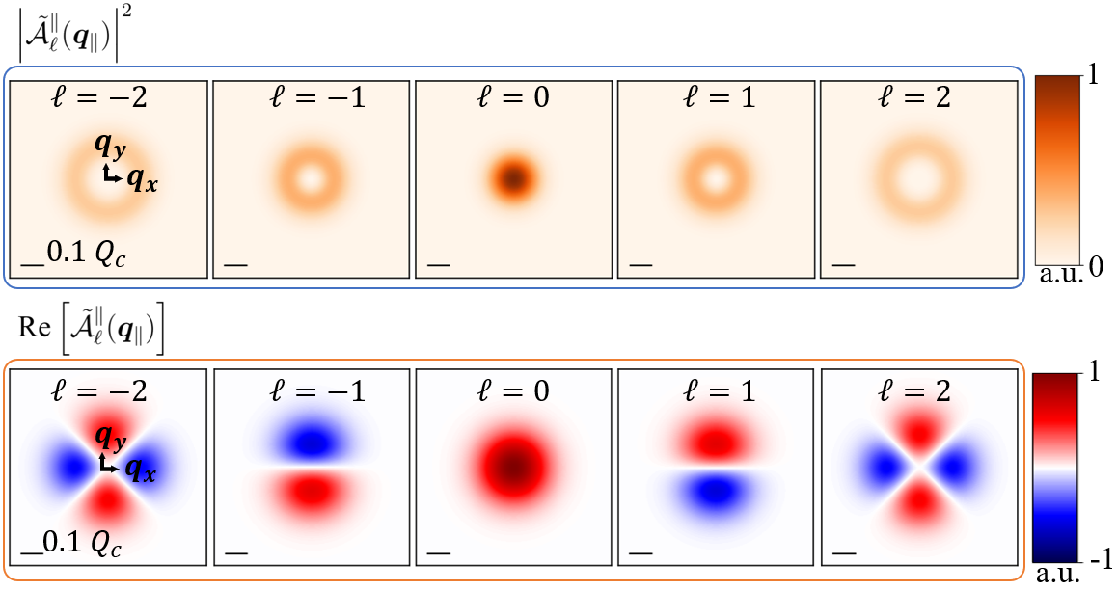
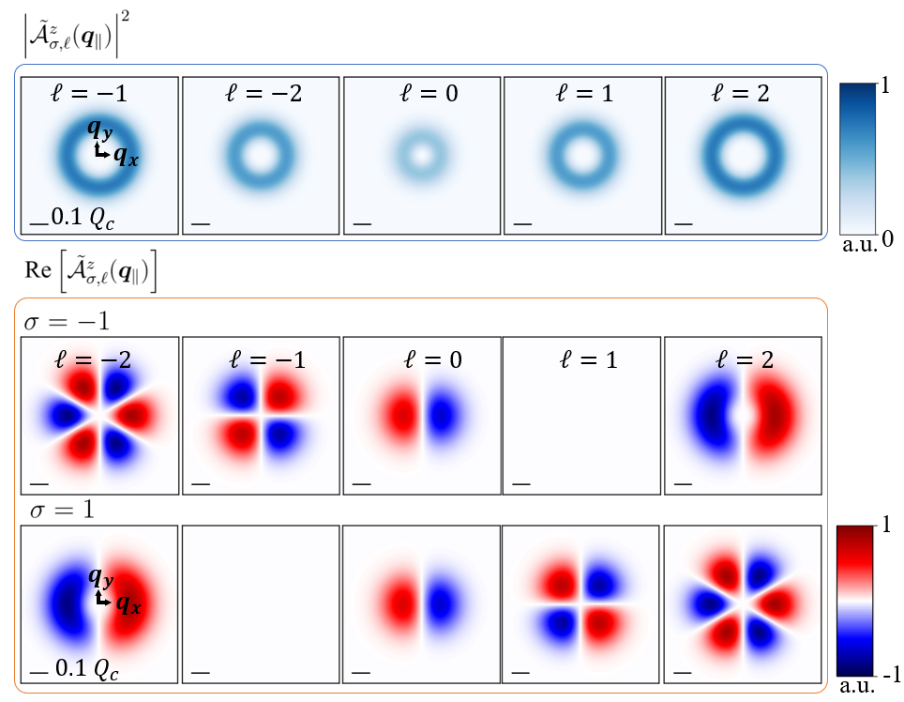
2. Longitudinal component : SOI effect
Transverse component :
$$_{σ,ℓ,p}^{C}\left(q_{∥}\right)$$
LG beam in angular spectrum / Coulomb gauge :
$$_{σ,ℓ}\left(q_{∥}\right)≡ _{σ,ℓ,p=0}^{C}\left(q_{∥}\right)≈{ }_{ℓ,p}^{∥}(q_{∥}){\hat{ε}}_{σ}+{ }_{σ,ℓ,p}^{z}(q_{∥})\hat{z}$$
Longitudinal component :
Transverse component :
$$_{ℓ}^{∥}\left(q_{∥}\right)≡ _{ℓ,p=0}^{∥}\left(q_{∥}\right)≈{\tilde{F}}_{\left|ℓ\right|}\left(q_{∥}\right)e^{iℓφ_{q_{∥}}}$$
Longitudinal component :
$$_{σ,ℓ}^{z}\left(q_{∥}\right)≡ _{σ,ℓ,p=0}^{z}\left(q_{∥}\right)≈−\frac{\sin{θ_{q}}}{\sqrt{2}}{\tilde{F}}_{\left|ℓ\right|}\left(q_{∥}\right)e^{i\left(σ+ℓ\right)φ_{q_{∥}}}$$
SOI

Slide 22
2. Longitudinal component : SOI effect
Transverse component :
$$_{σ,ℓ,p}^{C}\left(q_{∥}\right)$$
LG beam in angular spectrum / Coulomb gauge :
$$_{σ,ℓ}\left(q_{∥}\right)≡ _{σ,ℓ,p=0}^{C}\left(q_{∥}\right)≈{ }_{ℓ,p}^{∥}(q_{∥}){\hat{ε}}_{σ}+{ }_{σ,ℓ,p}^{z}(q_{∥})\hat{z}$$
Longitudinal component :
Transverse component :
$$_{ℓ}^{∥}\left(q_{∥}\right)≡ _{ℓ,p=0}^{∥}\left(q_{∥}\right)≈{\tilde{F}}_{\left|ℓ\right|}\left(q_{∥}\right)e^{iℓφ_{q_{∥}}}$$
Longitudinal component :
$$_{σ,ℓ}^{z}\left(q_{∥}\right)≡ _{σ,ℓ,p=0}^{z}\left(q_{∥}\right)≈−\frac{\sin{θ_{q}}}{\sqrt{2}}{\tilde{F}}_{\left|ℓ\right|}\left(q_{∥}\right)e^{i\left(σ+ℓ\right)φ_{q_{∥}}}$$
SOI

Slide 23
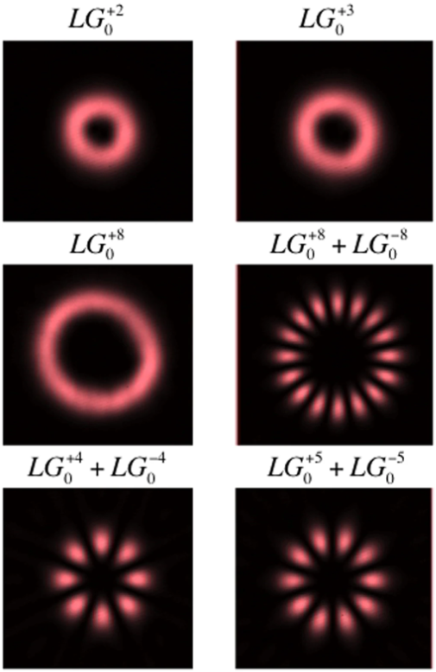









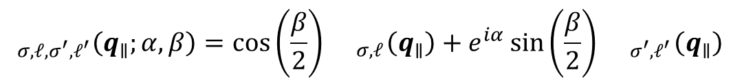


2. Vector vortex beams (VVB)
Forming vector vortex beams (VVB) by Superimposing LG beams
$$_{σ,ℓ,σ^{′},ℓ^{′}}\left(q_{∥};α,β\right)=\cos\left(\frac{β}{2}\right){ }_{σ,ℓ}\left(q_{∥}\right)+e^{iα}\sin\left(\frac{β}{2}\right){ }_{σ^{′},ℓ^{′}}\left(q_{∥}\right)$$
$${ }_{σ,ℓ}\left(q_{∥}\right)$$
LG beams and vector vortex beams
F. Steinlechner et al., Sci. Rep. 6, 21390 (2016)
$$\frac{1}{\sqrt{2}}{ }_{σ,ℓ}\left(q_{∥}\right)−\frac{i}{\sqrt{2}}{ }_{σ^{′},ℓ^{′}}\left(q_{∥}\right)$$
$$z$$
$$\frac{1}{\sqrt{2}}{ }_{σ,ℓ}\left(q_{∥}\right)+\frac{1}{\sqrt{2}}{ }_{σ^{′},ℓ^{′}}\left(q_{∥}\right)$$
$$β$$
$$\frac{1}{\sqrt{2}}{ }_{σ,ℓ}\left(q_{∥}\right)−\frac{1}{\sqrt{2}}{ }_{σ^{′},ℓ^{′}}\left(q_{∥}\right)$$
$$x$$
$$α$$
LG beams and vector vortex beams (transverse plane)
Reproduced from Miles J. Padgett, International School on Parametric Nonlinear Optics (2015)
$$y$$
$$\frac{1}{\sqrt{2}}{ }_{σ,ℓ}\left(q_{∥}\right)+\frac{i}{\sqrt{2}}{ }_{σ^{′},ℓ^{′}}\left(q_{∥}\right)$$
$${ }_{σ^{′},ℓ^{′}}\left(q_{∥}\right)$$
Poincaré sphere for VVB states

Slide 24

2. Vector vortex beams (VVB)
Forming vector vortex beams (VVB) by Superimposing LG beams
$$_{σ,ℓ,σ^{′},ℓ^{′}}\left(q_{∥};α,β\right)=\cos\left(\frac{β}{2}\right){ }_{σ,ℓ}\left(q_{∥}\right)+e^{iα}\sin\left(\frac{β}{2}\right){ }_{σ^{′},ℓ^{′}}\left(q_{∥}\right)$$
$$={ }_{σ,ℓ,σ^{′},ℓ^{′}}^{∥}\left(q_{∥};α, β\right)+{ }_{σ,ℓ,σ^{′},ℓ^{′}}^{z}\left(q_{∥};α, β\right)$$
LG beams and vector vortex beams
F. Steinlechner et al., Sci. Rep. 6, 21390 (2016)
LG beams and vector vortex beams (transverse plane)
Reproduced from Miles J. Padgett, International School on Parametric Nonlinear Optics (2015)

Slide 25





2. Vector vortex beams (VVB)
Forming vector vortex beams (VVB) by Superimposing LG beams
$$_{σ,ℓ,σ^{′},ℓ^{′}}\left(q_{∥};α,β\right)=\cos\left(\frac{β}{2}\right){ }_{σ,ℓ}\left(q_{∥}\right)+e^{iα}\sin\left(\frac{β}{2}\right){ }_{σ^{′},ℓ^{′}}\left(q_{∥}\right)$$
$$={ }_{σ,ℓ,σ^{′},ℓ^{′}}^{∥}\left(q_{∥};α, β\right)+{ }_{σ,ℓ,σ^{′},ℓ^{′}}^{z}\left(q_{∥};α, β\right)$$
Define $Δℓ≡ℓ^{′}−ℓ$
$$2\overline{ℓ}≡ℓ^{′}+ℓ$$
$Δσ≡σ^{′}−σ$
$$2\overline{σ}≡σ^{′}+σ$$
LG beams and vector vortex beams
F. Steinlechner et al., Sci. Rep. 6, 21390 (2016)
$$={ }_{Δℓ,\overline{ℓ},Δσ,\overline{σ}}^{∥}\left(q_{∥};α, β\right)+{ }_{Δℓ,\overline{ℓ},Δσ,\overline{σ}}^{z}\left(q_{∥};α, β\right)$$
LG beams and vector vortex beams (transverse plane)
Reproduced from Miles J. Padgett, International School on Parametric Nonlinear Optics (2015)

Slide 26
2. Transverse component : Vector vortex beams (VVB)
Transverse component of VVB:
$${ }_{Δℓ,\overline{ℓ},Δσ,\overline{σ}}^{∥}\left(q_{∥};α, β\right)={ }_{Δℓ,\overline{ℓ} }^{x}\left(q_{∥};α, β\right)\hat{x}+{ }_{Δℓ,\overline{ℓ},Δσ,\overline{σ}}^{y}\left(q_{∥};α, β\right)\hat{y}$$

Slide 27

2. Transverse component : Vector vortex beams (VVB)
Transverse component of VVB:
$${ }_{Δℓ,\overline{ℓ},Δσ,\overline{σ}}^{∥}\left(q_{∥};α, β\right)={ }_{Δℓ,\overline{ℓ} }^{x}\left(q_{∥};α, β\right)\hat{x}+{ }_{Δℓ,\overline{ℓ},Δσ,\overline{σ}}^{y}\left(q_{∥};α, β\right)\hat{y}$$
Transverse component of VVB: $Δσ=−2,\overline{σ}=0$/ $β=\frac{π}{2}$
$${ }_{Δℓ,\overline{ℓ},−2,0 }^{∥}\left(q_{∥};α, β=\frac{π}{2}\right)$$
$$=\frac{1}{2}e^{i\left(\overline{ℓ}φ_{q_{∥}}+\frac{α}{2}\right)}\left\{cos\left[\frac{1}{2}\left(Δℓφ_{q_{∥}}+α\right)\right]\left[{\tilde{F}}_{\left|\overline{ℓ}−\frac{Δℓ}{2}\right|}\left(q_{∥}\right)+{\tilde{F}}_{\left|\overline{ℓ}+\frac{Δℓ}{2}\right|}\left(q_{∥}\right)\right]−i sin\left[\frac{1}{2}\left(Δℓφ_{q_{∥}}+α\right)\right]\left[{\tilde{F}}_{\left|\overline{ℓ}−\frac{Δℓ}{2}\right|}\left(q_{∥}\right)−{\tilde{F}}_{\left|\overline{ℓ}+\frac{Δℓ}{2}\right|}\left(q_{∥}\right)\right]\right\}\hat{x}$$
$$+\frac{1}{2}e^{i\left(\overline{ℓ}φ_{q_{∥}}+\frac{α}{2}\right)}\left\{sin\left[\frac{1}{2}\left(Δℓφ_{q_{∥}}+α\right)\right]\left[{\tilde{F}}_{\left|\overline{ℓ}−\frac{Δℓ}{2}\right|}\left(q_{∥}\right)+{\tilde{F}}_{\left|\overline{ℓ}+\frac{Δℓ}{2}\right|}\left(q_{∥}\right)\right]+i sin\left[\frac{1}{2}\left(Δℓφ_{q_{∥}}+α+π\right)\right]\left[{\tilde{F}}_{\left|\overline{ℓ}−\frac{Δℓ}{2}\right|}\left(q_{∥}\right)−{\tilde{F}}_{\left|\overline{ℓ}+\frac{Δℓ}{2}\right|}\left(q_{∥}\right)\right]\right\}\hat{y}$$

Slide 28

2. Transverse component : Vector vortex beams (VVB)
Transverse component of VVB:
$${ }_{Δℓ,\overline{ℓ},Δσ,\overline{σ}}^{∥}\left(q_{∥};α, β\right)={ }_{Δℓ,\overline{ℓ} }^{x}\left(q_{∥};α, β\right)\hat{x}+{ }_{Δℓ,\overline{ℓ},Δσ,\overline{σ}}^{y}\left(q_{∥};α, β\right)\hat{y}$$
Transverse component of VVB: $Δσ=−2,\overline{σ}=0$/ $β=\frac{π}{2}$
$${ }_{Δℓ,\overline{ℓ},−2,0 }^{∥}\left(q_{∥};α, β=\frac{π}{2}\right)$$
$$=\frac{1}{2}e^{i\left(\overline{ℓ}φ_{q_{∥}}+\frac{α}{2}\right)}\left\{cos\left[\frac{1}{2}\left(Δℓφ_{q_{∥}}+α\right)\right]\left[{\tilde{F}}_{\left|\overline{ℓ}−\frac{Δℓ}{2}\right|}\left(q_{∥}\right)+{\tilde{F}}_{\left|\overline{ℓ}+\frac{Δℓ}{2}\right|}\left(q_{∥}\right)\right]−i sin\left[\frac{1}{2}\left(Δℓφ_{q_{∥}}+α\right)\right]\left[{\tilde{F}}_{\left|\overline{ℓ}−\frac{Δℓ}{2}\right|}\left(q_{∥}\right)−{\tilde{F}}_{\left|\overline{ℓ}+\frac{Δℓ}{2}\right|}\left(q_{∥}\right)\right]\right\}\hat{x}$$
$$+\frac{1}{2}e^{i\left(\overline{ℓ}φ_{q_{∥}}+\frac{α}{2}\right)}\left\{sin\left[\frac{1}{2}\left(Δℓφ_{q_{∥}}+α\right)\right]\left[{\tilde{F}}_{\left|\overline{ℓ}−\frac{Δℓ}{2}\right|}\left(q_{∥}\right)+{\tilde{F}}_{\left|\overline{ℓ}+\frac{Δℓ}{2}\right|}\left(q_{∥}\right)\right]+i sin\left[\frac{1}{2}\left(Δℓφ_{q_{∥}}+α+π\right)\right]\left[{\tilde{F}}_{\left|\overline{ℓ}−\frac{Δℓ}{2}\right|}\left(q_{∥}\right)−{\tilde{F}}_{\left|\overline{ℓ}+\frac{Δℓ}{2}\right|}\left(q_{∥}\right)\right]\right\}\hat{y}$$
If ${\tilde{F}}_{\left|\overline{ℓ}−\frac{Δℓ}{2}\right|}\left(q_{∥}\right)={\tilde{F}}_{\left|\overline{ℓ}+\frac{Δℓ}{2}\right|}\left(q_{∥}\right)$
$${ }_{Δℓ,\overline{ℓ},−2,0}^{∥}\left(q_{∥};α, β=\frac{π}{2}\right)={\tilde{F}}_{\left|\overline{ℓ}±\frac{Δℓ}{2}\right|}\left(q_{∥}\right) e^{i\left(\overline{ℓ}φ_{q_{∥}}+\frac{α}{2}\right)}\left\{cos\left[\frac{1}{2}\left(Δℓφ_{q_{∥}}+α\right)\right]\hat{x}+sin\left[\frac{1}{2}\left(Δℓφ_{q_{∥}}+α\right)\right]\hat{y}\right\}$$
Doughnut shape
Linear polarization

Slide 29
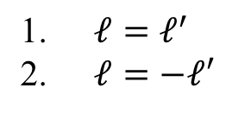

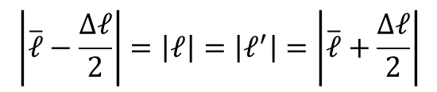
2. Transverse component : Vector vortex beams (VVB)
Transverse component of VVB:
$${ }_{Δℓ,\overline{ℓ},−2,0}^{∥}\left(q_{∥};α, β=\frac{π}{2}\right)={\tilde{F}}_{\left|\overline{ℓ}±\frac{Δℓ}{2}\right|}\left(q_{∥}\right) e^{i\left(\overline{ℓ}φ_{q_{∥}}+\frac{α}{2}\right)}\left\{cos\left[\frac{1}{2}\left(Δℓφ_{q_{∥}}+α\right)\right]\hat{x}+sin\left[\frac{1}{2}\left(Δℓφ_{q_{∥}}+α\right)\right]\hat{y}\right\}$$
Doughnut shape
Linear polarization
$$\left|\overline{ℓ}−\frac{Δℓ}{2}\right|=\left|ℓ\right|=\left|ℓ^{′}\right|=\left|\overline{ℓ}+\frac{Δℓ}{2}\right|$$
Conditions for ${\tilde{F}}_{\left|\overline{ℓ}−\frac{Δℓ}{2}\right|}\left(q_{∥}\right)={\tilde{F}}_{\left|\overline{ℓ}+\frac{Δℓ}{2}\right|}\left(q_{∥}\right)$ in LG beams
$ℓ=ℓ^{′}$
$ℓ=−ℓ′$

Slide 30
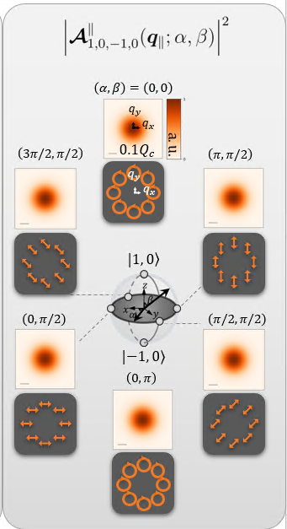
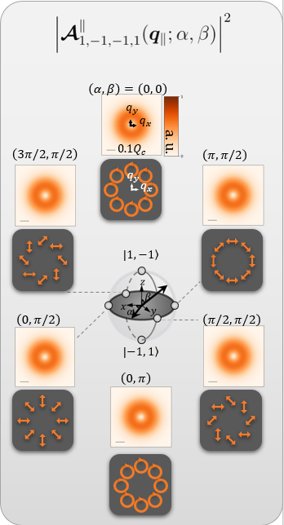
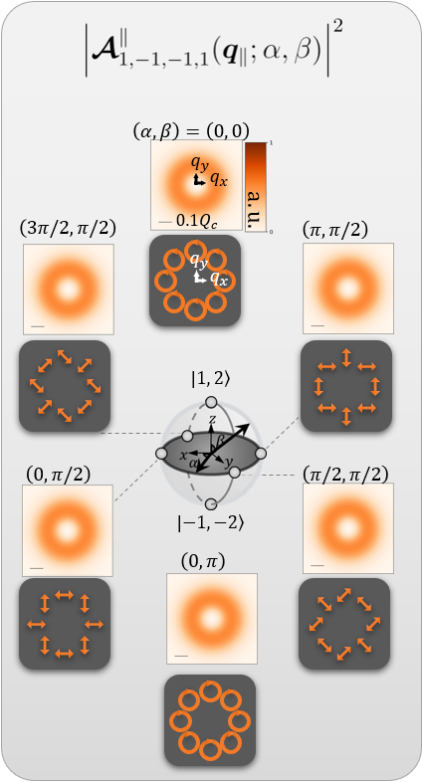
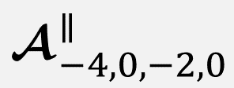
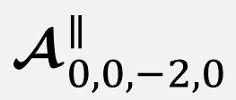
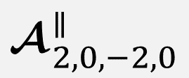
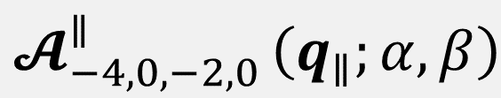




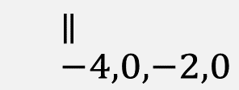

2. Transverse component : Vector vortex beams (VVB)
Second case : $ℓ=−ℓ^{′}$
$${ }_{−2ℓ,0,−2,0}^{∥}\left(q_{∥};α, β=\frac{π}{2}\right)={\tilde{F}}_{\left|ℓ\right|}\left(q_{∥}\right) e^{i\frac{α}{2}}\left\{cos\left(−ℓφ_{q_{∥}}+\frac{α}{2}\right)\hat{x}+sin\left(−ℓφ_{q_{∥}}+\frac{α}{2}\right)\hat{y}\right\}$$
Doughnut shape
Linear polarization changed with $α$ and$ℓ$
$$ℓ=0$$
$$ℓ=−1$$
$$ℓ=2$$
$${ }_{−4,0,−2,0 }^{∥}$$

Slide 31


2. Longitudinal component : Vector vortex beams (VVB)
Longitudinal component of VVB:
$${ }_{Δℓ,\overline{ℓ},Δσ,\overline{σ}}^{z}\left(q_{∥};α, β\right)$$
$$=−\frac{\sin{θ_{q}}}{\sqrt{2}}e^{i\left(\left(\overline{ℓ}+\overline{σ}\right)φ_{q_{∥}}+\frac{α}{2}\right)}\left\{cos\left[\frac{1}{2}\left(\left(Δℓ+Δσ\right)φ_{q_{∥}}+α\right)\right]\left[\cos\left(\frac{β}{2}\right){\tilde{F}}_{\left|\overline{ℓ}−\frac{Δℓ}{2}\right|}\left(q_{∥}\right)+\sin\left(\frac{β}{2}\right){\tilde{F}}_{\left|\overline{ℓ}+\frac{Δℓ}{2}\right|}\left(q_{∥}\right)\right]−i sin\left[\frac{1}{2}\left(\left(Δℓ+Δσ\right)φ_{q_{∥}}+α\right)\right]\left[\cos\left(\frac{β}{2}\right){\tilde{F}}_{\left|\overline{ℓ}−\frac{Δℓ}{2}\right|}\left(q_{∥}\right)−\sin\left(\frac{β}{2}\right){\tilde{F}}_{\left|\overline{ℓ}+\frac{Δℓ}{2}\right|}\left(q_{∥}\right)\right]\right\}\hat{z}$$

Slide 32



2. Longitudinal component : Vector vortex beams (VVB)
Longitudinal component of VVB:
$${ }_{Δℓ,\overline{ℓ},Δσ,\overline{σ}}^{z}\left(q_{∥};α, β\right)$$
$$=−\frac{\sin{θ_{q}}}{\sqrt{2}}e^{i\left(\left(\overline{ℓ}+\overline{σ}\right)φ_{q_{∥}}+\frac{α}{2}\right)}\left\{cos\left[\frac{1}{2}\left(\left(Δℓ+Δσ\right)φ_{q_{∥}}+α\right)\right]\left[\cos\left(\frac{β}{2}\right){\tilde{F}}_{\left|\overline{ℓ}−\frac{Δℓ}{2}\right|}\left(q_{∥}\right)+\sin\left(\frac{β}{2}\right){\tilde{F}}_{\left|\overline{ℓ}+\frac{Δℓ}{2}\right|}\left(q_{∥}\right)\right]−i sin\left[\frac{1}{2}\left(\left(Δℓ+Δσ\right)φ_{q_{∥}}+α\right)\right]\left[\cos\left(\frac{β}{2}\right){\tilde{F}}_{\left|\overline{ℓ}−\frac{Δℓ}{2}\right|}\left(q_{∥}\right)−\sin\left(\frac{β}{2}\right){\tilde{F}}_{\left|\overline{ℓ}+\frac{Δℓ}{2}\right|}\left(q_{∥}\right)\right]\right\}\hat{z}$$
Define $ΔJ≡Δℓ+Δσ$
$$\overline{J}≡\overline{ℓ}+\overline{σ}$$
Longitudinal component of VVB: $β=\frac{π}{2}$
$${ }_{Δℓ,\overline{ℓ},ΔJ,\overline{J}}^{z}\left(q_{∥};α, β=\frac{π}{2}\right)$$
$$=−\frac{\sin{θ_{q}}}{2}e^{i\left(\overline{J}φ_{q_{∥}}+\frac{α}{2}\right)}\left\{cos\left[\frac{1}{2}\left(ΔJφ_{q_{∥}}+α\right)\right]\left[{\tilde{F}}_{\left|\overline{ℓ}−\frac{Δℓ}{2}\right|}\left(q_{∥}\right)+{\tilde{F}}_{\left|\overline{ℓ}+\frac{Δℓ}{2}\right|}\left(q_{∥}\right)\right]−i sin\left[\frac{1}{2}\left(ΔJφ_{q_{∥}}+α\right)\right]\left[{\tilde{F}}_{\left|\overline{ℓ}−\frac{Δℓ}{2}\right|}\left(q_{∥}\right)−{\tilde{F}}_{\left|\overline{ℓ}+\frac{Δℓ}{2}\right|}\left(q_{∥}\right)\right]\right\}\hat{z}$$

Slide 33
2. Longitudinal component : Vector vortex beams (VVB)
Longitudinal component of VVB:
$${ }_{Δℓ,\overline{ℓ},Δσ,\overline{σ}}^{z}\left(q_{∥};α, β\right)$$
$$=−\frac{\sin{θ_{q}}}{\sqrt{2}}e^{i\left(\left(\overline{ℓ}+\overline{σ}\right)φ_{q_{∥}}+\frac{α}{2}\right)}\left\{cos\left[\frac{1}{2}\left(\left(Δℓ+Δσ\right)φ_{q_{∥}}+α\right)\right]\left[\cos\left(\frac{β}{2}\right){\tilde{F}}_{\left|\overline{ℓ}−\frac{Δℓ}{2}\right|}\left(q_{∥}\right)+\sin\left(\frac{β}{2}\right){\tilde{F}}_{\left|\overline{ℓ}+\frac{Δℓ}{2}\right|}\left(q_{∥}\right)\right]−i sin\left[\frac{1}{2}\left(\left(Δℓ+Δσ\right)φ_{q_{∥}}+α\right)\right]\left[\cos\left(\frac{β}{2}\right){\tilde{F}}_{\left|\overline{ℓ}−\frac{Δℓ}{2}\right|}\left(q_{∥}\right)−\sin\left(\frac{β}{2}\right){\tilde{F}}_{\left|\overline{ℓ}+\frac{Δℓ}{2}\right|}\left(q_{∥}\right)\right]\right\}\hat{z}$$
Define $ΔJ≡Δℓ+Δσ$
$$\overline{J}≡\overline{ℓ}+\overline{σ}$$
Longitudinal component of VVB: $β=\frac{π}{2}$
$${ }_{Δℓ,\overline{ℓ},ΔJ,\overline{J}}^{z}\left(q_{∥};α, β=\frac{π}{2}\right)$$
$$=−\frac{\sin{θ_{q}}}{2}e^{i\left(\overline{J}φ_{q_{∥}}+\frac{α}{2}\right)}\left\{cos\left[\frac{1}{2}\left(ΔJφ_{q_{∥}}+α\right)\right]\left[{\tilde{F}}_{\left|\overline{ℓ}−\frac{Δℓ}{2}\right|}\left(q_{∥}\right)+{\tilde{F}}_{\left|\overline{ℓ}+\frac{Δℓ}{2}\right|}\left(q_{∥}\right)\right]−i sin\left[\frac{1}{2}\left(ΔJφ_{q_{∥}}+α\right)\right]\left[{\tilde{F}}_{\left|\overline{ℓ}−\frac{Δℓ}{2}\right|}\left(q_{∥}\right)−{\tilde{F}}_{\left|\overline{ℓ}+\frac{Δℓ}{2}\right|}\left(q_{∥}\right)\right]\right\}\hat{z}$$
If ${\tilde{F}}_{\left|\overline{ℓ}−\frac{Δℓ}{2}\right|}\left(q_{∥}\right)={\tilde{F}}_{\left|\overline{ℓ}+\frac{Δℓ}{2}\right|}\left(q_{∥}\right)$
$${ }_{Δℓ,\overline{ℓ},ΔJ,\overline{J}}^{z}\left(q_{∥};α, β=\frac{π}{2}\right)=−\frac{\sin{θ_{q}}}{2}{\tilde{F}}_{\left|\overline{ℓ}±\frac{Δℓ}{2}\right|}\left(q_{∥}\right) e^{i\left(\overline{J}φ_{q_{∥}}+\frac{α}{2}\right)} cos\left[\frac{1}{2}\left(ΔJφ_{q_{∥}}+α\right)\right] \hat{z}$$
Doughnut shape
Azimuthal structure

Slide 34

















2. Longitudinal component : Vector vortex beams (VVB)
Second case : $ℓ=−ℓ^{′}$
$${ }_{−2ℓ,0,−2ℓ+Δσ, \overline{σ}}^{z}\left(q_{∥};α, β=\frac{π}{2}\right)=−\frac{\sin{θ_{q}}}{2}{\tilde{F}}_{\left|ℓ\right|}\left(q_{∥}\right) e^{i\left(\overline{σ}φ_{q_{∥}}+\frac{α}{2}\right)} cos\left\{\frac{1}{2}\left[\left(−2ℓ+Δσ\right)φ_{q_{∥}}+α\right]\right\} \hat{z}$$
Doughnut shape
Azimuthal structure
Total AM difference: $ΔJ=−2ℓ+Δσ$
$⇒$even number of nodes
$$ΔJ=−4$$
$$ΔJ=−2$$
$$ΔJ=0$$
$$ΔJ=2$$
$${ }_{−2ℓ,0,ΔJ=−2ℓ+Δσ,\overline{J}=\overline{σ}}^{z}$$
$${ }_{−2,0,−4,0 }^{z}$$
$${ }_{−2ℓ,0,−2ℓ−2,0}^{z}$$

Slide 35
2. Longitudinal component : Vector vortex beams (VVB)
Can we have odd numbers of nodes ?

Slide 36

2. Longitudinal component : Vector vortex beams (VVB)
Can we have odd numbers of nodes ?
Longitudinal component of VVB: $β=\frac{π}{2}$
$${ }_{Δℓ,\overline{ℓ},ΔJ,\overline{J}}^{z}\left(q_{∥};α, β=\frac{π}{2}\right)$$
$$=−\frac{\sin{θ_{q}}}{2}e^{i\left(\overline{J}φ_{q_{∥}}+\frac{α}{2}\right)}\left\{cos\left[\frac{1}{2}\left(ΔJφ_{q_{∥}}+α\right)\right]\left[{\tilde{F}}_{\left|ℓ\right|}\left(q_{∥}\right)+{\tilde{F}}_{\left|ℓ^{′}\right|}\left(q_{∥}\right)\right]−i sin\left[\frac{1}{2}\left(ΔJφ_{q_{∥}}+α\right)\right]\left[{\tilde{F}}_{\left|ℓ\right|}\left(q_{∥}\right)−{\tilde{F}}_{\left|ℓ^{′}\right|}\left(q_{∥}\right)\right]\right\}\hat{z}$$

Slide 37

2. Longitudinal component : Vector vortex beams (VVB)
Can we have odd numbers of nodes ?
Longitudinal component of VVB: $β=\frac{π}{2}$
$${ }_{Δℓ,\overline{ℓ},ΔJ,\overline{J}}^{z}\left(q_{∥};α, β=\frac{π}{2}\right)$$
$$=−\frac{\sin{θ_{q}}}{2}e^{i\left(\overline{J}φ_{q_{∥}}+\frac{α}{2}\right)}\left\{cos\left[\frac{1}{2}\left(ΔJφ_{q_{∥}}+α\right)\right]\left[{\tilde{F}}_{\left|ℓ\right|}\left(q_{∥}\right)+{\tilde{F}}_{\left|ℓ^{′}\right|}\left(q_{∥}\right)\right]−i sin\left[\frac{1}{2}\left(ΔJφ_{q_{∥}}+α\right)\right]\left[{\tilde{F}}_{\left|ℓ\right|}\left(q_{∥}\right)−{\tilde{F}}_{\left|ℓ^{′}\right|}\left(q_{∥}\right)\right]\right\}\hat{z}$$
Substitute ${\tilde{F}}_{\left|ℓ\right|}\left(q_{∥}\right)={\left(−i\right)}^{\left|ℓ\right|}F_{\left|ℓ\right|}\left(q_{∥}\right)$, and define $\overline{\left|ℓ\right|}≡\left(\left|ℓ′\right|+\left|ℓ\right|\right)/2$, $Δ\left|ℓ\right|≡\left|ℓ′\right|−\left|ℓ\right|$
$${ }_{Δℓ,\overline{ℓ},ΔJ,\overline{J}}^{z}\left(q_{∥};α, β=\frac{π}{2}\right)$$
$$=−\frac{\sin{θ_{q}}}{2}e^{i\left(\overline{J}φ_{q_{∥}}−\frac{π}{2}\overline{\left|ℓ\right|}+\frac{α}{2}\right)}\left\{cos\left[\frac{1}{2}\left(ΔJφ_{q_{∥}}−\frac{π}{2}Δ\left|ℓ\right|+α\right)\right]\left[F_{\left|ℓ\right|}\left(q_{∥}\right)+F_{\left|ℓ^{′}\right|}\left(q_{∥}\right)\right]+i sin\left[\frac{1}{2}\left(ΔJφ_{q_{∥}}−\frac{π}{2}Δ\left|ℓ\right|+α\right)\right]\left[F_{\left|ℓ\right|}\left(q_{∥}\right)−F_{\left|ℓ^{′}\right|}\left(q_{∥}\right)\right]\right\}\hat{z}$$

Slide 38



2. Longitudinal component : Vector vortex beams (VVB)
Can we have odd numbers of nodes ?
Longitudinal component of VVB: $β=\frac{π}{2}$
$${ }_{Δℓ,\overline{ℓ},ΔJ,\overline{J}}^{z}\left(q_{∥};α, β=\frac{π}{2}\right)$$
$$=−\frac{\sin{θ_{q}}}{2}e^{i\left(\overline{J}φ_{q_{∥}}+\frac{α}{2}\right)}\left\{cos\left[\frac{1}{2}\left(ΔJφ_{q_{∥}}+α\right)\right]\left[{\tilde{F}}_{\left|ℓ\right|}\left(q_{∥}\right)+{\tilde{F}}_{\left|ℓ^{′}\right|}\left(q_{∥}\right)\right]−i sin\left[\frac{1}{2}\left(ΔJφ_{q_{∥}}+α\right)\right]\left[{\tilde{F}}_{\left|ℓ\right|}\left(q_{∥}\right)−{\tilde{F}}_{\left|ℓ^{′}\right|}\left(q_{∥}\right)\right]\right\}\hat{z}$$
Substitute ${\tilde{F}}_{\left|ℓ\right|}\left(q_{∥}\right)={\left(−i\right)}^{\left|ℓ\right|}F_{\left|ℓ\right|}\left(q_{∥}\right)$, and define $\overline{\left|ℓ\right|}≡\left(\left|ℓ′\right|+\left|ℓ\right|\right)/2$, $Δ\left|ℓ\right|≡\left|ℓ′\right|−\left|ℓ\right|$
$${ }_{Δℓ,\overline{ℓ},ΔJ,\overline{J}}^{z}\left(q_{∥};α, β=\frac{π}{2}\right)$$
$$=−\frac{\sin{θ_{q}}}{2}e^{i\left(\overline{J}φ_{q_{∥}}−\frac{π}{2}\overline{\left|ℓ\right|}+\frac{α}{2}\right)}\left\{cos\left[\frac{1}{2}\left(ΔJφ_{q_{∥}}−\frac{π}{2}Δ\left|ℓ\right|+α\right)\right]\left[F_{\left|ℓ\right|}\left(q_{∥}\right)+F_{\left|ℓ^{′}\right|}\left(q_{∥}\right)\right]−i sin\left[\frac{1}{2}\left(ΔJφ_{q_{∥}}−\frac{π}{2}Δ\left|ℓ\right|+α\right)\right]\left[F_{\left|ℓ\right|}\left(q_{∥}\right)−F_{\left|ℓ^{′}\right|}\left(q_{∥}\right)\right]\right\}\hat{z}$$
Define $G_{\left|ℓ\right|,\left|ℓ^{′}\right|}\left(q_{∥}\right)≡\left[F_{\left|ℓ\right|}\left(q_{∥}\right)+F_{\left|ℓ^{′}\right|}\left(q_{∥}\right)\right]$
$$H_{\left|ℓ\right|,\left|ℓ^{′}\right|}\left(q_{∥}\right)≡\left[F_{\left|ℓ\right|}\left(q_{∥}\right)−F_{\left|ℓ^{′}\right|}\left(q_{∥}\right)\right]$$
$${ }_{Δℓ,\overline{ℓ},ΔJ,\overline{J}}^{z}\left(q_{∥};α, β=\frac{π}{2}\right)$$
$$=−\frac{\sin{θ_{q}}}{2}e^{i\left(\overline{J}φ_{q_{∥}}−\frac{π}{2}\overline{\left|ℓ\right|}+\frac{α}{2}\right)}\left\{ cos\left[\frac{1}{2}\left(ΔJφ_{q_{∥}}−\frac{π}{2}Δ\left|ℓ\right|+α\right)\right] G_{\left|ℓ\right|,\left|ℓ^{′}\right|}\left(q_{∥}\right)− i sin\left[\frac{1}{2}\left(ΔJφ_{q_{∥}}−\frac{π}{2}Δ\left|ℓ\right|+α\right)\right] H_{\left|ℓ\right|,\left|ℓ^{′}\right|}\left(q_{∥}\right) \right\}\hat{z}$$
$${ }_{Δℓ,\overline{ℓ},ΔJ,\overline{J}}^{z}\left(q_{∥};α, β=\frac{π}{2}\right)=−\frac{\sin{θ_{q}}}{2}e^{i\left(\overline{J}φ_{q_{∥}}−\frac{π}{2}\overline{\left|ℓ\right|}+\frac{α}{2}\right)}\left\{ cos\left[\frac{1}{2}\left(ΔJφ_{q_{∥}}−\frac{π}{2}Δ\left|ℓ\right|+α\right)\right] G_{\left|ℓ\right|,\left|ℓ^{′}\right|}\left(q_{∥}\right)− i sin\left[\frac{1}{2}\left(ΔJφ_{q_{∥}}−\frac{π}{2}Δ\left|ℓ\right|+α\right)\right] H_{\left|ℓ\right|,\left|ℓ^{′}\right|}\left(q_{∥}\right) \right\}\hat{z}$$

Slide 39











2. Longitudinal component : Vector vortex beams (VVB)
Longitudinal component of VVB: $β=\frac{π}{2}$
$${ }_{Δℓ,\overline{ℓ},ΔJ,\overline{J}}^{z}\left(q_{∥};α, β=\frac{π}{2}\right)$$
$$=−\frac{\sin{θ_{q}}}{2}e^{i\left(\overline{J}φ_{q_{∥}}−\frac{π}{2}\overline{\left|ℓ\right|}+\frac{α}{2}\right)}\left\{ cos\left[\frac{1}{2}\left(ΔJφ_{q_{∥}}−\frac{π}{2}Δ\left|ℓ\right|+α\right)\right] G_{\left|ℓ\right|,\left|ℓ^{′}\right|}\left(q_{∥}\right)− i sin\left[\frac{1}{2}\left(ΔJφ_{q_{∥}}−\frac{π}{2}Δ\left|ℓ\right|+α\right)\right] H_{\left|ℓ\right|,\left|ℓ^{′}\right|}\left(q_{∥}\right) \right\}\hat{z}$$
Example for odd number $ΔJ$: $σ,ℓ,σ^{′},ℓ^{′}=1, −1, −1, 2$
$1$
$$ΔJ=1$$
$⇒$one node
$$a.u.$$
$0$
$${ }_{−2ℓ,0,ΔJ=−2ℓ+Δσ,\overline{J}=\overline{σ}}^{z}$$
$${ }_{3,\frac{1}{2},1,\frac{1}{4}}^{z}$$

Slide 40






2. Longitudinal component : Vector vortex beams (VVB)
Longitudinal component of VVB: $β=\frac{π}{2}$
$${ }_{Δℓ,\overline{ℓ},ΔJ,\overline{J}}^{z}\left(q_{∥};α, β=\frac{π}{2}\right)$$
$$=−\frac{\sin{θ_{q}}}{2}e^{i\left(\overline{J}φ_{q_{∥}}−\frac{π}{2}\overline{\left|ℓ\right|}+\frac{α}{2}\right)}\left\{ cos\left[\frac{1}{2}\left(ΔJφ_{q_{∥}}−\frac{π}{2}Δ\left|ℓ\right|+α\right)\right] G_{\left|ℓ\right|,\left|ℓ^{′}\right|}\left(q_{∥}\right)− i sin\left[\frac{1}{2}\left(ΔJφ_{q_{∥}}−\frac{π}{2}Δ\left|ℓ\right|+α\right)\right] H_{\left|ℓ\right|,\left|ℓ^{′}\right|}\left(q_{∥}\right) \right\}\hat{z}$$
$1$
$$\left(α, β\right)=\left(0, π/2\right)$$
But ! For $α=0$, node appear when $φ_{q_{∥}}=\frac{3π}{2}$
$$cos\left[\frac{1}{2}\left(ΔJφ_{q_{∥}}−\frac{π}{2}Δ\left|ℓ\right|+α\right)\right]=cos\left[\frac{π}{2}\right]=0$$
here
$$sin\left[\frac{1}{2}\left(ΔJφ_{q_{∥}}−\frac{π}{2}Δ\left|ℓ\right|+α\right)\right] =sin\left[\frac{π}{2}\right] =1$$
Maximum value !?
$$a.u.$$
$0$
$σ,ℓ,σ^{′},ℓ^{′}=1, −1, −1, 2$
$${ }_{−2ℓ,0,ΔJ=−2ℓ+Δσ,\overline{J}=\overline{σ}}^{z}$$
$${ }_{3,\frac{1}{2},1,\frac{1}{4}}^{z}$$

Slide 41








2. Longitudinal component : Vector vortex beams (VVB)
Longitudinal component of VVB: $β=\frac{π}{2}$
$${ }_{Δℓ,\overline{ℓ},ΔJ,\overline{J}}^{z}\left(q_{∥};α, β=\frac{π}{2}\right)$$
$$=−\frac{\sin{θ_{q}}}{2}e^{i\left(\overline{J}φ_{q_{∥}}−\frac{π}{2}\overline{\left|ℓ\right|}+\frac{α}{2}\right)}\left\{ cos\left[\frac{1}{2}\left(ΔJφ_{q_{∥}}−\frac{π}{2}Δ\left|ℓ\right|+α\right)\right] G_{\left|ℓ\right|,\left|ℓ^{′}\right|}\left(q_{∥}\right)− i sin\left[\frac{1}{2}\left(ΔJφ_{q_{∥}}−\frac{π}{2}Δ\left|ℓ\right|+α\right)\right] H_{\left|ℓ\right|,\left|ℓ^{′}\right|}\left(q_{∥}\right) \right\}\hat{z}$$
$1$
$1$
$0$.05
$$a.u.$$
$0$
$$a.u.$$
$0$
$$a.u.$$
$0$
$$G_{\left|ℓ\right|,\left|ℓ^{′}\right|}\left(q_{∥}\right)≡\left[F_{\left|ℓ\right|}\left(q_{∥}\right)+F_{\left|ℓ^{′}\right|}\left(q_{∥}\right)\right]$$
$$H_{\left|ℓ\right|,\left|ℓ^{′}\right|}\left(q_{∥}\right)≡\left[F_{\left|ℓ\right|}\left(q_{∥}\right)−F_{\left|ℓ^{′}\right|}\left(q_{∥}\right)\right]$$
$σ,ℓ,σ^{′},ℓ^{′}=1, −1, −1, 2$
Nearly zero

Slide 42

2. Longitudinal component : Vector vortex beams (VVB)
Longitudinal component of VVB: $β=\frac{π}{2}$
$${ }_{Δℓ,\overline{ℓ},ΔJ,\overline{J}}^{z}\left(q_{∥};α, β=\frac{π}{2}\right)$$
$$=−\frac{\sin{θ_{q}}}{2}e^{i\left(\overline{J}φ_{q_{∥}}−\frac{π}{2}\overline{\left|ℓ\right|}+\frac{α}{2}\right)}\left\{ cos\left[\frac{1}{2}\left(ΔJφ_{q_{∥}}−\frac{π}{2}Δ\left|ℓ\right|+α\right)\right] G_{\left|ℓ\right|,\left|ℓ^{′}\right|}\left(q_{∥}\right)− i sin\left[\frac{1}{2}\left(ΔJφ_{q_{∥}}−\frac{π}{2}Δ\left|ℓ\right|+α\right)\right] H_{\left|ℓ\right|,\left|ℓ^{′}\right|}\left(q_{∥}\right) \right\}\hat{z}$$
$1$
What does it means to have a horseshoe shape light?
$$a.u.$$
$0$
$σ,ℓ,σ^{′},ℓ^{′}=1, −1, −1, 2$

Slide 43

2. Longitudinal component : Vector vortex beams (VVB)
Longitudinal component of VVB: $β=\frac{π}{2}$
$${ }_{Δℓ,\overline{ℓ},ΔJ,\overline{J}}^{z}\left(q_{∥};α, β=\frac{π}{2}\right)$$
$$=−\frac{\sin{θ_{q}}}{2}e^{i\left(\overline{J}φ_{q_{∥}}−\frac{π}{2}\overline{\left|ℓ\right|}+\frac{α}{2}\right)}\left\{ cos\left[\frac{1}{2}\left(ΔJφ_{q_{∥}}−\frac{π}{2}Δ\left|ℓ\right|+α\right)\right] G_{\left|ℓ\right|,\left|ℓ^{′}\right|}\left(q_{∥}\right)− i sin\left[\frac{1}{2}\left(ΔJφ_{q_{∥}}−\frac{π}{2}Δ\left|ℓ\right|+α\right)\right] H_{\left|ℓ\right|,\left|ℓ^{′}\right|}\left(q_{∥}\right) \right\}\hat{z}$$
Find the real field !
$$Re\left[{ }_{Δℓ,\overline{ℓ},ΔJ,\overline{J}}^{z}\left(q_{∥};α, β=\frac{π}{2}\right)e^{−iωt}\right]$$
$1$
$$a.u.$$
$0$
$σ,ℓ,σ^{′},ℓ^{′}=1, −1, −1, 2$

Slide 44


2. Longitudinal component : Vector vortex beams (VVB)
Longitudinal component of VVB: $β=\frac{π}{2}$
$${ }_{Δℓ,\overline{ℓ},ΔJ,\overline{J}}^{z}\left(q_{∥};α, β=\frac{π}{2}\right)$$
$$=−\frac{\sin{θ_{q}}}{2}e^{i\left(\overline{J}φ_{q_{∥}}−\frac{π}{2}\overline{\left|ℓ\right|}+\frac{α}{2}\right)}\left\{ cos\left[\frac{1}{2}\left(ΔJφ_{q_{∥}}−\frac{π}{2}Δ\left|ℓ\right|+α\right)\right] G_{\left|ℓ\right|,\left|ℓ^{′}\right|}\left(q_{∥}\right)− i sin\left[\frac{1}{2}\left(ΔJφ_{q_{∥}}−\frac{π}{2}Δ\left|ℓ\right|+α\right)\right] H_{\left|ℓ\right|,\left|ℓ^{′}\right|}\left(q_{∥}\right) \right\}\hat{z}$$
Find the real field !
$$Re\left[{ }_{Δℓ,\overline{ℓ},ΔJ,\overline{J}}^{z}\left(q_{∥};α, β=\frac{π}{2}\right)e^{−iωt}\right]$$
$1$
$$a.u.$$
$0$
$σ,ℓ,σ^{′},ℓ^{′}=1, −1, −1, 2$

Slide 45
Outline
1. Introduction
2. Spin-orbital angular momentum interaction in light
3. Light-matter interaction
Selective excitation
Encoding SOI information
4. Exciton wave packet
Summary and outlook

Slide 46
3. Light-matter interaction

Slide 47
Outline
1. Introduction
2. Spin-orbital angular momentum interaction in light
3. Light-matter interaction
4. Exciton wave packet
Summary and outlook

Slide 48
4. Exciton wave packet

Slide 49
Summary and outlook
Summary and outlook

