Slide 1
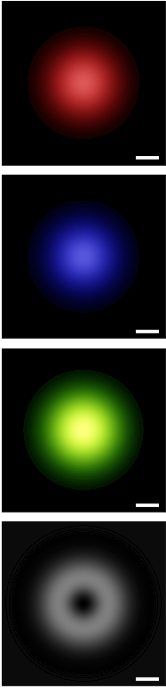
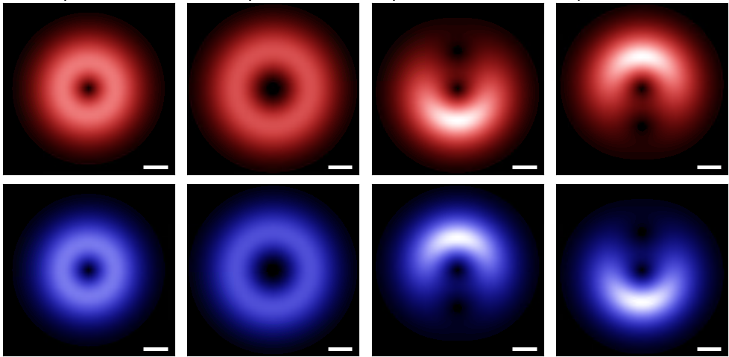
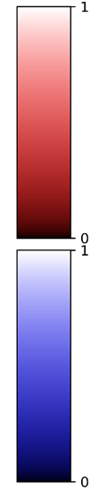
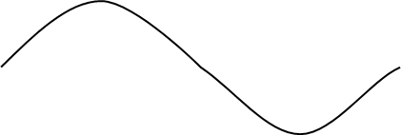
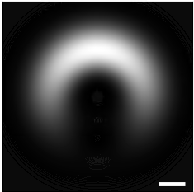
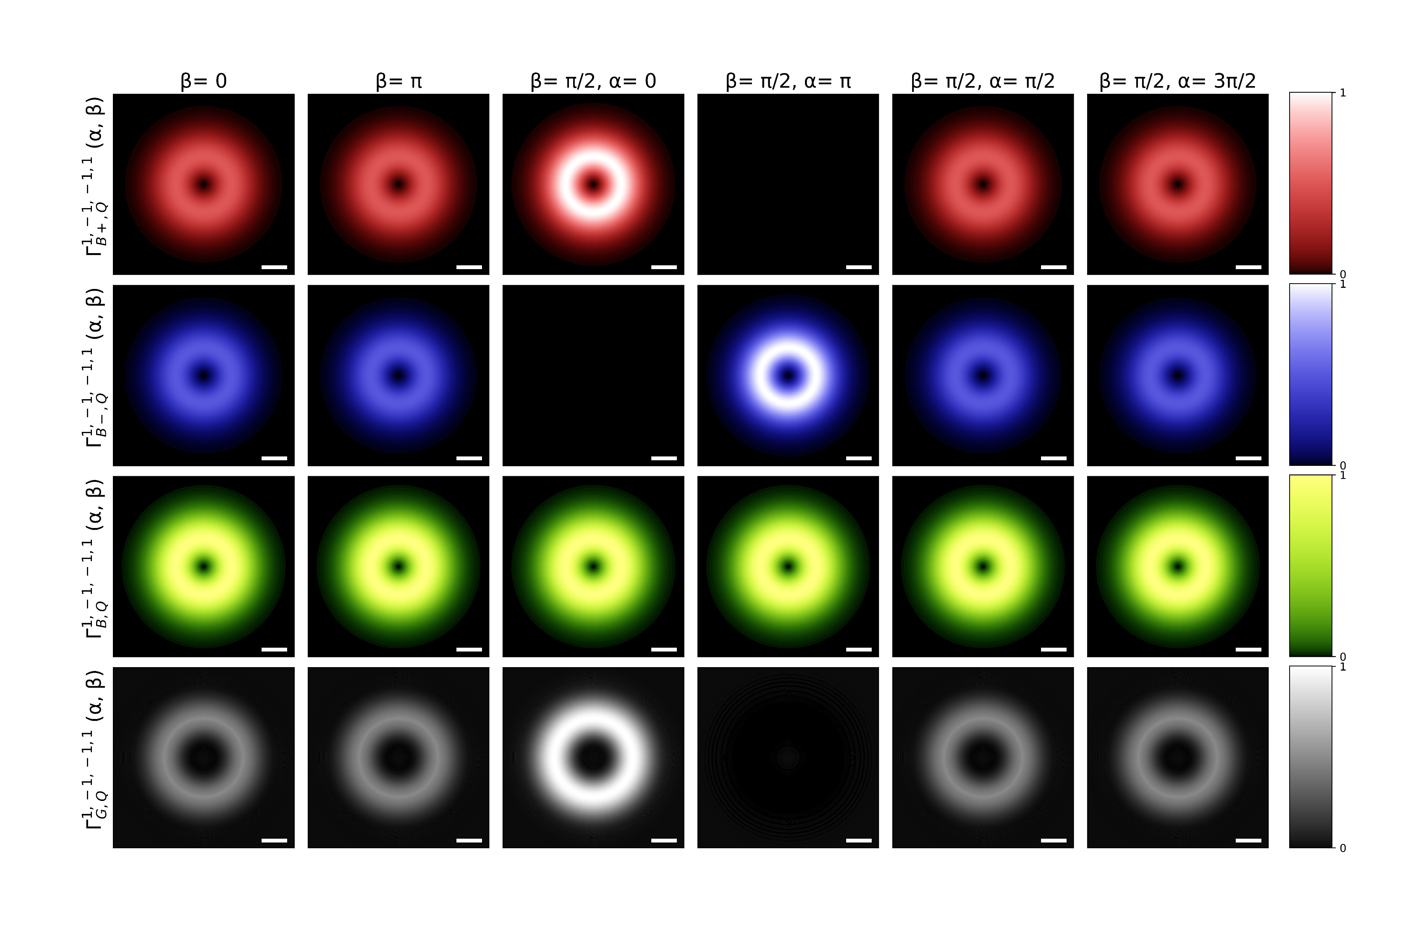


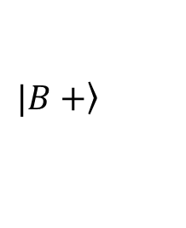










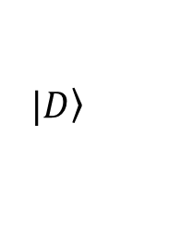



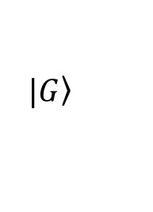





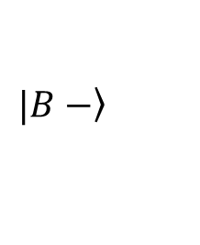



Gaussian beam
VVB
$$1$$
$$a.u.$$
$$\left.|B+\right\rangle$$
$${0.1Q}_{c}$$
$${0.1Q}_{c}$$
$$0$$
$$Γ_{1, 0, −1, 0}^{B+, Q}\left(Q;0, 0\right)$$
$$Γ_{1, −1, −1, 2}^{B+, Q}\left(Q;0, \frac{π}{2}\right)$$
$$1$$
$$Q_{y}$$
Blue shift
$$a.u.$$
$$\left.|B−\right\rangle$$
$$Q_{x}$$
$$0$$
$$Γ_{1, 0, −1, 0}^{B−, Q}\left(Q;0, 0\right)$$
$$Γ_{1, −1, −1, 2}^{B−, Q}\left(Q;0, \frac{π}{2}\right)$$
$$\left.|G\right\rangle$$
$$1$$
$$a.u.$$
$$\left.|D\right\rangle$$
$$Q_{y}$$
$$0$$
$$Q_{y}$$
$$Q_{x}$$
$$Q_{y}$$
$$Γ_{1, 0, −1, 0}^{G, Q}\left(Q;0, 0\right)$$
$$Q=0$$
$$Γ_{1, −1, −1, 2}^{G, Q}\left(Q;0, \frac{π}{2}\right)$$
$$Q=0$$

