Slide 1
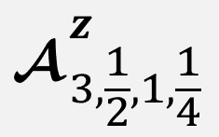
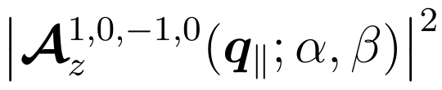
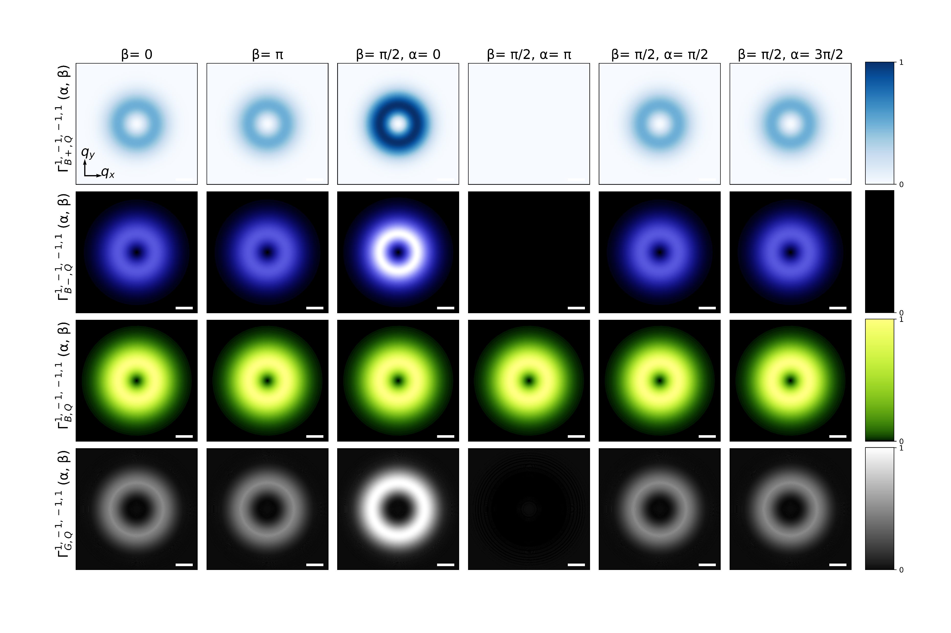



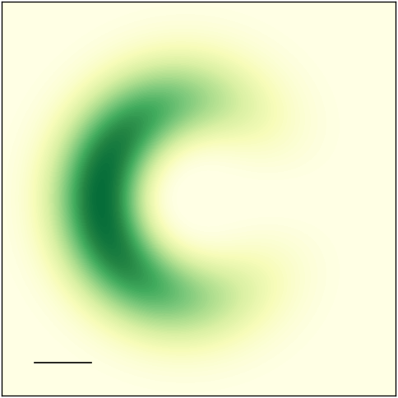
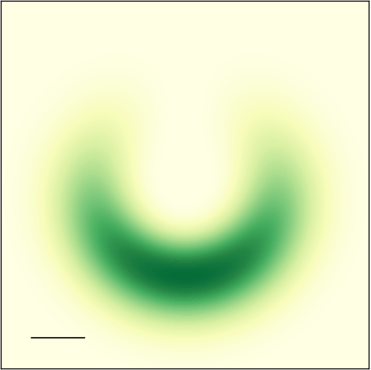


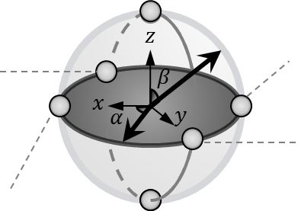


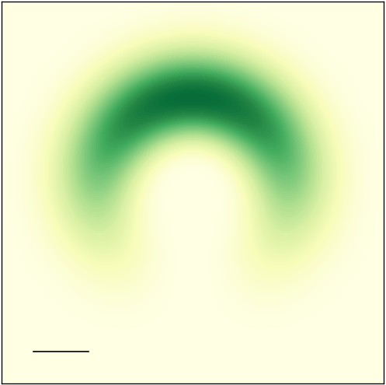
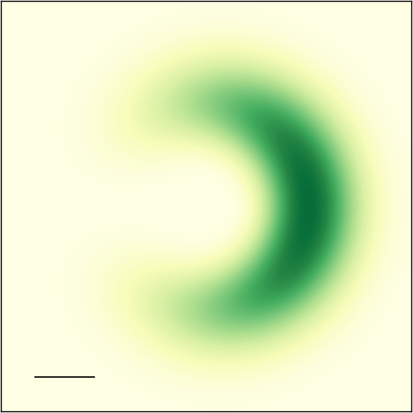












































$$\left(α, β\right)=\left(0, \text{0}\right)$$
$1$
$${\left|−\frac{\sin{θ_{q}}}{2}cos\left[\frac{1}{2}\left(φ_{q_{∥}}−\frac{π}{2}+α\right)\right] G_{\left|−1\right|,\left|2\right|}\left(q_{∥}\right)\right|}^{2}$$
$${\left|\frac{\sin{θ_{q}}}{2}i sin\left[\frac{1}{2}\left(ΔJφ_{q_{∥}}−\frac{π}{2}+α\right)\right] H_{\left|−1\right|,\left|2\right|}\left(q_{∥}\right)\right|}^{2}$$
$$q_{y}$$
$$q_{x}$$
$$\left(3π/2,π/2\right)$$
$$\left(π,π/2\right)$$
$$\left(α, β\right)= \left(3π/2,π/2\right)$$
$$\left(π,π/2\right)$$
$$\left(α, β\right)= \left(3π/2,π/2\right)$$
$$\left(π,π/2\right)$$
$${0.1Q}_{c}$$
$$q_{y}$$
$$q_{y}$$
$$|\left.1, −1\right\rangle$$
$$q_{x}$$
$$|\left.1, −1\right\rangle$$
$$q_{x}$$
$$|\left.1, −1\right\rangle$$
$${0.1Q}_{c}$$
$${0.1Q}_{c}$$
$$\left(0, π/2\right)$$
$$\left(π/2,π/2\right)$$
$$\left(0, π/2\right)$$
$$\left(π/2,π/2\right)$$
$$\left(0, π/2\right)$$
$$\left(π/2,π/2\right)$$
$$|\left.−1, 2\right\rangle$$
$$|\left.−1, 2\right\rangle$$
$$|\left.−1, 2\right\rangle$$
$$\left(0,π\right)$$
$$a.u.$$
$0$
$σ,ℓ,σ^{′},ℓ^{′}=1, −1, −1, 2$
$1$
$0$.05
$$z$$
$$β$$
$$x$$
$$α$$
$$y$$
$$a.u.$$
$0$
$$a.u.$$
$0$

Slide 2


















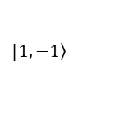



$0$
$1$
$${\left|−\frac{\sin{θ_{q}}}{2}cos\left[\frac{1}{2}\left(φ_{q_{∥}}−\frac{π}{2}+α\right)\right] G_{\left|−1\right|,\left|2\right|}\left(q_{∥}\right)\right|}^{2}$$
$0$
$1$
$${\left|\frac{\sin{θ_{q}}}{2}i sin\left[\frac{1}{2}\left(ΔJφ_{q_{∥}}−\frac{π}{2}+α\right)\right] H_{\left|−1\right|,\left|2\right|}\left(q_{∥}\right)\right|}^{2}$$
$0$
$0$.05
$$a.u.$$
$$\left(α, β\right)=\left(0, \text{0}\right)$$
$$\left(3π/2,π/2\right)$$
$$\left(π,π/2\right)$$
$$q_{y}$$
$$q_{y}$$
$$q_{y}$$
$$q_{x}$$
$$q_{x}$$
$$q_{x}$$
$$|\left.1, −1\right\rangle$$
$${0.1Q}_{c}$$
$${0.1Q}_{c}$$
$${0.1Q}_{c}$$
$$\left(0, π/2\right)$$
$$\left(π/2,π/2\right)$$
$$|\left.−1, 2\right\rangle$$
$$\left(0,π\right)$$
$σ,ℓ,σ^{′},ℓ^{′}=1, −1, −1, 2$

Slide 3





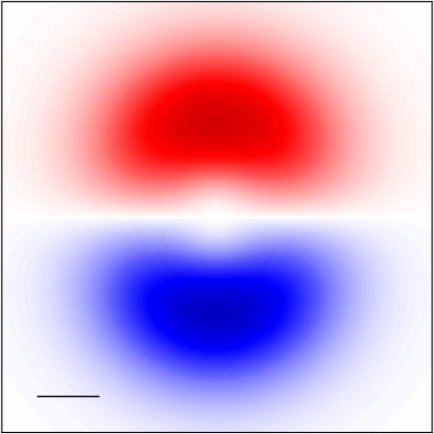
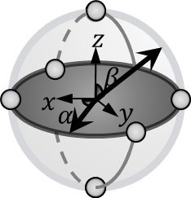


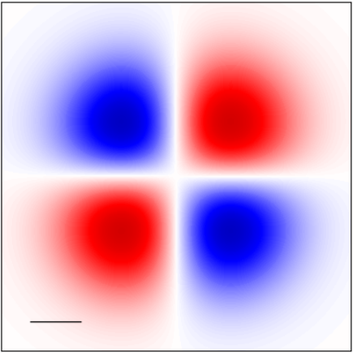




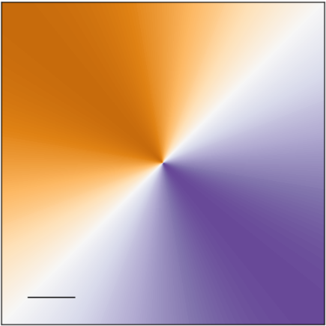



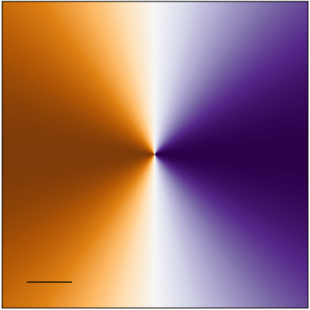
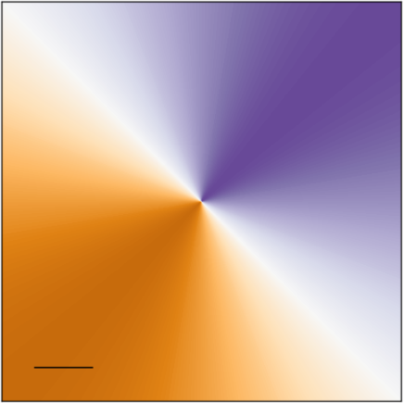







































$$Re\left[{ }_{1, −1,−1,1}^{z}\left(q_{∥}\right)\right]$$
$$Re\left[{ }_{1, −1,−1,−1}^{z}\left(q_{∥}\right)\right]$$
$$\left(α, β\right)=\left(0, \text{0}\right)$$
$$\left(α, β\right)=\left(0, \text{0}\right)$$
$$q_{y}$$
$$a.u.$$
$$q_{y}$$
$$a.u.$$
$$q_{x}$$
$$q_{x}$$
$$\left(3π/2,π/2\right)$$
$${0.1Q}_{c}$$
$$\left(π,π/2\right)$$
$$\left(3π/2,π/2\right)$$
$${0.1Q}_{c}$$
$$\left(π,π/2\right)$$
$$|\left.1, −1\right\rangle$$
$$|\left.1, −1\right\rangle$$
$$⇒\overline{J}=0$$
$$⇒\overline{J}=−1$$
$$\left(0, π/2\right)$$
$$\left(π/2,π/2\right)$$
$$\left(0, π/2\right)$$
$$\left(π/2,π/2\right)$$
$$|\left.−1, 1\right\rangle$$
$$|\left.−1, −1\right\rangle$$
$$\left(0,π\right)$$
$$\left(0,π\right)$$
$$Re\left[{\hat{ε}}_{1, −1,−1,1 }^{z}\left(q_{∥};α\right)\right]$$
$$Re\left[{\hat{ε}}_{1, −1,−1,−1 }^{z}\left(q_{∥};α\right)\right]$$
$$\left(α, β\right)=\left(0, \text{0}\right)$$
$$\left(α, β\right)=\left(0, \text{0}\right)$$
$$q_{y}$$
$$a.u.$$
$$q_{y}$$
$$a.u.$$
$$q_{x}$$
$$q_{x}$$
$$\left(3π/2,π/2\right)$$
$${0.1Q}_{c}$$
$$\left(π,π/2\right)$$
$$\left(3π/2,π/2\right)$$
$${0.1Q}_{c}$$
$$\left(π,π/2\right)$$
$$|\left.1, −1\right\rangle$$
$$|\left.1, −1\right\rangle$$
$$⇒ΔJ=0$$
$$⇒ΔJ=−2$$
$$\left(0, π/2\right)$$
$$\left(π/2,π/2\right)$$
$$\left(0, π/2\right)$$
$$\left(π/2,π/2\right)$$
$$|\left.−1, 1\right\rangle$$
$$|\left.−1, −1\right\rangle$$
$$\left(0,π\right)$$
$$\left(0,π\right)$$

