Slide 1
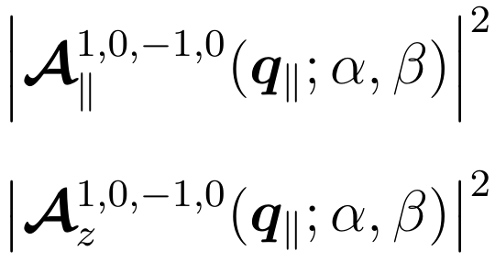




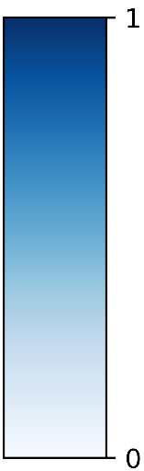





















Longitudinal component
$$1, 0, −1, 1$$
$$\left(α, β\right)=\left(0, \text{0}\right)$$
$$q_{y}$$
$$q_{x}$$
$$\left(3π/2,π/2\right)$$
$${0.1Q}_{c}$$
$$\left(π,π/2\right)$$
$$|\left.1, −1\right\rangle$$
$$z$$
$$β$$
$$x$$
$$y$$
$$α$$
$$a.u.$$
$$\left(0, π/2\right)$$
$$\left(π/2,π/2\right)$$
$$|\left.−1, 2\right\rangle$$
$$\left(0,π\right)$$

Slide 2
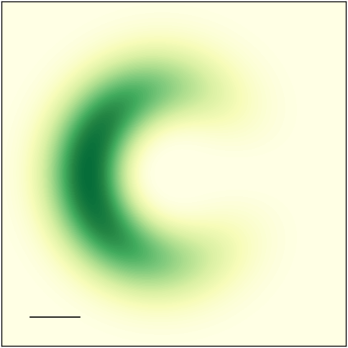
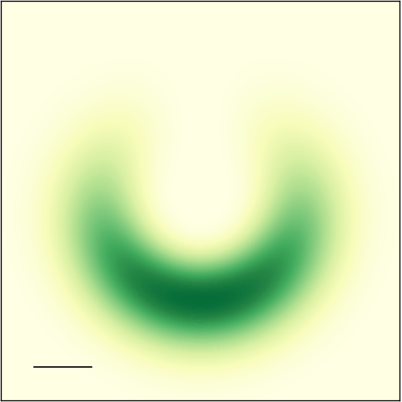


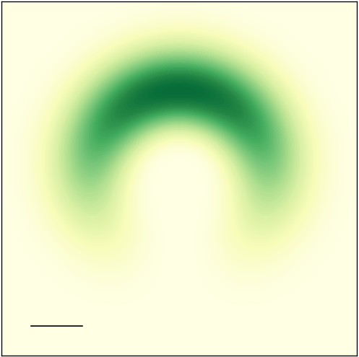
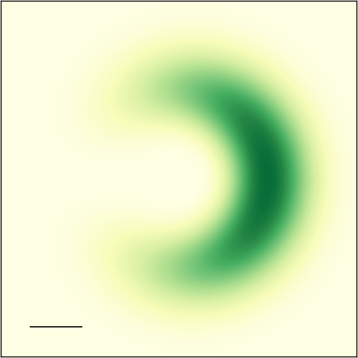







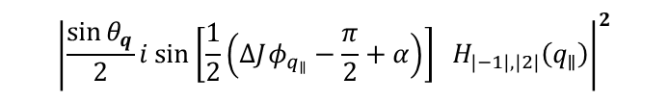












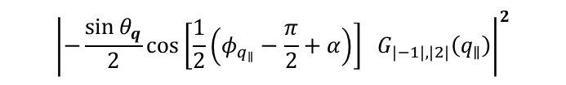





Longitudinal component
$$1, 0, −1, 1$$
$${\left|−\frac{\sin{θ_{q}}}{2}cos\left[\frac{1}{2}\left(φ_{q_{∥}}−\frac{π}{2}+α\right)\right] G_{\left|−1\right|,\left|2\right|}\left(q_{∥}\right)\right|}^{2}$$
$${\left|\frac{\sin{θ_{q}}}{2}i sin\left[\frac{1}{2}\left(ΔJφ_{q_{∥}}−\frac{π}{2}+α\right)\right] H_{\left|−1\right|,\left|2\right|}\left(q_{∥}\right)\right|}^{2}$$
$$a.u.$$
$$\left(α, β\right)= \left(3π/2,π/2\right)$$
$$\left(π,π/2\right)$$
$$\left(α, β\right)= \left(3π/2,π/2\right)$$
$$\left(π,π/2\right)$$
$$q_{y}$$
$$|\left.1, −1\right\rangle$$
$$q_{y}$$
$$|\left.1, −1\right\rangle$$
$$q_{x}$$
$$q_{x}$$
$$z$$
$$z$$
$$a.u.$$
$${0.1Q}_{c}$$
$${0.1Q}_{c}$$
$$β$$
$$β$$
$$x$$
$$y$$
$$x$$
$$y$$
$$\left(0, π/2\right)$$
$$α$$
$$\left(π/2,π/2\right)$$
$$\left(0, π/2\right)$$
$$α$$
$$\left(π/2,π/2\right)$$
$$|\left.−1, 2\right\rangle$$
$$|\left.−1, 2\right\rangle$$

Slide 3

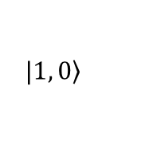
















Longitudinal component
$$1,−1,−1, 2$$
$$\left(α, β\right)=\left(0, \text{0}\right)$$
$$q_{y}$$
$$q_{x}$$
$${0.1Q}_{c}$$
$$a.u.$$
$$|\left.1, 0\right\rangle$$
$$z$$
$$\left(0, π/2\right)$$
$$\left(π,π/2\right)$$
$$β$$
$$x$$
$$y$$
$$α$$
$$|\left.−1, 0\right\rangle$$
$$\left(0,π\right)$$

Slide 4

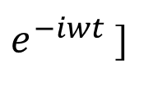

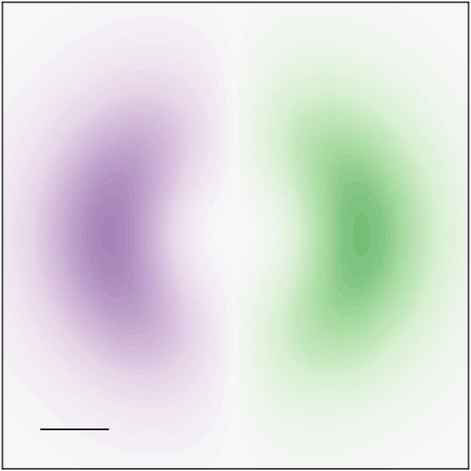
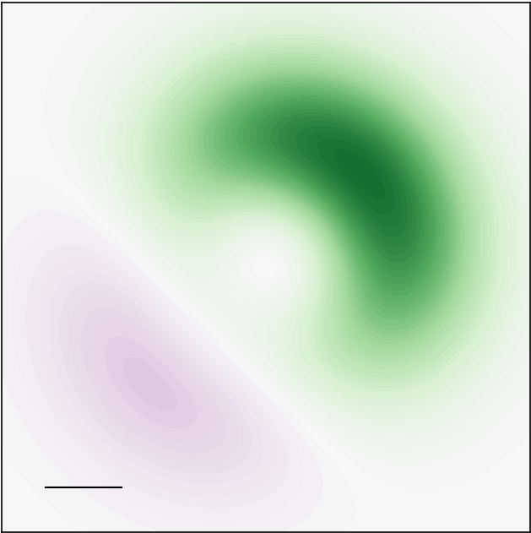
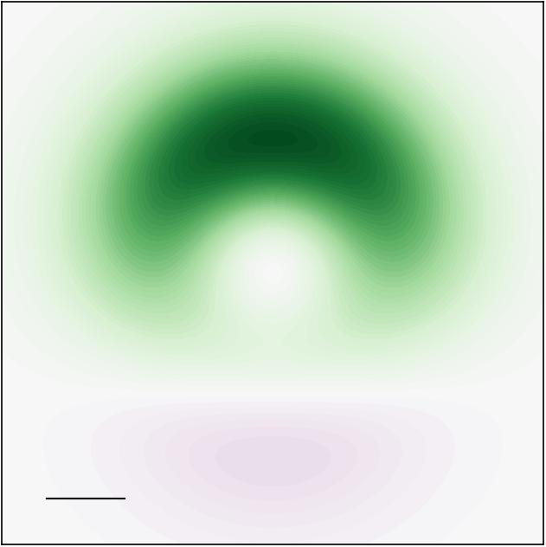
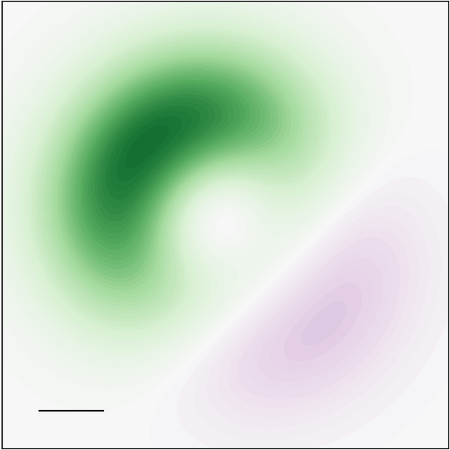
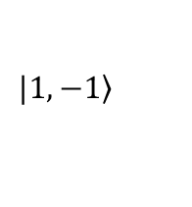


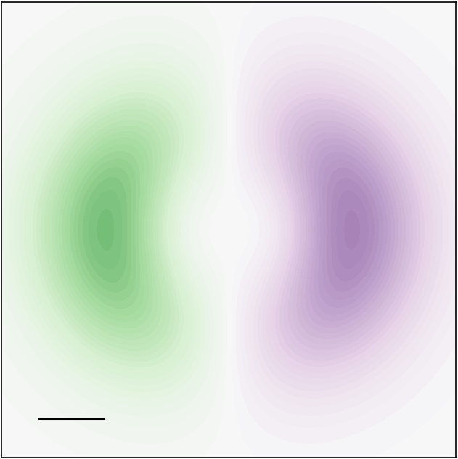
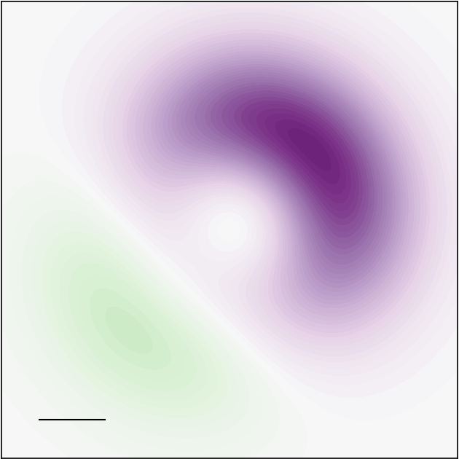

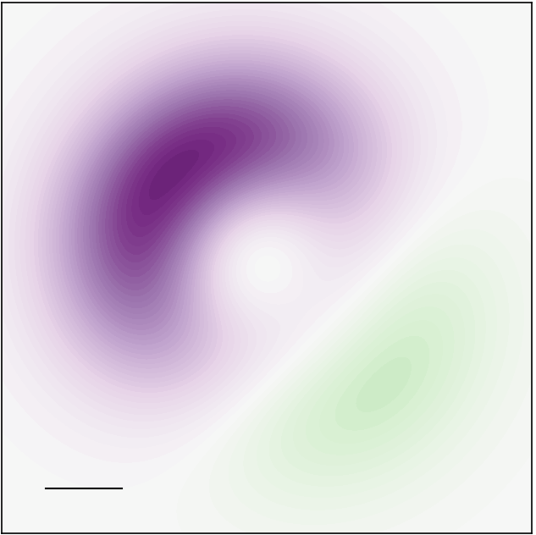











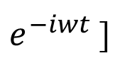








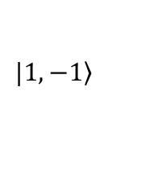

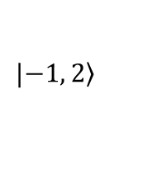









Re[
$e^{−iwt}$]
Longitudinal component
For $\left(α, β\right)=\left(0, π/2\right)$
$$\left(α, β\right)=\left(0, \text{0}\right)$$
$$q_{y}$$
$$q_{y}$$
$$q_{x}$$
$$q_{x}$$
$$a.u.$$
$$\left(3π/2,π/2\right)$$
$${0.1Q}_{c}$$
$$\left(π,π/2\right)$$
$$a.u.$$
$${0.1Q}_{c}$$
$$|\left.1, −1\right\rangle$$
$$wt=0$$
$$0.25π$$
$$0.5π$$
$$0.75π$$
$$z$$
$$β$$
$$x$$
$$y$$
$$α$$
$$\left(0, π/2\right)$$
$$\left(π/2,π/2\right)$$
$$|\left.−1, 2\right\rangle$$
$$\left(0,π\right)$$
$$π$$
$$1.25π$$
$$1.5π$$
$$1.75π$$

Slide 5

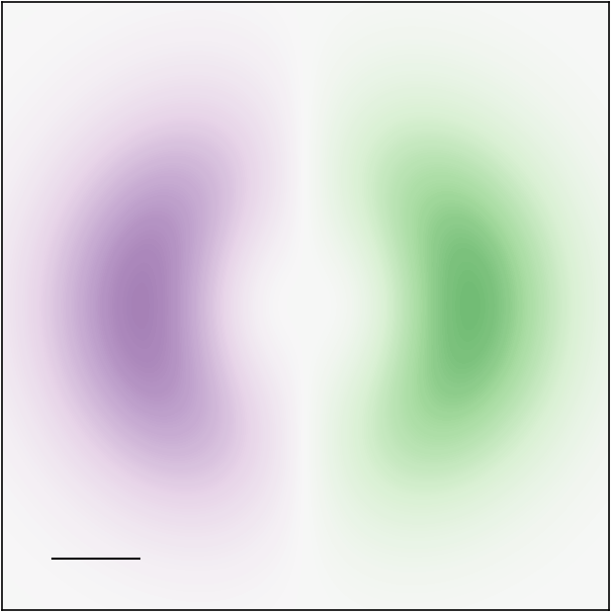
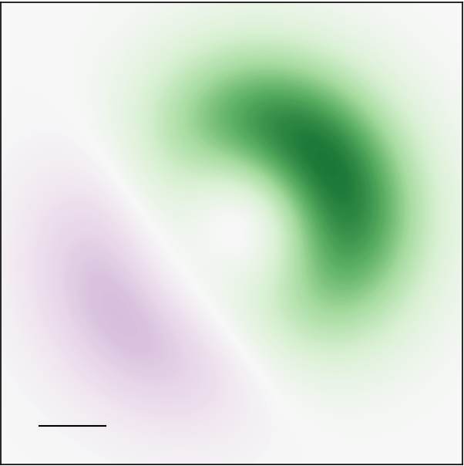
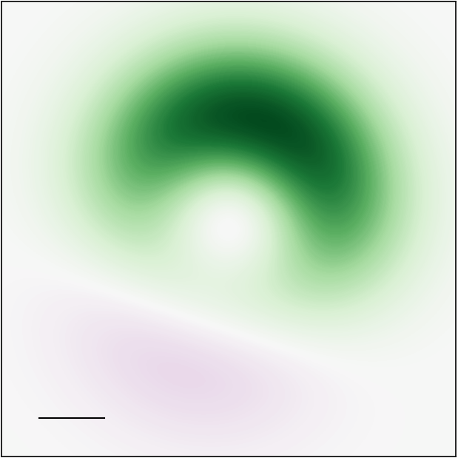


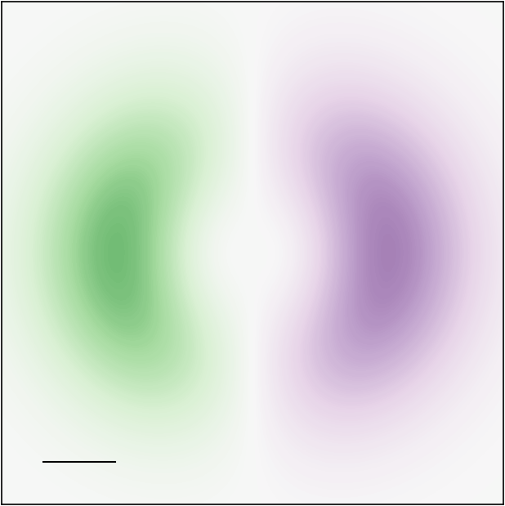



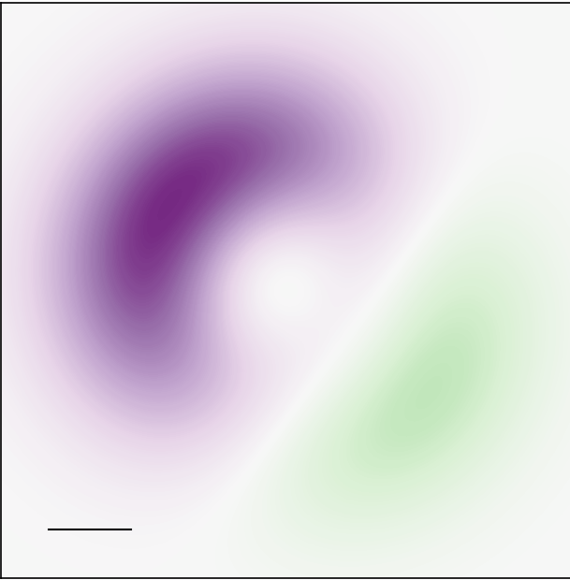
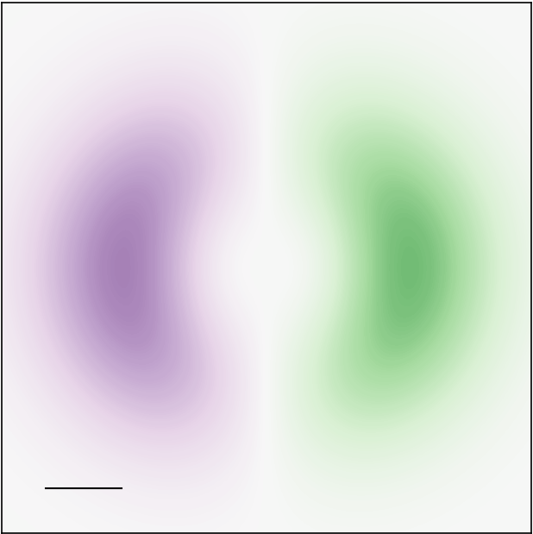
















Re[
$e^{−iwt}$]
For $\left(α, β\right)=\left(0, π/2\right)$
$$1$$
$$q_{y}$$
$$q_{x}$$
$${0.1Q}_{c}$$
$$wt=0$$
$$0.2π$$
$$0.4π$$
$$0.6π$$
$$0.8π$$
$$a.u.$$
$$−1$$
$$π$$
$$1.2π$$
$$1.4π$$
$$1.6π$$
$$1.8π$$
$$2π$$

Slide 6



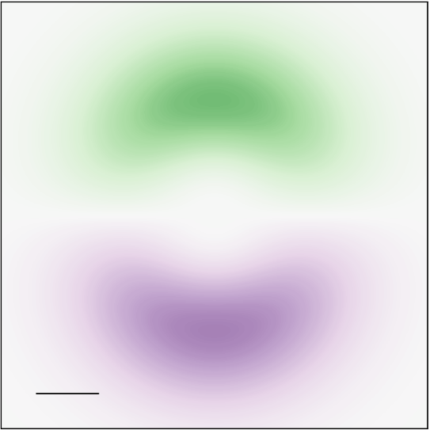
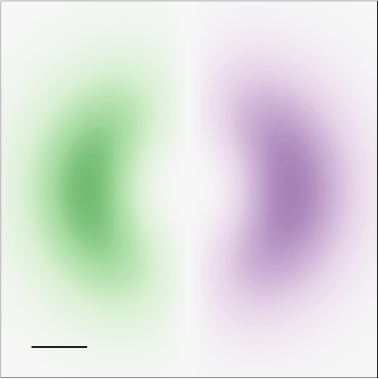

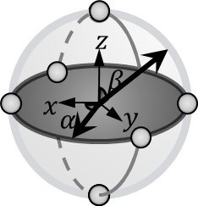
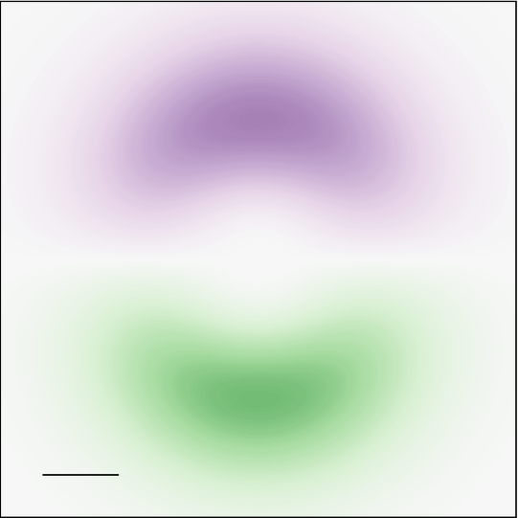

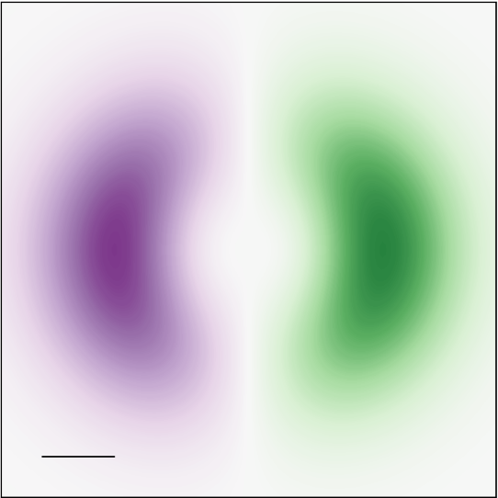







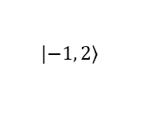
























$$Re\left[{ }_{1, −1,−1,2 }^{z}\left(q_{∥};α, β=\frac{π}{2}\right)\right]$$
$$1$$
$$\left(α, β\right)=\left(0, \text{0}\right)$$
$$a.u.$$
$$q_{y}$$
$$a.u.$$
$$Re\left[{ }_{1, −1,−1,2}^{z}\left(q_{∥};α=0, β=\frac{π}{2}\right)e^{−iωt}\right]$$
$$q_{x}$$
$$−1$$
$$\left(3π/2,π/2\right)$$
$${0.1Q}_{c}$$
$$\left(π,π/2\right)$$
$$|\left.1, −1\right\rangle$$
$$q_{y}$$
$$q_{x}$$
$${0.1Q}_{c}$$
$$\left(0, π/2\right)$$
$$\left(π/2,π/2\right)$$
$$wt=0$$
$$0.2π$$
$$0.4π$$
$$0.5π$$
$$0.6π$$
$$0.8π$$
$$|\left.−1, 2\right\rangle$$
$$\left(0,π\right)$$
$$π$$
$$1.2π$$
$$1.4π$$
$$1.5π$$
$$1.6π$$
$$1.8π$$

