Slide 1
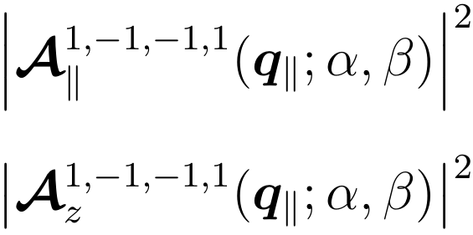
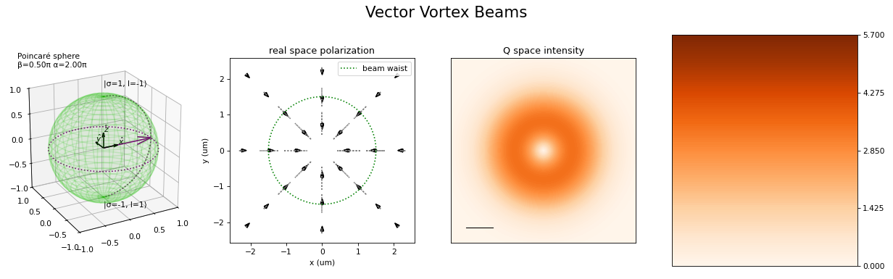
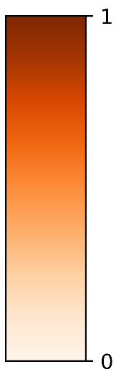
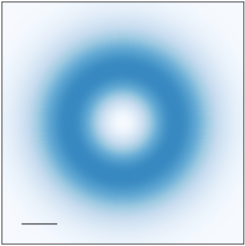
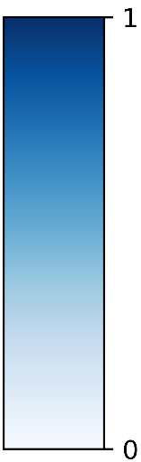
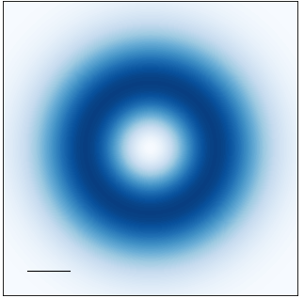
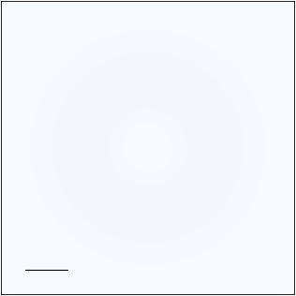
































Transverse component
Longitudinal component
$$\left(α, β\right)=\left(0, \text{0}\right)$$
$$\left(α, β\right)=\left(0, \text{0}\right)$$
$$q_{y}$$
$$q_{y}$$
$$q_{y}$$
$$q_{x}$$
$$q_{x}$$
$$q_{x}$$
$${0.1Q}_{c}$$
$${0.1Q}_{c}$$
$$a.u.$$
$$a.u.$$
$$|\left.1, −1\right\rangle$$
$$|\left.1, −1\right\rangle$$
$$\left(0, π/2\right)$$
$$z$$
$$\left(π,π/2\right)$$
$$\left(0, π/2\right)$$
$$z$$
$$\left(π,π/2\right)$$
$$β$$
$$β$$
$$x$$
$$α$$
$$y$$
$$x$$
$$α$$
$$y$$
$$|\left.−1, 1\right\rangle$$
$$|\left.−1, 1\right\rangle$$
$$\left(0,π\right)$$
$$\left(0,π\right)$$

Slide 2

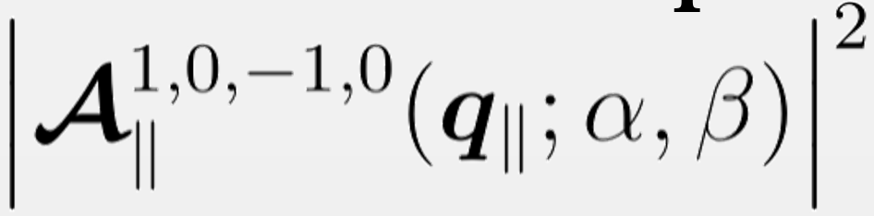

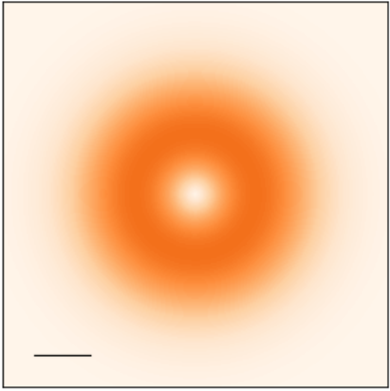
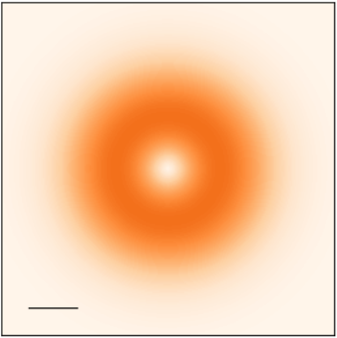




















Transverse component
$$\left(α, β\right)=\left(0, \text{0}\right)$$
$$q_{y}$$
$$q_{y}$$
$$q_{x}$$
$$q_{x}$$
$${0.1Q}_{c}$$
$$a.u.$$
$$1, −1, −1, 1$$
$$\left(3π/2,π/2\right)$$
$$|\left.1, −1\right\rangle$$
$$\left(π,π/2\right)$$
$$z$$
$$β$$
$$x$$
$$α$$
$$y$$
$$\left(0, π/2\right)$$
$$\left(π/2,π/2\right)$$
$$|\left.−1, 1\right\rangle$$
$$\left(0,π\right)$$

Slide 3
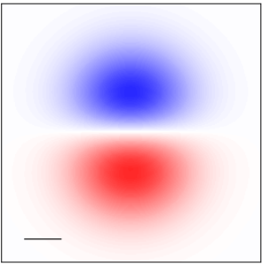

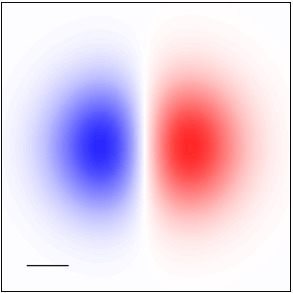
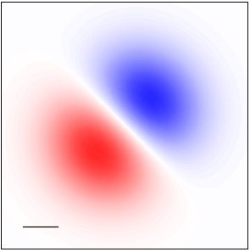
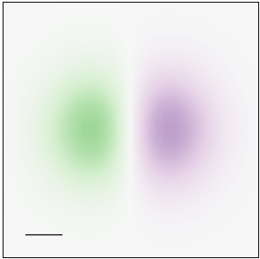

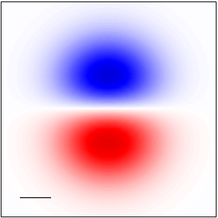
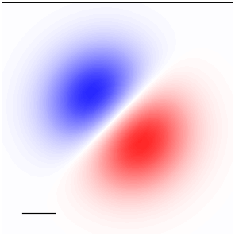
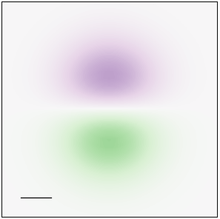
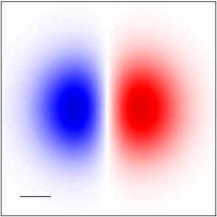
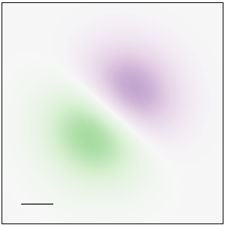

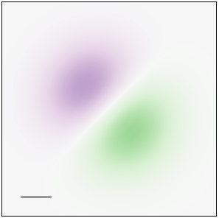

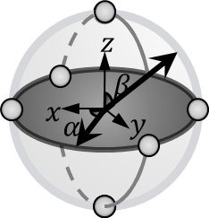



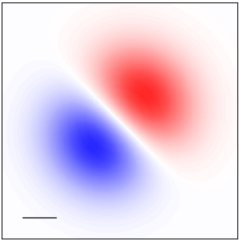
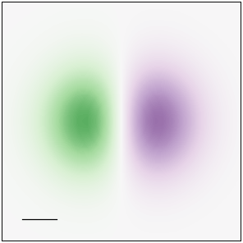
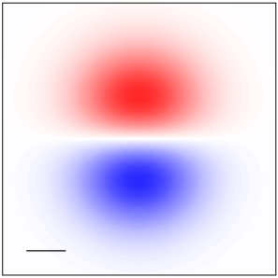
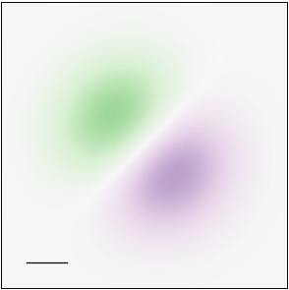
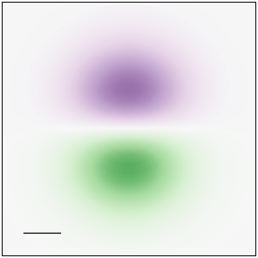
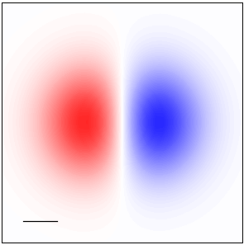
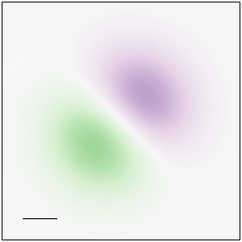
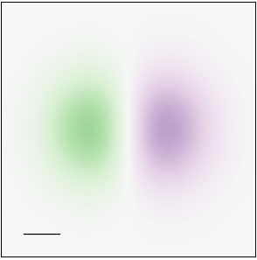
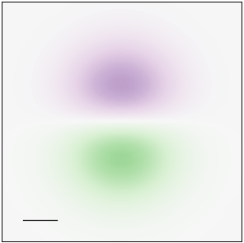












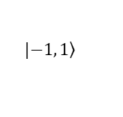





















Real and imaginary part of
Real and imaginary part of
$$\left(α, β\right)=\left(0, \text{0}\right)$$
$$\left(α, β\right)=\left(0, \text{0}\right)$$
$$\left(α, β\right)=\left(0, \text{0}\right)$$
Re
Re
$$q_{y}$$
$$a.u.$$
$$q_{y}$$
$$a.u.$$
$$q_{y}$$
$$q_{x}$$
$$q_{x}$$
$$q_{x}$$
$${0.1Q}_{c}$$
$${0.1Q}_{c}$$
$$a.u.$$
$$\left(3π/2,π/2\right)$$
$$\left(π,π/2\right)$$
$$\left(3π/2,π/2\right)$$
$${0.1Q}_{c}$$
$$\left(π,π/2\right)$$
$$\left(3π/2,π/2\right)$$
$$\left(π,π/2\right)$$
$$q_{y}$$
Im
Im
$$a.u.$$
$$q_{y}$$
$$a.u.$$
$$q_{y}$$
$$q_{x}$$
$$q_{x}$$
$$q_{x}$$
$${0.1Q}_{c}$$
$${0.1Q}_{c}$$
$$|\left.1, −1\right\rangle$$
$$|\left.1, −1\right\rangle$$
$$|\left.1, −1\right\rangle$$
$$\left(0, π/2\right)$$
$$\left(π/2,π/2\right)$$
$$\left(0, π/2\right)$$
$$\left(π/2,π/2\right)$$
$$\left(0, π/2\right)$$
$$\left(π/2,π/2\right)$$
$$|\left.−1, 1\right\rangle$$
$$|\left.−1, 1\right\rangle$$
$$|\left.−1, 1\right\rangle$$
$$\left(0,π\right)$$
$$\left(0,π\right)$$
$$\left(0,π\right)$$

Slide 4








$$\left(α, β\right)=\left(0, \text{0}\right)$$
$$q_{y}$$
$$q_{x}$$
$${0.1Q}_{c}$$
$$a.u.$$
$$\left(3π/2,π/2\right)$$
$$\left(π,π/2\right)$$
$$q_{y}$$
$$q_{x}$$
$$|\left.1, −1\right\rangle$$
$$\left(0, π/2\right)$$
$$\left(π/2,π/2\right)$$
$$|\left.−1, 1\right\rangle$$
$$\left(0,π\right)$$

Slide 5
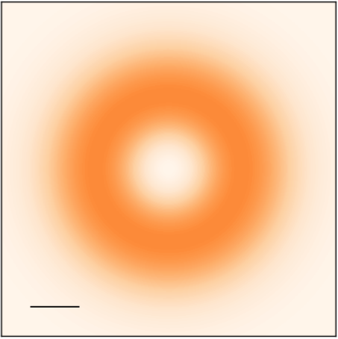
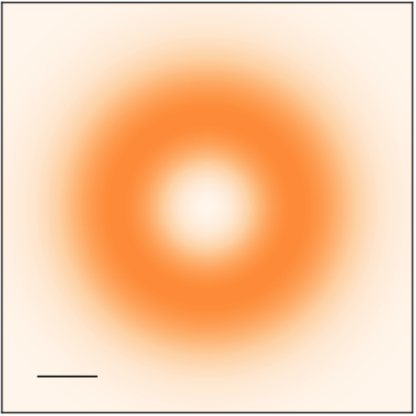
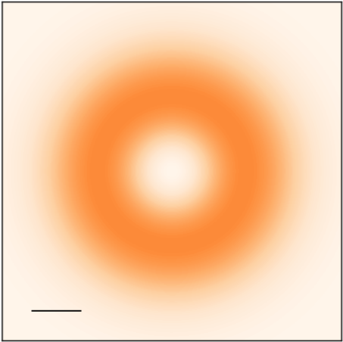
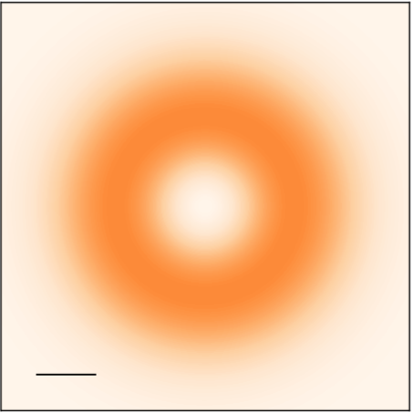
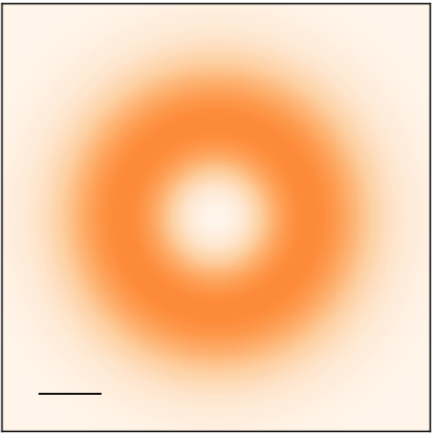
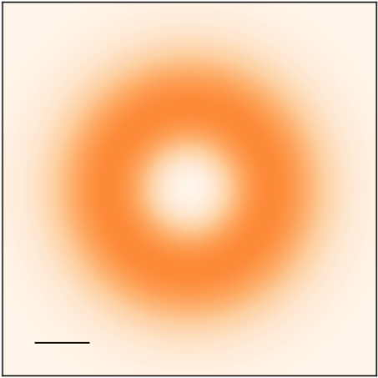

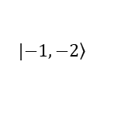

$$\left(α, β\right)=\left(0, \text{0}\right)$$
$$q_{y}$$
$$q_{x}$$
$${0.1Q}_{c}$$
$$a.u.$$
$$\left(3π/2,π/2\right)$$
$$\left(π,π/2\right)$$
$$q_{y}$$
$$q_{x}$$
$$|\left.1, 2\right\rangle$$
$$\left(0, π/2\right)$$
$$\left(π/2,π/2\right)$$
$$|\left.−1, −2\right\rangle$$
$$\left(0,π\right)$$

Slide 6
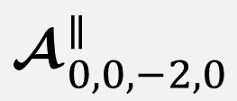
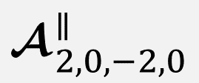
































$$\left(α, β\right)=\left(0, \text{0}\right)$$
$$\left(α, β\right)=\left(0, \text{0}\right)$$
$$\left(α, β\right)=\left(0, \text{0}\right)$$
$$q_{y}$$
$$q_{y}$$
$$q_{y}$$
$$q_{x}$$
$$q_{x}$$
$$q_{x}$$
$$\left(3π/2,π/2\right)$$
$${0.1Q}_{c}$$
$$a.u.$$
$${0.1Q}_{c}$$
$$a.u.$$
$${0.1Q}_{c}$$
$$a.u.$$
$$\left(π,π/2\right)$$
$$\left(3π/2,π/2\right)$$
$$\left(π,π/2\right)$$
$$\left(3π/2,π/2\right)$$
$$\left(π,π/2\right)$$
$$q_{y}$$
$$q_{y}$$
$$q_{y}$$
$$q_{x}$$
$$q_{x}$$
$$q_{x}$$
$$|\left.1, 0\right\rangle$$
$$|\left.1, 2\right\rangle$$
$$|\left.1, −1\right\rangle$$
$$\left(0, π/2\right)$$
$$\left(π/2,π/2\right)$$
$$\left(0, π/2\right)$$
$$\left(π/2,π/2\right)$$
$$\left(0, π/2\right)$$
$$\left(π/2,π/2\right)$$
$$|\left.−1, 0\right\rangle$$
$$|\left.−1, −2\right\rangle$$
$$|\left.−1, 1\right\rangle$$
$$\left(0,π\right)$$
$$\left(0,π\right)$$
$$\left(0,π\right)$$

Slide 7






















































$$\left(α, β\right)=\left(0, \text{0}\right)$$
$$\left(α, β\right)=\left(0, \text{0}\right)$$
$$\left(α, β\right)=\left(0, \text{0}\right)$$
$$q_{y}$$
$$q_{y}$$
$$q_{y}$$
$$q_{x}$$
$$q_{x}$$
$$q_{x}$$
$$\left(3π/2,π/2\right)$$
$${0.1Q}_{c}$$
$$a.u.$$
$$\left(π,π/2\right)$$
$$\left(3π/2,π/2\right)$$
$${0.1Q}_{c}$$
$$a.u.$$
$$\left(π,π/2\right)$$
$$\left(3π/2,π/2\right)$$
$${0.1Q}_{c}$$
$$a.u.$$
$$\left(π,π/2\right)$$
$$q_{y}$$
$$q_{x}$$
$$q_{y}$$
$$q_{x}$$
$$q_{y}$$
$$q_{x}$$
$$|\left.1, −1\right\rangle$$
$$|\left.1, 0\right\rangle$$
$$|\left.1, 2\right\rangle$$
$$\left(0, π/2\right)$$
$$\left(π/2,π/2\right)$$
$$\left(0, π/2\right)$$
$$\left(π/2,π/2\right)$$
$$\left(0, π/2\right)$$
$$\left(π/2,π/2\right)$$
$$|\left.−1, 1\right\rangle$$
$$|\left.−1, 0\right\rangle$$
$$|\left.−1, −2\right\rangle$$
$$\left(0,π\right)$$
$$\left(0,π\right)$$
$$\left(0,π\right)$$
$$ℓ=−1$$
$$ℓ=0$$
$$ℓ=2$$

Slide 8





$${\left|{ }_{1, ℓ,−1,−ℓ}^{∥}\right|}^{2}$$
$$ℓ=−1$$
$$ℓ=0$$
$$ℓ=2$$
$$\left(α, β\right)=\left(0, \text{0}\right)$$
$$\left(α, β\right)=\left(0, \text{0}\right)$$
$$\left(α, β\right)=\left(0, \text{0}\right)$$
$$q_{y}$$
$$q_{y}$$
$$q_{y}$$
$$q_{x}$$
$$q_{x}$$
$$q_{x}$$
$$\left(3π/2,π/2\right)$$
$${0.1Q}_{c}$$
$$a.u.$$
$$\left(π,π/2\right)$$
$$\left(3π/2,π/2\right)$$
$${0.1Q}_{c}$$
$$a.u.$$
$$\left(π,π/2\right)$$
$$\left(3π/2,π/2\right)$$
$${0.1Q}_{c}$$
$$a.u.$$
$$\left(π,π/2\right)$$
$$q_{y}$$
$$q_{x}$$
$$q_{y}$$
$$q_{x}$$
$$q_{y}$$
$$q_{x}$$
$$|\left.1, −1\right\rangle$$
$$|\left.1, 0\right\rangle$$
$$|\left.1, 2\right\rangle$$
$$\left(0, π/2\right)$$
$$\left(π/2,π/2\right)$$
$$\left(0, π/2\right)$$
$$\left(π/2,π/2\right)$$
$$\left(0, π/2\right)$$
$$\left(π/2,π/2\right)$$
$$|\left.−1, 1\right\rangle$$
$$|\left.−1, 0\right\rangle$$
$$|\left.−1, −2\right\rangle$$
$$\left(0,π\right)$$
$$\left(0,π\right)$$
$$\left(0,π\right)$$

Slide 9











































$$Re\left[{ }_{1, −1,−1,1}^{∥}\left(q_{∥}\right)\right]$$
$$Re\left[{ }_{1, −1,−1,−1}^{∥}\left(q_{∥}\right)\right]$$
$$\left(α, β\right)=\left(0, \text{0}\right)$$
$$\left(α, β\right)=\left(0, \text{0}\right)$$
$$q_{y}$$
$$a.u.$$
$$q_{y}$$
$$a.u.$$
$$q_{x}$$
$$q_{x}$$
$$\left(3π/2,π/2\right)$$
$${0.1Q}_{c}$$
$$\left(π,π/2\right)$$
$$\left(3π/2,π/2\right)$$
$${0.1Q}_{c}$$
$$\left(π,π/2\right)$$
$$|\left.1, −1\right\rangle$$
$$|\left.1, −1\right\rangle$$
$$⇒\overline{ℓ}=0$$
$$⇒\overline{ℓ}=−1$$
$$\left(0, π/2\right)$$
$$\left(π/2,π/2\right)$$
$$\left(0, π/2\right)$$
$$\left(π/2,π/2\right)$$
$$|\left.−1, 1\right\rangle$$
$$|\left.−1, −1\right\rangle$$
$$\left(0,π\right)$$
$$\left(0,π\right)$$
$$Re\left[{\hat{ε}}_{1, −1,−1,1 }^{∥}\left(q_{∥};α\right)\right]$$
$$Re\left[{\hat{ε}}_{1, −1,−1,−1 }^{∥}\left(q_{∥};α\right)\right]$$
$$\left(α, β\right)=\left(0, \text{0}\right)$$
$$\left(α, β\right)=\left(0, \text{0}\right)$$
$$q_{y}$$
$$q_{y}$$
$$q_{x}$$
$$q_{x}$$
$$\left(3π/2,π/2\right)$$
$$\left(π,π/2\right)$$
$$\left(3π/2,π/2\right)$$
$$\left(π,π/2\right)$$
$$|\left.1, −1\right\rangle$$
$$|\left.1, −1\right\rangle$$
$$⇒Δℓ=2$$
$$⇒Δℓ=0$$
$$\left(0, π/2\right)$$
$$\left(π/2,π/2\right)$$
$$\left(0, π/2\right)$$
$$\left(π/2,π/2\right)$$
$$|\left.−1, 1\right\rangle$$
$$|\left.−1, −1\right\rangle$$
$$\left(0,π\right)$$
$$\left(0,π\right)$$

