Slide 1
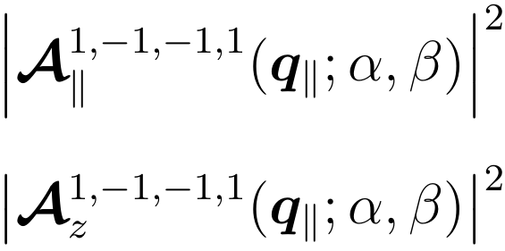
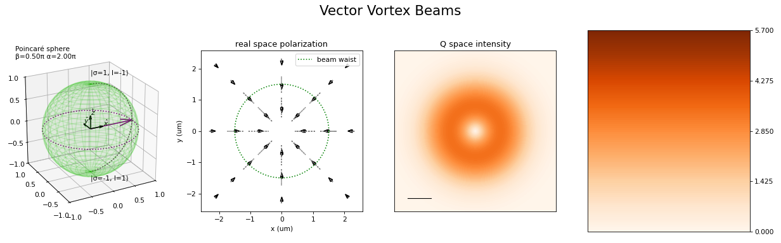
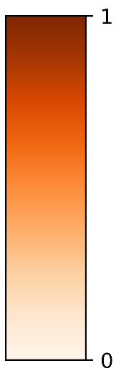
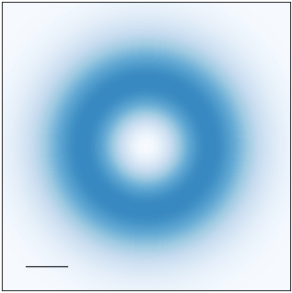
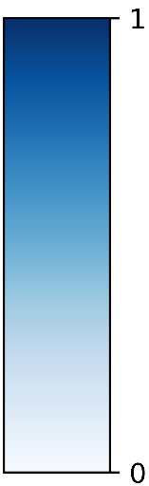
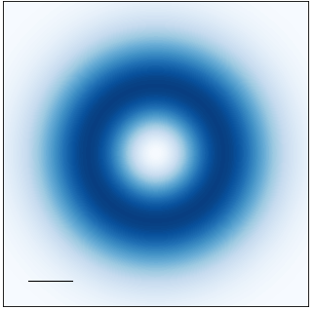
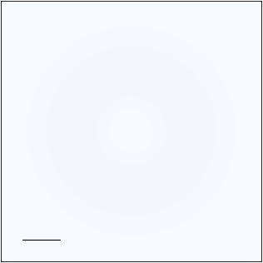
































Transverse component
Longitudinal component
$$\left(α, β\right)=\left(0, \text{0}\right)$$
$$\left(α, β\right)=\left(0, \text{0}\right)$$
$$q_{y}$$
$$q_{y}$$
$$q_{y}$$
$$q_{x}$$
$$q_{x}$$
$$q_{x}$$
$${0.1Q}_{c}$$
$${0.1Q}_{c}$$
$$a.u.$$
$$a.u.$$
$$|\left.1, −1\right\rangle$$
$$|\left.1, −1\right\rangle$$
$$z$$
$$z$$
$$\left(0, π/2\right)$$
$$\left(π,π/2\right)$$
$$\left(0, π/2\right)$$
$$\left(π,π/2\right)$$
$$β$$
$$β$$
$$x$$
$$α$$
$$y$$
$$x$$
$$y$$
$$α$$
$$|\left.−1, 1\right\rangle$$
$$|\left.−1, 1\right\rangle$$
$$\left(0,π\right)$$
$$\left(0,π\right)$$

Slide 2
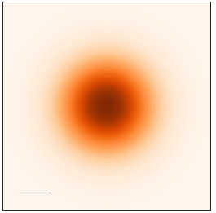
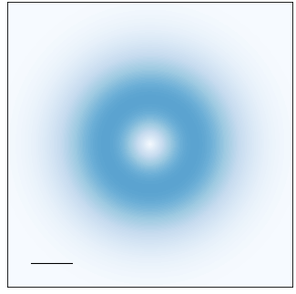
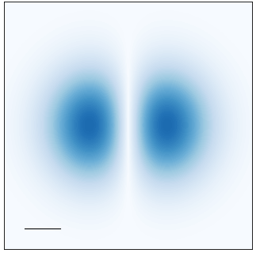
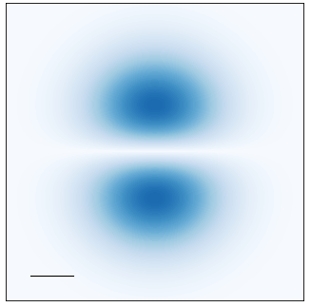







Transverse component
Longitudinal component
$$\left(α, β\right)=\left(0, \text{0}\right)$$
$$\left(α, β\right)=\left(0, \text{0}\right)$$
$$q_{y}$$
$$q_{y}$$
$$q_{y}$$
$$q_{x}$$
$$q_{x}$$
$$q_{x}$$
$${0.1Q}_{c}$$
$${0.1Q}_{c}$$
$$a.u.$$
$$a.u.$$
$$|\left.1, 0\right\rangle$$
$$|\left.1, 0\right\rangle$$
$$z$$
$$z$$
$$\left(0, π/2\right)$$
$$\left(π,π/2\right)$$
$$\left(0, π/2\right)$$
$$\left(π,π/2\right)$$
$$β$$
$$β$$
$$x$$
$$α$$
$$y$$
$$x$$
$$y$$
$$α$$
$$|\left.−1, 0\right\rangle$$
$$|\left.−1, 0\right\rangle$$
$$\left(0,π\right)$$
$$\left(0,π\right)$$

Slide 3
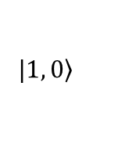






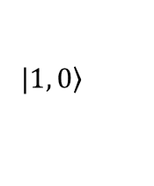










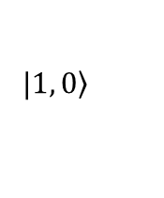
$$|\left.1, 0\right\rangle$$
$$|\left.1, 0\right\rangle$$
$$|\left.1, 0\right\rangle$$
$$z$$
$$z$$
$$z$$
$$β$$
$$β$$
$$β$$
$$x$$
$$α$$
$$y$$
$$x$$
$$α$$
$$y$$
$$x$$
$$α$$
$$y$$
$$|\left.−1, 0\right\rangle$$

Slide 4
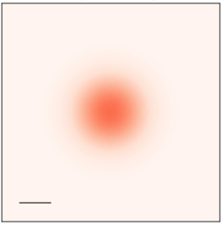

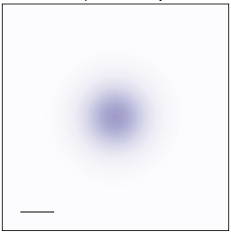
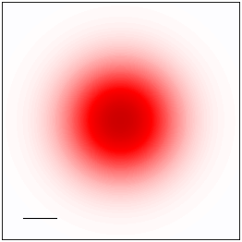

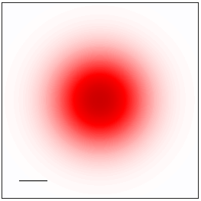
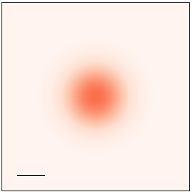

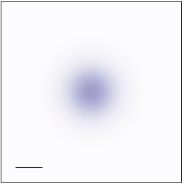
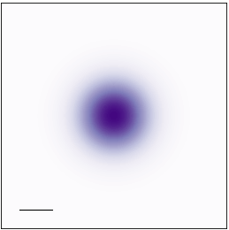
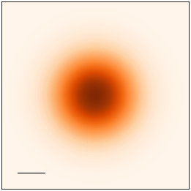
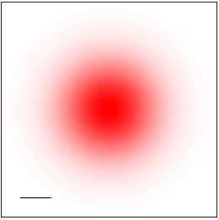

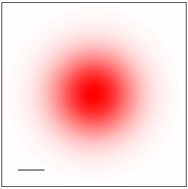
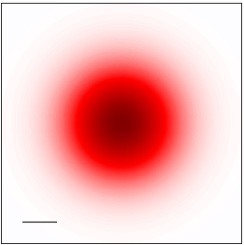
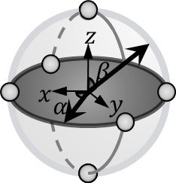
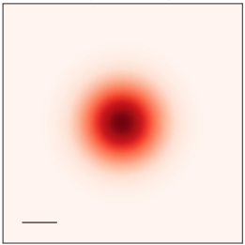
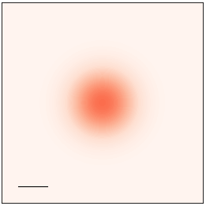


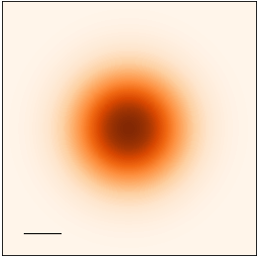
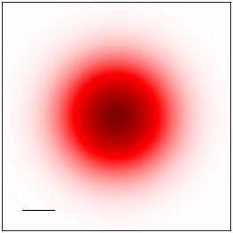
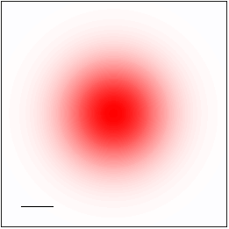

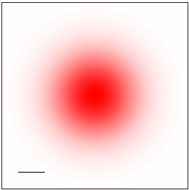
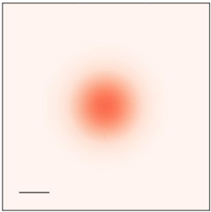
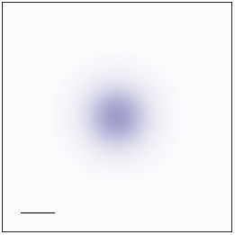
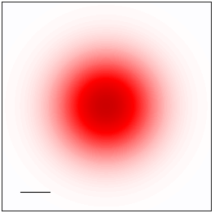
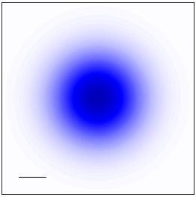










Real and imaginary part of
Real and imaginary part of
$$\left(α, β\right)=\left(0, \text{0}\right)$$
$$q_{y}$$
$$q_{x}$$
$$q_{y}$$
$${0.1Q}_{c}$$
$$q_{x}$$
$$\left(3π/2,π/2\right)$$
$$a.u.$$
$$\left(π,π/2\right)$$
$$\left(0, π/2\right)$$
$$\left(π/2,π/2\right)$$
$$\left(0,π\right)$$

Slide 5



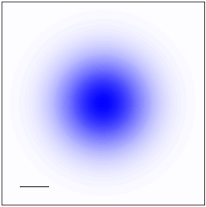
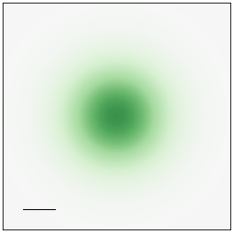

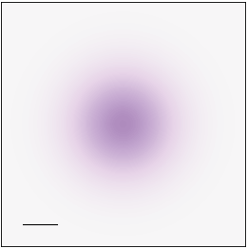

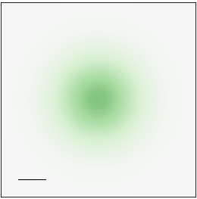
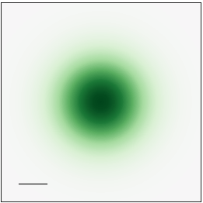













































Real and imaginary part of
Real and imaginary part of
$$\left(α, β\right)=\left(0, \text{0}\right)$$
$$\left(α, β\right)=\left(0, \text{0}\right)$$
$$\left(α, β\right)=\left(0, \text{0}\right)$$
Re
Re
$$q_{y}$$
$$a.u.$$
$$q_{y}$$
$$a.u.$$
$$q_{y}$$
$$q_{x}$$
$$q_{x}$$
$$q_{x}$$
$${0.1Q}_{c}$$
$${0.1Q}_{c}$$
$${0.1Q}_{c}$$
$$a.u.$$
$$\left(3π/2,π/2\right)$$
$$\left(π,π/2\right)$$
$$\left(3π/2,π/2\right)$$
$$\left(π,π/2\right)$$
$$\left(3π/2,π/2\right)$$
$$\left(π,π/2\right)$$
$$q_{y}$$
Im
Im
$$a.u.$$
$$q_{y}$$
$$a.u.$$
$$q_{y}$$
$$q_{x}$$
$$q_{x}$$
$$q_{x}$$
$${0.1Q}_{c}$$
$${0.1Q}_{c}$$
$$|\left.1, 0\right\rangle$$
$$|\left.1, 0\right\rangle$$
$$|\left.1, 0\right\rangle$$
$$\left(0, π/2\right)$$
$$\left(π/2,π/2\right)$$
$$\left(0, π/2\right)$$
$$\left(π/2,π/2\right)$$
$$\left(0, π/2\right)$$
$$\left(π/2,π/2\right)$$
$$|\left.−1, 0\right\rangle$$
$$|\left.−1, 0\right\rangle$$
$$|\left.−1, 0\right\rangle$$
$$\left(0,π\right)$$
$$\left(0,π\right)$$
$$\left(0,π\right)$$

Slide 6






$$\left(α, β\right)=\left(0, \text{0}\right)$$
$$q_{y}$$
$$q_{x}$$
$${0.1Q}_{c}$$
$$a.u.$$
$$\left(3π/2,π/2\right)$$
$$\left(π,π/2\right)$$
$$q_{y}$$
$$q_{x}$$
$$|\left.1, 0\right\rangle$$
$$\left(0, π/2\right)$$
$$\left(π/2,π/2\right)$$
$$|\left.−1, 0\right\rangle$$
$$\left(0,π\right)$$

Slide 7









$$1, 1, −1, 1$$
$$\left(α, β\right)=\left(0, \text{0}\right)$$
$$q_{y}$$
$$q_{x}$$
$${0.1Q}_{c}$$
$$a.u.$$
$$\left(3π/2,π/2\right)$$
$$\left(π,π/2\right)$$
$$q_{y}$$
$$q_{x}$$
$$|\left.1, −1\right\rangle$$
$$\left(0, π/2\right)$$
$$\left(π/2,π/2\right)$$
$$|\left.−1, −1\right\rangle$$
$$\left(0,π\right)$$

Slide 8







$$1, 1, −1, 1$$
$$\left(α, β\right)=\left(0, \text{0}\right)$$
$$q_{y}$$
$$q_{x}$$
$${0.1Q}_{c}$$
$$a.u.$$
$$\left(3π/2,π/2\right)$$
$$\left(π,π/2\right)$$
$$q_{y}$$
$$q_{x}$$
$$|\left.1, 2\right\rangle$$
$$\left(0, π/2\right)$$
$$\left(π/2,π/2\right)$$
$$|\left.−1, 2\right\rangle$$
$$\left(0,π\right)$$

Slide 9







































$$\left(α, β\right)=\left(0, \text{0}\right)$$
$$q_{y}$$
$$q_{y}$$
$$q_{y}$$
$$q_{y}$$
Transverse component
$$q_{x}$$
$$q_{x}$$
$$q_{x}$$
$$q_{x}$$
$${0.1Q}_{c}$$
$${0.1Q}_{c}$$
$${0.1Q}_{c}$$
$$a.u.$$
$$a.u.$$
$$a.u.$$
$$1, −1, −1, 1$$
$$\left(3π/2,π/2\right)$$
$$|\left.1, −1\right\rangle$$
$$\left(π,π/2\right)$$
$$z$$
$$β$$
$$x$$
$$α$$
$$y$$
$$\left(0, π/2\right)$$
$$\left(π/2,π/2\right)$$
$$|\left.−1, 1\right\rangle$$
$$\left(0,π\right)$$

