Slide 1
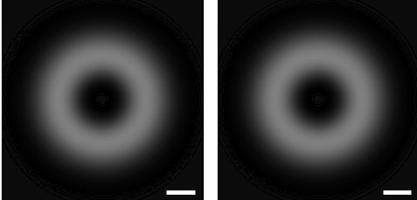
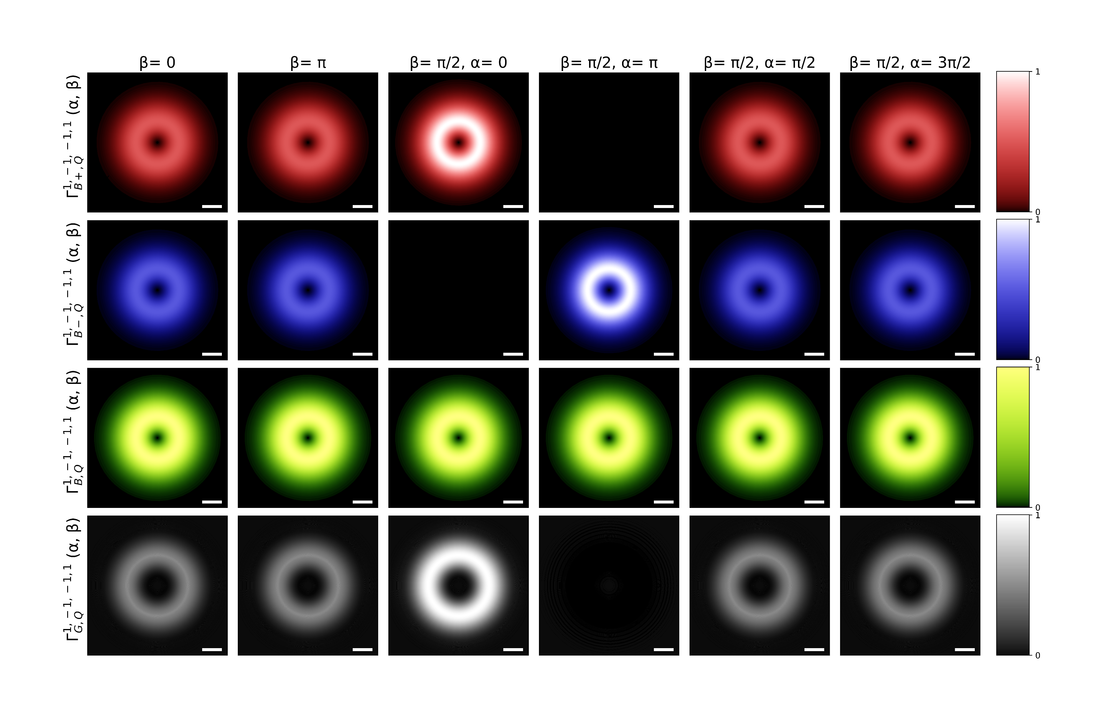

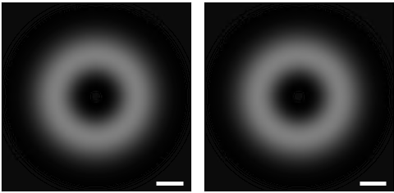
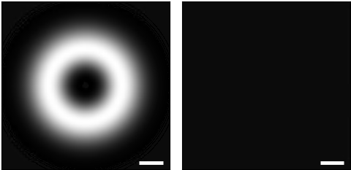



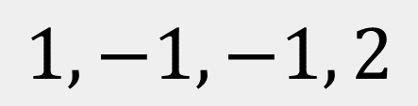

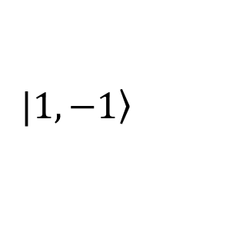




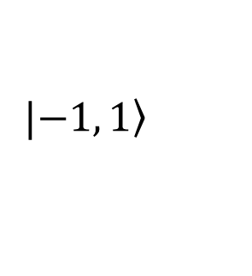







$$1, −1, −1, 2$$
Gray excitons transition rate
$$Q_{y}$$
$$Q_{x}$$
$${0.1Q}_{c}$$
$$a.u.$$
$$\left(α, β\right)=\left(0, \text{0}\right)$$
$$|\left.1, −1\right\rangle$$
$$z$$
$$\left(3π/2, π/2\right)$$
$$β$$
$$\left(π,π/2\right)$$
$$x$$
$$α$$
$$y$$
$$|\left.−1, 1\right\rangle$$
$$\left(0, π/2\right)$$
$$\left(π/2,π/2\right)$$
$$\left(0, π\right)$$

Slide 2
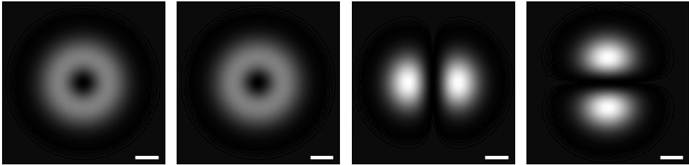

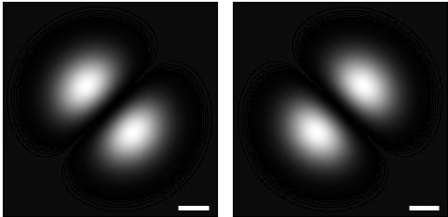
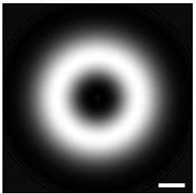

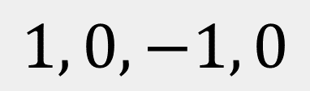


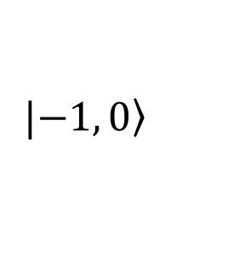


$$1, 0, −1, 0$$
Gray excitons transition rate
$$Q_{y}$$
$$Q_{x}$$
$${0.1Q}_{c}$$
$$a.u.$$
$$\left(α, β\right)=\left(0, \text{0}\right)$$
$$|\left.1, 0\right\rangle$$
$$z$$
$$β$$
$$\left(π,π/2\right)$$
$$\left(3π/2, π/2\right)$$
$$x$$
$$α$$
$$y$$
$$|\left.−1, 0\right\rangle$$
$$\left(0, π/2\right)$$
$$\left(π/2,π/2\right)$$
$$\left(0, π\right)$$

Slide 3
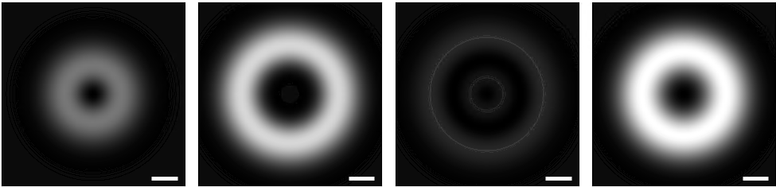


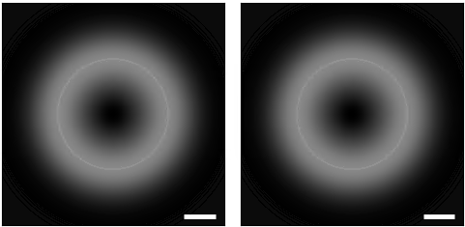

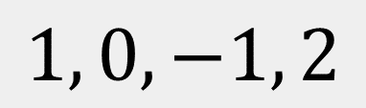

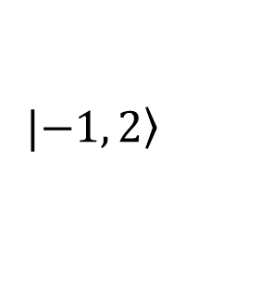


$$1, 0, −1, 2$$
Gray excitons transition rate
$$Q_{y}$$
$$Q_{x}$$
$${0.1Q}_{c}$$
$$a.u.$$
$$\left(α, β\right)=\left(0, \text{0}\right)$$
$$|\left.1, 0\right\rangle$$
$$z$$
$$\left(3π/2, π/2\right)$$
$$β$$
$$\left(π,π/2\right)$$
$$x$$
$$α$$
$$y$$
$$|\left.−1, 2\right\rangle$$
$$\left(0, π/2\right)$$
$$\left(π/2,π/2\right)$$
$$\left(0, π\right)$$

Slide 4
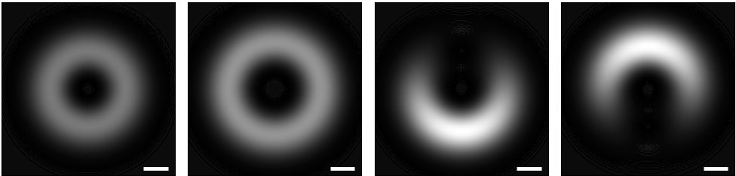

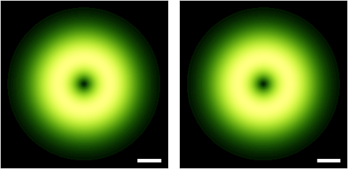
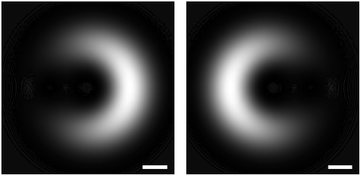


$$1, −1, −1, 2$$
Gray excitons transition rate
$$Q_{y}$$
$$Q_{x}$$
$${0.1Q}_{c}$$
$$a.u.$$
$$\left(α, β\right)=\left(0, \text{0}\right)$$
$$|\left.1, −1\right\rangle$$
$$z$$
$$\left(3π/2, π/2\right)$$
$$β$$
$$\left(π,π/2\right)$$
$$x$$
$$α$$
$$y$$
$$|\left.−1, 2\right\rangle$$
$$\left(0, π/2\right)$$
$$\left(π/2,π/2\right)$$
$$\left(0, π\right)$$

Slide 5

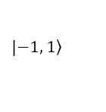











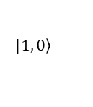


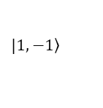



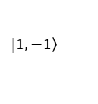












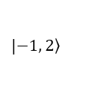






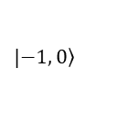


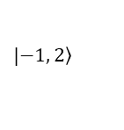


Gray excitons transition rate
$$Q_{y}$$
$$Q_{y}$$
$$Q_{y}$$
$$Q_{y}$$
$$Q_{x}$$
$$Q_{x}$$
$$Q_{x}$$
$$Q_{x}$$
$${0.1Q}_{c}$$
$$a.u.$$
$${0.1Q}_{c}$$
$$a.u.$$
$${0.1Q}_{c}$$
$$a.u.$$
$${0.1Q}_{c}$$
$$a.u.$$
$$\left(α, β\right)=\left(0, \text{0}\right)$$
$$\left(α, β\right)=\left(0, \text{0}\right)$$
$$\left(α, β\right)=\left(0, \text{0}\right)$$
$$\left(α, β\right)=\left(0, \text{0}\right)$$
$$|\left.1, −1\right\rangle$$
$$|\left.1, 0\right\rangle$$
$$|\left.1, 0\right\rangle$$
$$|\left.1, −1\right\rangle$$
$$z$$
$$z$$
$$z$$
$$z$$
$$\left(3π/2, π/2\right)$$
$$β$$
$$\left(π,π/2\right)$$
$$\left(3π/2, π/2\right)$$
$$β$$
$$\left(π,π/2\right)$$
$$\left(3π/2, π/2\right)$$
$$β$$
$$\left(π,π/2\right)$$
$$\left(3π/2, π/2\right)$$
$$β$$
$$\left(π,π/2\right)$$
$$x$$
$$α$$
$$y$$
$$x$$
$$α$$
$$y$$
$$x$$
$$α$$
$$y$$
$$x$$
$$y$$
$$α$$
$$|\left.−1, 1\right\rangle$$
$$|\left.−1, 0\right\rangle$$
$$|\left.−1, 2\right\rangle$$
$$|\left.−1, 2\right\rangle$$
$$\left(0, π/2\right)$$
$$\left(π/2,π/2\right)$$
$$\left(0, π/2\right)$$
$$\left(π/2,π/2\right)$$
$$\left(0, π/2\right)$$
$$\left(π/2,π/2\right)$$
$$\left(0, π/2\right)$$
$$\left(π/2,π/2\right)$$
$$\left(0, π\right)$$
$$\left(0, π\right)$$
$$\left(0, π\right)$$
$$\left(0, π\right)$$

