Slide 1
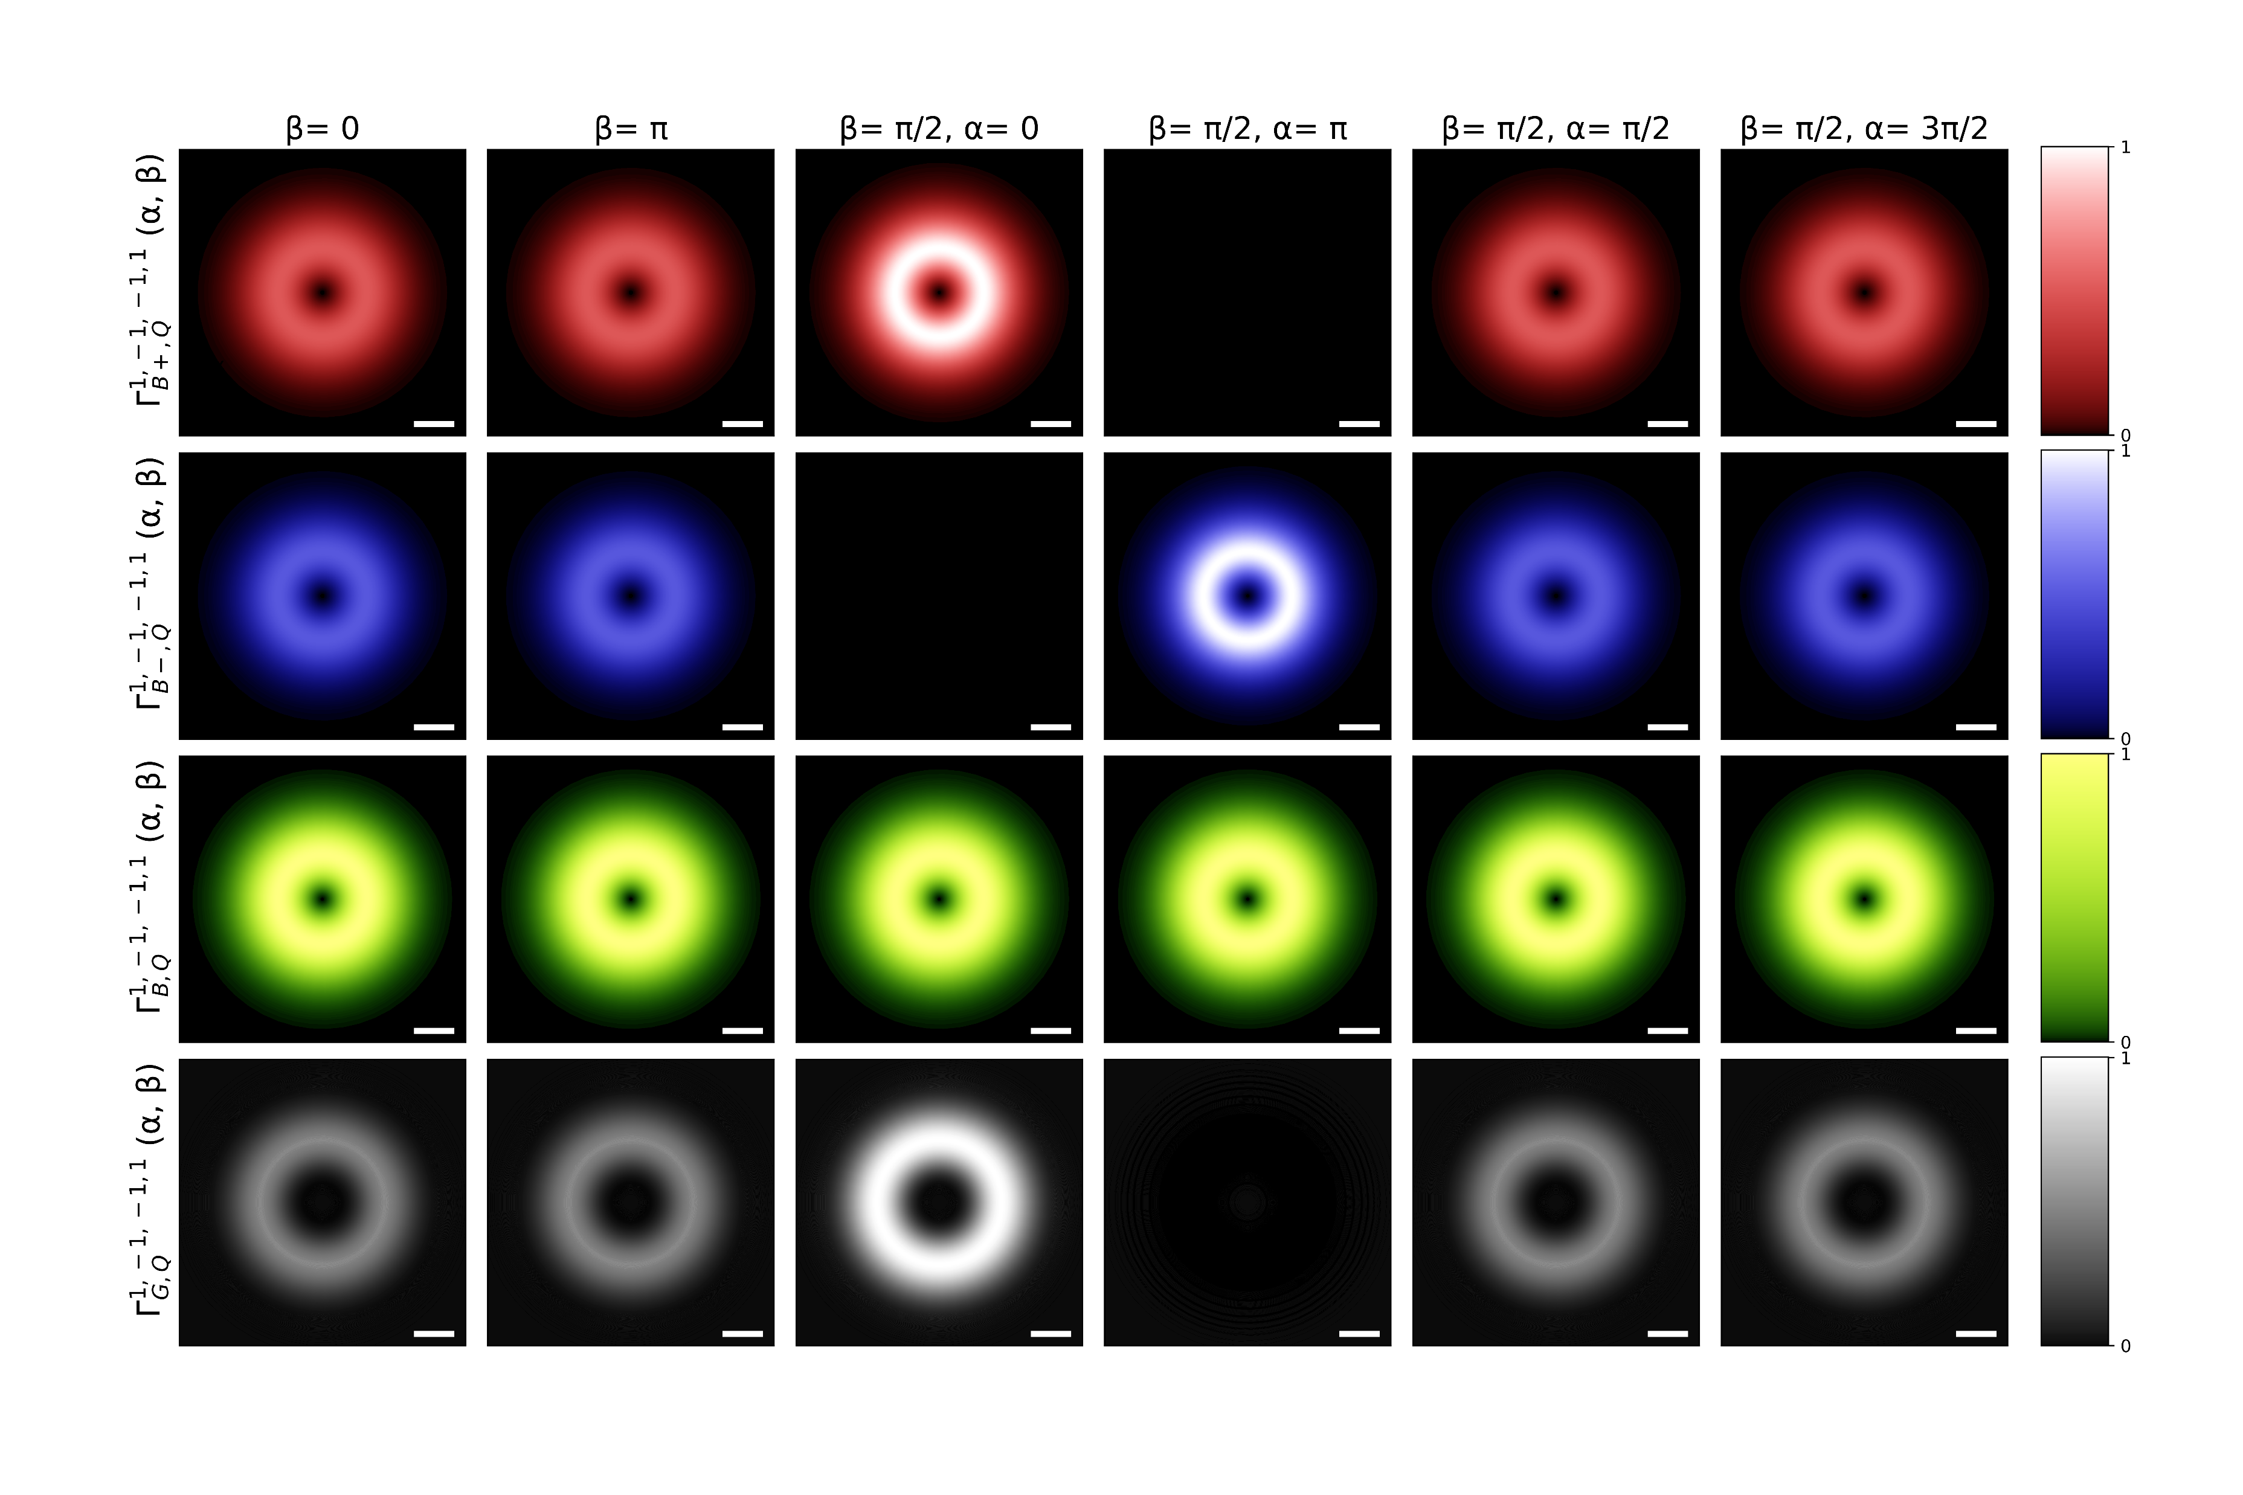
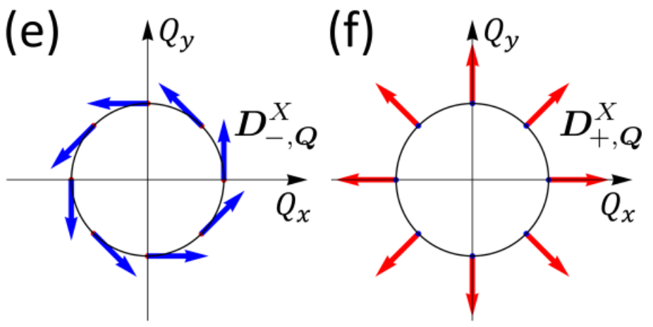

Slide 2
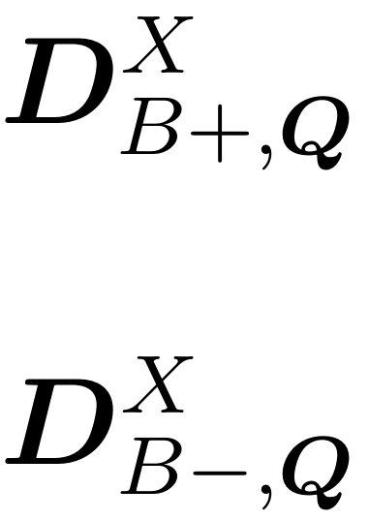
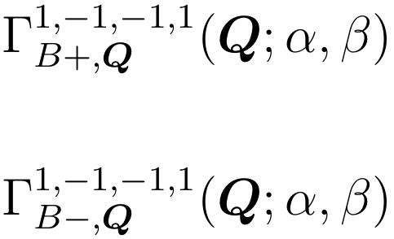




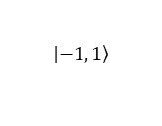
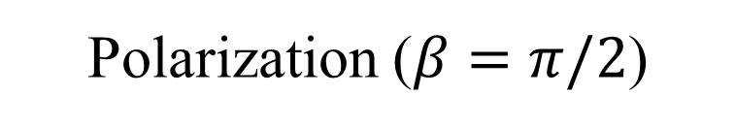












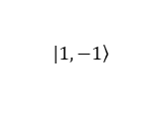


Valley-mixed excitons transition rate
$$\left(α, β\right)=\left(0, \text{0}\right)$$
$$Q_{y}$$
$$Q_{y}$$
$$Q_{x}$$
$$Q_{x}$$
$$Q_{c}$$
$$Q_{c}$$
$$Q_{y}$$
$$Q_{y}$$
Transition dipole (BXs)
$$|\left.1, −1\right\rangle$$
$$Q_{x}$$
$$Q_{x}$$
$$z$$
$$\left(0, π/2\right)$$
$$\left(π,π/2\right)$$
$$b$$
$$x$$
$$α=0$$
$$α=π$$
$$a$$
$$y$$
Polarization ($β=π/2$)
$$Q_{y}$$
$$Q_{y}$$
$$Q_{x}$$
$$Q_{x}$$
$$|\left.−1, 1\right\rangle$$
$$\left(0, π\right)$$

Slide 3
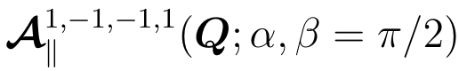










$$Q_{y}$$
$$Q_{y}$$
Transition dipole (BXs)
$$Q_{x}$$
$$Q_{x}$$
$$α=0$$
$$α=π$$
Polarization of
$$Q_{y}$$
$$Q_{y}$$
$$Q_{x}$$
$$Q_{x}$$

Slide 4
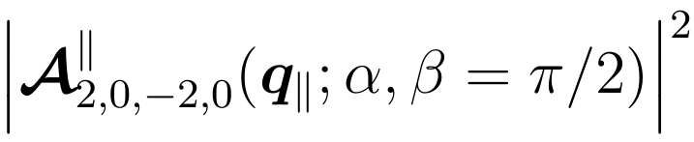
$$Q_{y}$$
$$Q_{y}$$
Transition dipole (BXs)
$$Q_{x}$$
$$Q_{x}$$
$$α=0$$
$$α=π$$
Polarization of
$$Q_{y}$$
$$Q_{y}$$
$$Q_{x}$$
$$Q_{x}$$

