Slide 1
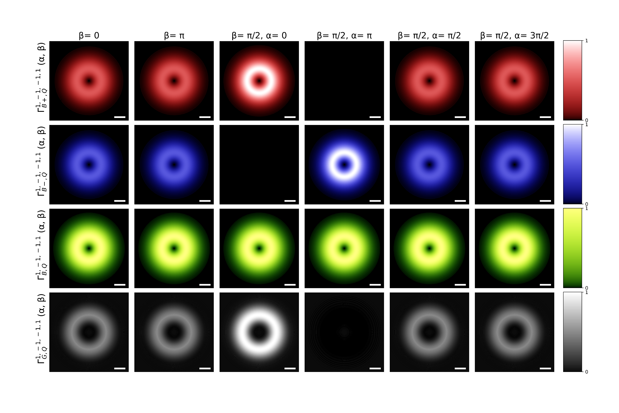
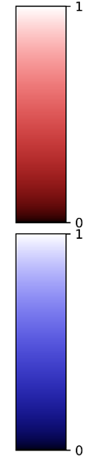
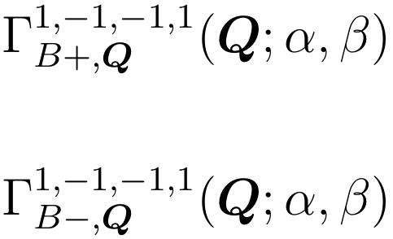
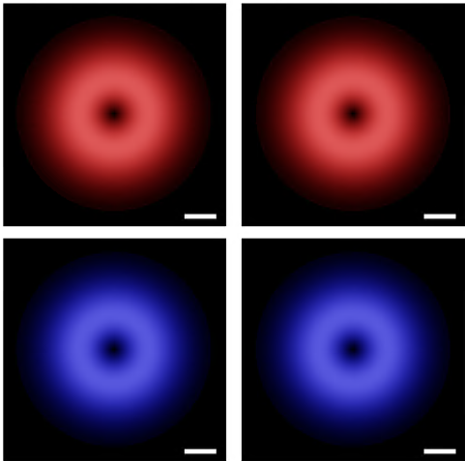




Valley-mixed excitons transition rate
$$Q_{y}$$
$$Q_{x}$$
$${0.1Q}_{c}$$
$$a.u.$$
$$Q_{y}$$
$$Q_{x}$$
$${0.1Q}_{c}$$
$$a.u.$$
$$\left(α, β\right)=\left(0, \text{0}\right)$$
$$|\left.1, −1\right\rangle$$
$$z$$
$$x$$
$$β$$
$$\left(3π/2, π/2\right)$$
$$α$$
$$y$$
$$\left(π,π/2\right)$$
$$|\left.−1, 1\right\rangle$$
$$\left(0, π/2\right)$$
$$\left(π/2,π/2\right)$$
$$\left(0, π\right)$$

Slide 2
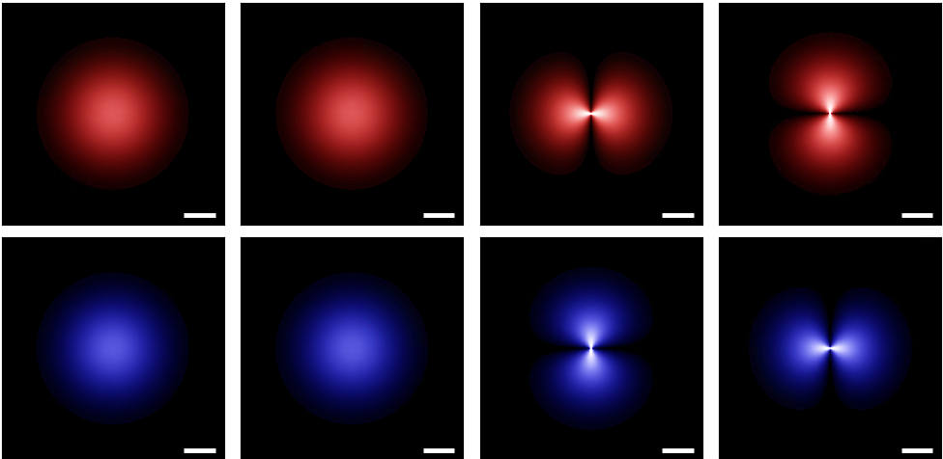

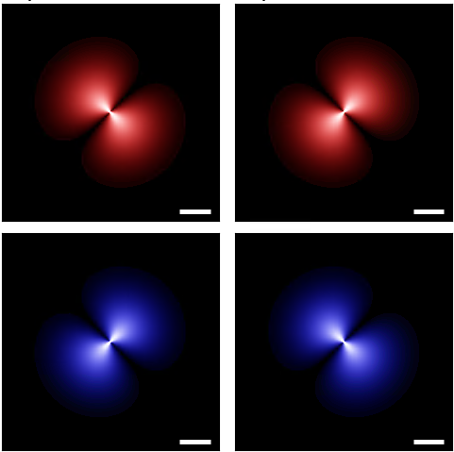


Valley-mixed excitons transition rate
$$Q_{y}$$
$$Q_{x}$$
$${0.1Q}_{c}$$
$$a.u.$$
$$Q_{y}$$
$$Q_{x}$$
$${0.1Q}_{c}$$
$$a.u.$$
$$\left(α, β\right)=\left(0, \text{0}\right)$$
$$|\left.1, 0\right\rangle$$
$$z$$
$$x$$
$$β$$
$$\left(3π/2, π/2\right)$$
$$α$$
$$y$$
$$\left(π,π/2\right)$$
$$|\left.−1, 0\right\rangle$$
$$\left(0, π/2\right)$$
$$\left(π/2,π/2\right)$$
$$\left(0, π\right)$$

Slide 3
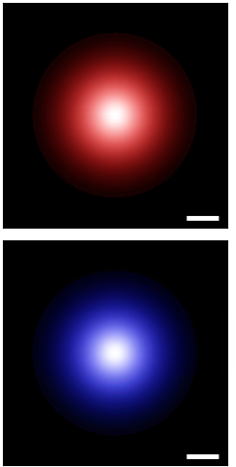

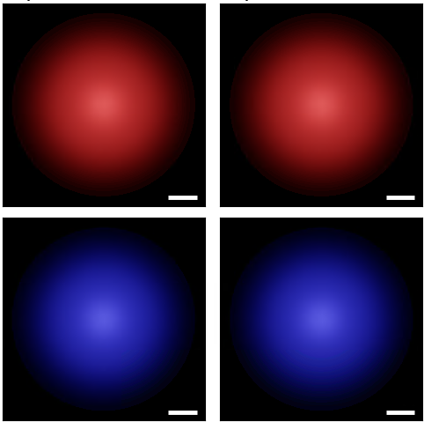
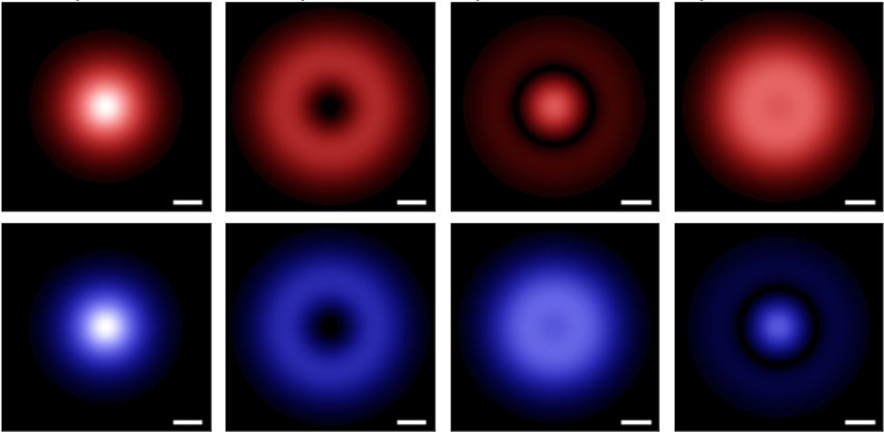

Valley-mixed excitons transition rate
$$Q_{y}$$
$$Q_{x}$$
$${0.1Q}_{c}$$
$$a.u.$$
$$Q_{y}$$
$$Q_{x}$$
$${0.1Q}_{c}$$
$$a.u.$$
$$\left(α, β\right)=\left(0, \text{0}\right)$$
$$|\left.1, 0\right\rangle$$
$$z$$
$$x$$
$$β$$
$$\left(3π/2, π/2\right)$$
$$α$$
$$y$$
$$\left(π,π/2\right)$$
$$|\left.−1, 2\right\rangle$$
$$\left(0, π/2\right)$$
$$\left(π/2,π/2\right)$$
$$\left(0, π\right)$$

Slide 4
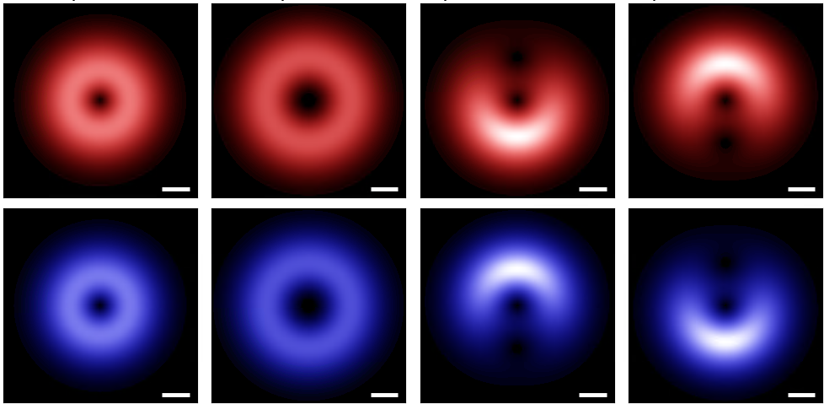

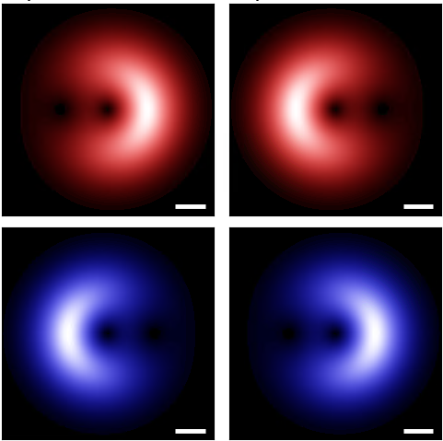
Valley-mixed excitons transition rate
$$Q_{y}$$
$$Q_{x}$$
$${0.1Q}_{c}$$
$$a.u.$$
$$Q_{y}$$
$$Q_{x}$$
$${0.1Q}_{c}$$
$$a.u.$$
$$\left(α, β\right)=\left(0, \text{0}\right)$$
$$|\left.1, −1\right\rangle$$
$$z$$
$$x$$
$$β$$
$$\left(3π/2, π/2\right)$$
$$α$$
$$y$$
$$\left(π,π/2\right)$$
$$|\left.−1, 2\right\rangle$$
$$\left(0, π/2\right)$$
$$\left(π/2,π/2\right)$$
$$\left(0, π\right)$$

Slide 5








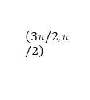


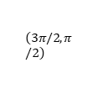





















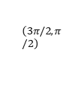












Valley-mixed excitons transition rate
$$Q_{y}$$
$$Q_{y}$$
$$Q_{y}$$
$$Q_{y}$$
$$Q_{x}$$
$$Q_{x}$$
$$Q_{x}$$
$$Q_{x}$$
$${0.1Q}_{c}$$
$$a.u.$$
$${0.1Q}_{c}$$
$$a.u.$$
$${0.1Q}_{c}$$
$$a.u.$$
$${0.1Q}_{c}$$
$$a.u.$$
$$Q_{y}$$
$$Q_{x}$$
$$Q_{y}$$
$$Q_{x}$$
$$Q_{y}$$
$$Q_{x}$$
$$Q_{y}$$
$$Q_{x}$$
$${0.1Q}_{c}$$
$$a.u.$$
$${0.1Q}_{c}$$
$$a.u.$$
$${0.1Q}_{c}$$
$$a.u.$$
$${0.1Q}_{c}$$
$$a.u.$$
$$\left(α, β\right)=\left(0, \text{0}\right)$$
$$\left(α, β\right)=\left(0, \text{0}\right)$$
$$\left(α, β\right)=\left(0, \text{0}\right)$$
$$\left(α, β\right)=\left(0, \text{0}\right)$$
$$|\left.1, −1\right\rangle$$
$$|\left.1, 0\right\rangle$$
$$|\left.1, 0\right\rangle$$
$$|\left.1, −1\right\rangle$$
$$z$$
$$z$$
$$z$$
$$z$$
$$x$$
$$β$$
$$x$$
$$β$$
$$x$$
$$β$$
$$x$$
$$β$$
$$\left(3π/2, π/2\right)$$
$$α$$
$$y$$
$$\left(π,π/2\right)$$
$$\left(3π/2, π/2\right)$$
$$α$$
$$y$$
$$\left(π,π/2\right)$$
$$\left(3π/2, π/2\right)$$
$$α$$
$$y$$
$$\left(π,π/2\right)$$
$$\left(3π/2, π/2\right)$$
$$α$$
$$y$$
$$\left(π,π/2\right)$$
$$|\left.−1, 1\right\rangle$$
$$|\left.−1, 0\right\rangle$$
$$|\left.−1, 2\right\rangle$$
$$|\left.−1, 2\right\rangle$$
$$\left(0, π/2\right)$$
$$\left(π/2,π/2\right)$$
$$\left(0, π/2\right)$$
$$\left(π/2,π/2\right)$$
$$\left(0, π/2\right)$$
$$\left(π/2,π/2\right)$$
$$\left(0, π/2\right)$$
$$\left(π/2,π/2\right)$$
$$\left(0, π\right)$$
$$\left(0, π\right)$$
$$\left(0, π\right)$$
$$\left(0, π\right)$$

Slide 6
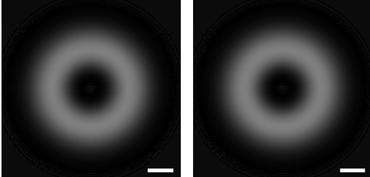


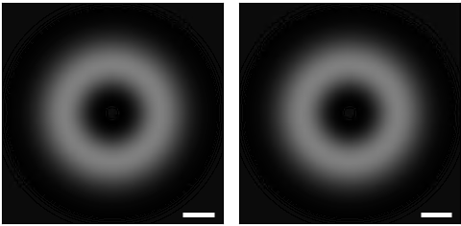
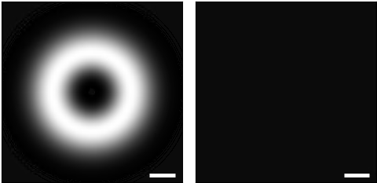















Valley-mixed excitons transition rate
$$Q_{y}$$
$$Q_{x}$$
$${0.1Q}_{c}$$
$$a.u.$$
$$Q_{y}$$
$$Q_{x}$$
$$Q_{y}$$
$${0.1Q}_{c}$$
$$Q_{x}$$
$$a.u.$$
$${0.1Q}_{c}$$
$$a.u.$$
$$\left(α, β\right)=\left(0, \text{0}\right)$$
$$\left(α, β\right)=\left(0, \text{0}\right)$$
$$|\left.1, −1\right\rangle$$
$$|\left.1, −1\right\rangle$$
$$z$$
$$z$$
$$x$$
$$β$$
$$\left(3π/2, π/2\right)$$
$$β$$
$$\left(π,π/2\right)$$
$$\left(3π/2, π/2\right)$$
$$α$$
$$y$$
$$\left(π,π/2\right)$$
$$x$$
$$α$$
$$y$$
$$|\left.−1, 1\right\rangle$$
$$|\left.−1, 1\right\rangle$$
$$\left(0, π/2\right)$$
$$\left(π/2,π/2\right)$$
$$\left(0, π/2\right)$$
$$\left(π/2,π/2\right)$$
$$\left(0, π\right)$$
$$\left(0, π\right)$$

Slide 7








$$Q_{y}$$
$$Q_{x}$$
$${0.1Q}_{c}$$
$$a.u.$$
$$Q_{y}$$
$$Q_{x}$$
$${0.1Q}_{c}$$
$$a.u.$$
$$\left(α, β\right)=\left(0, \text{0}\right)$$
$$|\left.1, −1\right\rangle$$
$$z$$
$$x$$
$$β$$
$$\left(3π/2, π/2\right)$$
$$α$$
$$y$$
$$\left(π,π/2\right)$$
$$|\left.−1, 2\right\rangle$$
$$\left(0, π/2\right)$$
$$\left(π/2,π/2\right)$$
$$\left(0, π\right)$$

