Slide 1
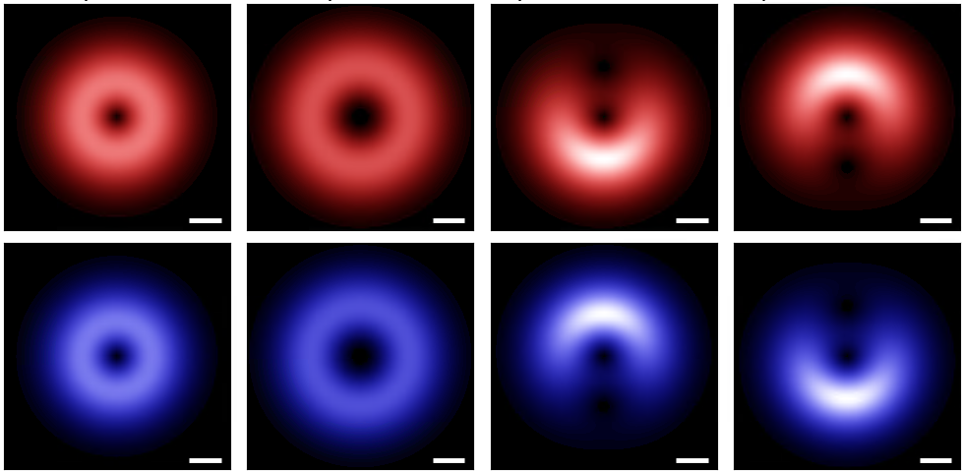
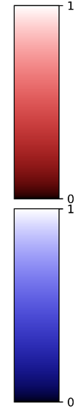
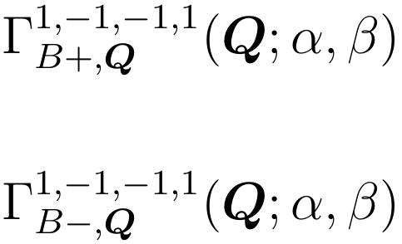
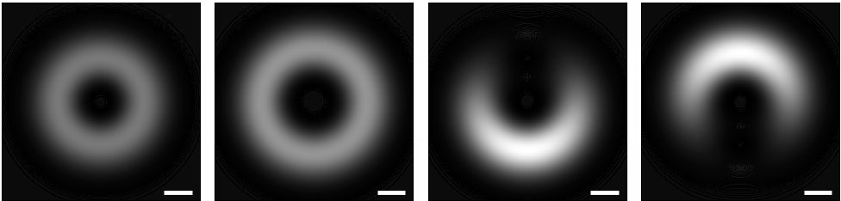
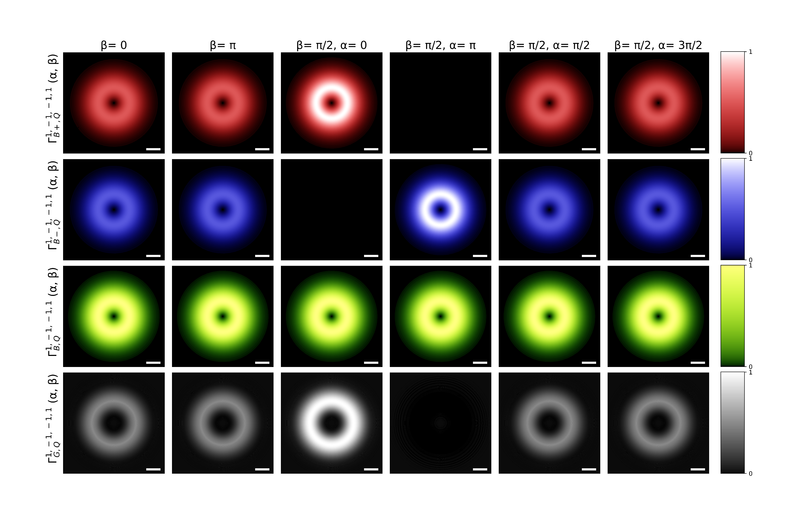

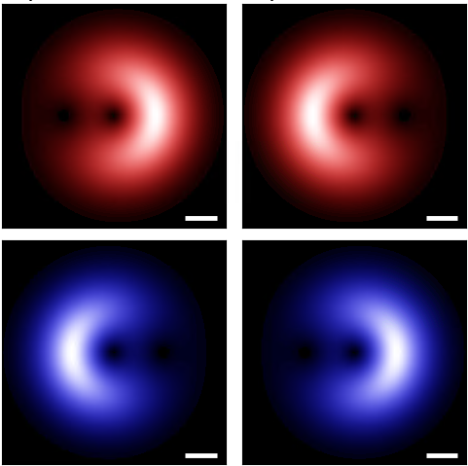
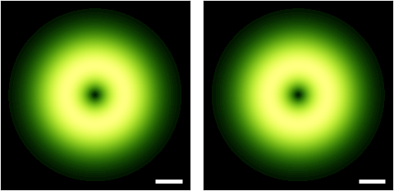
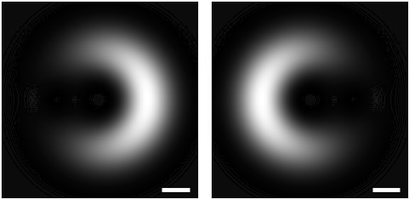
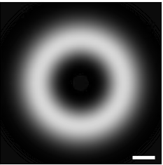

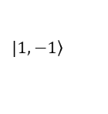
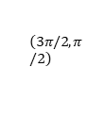






















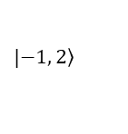

$$Q_{y}$$
$$Q_{y}$$
$$Q_{x}$$
$$Q_{x}$$
$${0.1Q}_{c}$$
$$a.u.$$
$$Q_{y}$$
$${0.1Q}_{c}$$
$$a.u.$$
$$Q_{x}$$
$$\left(α, β\right)=\left(0, \text{0}\right)$$
$${0.1Q}_{c}$$
$$a.u.$$
$$\left(α, β\right)=\left(0, \text{0}\right)$$
$$|\left.1, −1\right\rangle$$
$$|\left.1, −1\right\rangle$$
$$z$$
$$z$$
$$β$$
$$\left(π,π/2\right)$$
$$x$$
$$β$$
$$\left(3π/2, π/2\right)$$
$$x$$
$$\left(3π/2, π/2\right)$$
$$α$$
$$y$$
$$\left(π,π/2\right)$$
$$α$$
$$y$$
$$|\left.−1, 2\right\rangle$$
$$|\left.−1, 2\right\rangle$$
$$\left(0, π/2\right)$$
$$\left(π/2,π/2\right)$$
$$\left(0, π/2\right)$$
$$\left(π/2,π/2\right)$$
$$\left(0, π\right)$$
$$\left(0, π\right)$$

